Slide 1

Rational Numbers
Unit 1 Lesson 1

Slide 2

Rational Numbers
Students will be able to:
• Understand informally that every number has a decimal expansion.
• Classify whole numbers, integers, and rational numbers using a visual representation such as a Venn diagram to describe relationships between sets of numbers.
• Order a set of rational numbers.

Slide 3
Rational Numbers
Key Vocabulary:
Rational numbers
Irrational numbers
Integers
Whole numbers
Natural numbers

Slide 4
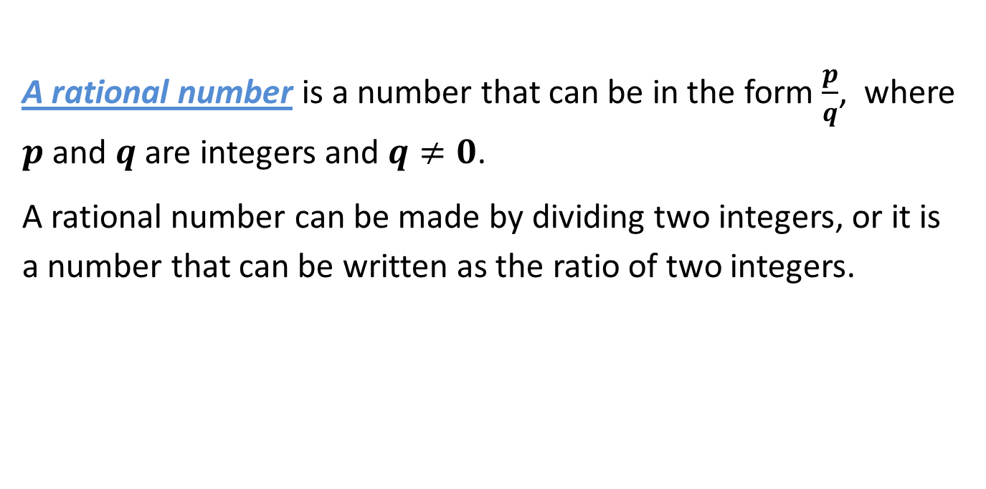
Rational Numbers
A rational number is a number that can be in the form $\frac{p}{q}$, where $p$ and $q$ are integers and $q≠0$.
A rational number can be made by dividing two integers, or it is a number that can be written as the ratio of two integers.

Slide 5
Rational Numbers
Rational Numbers
include fractions,
terminating decimals,
repeating decimals, integers,
whole and natural numbers.
Irrational Numbers
include square roots that don’t work out to be ratios (no perfect answers) and decimals that don’t repeat but that never end.
Integer
Whole Numbers
Natural
numbers

Slide 6
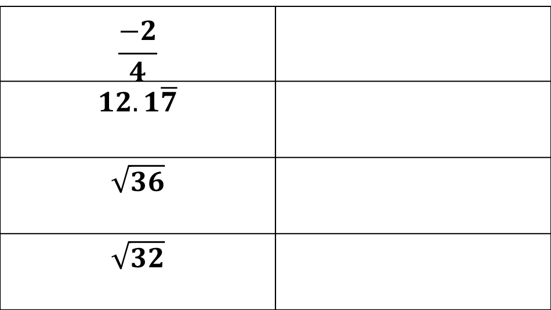
Rational Numbers
Sample Problem 1: Identify each number as rational or irrational.
a.
$$\frac{−2}{4}$$
$$12.1\overline{7}$$
$$\sqrt{36}$$
$$\sqrt{32}$$

Slide 7
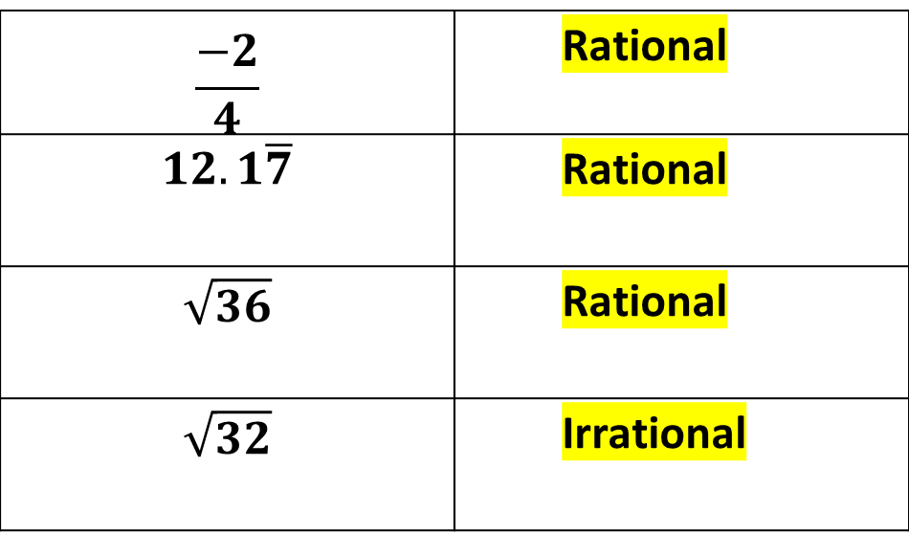
Rational Numbers
Sample Problem 1: Identify each number as rational or irrational.
a.
$$\frac{−2}{4}$$ | Rational
$$12.1\overline{7}$$ | Rational
$$\sqrt{36}$$ | Rational
$$\sqrt{32}$$ | Irrational

Slide 8
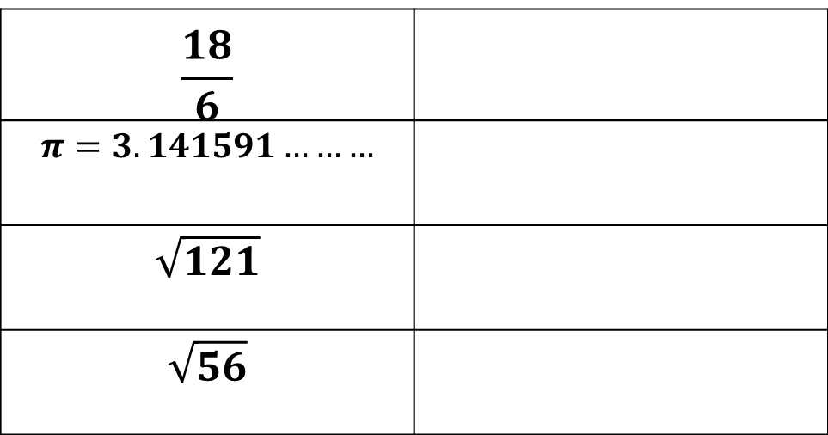
Rational Numbers
Sample Problem 1: Identify each number as rational or irrational.
b.
$$\frac{18}{6}$$
$π=3.141591………$
$$\sqrt{121}$$
$$\sqrt{56}$$

Slide 9
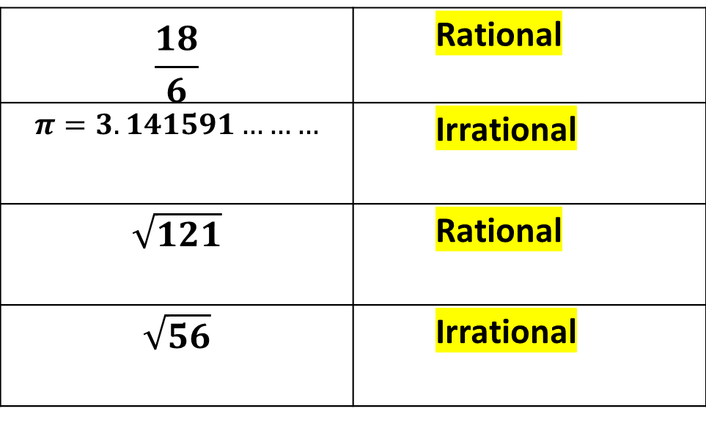
Rational Numbers
Sample Problem 1: Identify each number as rational or irrational.
b.
$$\frac{18}{6}$$ | Rational
$π=3.141591………$ | Irrational
$$\sqrt{121}$$ | Rational
$$\sqrt{56}$$ | Irrational

Slide 10
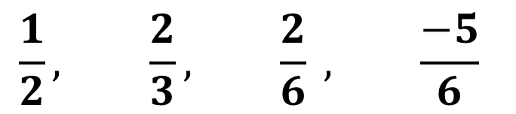
Rational Numbers
Sample Problem 2: Write the numbers in order from least to greatest.
a.
$$\frac{1}{2}, \frac{2}{3}, \frac{2}{6} , \frac{−5}{6}$$

Slide 11
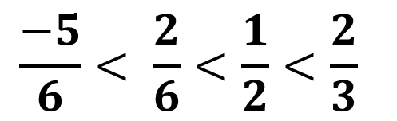
Rational Numbers
Sample Problem 2: Write the numbers in order from least to greatest.
a.
$$\frac{1}{2}, \frac{2}{3}, \frac{2}{6} , \frac{−5}{6}$$
$$\frac{−5}{6}< \frac{2}{6}<\frac{1}{2}<\frac{2}{3}$$

Slide 12
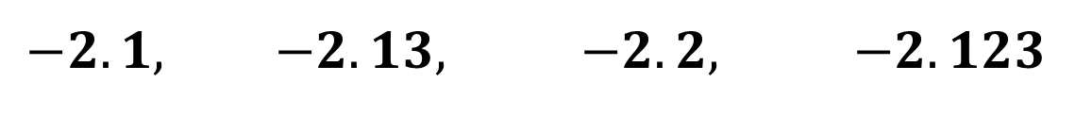
Rational Numbers
Sample Problem 2: Write the numbers in order from least to greatest.
b.
$$−2.1, −2.13, −2.2, −2.123$$

Slide 13
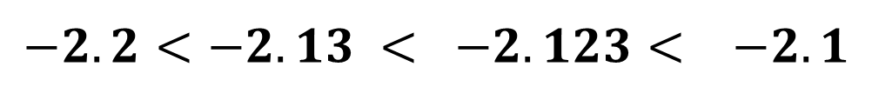
Rational Numbers
Sample Problem 2: Write the numbers in order from least to greatest.
b.
$$−2.1, −2.13, −2.2, −2.123$$
$$−2.2<−2.13 < −2.123< −2.1$$

Slide 14
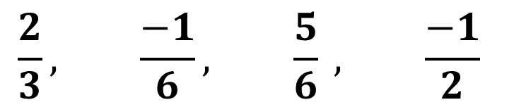
Rational Numbers
Sample Problem 2: Write the numbers in order from least to greatest.
c.
$$\frac{2}{3}, \frac{−1}{6}, \frac{5}{6} , \frac{−1}{2}$$

Slide 15
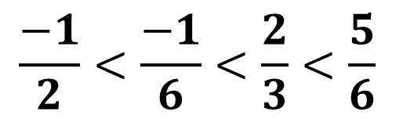
Rational Numbers
Sample Problem 2: Write the numbers in order from least to greatest.
c.
$$\frac{2}{3}, \frac{−1}{6}, \frac{5}{6} , \frac{−1}{2}$$
$$\frac{−1}{2}<\frac{−1}{6}<\frac{2}{3}<\frac{5}{6}$$

Slide 16
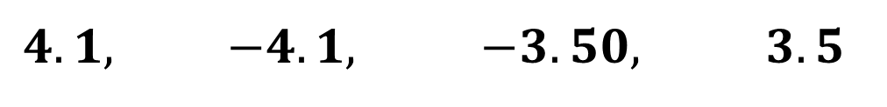
Rational Numbers
Sample Problem 2: Write the numbers in order from least to greatest.
d.
$$4.1, −4.1, −3.50, 3.5$$

Slide 17
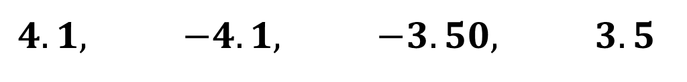
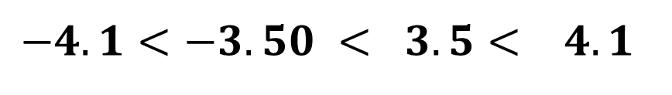
Rational Numbers
Sample Problem 2: Write the numbers in order from least to greatest.
d.
$$4.1, −4.1, −3.50, 3.5$$
$$−4.1<−3.50 < 3.5< 4.1$$

Slide 18
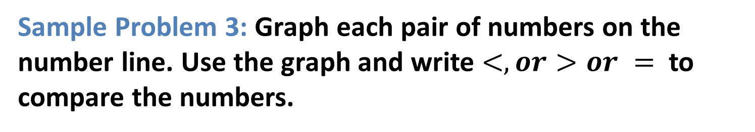
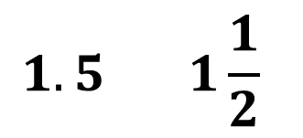
Rational Numbers
Sample Problem 3: Graph each pair of numbers on the number line. Use the graph and write $<,or>or =$ to compare the numbers.
$$1.5 1\frac{1}{2}$$
a.

Slide 19
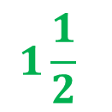
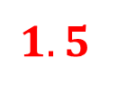
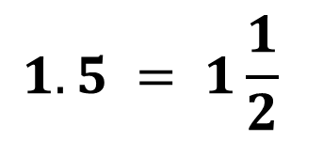
Rational Numbers
Sample Problem 3: Graph each pair of numbers on the number line. Use the graph and write $<,or>or =$ to compare the numbers.
$$1.5 = 1\frac{1}{2}$$
a.
$$1.5$$
$$1\frac{1}{2}$$
-4
-3
-2
-1
0
1
2
3
4
5

Slide 20
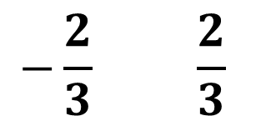
Rational Numbers
Sample Problem 3: Graph each pair of numbers on the number line. Use the graph and write $<,or>or =$ to compare the numbers.
$$−\frac{2}{3} \frac{2}{3}$$
b.

Slide 21

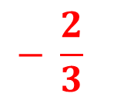
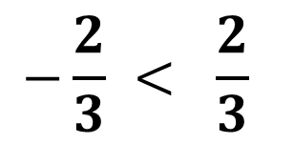
Rational Numbers
Sample Problem 3: Graph each pair of numbers on the number line. Use the graph and write $<,or>or =$ to compare the numbers.
$$−\frac{2}{3} < \frac{2}{3}$$
b.
$$− \frac{2}{3}$$
$$\frac{2}{3}$$
-4
-3
-2
-1
0
1
2
3
4
5

Slide 22
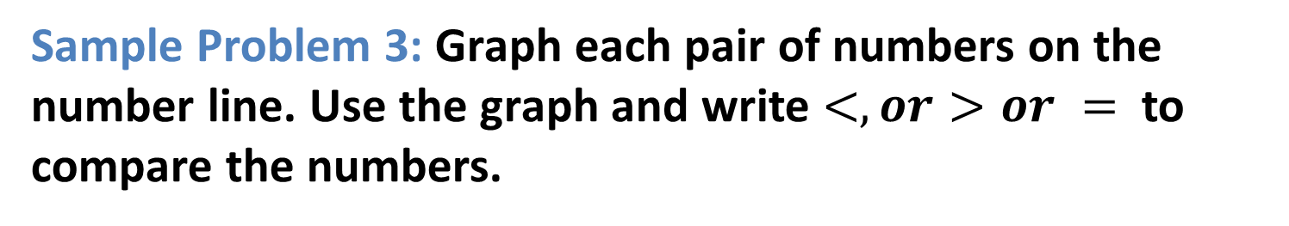
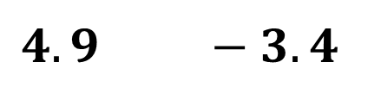
Rational Numbers
Sample Problem 3: Graph each pair of numbers on the number line. Use the graph and write $<,or>or =$ to compare the numbers.
c.
$$4.9 −3.4$$

Slide 23
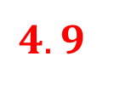
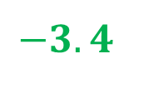
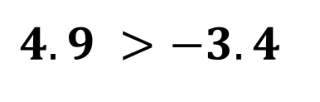
Rational Numbers
Sample Problem 3: Graph each pair of numbers on the number line. Use the graph and write $<,or>or =$ to compare the numbers.
c.
$$4.9 >−3.4$$
$$4.9$$
$$−3.4$$
-4
-3
-2
-1
0
1
2
3
4
5

Slide 24
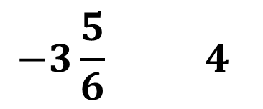
Rational Numbers
Sample Problem 3: Graph each pair of numbers on the number line. Use the graph and write $<,or>or =$ to compare the numbers.
$$−3\frac{5}{6} 4$$
d.

Slide 25

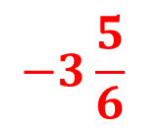
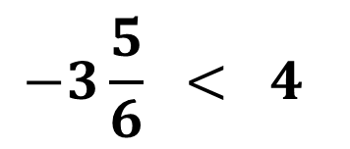
Rational Numbers
Sample Problem 3: Graph each pair of numbers on the number line. Use the graph and write $<,or>or =$ to compare the numbers.
$$−3\frac{5}{6} < 4$$
d.
$$−3\frac{5}{6}$$
$$4$$
-4
-3
-2
-1
0
1
2
3
4
5

Slide 26
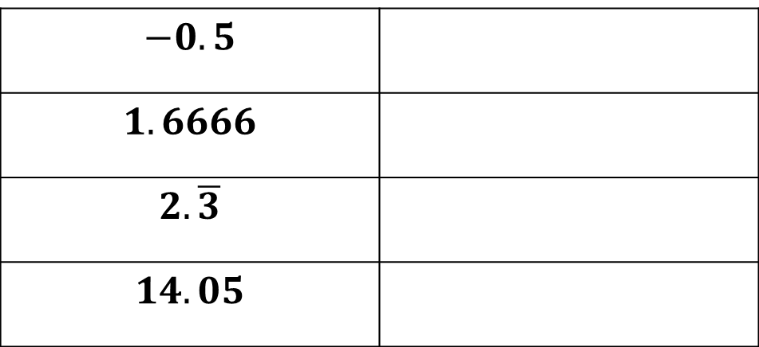
Rational Numbers
Sample Problem 4: Identify each decimal as repeating or terminating.
a.
$$−0.5$$
$$1.6666$$
$$2.\overline{3}$$
$$14.05$$

Slide 27
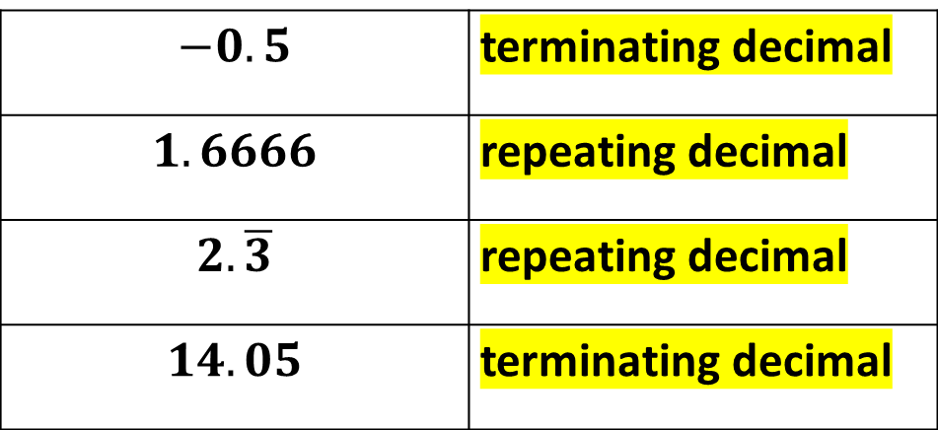
Rational Numbers
Sample Problem 4: Identify each decimal as repeating or terminating.
a.
$$−0.5$$ | terminating decimal
$$1.6666$$ | repeating decimal
$$2.\overline{3}$$ | repeating decimal
$$14.05$$ | terminating decimal

Slide 28
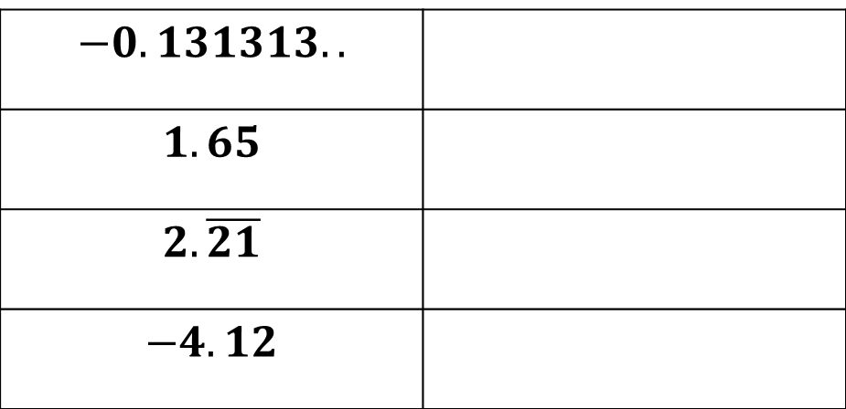
Rational Numbers
Sample Problem 4: Identify each decimal as repeating or terminating.
b.
$$−0.131313..$$
$$1.65$$
$$2.\overline{21}$$
$$−4.12$$

Slide 29
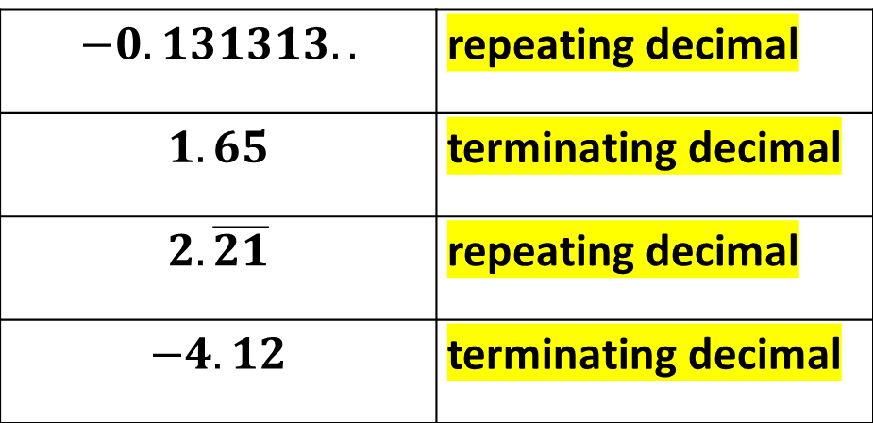
Rational Numbers
Sample Problem 4: Identify each decimal as repeating or terminating.
b.
$$−0.131313..$$ | repeating decimal
$$1.65$$ | terminating decimal
$$2.\overline{21}$$ | repeating decimal
$$−4.12$$ | terminating decimal

