Slide 1
Ratios
Unit 1 Lesson 1
Math 6

Slide 2
Ratios
Students will be able to:
Determine the comparison between or relationship of two things using ratio.
Solve word problems involving ratio.

Slide 3
Ratios
Key Vocabulary:
Ratio
Equal Ratios
Reduced Ratio
Fraction
GCF

Slide 4
Ratios
Ratio is a comparison between, or a relationship of two things.
Example:
There is 1 ice cream cone to 3 cookies.

Slide 5
Ratios
Example:
There are 4 boys to 2 girls.

Slide 6
Ratios
Ratios can be shown in different ways!
There is 1 ice cream cone to 3 cookies.

Slide 7
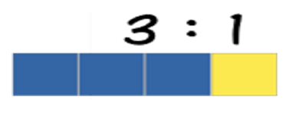
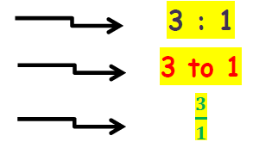
Ratios
Sample Problem 1:
Write in three different ways the ratio of the given figure.
The ratio of 3 blue rectangles to 1 yellow rectangle.

Slide 8
Ratios
Sample Problem 2:
Answer the following questions given the picture below.
What is the ratio of apples to bananas?
Solution: 5 : 2
What is the ratio of bananas to apples?
Solution: 2 : 5

Slide 9
Ratios
Equal Ratios
To find an equal ratio, you can either multiply or divide each term in the ratio by the same number (but not zero).

Slide 10
Ratios
Equal Ratios

Slide 11
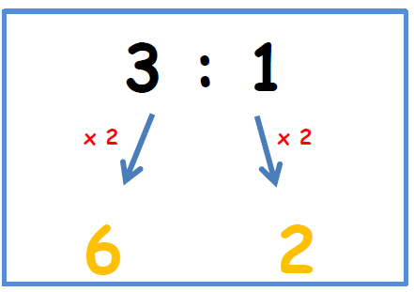
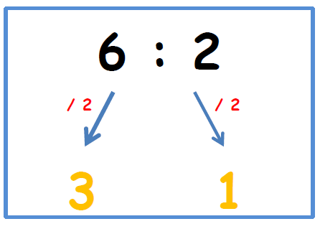
Ratios
Equal Ratios
or

Slide 12
Ratios
How do we know that the RATIOS are EQUAL?
Example: Are the ratios 4 : 1 and 12 : 3 equal?
Step 1: Find the quotient of the numbers in the ratio.
4 $÷$ 1 = 4 12 $÷$ 3 = 4
Step 2: If the quotients are the SAME, then ratios are EQUAL!
4:1 = 12:3

Slide 13
Ratios
Sample Problem 3:
Are the ratios 3:4 and 12:16 EQUAL or NOT?
Solution:
3 $÷$ 4 = 0.75
12 $÷$ 16 = 0.75
Therefore, 3:4 = 12:16

Slide 14
Ratios
Reducing Ratios
Reducing ratios is similar to reducing a fraction in lowest terms since ratios can be expressed as fractions.
Example: Reduce 12:16 in lowest terms.
Step 1: Find the GCF of the numbers in the ratio.
GCF is 4

Slide 15
Ratios
Reducing Ratios
Step 2: Divide the numbers in the ratio by the GCF.
$\frac{12}{4} : \frac{16}{4}$ 3 : 4
IMPORTANT: Ratios are in lowest terms if and only if, the Greatest Common Factor left is 1.

Slide 16
Ratios

Slide 17
Ratios

Slide 18
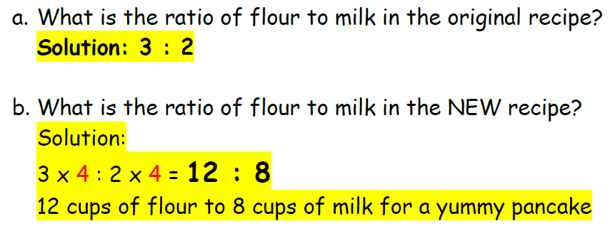
Ratios

