Slide 1

Variables and Expressions
Unit 1 Lesson 1

Slide 2

VARIABLES AND EXPRESSIONS
Students will be able to:
write mathematical expressions for verbal expressions,
and vice versa.
Key Vocabulary:
Variables • Power
Algebraic Expression • Base
Factors • Exponent
Product

Slide 3
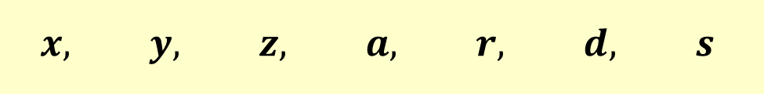
VARIABLES AND EXPRESSIONS
VARIABLES are symbols used to represent unspecified numbers or values. Any letter can be used as a variable.
$$x, y, z, a, r, d, s$$

Slide 4
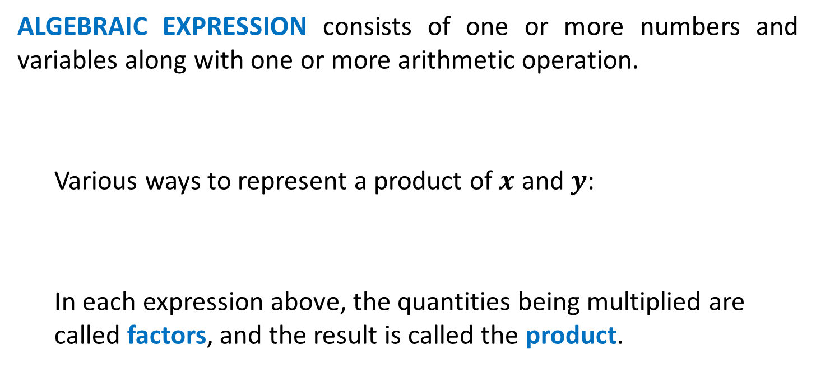
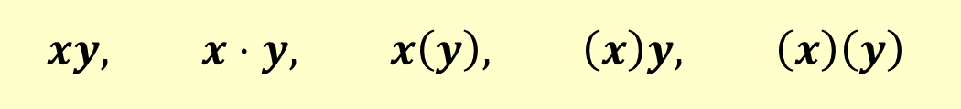
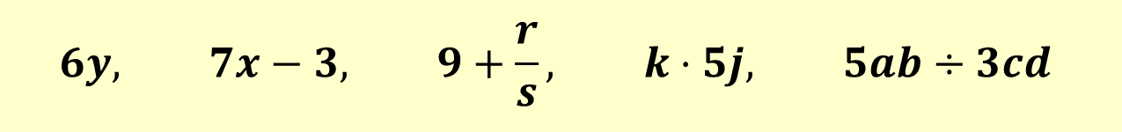
VARIABLES AND EXPRESSIONS
ALGEBRAIC EXPRESSION consists of one or more numbers and variables along with one or more arithmetic operation.
  Various ways to represent a product of $x$ and $y$:
  In each expression above, the quantities being multiplied are called factors, and the result is called the product.
$$6y, 7x−3, 9+\frac{r}{s}, k⋅5j, 5ab÷3cd$$
$$xy, x⋅y, x\left(y\right), \left(x\right)y, \left(x\right)\left(y\right)$$

Slide 5
VARIABLES AND EXPRESSIONS
Translating Verbal Expression into Algebraic Expression:
Addition | Subtraction | Multiplication | Division
Plus | Minus | Times | Divided
Sum of | Difference between/of | Product of | Quotient of
More than | Less than | Multiplied by | Ratio of
Increased by | Decreased by |  | Per
Combined | Fewer than |  | Out of
Together |  |  | percent
Total of
Added to

Slide 6
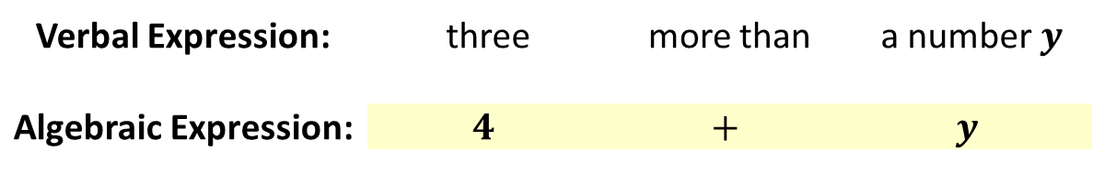

VARIABLES AND EXPRESSIONS
Translating Verbal Expression into Algebraic Expression:
Example: four more than a number $y$
Verbal Expression: | three | more than | a number $y$
Algebraic Expression: | $$4$$ | $$+$$ | $$y$$

Slide 7
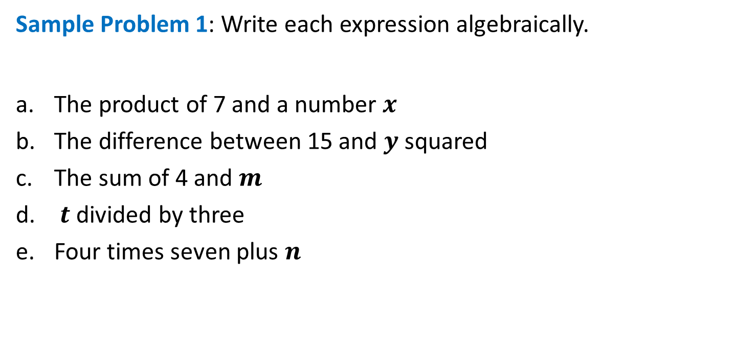
VARIABLES AND EXPRESSIONS
Sample Problem 1: Write each expression algebraically.
The product of 7 and a number $x$
The difference between 15 and $y$ squared
The sum of 4 and $m$
$t$ divided by three
Four times seven plus $n$

Slide 8

VARIABLES AND EXPRESSIONS
Sample Problem 1: Write each expression algebraically.
The product of 7 and a number $x$ $=7x$
The difference between 15 and $y$ squared $=15−y^{2}$
The sum of 4 and $m$ $=4+m$
$t$ divided by three $=\frac{t}{3}$
Four times seven plus $n$ $=4\left(7+n\right)$

Slide 9
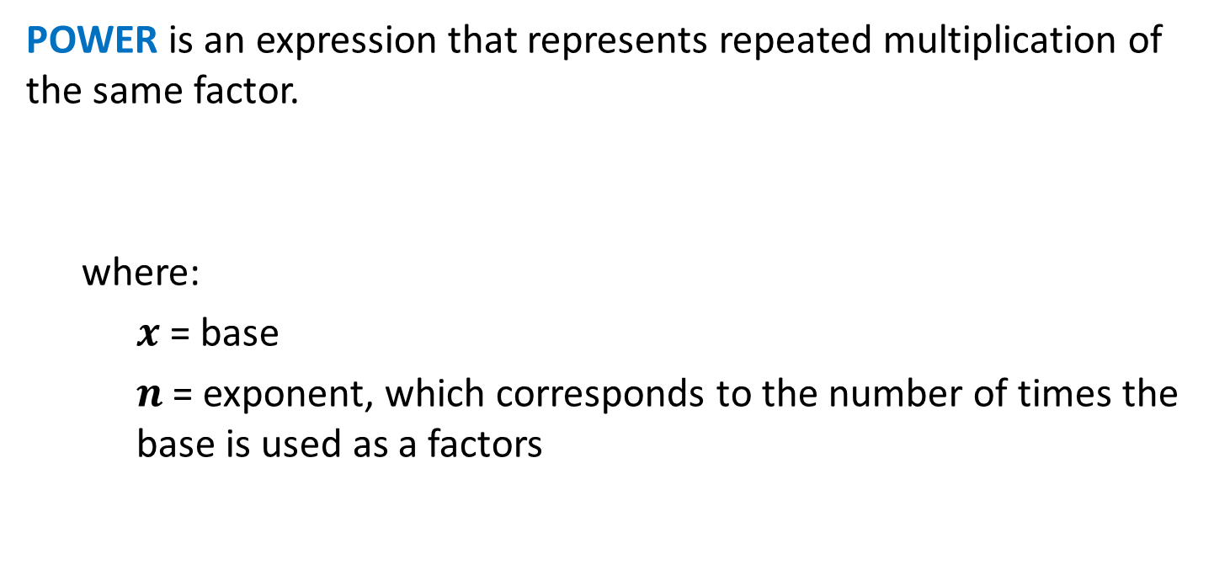

VARIABLES AND EXPRESSIONS
POWER is an expression that represents repeated multiplication of the same factor.
  where:
    $x$ = base
    $n$ = exponent, which corresponds to the number of times the base is used as a factors
$$x^{n}$$

Slide 10
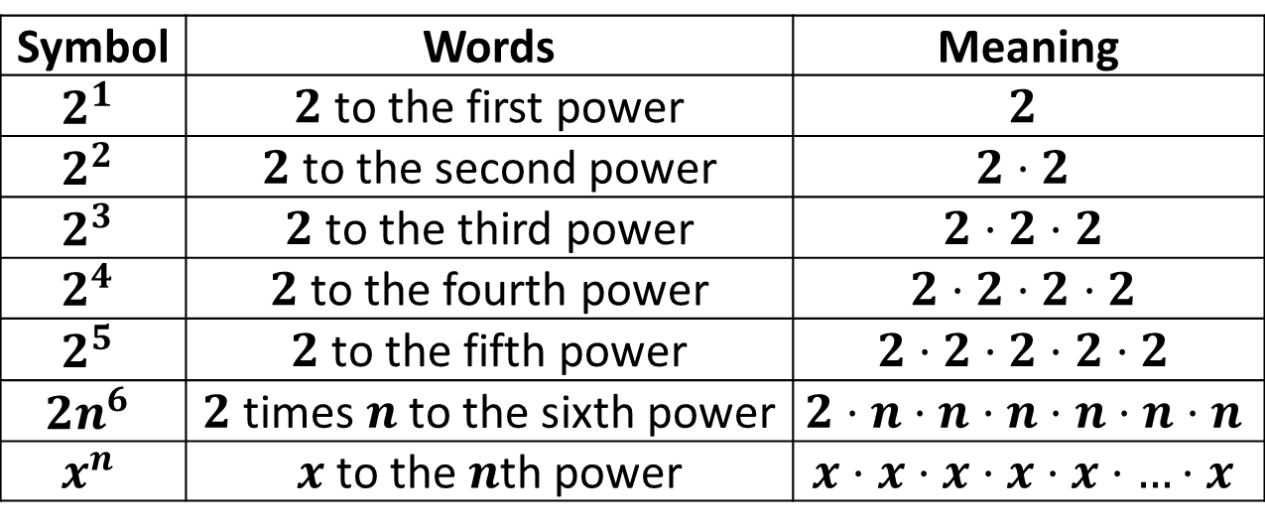
VARIABLES AND EXPRESSIONS
POWER is an expression that represents repeated multiplication of the same factor.
Symbol | Words | Meaning
$$2^{1}$$ | $2$ to the first power | $$2$$
$$2^{2}$$ | $2$ to the second power | $$2⋅2$$
$$2^{3}$$ | $2$ to the third power | $$2⋅2⋅2$$
$$2^{4}$$ | $2$ to the fourth power | $$2⋅2⋅2⋅2$$
$$2^{5}$$ | $2$ to the fifth power | $$2⋅2⋅2⋅2⋅2$$
$${2n}^{6}$$ | $2$ times $n$ to the sixth power | $$2⋅n⋅n⋅n⋅n⋅n⋅n$$
$$x^{n}$$ | $x$ to the $n$th power | $$x⋅x⋅x⋅x⋅x⋅…⋅x$$

Slide 11

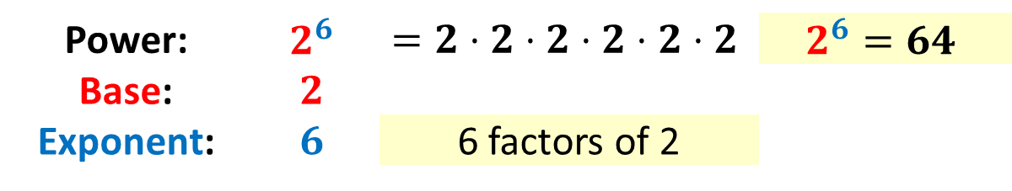
VARIABLES AND EXPRESSIONS
POWER is an expression that represents repeated multiplication of the same factor.
Example: $2^{6}$
Power: | $$2^{6}$$ | $$=2⋅2⋅2⋅2⋅2⋅2$$ | $$2^{6}=64$$
Base: | $$2$$
Exponent: | $$6$$ | 6 factors of 2

Slide 12

VARIABLES AND EXPRESSIONS
Sample Problem 2: Find each value.
$2^{2}$
$3^{3}$
$4^{2}$
$7^{2}$
$1^{4}$

Slide 13

VARIABLES AND EXPRESSIONS
Sample Problem 2: Find each value.
$2^{2}$ $=2⋅2$ $=4$
$3^{3}$ $=3⋅3⋅3$ $=27$
$4^{2}$ $=4⋅4$ $=16$
$7^{2}$ $=7⋅7$ $=49$
$1^{4}$ $=1⋅1⋅1⋅1$ $=1$

Slide 14
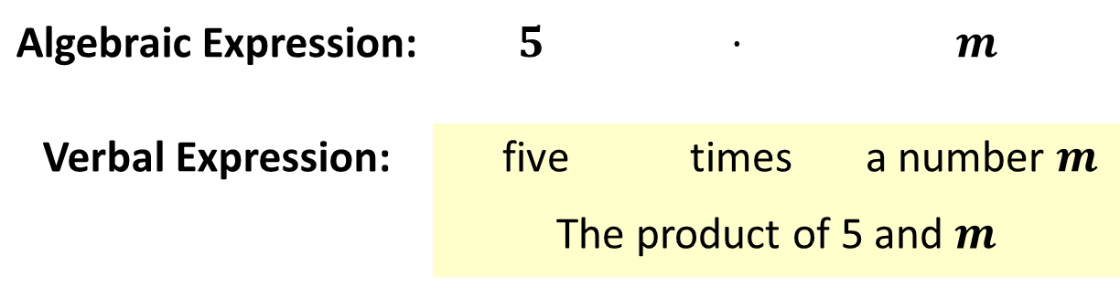

VARIABLES AND EXPRESSIONS
Translating Algebraic Expression into Verbal Expression:
Example: $5m$
Algebraic Expression: | $$5$$ | $$⋅$$ | $$m$$
Verbal Expression: | five | times | a number $m$
 | The product of 5 and $m$

Slide 15

VARIABLES AND EXPRESSIONS
Sample Problem 3: Write a verbal expression for each algebraic expression.
$4−t$
$x+8$
$\frac{3}{s}$
$2z$
$21d−4$

Slide 16

VARIABLES AND EXPRESSIONS
Sample Problem 3: Write a verbal expression for each algebraic expression.
$4−t$ = the difference between $4$ and $t$
$x+8$ = the sum of $x$ and $8$
$\frac{3}{s}$ = the ratio between $3$ and $s$
$2z$ = the product of $2$ and $z$
$21d−4$ = the difference between $21$ times $d$ and $4$

