Slide 1
Writing and Interpreting Numerical Expressions
Unit 1 Lesson 1
Math 5

Slide 2
Writing and Interpreting Numerical Expressions
Students will be able to:
Recognize numerical expressions.
Familiarize the words used to represent operations such as addition, subtraction, multiplication and division.
Write a numerical expression that records calculations with numbers given a verbal phrase.
Translate numerical expressions into words.
Interpret numerical expressions without evaluating them.
Compare expressions using visual models.

Slide 3
Writing and Interpreting Numerical Expressions
Key Vocabulary:
Numerical expression
Parentheses
Operations
Addition
Subtraction
Multiplication
Division
Tape diagram

Slide 4
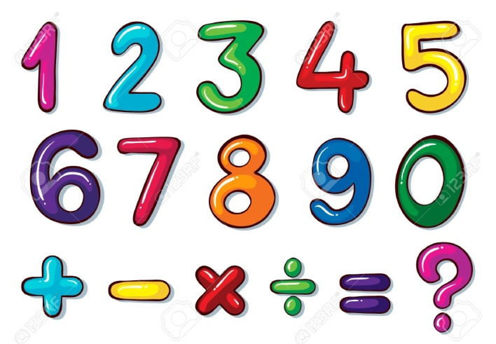
Writing and Interpreting Numerical Expressions
What are NUMERICAL EXPRESSIONS?
A numerical expression is a mathematical phrase representing a single value consisting of one or more numbers and operations. These operations involve Addition, Subtraction, Multiplication, and Division.

Slide 5
Writing and Interpreting Numerical Expressions
What are NUMERICAL EXPRESSIONS?
The picture shows the numbers and operations you can mix up to form a numerical expression.
Also, remember that there should be NO equal sign “=” in the expression because that would be a different story ☺!

Slide 6
Writing and Interpreting Numerical Expressions
Sample Problem 1:
Which among the following is a numerical expression?
$x+y+3$
$1+3=2+2$
$\left(4+5\right)÷3$
$24×(9−1)$
Solution:
The correct answers are C and D.

Slide 7
Writing and Interpreting Numerical Expressions
Writing Numerical Expressions
How do I write numerical expressions?
In writing numerical expressions from verbal statements, you must familiarize yourself with the CLUES!!! These clues are words that are used to represent the four operations: addition, subtraction, multiplication, and division. These words/phrases are identified on the next slide.

Slide 8
Writing and Interpreting Numerical Expressions

Slide 9
Writing and Interpreting Numerical Expressions
Example 1:
Write a numerical expression given the verbal phrase below:
The sum of nine and five multiplied by three
Looking at the given example, you must understand that you need to get the sum of nine and five first and multiply whatever the answer is by three.
This should be done first the sum of nine and five
Then, whatever the answer is multiply it by three

Slide 10
Writing and Interpreting Numerical Expressions
So how do we write it as a numerical expression?
We need to do some grouping to indicate that one operation must be done before doing another. We use open/close parentheses “( )” to group the numbers and operations.

Slide 11
Writing and Interpreting Numerical Expressions

Slide 12
Writing and Interpreting Numerical Expressions
Example 2:
Write a numerical expression given the verbal phrase below:
The sum of nine and the product of five and three
If you compare it to the first example, both involve the same numbers and the same operations.
Example 1: The sum of nine and five multiplied by three
Example 2: The sum of nine and the product of five and three

Slide 13
Writing and Interpreting Numerical Expressions
Both examples in the previous slide involve numbers nine, five and three, and operations addition and subtraction.
But do they really mean the same?
BIG NO!!!

Slide 14
Writing and Interpreting Numerical Expressions
In Example 2, “The sum of nine and the product of five and three”, the operation that must be done first is to multiply five and three… then add nine to whatever the product is.
The grouping will then be:

Slide 15
Writing and Interpreting Numerical Expressions
Let’s compare the two verbal phrases!

Slide 16
Writing and Interpreting Numerical Expressions
Here, both verbal statements may have exactly the same numbers and involve the same operations; they mean differently. Pay close attention to the given phrase and group the numbers with operations that must be done first.
The examples in the previous slide will also give DIFFERENT answers when evaluated.

Slide 17
Writing and Interpreting Numerical Expressions
Sample Problem 2:
Tell whether the given phrases below have the same meaning by writing their corresponding numerical expression.
The difference between twenty and twelve divided by two
The difference between twenty and the quotient of twelve and two

Slide 18
Writing and Interpreting Numerical Expressions
Sample Problem 2:
Solution:
The difference between twenty and twelve divided by two
$$(20−12)÷2$$
The difference between twenty and the quotient of twelve and two
$$20−(12÷2)$$
The given phrases do not mean the same.

Slide 19
Writing and Interpreting Numerical Expressions
Now, let’s do it the other way around!!!
Translating Verbal Phrases into Numerical Expressions
Instead of writing numeral expressions given the verbal phrases, you’ll do it the other way around. You are going to translate numerical expressions into words.
Remember that the ORDER OF OPERATIONS is very IMPORTANT!!! Always pay attention to the following:
“What should be done first?”

Slide 20
Writing and Interpreting Numerical Expressions
How do I write numerical expressions into verbal phrases?
Example 3: Translate $24÷(8−4)$ into words.
As mentioned, take note of the order of operations and “What should be done first?”
In this example, which verbal phrase do you think is correct?
Twenty-four divided by eight minus four
Twenty-four divided by the difference of eight and four
The correct answer is B.

Slide 21
Writing and Interpreting Numerical Expressions
Take note that there are numbers to be grouped in the given example, and should be done first.

Slide 22
Writing and Interpreting Numerical Expressions
A on the other hand is incorrect.
“Twenty-four divided by eight minus four”
Looking at the order of operations, the numerical expression for this verbal phrase is $(24÷8)−4.$

Slide 23
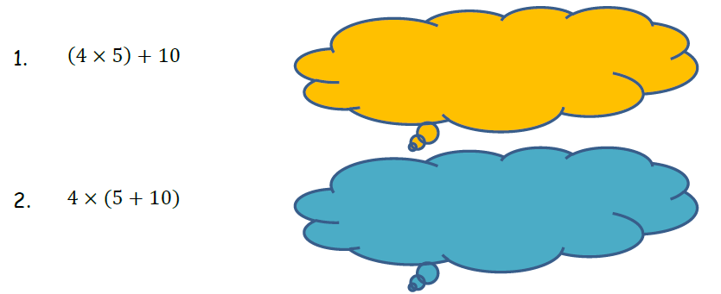
Writing and Interpreting Numerical Expressions
Sample Problem 3:
Translate each numerical expression into words and write them in each cloud.

Slide 24
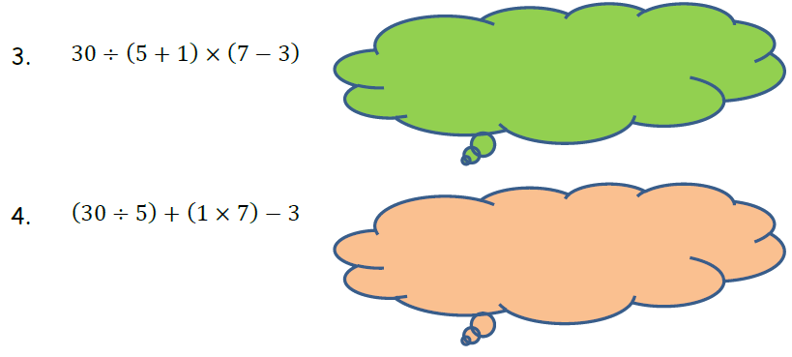
Writing and Interpreting Numerical Expressions
Sample Problem 3:
Translate each numerical expression into words and write them in each cloud.

Slide 25
Writing and Interpreting Numerical Expressions
Sample Problem 3:
Translate each numerical expression into words and write them in each cloud.
Solution: (Answers may vary)
Four times five plus ten.
Four times the sum of five and ten
Thirty divided by the sum of five and one times the difference of seven and three
Thirty divided by five plus the product of one and seven, minus three

Slide 26
Writing and Interpreting Numerical Expressions
Interpreting Numerical Expressions
How are numerical expressions interpreted without evaluating them? “Evaluate” means getting the value of a given numerical word with any given operation, following a correct order. But how is it done without evaluation?
Without evaluating, compare the value of:
$(20+4)$ and $5×(20+4)$
To compare the values of the given numerical expressions without evaluating them, a visual model such as a TAPE DIAGRAM is used.

Slide 27
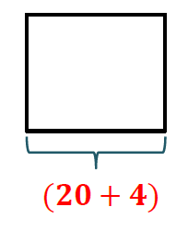
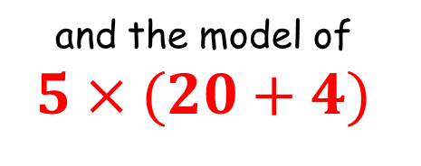
Writing and Interpreting Numerical Expressions
Using a tape diagram, we can draw the model of $(20+4)$
and the model of $5×(20+4)$

Slide 28
Writing and Interpreting Numerical Expressions
Without evaluating and by only drawing a model of the given numerical expressions, we can say that:
$5×(20+4)$
is 5 times as large as
$$(20+4)$$

Slide 29
Writing and Interpreting Numerical Expressions
Sample Problem 4:
Without evaluating, which do you think has a bigger value? Draw the model to compare.
The sum of 12 and 8 tripled
or
$$\left(3×12\right)+(3×8)$$

Slide 30
Writing and Interpreting Numerical Expressions
Sample Problem 4:
Solution:
Without calculating, the visual models clearly show that the sum of 12 and 8 tripled and $\left(3×12\right)+(3×8)$ have exactly the same value.

Slide 31
Writing and Interpreting Numerical Expressions
Sample Problem 5:
Compare the given numerical expressions using >, < or =, without calculating. Draw tape diagrams to help you decide.
$24×(20+5)$ $(20+5)×12$

Slide 32
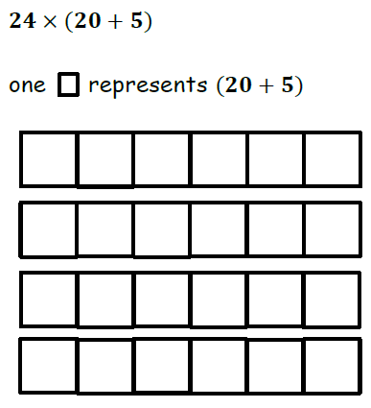
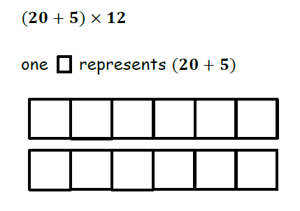
Writing and Interpreting Numerical Expressions
Sample Problem 5- Solution:

Slide 33
Writing and Interpreting Numerical Expressions
Sample Problem 5- Solution:

Slide 34
Writing and Interpreting Numerical Expressions
Sample Problem 6:
A pastry box contains 12 pcs of assorted cookies. Paul bought 3 boxes to be given to his parents and 5 boxes for his friends. Draw a tape diagram and write the numerical expression that shows the total number of cookies bought.

Slide 35
Writing and Interpreting Numerical Expressions
Sample Problem 6:

Slide 36
Writing and Interpreting Numerical Expressions
Sample Problem 6:
Solution:
Numerical Expression:
$$\left(3×12\right)+(5×12)$$

