Slide 1
Analyzing Graphs of Functions and Relations
Unit 1 Lesson 2

Slide 2
Analyzing Graphs of Functions and Relations
Students will be able to:
Analyze graphs of functions and relations
( x and y – intercepts, zeros, symmetry, even and odd functions)
Key Vocabulary:
Graph of a function,
An intercept,
A zero of a function,
Symmetry

Slide 3
Analyzing Graphs of Functions and Relations
The graph of a function $f$ is the set of ordered pairs$(x,f\left(x\right))$, in the coordinate plane, such that $x$ is the domain of $f$.
$x$ $−$ the directed distance from the $y$ -axis
$y=f\left(x\right)−$ the directed distance from the $x$ -axis
You can use the graph to estimate function values.

Slide 4
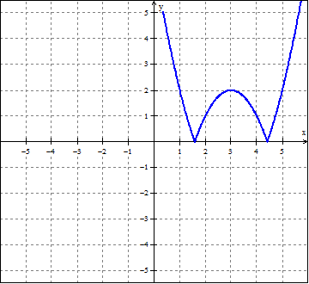
Analyzing Graphs of Functions and Relations
Sample Problem 1: Use a graph of each function to estimate the indicated function values. Then find the values algebraically.
a.
$$f\left(x\right)=\left|{\left(x−3\right)}^{2}−2\right|$$
$$f\left(3\right)=? f\left(4\right)=?$$

Slide 5
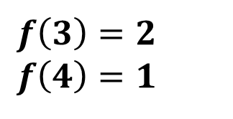
Analyzing Graphs of Functions and Relations
Sample Problem 1: Use a graph of each function to estimate the indicated function values. Then find the values algebraically.
a.
$$f\left(x\right)=\left|{\left(x−3\right)}^{2}−2\right|$$
$$Graphically$$
$$f\left(3\right)=2 \\ f\left(4\right)=1$$

Slide 6
Analyzing Graphs of Functions and Relations
Sample Problem 1: Use a graph of each function to estimate the indicated function values. Then find the values algebraically.
a.
$$f\left(x\right)=\left|{\left(x−3\right)}^{2}−2\right|$$
$$Algebraically$$
$$f\left(3\right)=\left|{\left(3−3\right)}^{2}−2\right|=\left|0−2\right|=2$$
$$f\left(4\right)=\left|{\left(4−3\right)}^{2}−2\right|=\left|1−2\right|=\left|−1\right|=1$$

Slide 7
Analyzing Graphs of Functions and Relations
Sample Problem 1: Use a graph of each function to estimate the indicated function values. Then find the values algebraically.
b.
$$f\left(x\right)=x^{2}+4x+4$$
$$f\left(3\right)=? f\left(4\right)=?$$

Slide 8
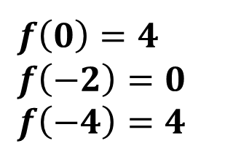
Analyzing Graphs of Functions and Relations
Sample Problem 1: Use a graph of each function to estimate the indicated function values. Then find the values algebraically.
b.
$$f\left(x\right)=x^{2}+4x+4$$
$$Graphically$$
$$f\left(0\right)=4$$
$$f\left(−2\right)=0$$
$$f\left(−4\right)=4$$

Slide 9
Analyzing Graphs of Functions and Relations
Sample Problem 1: Use a graph of each function to estimate the indicated function values. Then find the values algebraically.
b.
$$f\left(x\right)=x^{2}+4x+4$$
$$Algebraically$$
$$f\left(0\right)=0^{2}+4∗0+4=4$$
$$f\left(−2\right)={\left(−2\right)}^{2}+4\left(−2\right)+4=4−8+4=0$$
$$f\left(−4\right)={\left(−4\right)}^{2}+4\left(−4\right)+4=16−16+4=4$$

Slide 10
Analyzing Graphs of Functions and Relations
Identifying Intercepts from a Functions Graph
A point where the graph intersects or meets the $x$ or $y$ axis is called an intercept.
An $x$ -intercept occurs where $y=0$.
A $y$ -intercept occurs where $x=0$.

Slide 11
Analyzing Graphs of Functions and Relations
Sample Problem 2: Use the graph of each function to approximate its $y$ –intercept. Then find the $y$ –intercept algebraically.
a.
$$g\left(x\right)= \left|x−4\right|$$

Slide 12
Analyzing Graphs of Functions and Relations
Sample Problem 2: Use the graph of each function to approximate its $y$ –intercept. Then find the $y$ –intercept algebraically.
a.
$$g\left(x\right)= \left|x−4\right|$$
$$Graphically$$
$$g\left(x\right)= \left|x−4\right|$$
$$y –intercept=4$$

Slide 13
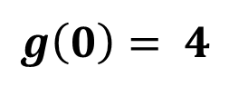
Analyzing Graphs of Functions and Relations
Sample Problem 2: Use the graph of each function to approximate its $y$ –intercept. Then find the $y$ –intercept algebraically.
a.
$$g\left(x\right)= \left|x−4\right|$$
$$Algebraically$$
$y$ -intercept occurs where $x=0$
$$g\left(0\right)= \left|0−4\right|=\left|−4\right|$$
$$g\left(0\right)= 4$$
$$y –intercept=4$$

Slide 14
Analyzing Graphs of Functions and Relations
Sample Problem 2: Use the graph of each function to approximate its $y$ –intercept. Then find the $y$ –intercept algebraically.
b.
$$f\left(x\right)= x^{2}+3x+4$$

Slide 15
Analyzing Graphs of Functions and Relations
Sample Problem 2: Use the graph of each function to approximate its $y$ –intercept. Then find the $y$ –intercept algebraically.
b.
$$f\left(x\right)= x^{2}+3x+4$$
$$Graphically$$
$$f\left(x\right)= x^{2}+3x+4$$
$$y –intercept=4$$

Slide 16
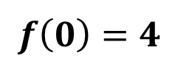
Analyzing Graphs of Functions and Relations
Sample Problem 2: Use the graph of each function to approximate its $y$ –intercept. Then find the $y$ –intercept algebraically.
b.
$$f\left(x\right)= x^{2}+3x+4$$
$$Algebraically$$
$y$ -intercept occurs where $x=0$
$$f\left(0\right)= 0^{2}+3∗0+4$$
$$f\left(0\right)=4$$
$$y –intercept=4$$

Slide 17
Analyzing Graphs of Functions and Relations
Zeros of a Function
The zeros of function $f\left(x\right)$are $x$ –values for which $f\left(x\right)=0$
If the graph of a function of $x$ has an $x$ -intercept at $(x,0)$ then $x$ is a zero of the function.
To find the zeros of a function, set the function equal to zero and solve for the independent variable.

Slide 18
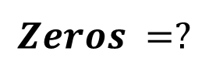
Analyzing Graphs of Functions and Relations
Sample Problem 3: Use the graph of each function to approximate its zeros. Then find the zeros of each function algebraically.
a.
$$f\left(x\right)={−x}^{2}−2x$$
$$Zeros =?$$

Slide 19
Analyzing Graphs of Functions and Relations
Sample Problem 3: Use the graph of each function to approximate its zeros. Then find the zeros of each function algebraically.
a.
$$f\left(x\right)={−x}^{2}−2x$$
$$Zeros =?$$
$$Graphically$$
$$f\left(x\right)={−x}^{2}−2x$$
$$x −intercepts −2 and 0$$

Slide 20
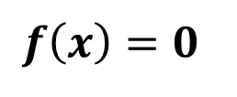
Analyzing Graphs of Functions and Relations
Sample Problem 3: Use the graph of each function to approximate its zeros. Then find the zeros of each function algebraically.
a.
$$f\left(x\right)={−x}^{2}−2x$$
$$Zeros =?$$
$$Algebraically$$
$$f\left(x\right)=0$$
$${−x}^{2}−2x=0$$
$$−x\left(x+2\right)=0$$
$$x=0 or x=−2$$
$$The zeros of f are 0 and−2$$

Slide 21
Analyzing Graphs of Functions and Relations
Sample Problem 3: Use the graph of each function to approximate its zeros. Then find the zeros of each function algebraically.
b.
$$f\left(x\right)=x^{3}+3$$
$$Zeros =?$$

Slide 22
Analyzing Graphs of Functions and Relations
Sample Problem 3: Use the graph of each function to approximate its zeros. Then find the zeros of each function algebraically.
b.
$$f\left(x\right)=x^{3}+3$$
$$Zeros =?$$
$$Graphically$$
$$f\left(x\right)=x^{3}+3$$
$$x −intercepts ≈1.3$$

Slide 23
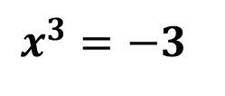
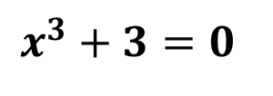
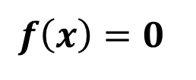
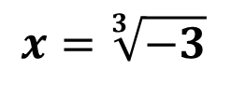
Analyzing Graphs of Functions and Relations
Sample Problem 3: Use the graph of each function to approximate its zeros. Then find the zeros of each function algebraically.
b.
$$f\left(x\right)=x^{3}+3$$
$$Zeros =?$$
$$Algebraically$$
$$f\left(x\right)=0$$
$$x^{3}+3=0$$
$$x^{3}=−3$$
$$x=\sqrt[3]{−3}$$
$$The zero of f is \sqrt[3]{−3}≈−1.44$$

Slide 24
Analyzing Graphs of Functions and Relations
Symmetry of Graphs
There are two possible types of symmetry that graphs of functions can have.
1. Line symmetry - graphs can be folded along a line so that the two halves match exactly.
2. Point symmetry - graphs can be rotated 180° with respect to a point and appear unchanged.

Slide 25
Analyzing Graphs of Functions and Relations
Tests for Symmetry
Graphical Test | Algebraic Test
The graph of a relation is symmetric with respect to the $x$ -axis if and only if for every point ($x,y)$, on the graph, the point ($x,−y)$, is also on the graph. | Replacing $y$ with -$y$ produces an equivalent equation.
The graph of a relation is symmetric with respect to the $y$ -axis if and only if for every point ($x,y)$on the graph, the point ($−x,y)$is also on the graph. | Replacing $x$ with -$x$ produces an equivalent equation.
The graph of a relation is symmetric with respect to the origin if and only if for every point ($x,y)$ on the graph, the point ($−x,−y)$is also on the graph. | Replacing $x$ with -$x$ and $y$ with -$y$ produces an equivalent equation.

Slide 26
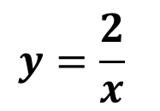
Analyzing Graphs of Functions and Relations
Sample Problem 4: Use the graph of each equation to test for symmetry with respect to the $x$ -axis, $y$ -axis, and the origin. Support the answer numerically. Then confirm algebraically.
$$y=\frac{2}{x}$$
a.

Slide 27
Analyzing Graphs of Functions and Relations
Sample Problem 4: Use the graph of each equation to test for symmetry with respect to the $x$ -axis, $y$ -axis, and the origin. Support the answer numerically. Then confirm algebraically.
$$y=\frac{2}{x}$$
a.
Graphically
The graph appears to be symmetric with respect to the origin
because for every point ($x$, $y$) on the graph, there is a point
(- $x$,- $y$).

Slide 28
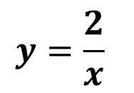
Analyzing Graphs of Functions and Relations
Sample Problem 4: Use the graph of each equation to test for symmetry with respect to the $x$ -axis, $y$ -axis, and the origin. Support the answer numerically. Then confirm algebraically.
$$y=\frac{2}{x}$$
Support Numerically
a.
There is a table of values to support this conjecture.
$$x$$ | $$−4$$ | $$−2$$ | $$−1$$ | $$1$$ | $$2$$ | $$4$$
$$y$$ | $$−\frac{1}{2}$$ | $$−1$$ | $$−2$$ | $$2$$ | $$1$$ | $$\frac{1}{2}$$
$$(x,y)$$ | $$(−4,−\frac{1}{2})$$ | $$(−2,−1)$$ | $$(−1,−2)$$ | $$(1,2)$$ | $$(2,1)$$ | $$(4,\frac{1}{2})$$

Slide 29
Analyzing Graphs of Functions and Relations
Sample Problem 4: Use the graph of each equation to test for symmetry with respect to the $x$ -axis, $y$ -axis, and the origin. Support the answer numerically. Then confirm algebraically.
$$y=\frac{2}{x}$$
Algebraically
a.
Because $−y=\frac{2}{−x}$ is equivalent to $y=\frac{2}{x},$
the graph is symmetric with respect to the origin.

Slide 30
Analyzing Graphs of Functions and Relations
Sample Problem 4: Use the graph of each equation to test for symmetry with respect to the $x$ -axis, $y$ -axis, and the origin. Support the answer numerically. Then confirm algebraically.
b.
$$4x+y^{2}=4$$

Slide 31
Analyzing Graphs of Functions and Relations
Sample Problem 4: Use the graph of each equation to test for symmetry with respect to the $x$ -axis, $y$ -axis, and the origin. Support the answer numerically. Then confirm algebraically.
b.
$$4x+y^{2}=4$$
Graphically
The graph appears to be symmetric with respect to the x -axis
because for every point ($x$, $y$) on the graph, there is a point
($x$,- $y$).

Slide 32
Analyzing Graphs of Functions and Relations
Sample Problem 4: Use the graph of each equation to test for symmetry with respect to the $x$ -axis, $y$ -axis, and the origin. Support the answer numerically. Then confirm algebraically.
Support Numerically
b.
$$4x+y^{2}=4$$
There is a table of values to support this conjecture.
$$x$$ | $$−2$$ | $$−1$$ | $$0$$ | $$1$$
$$y$$ | $$±2\sqrt{3}$$ | $$±2\sqrt{2}$$ | $$±2$$ | $$0$$
$$(x,y)$$ | $$\left(−2,±2\sqrt{3}\right)$$ | $$(−2,±2\sqrt{2})$$ | $$(−1,±2)$$ | $$(1,0)$$

Slide 33
Analyzing Graphs of Functions and Relations
Sample Problem 4: Use the graph of each equation to test for symmetry with respect to the $x$ -axis, $y$ -axis, and the origin. Support the answer numerically. Then confirm algebraically.
Algebraically
b.
$$4x+y^{2}=4$$
$$4x+{\left(−y\right)}^{2}=4$$
$$4x+y^{2}=4$$
Because$4x+{\left(−y\right)}^{2}=4$is equivalent to $4x+y^{2}=4,$
the graph is symmetric with respect to the $x−axis$.

Slide 34
Analyzing Graphs of Functions and Relations
Identify Even and Odd Functions
If $f\left(−x\right)=f\left(x\right),$ then the function is even, and symmetric to the y-axis.
If $f\left(−x\right)=−f\left(x\right),$then the function is odd, and symmetric to the origin.

Slide 35
Analyzing Graphs of Functions and Relations
Sample Problem 5: Determine whether the following are even, odd, or neither.
a.
$$f\left(x\right)=x^{4}+4$$

Slide 36
Analyzing Graphs of Functions and Relations
Sample Problem 5: Determine whether the following are even, odd, or neither.
a.
$$f\left(x\right)=x^{4}+4$$
$$f\left(−x\right)={\left(−x\right)}^{4}+4$$
$$f\left(−x\right)=x^{4}+4$$
$$f\left(−x\right)=f\left(x\right)$$
The function is even.

Slide 37
Analyzing Graphs of Functions and Relations
Sample Problem 5: Determine whether the following are even, odd, or neither.
b.
$$g\left(x\right)=9x^{5}−x^{3}$$

Slide 38
Analyzing Graphs of Functions and Relations
Sample Problem 5: Determine whether the following are even, odd, or neither.
b.
$$g\left(x\right)=9x^{5}−x^{3}$$
$$g\left(−x\right)=9{\left(−x\right)}^{5}−{\left(−x\right)}^{3}$$
$$g\left(−x\right)=−9x^{5}+x^{3}$$
$$g\left(−x\right)=−(9x^{5}−x^{3})$$
$$g\left(−x\right)=−g\left(x\right)$$
The function is odd.

Slide 39
Analyzing Graphs of Functions and Relations
Sample Problem 5: Determine whether the following are even, odd, or neither.
c.
$$h\left(t\right)=t^{2}+t$$

Slide 40
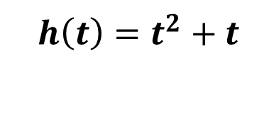
Analyzing Graphs of Functions and Relations
Sample Problem 5: Determine whether the following are even, odd, or neither.
c.
$$h\left(t\right)=t^{2}+t$$
$$h\left(−t\right)={\left(−t\right)}^{2}+(−t)$$
$$h\left(−t\right)=t^{2}−t$$
$$h\left(−t\right)≠h\left(t\right) h\left(−t\right)≠−h\left(t\right)$$
The function is neither.

