Slide 1

Operations with Rational Numbers
Unit 1 Lesson 2

Slide 2

Operations with Rational Numbers
Students will be able to:
•Add, subtract, multiply, and divide rational numbers using the standard algorithm for each operation.

Slide 3
Operations with Rational Numbers
Key Vocabulary:
Rational numbers
Adding
Subtracting
Multiplying
Dividing

Slide 4
Operations with Rational Numbers
Adding and Subtracting Rational Numbers
The rules for adding and subtracting integers and fractions also apply to adding and subtracting rational numbers.

Slide 5
Operations with Rational Numbers
Rules for adding and subtracting rational numbers
When adding numbers with the same signs, add the absolute value of each number and take the common sign.
When adding numbers with different signs, subtract the smaller absolute value from the larger absolute value and take the sign of the larger absolute value.

Slide 6
Operations with Rational Numbers
Rules for adding and subtracting rational numbers
To subtract, change to adding the opposite and follow the rules for adding signed numbers.
To add or subtract fractions, you must have a common denominator.
To add or subtract decimals, it is very important that you are adding values together for the same place value, which means you, must line up the decimal when adding numbers with decimals.

Slide 7
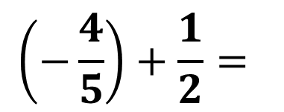
Operations with Rational Numbers
Sample Problem 1: Find each sum or difference.
$$\left(−\frac{4}{5}\right)+\frac{1}{2}=$$
a.

Slide 8
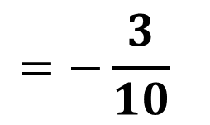
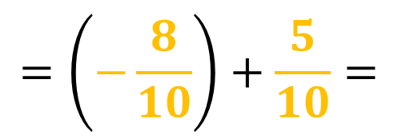
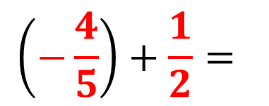
Operations with Rational Numbers
Sample Problem 1: Find each sum or difference.
$$\left(−\frac{4}{5}\right)+\frac{1}{2}=$$
a.
$$\left(−\frac{4}{5}\right)+\frac{1}{2}=$$
$$=\left(−\frac{8}{10}\right)+\frac{5}{10}=$$
$$=−\frac{3}{10}$$

Slide 9
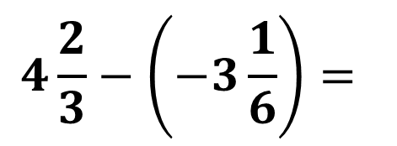
Operations with Rational Numbers
Sample Problem 1: Find each sum or difference.
$$4\frac{2}{3}−\left(−3\frac{1}{6}\right)=$$
b.

Slide 10
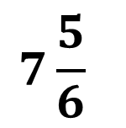
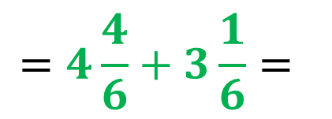
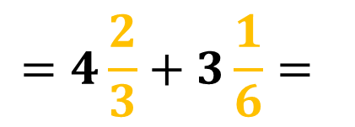
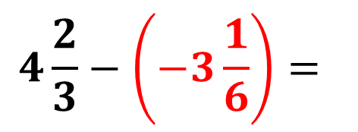
Operations with Rational Numbers
Sample Problem 1: Find each sum or difference.
$$4\frac{2}{3}−\left(−3\frac{1}{6}\right)=$$
b.
$$4\frac{2}{3}−\left(−3\frac{1}{6}\right)=$$
$$=4\frac{2}{3}+3\frac{1}{6}=$$
$$=4\frac{4}{6}+3\frac{1}{6}=$$
$$7\frac{5}{6}$$

Slide 11
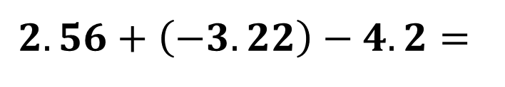
Operations with Rational Numbers
Sample Problem 1: Find each sum or difference.
c.
$$2.56+\left(−3.22\right)−4.2=$$

Slide 12
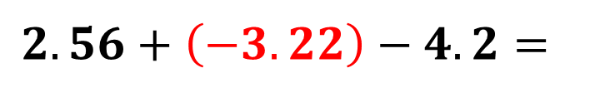
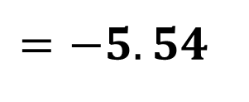
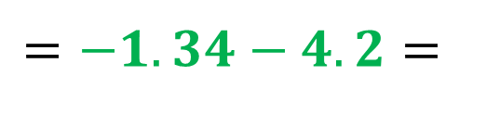
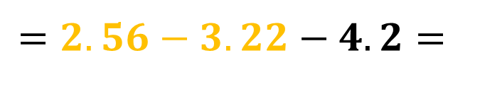
Operations with Rational Numbers
Sample Problem 1: Find each sum or difference.
c.
$$2.56+\left(−3.22\right)−4.2=$$
$$=2.56−3.22−4.2=$$
$$=−1.34−4.2=$$
$$=−5.54$$

Slide 13
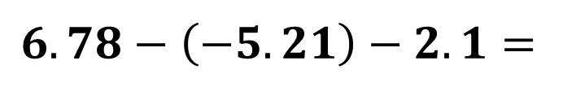
Operations with Rational Numbers
Sample Problem 1: Find each sum or difference.
d.
$$6.78−\left(−5.21\right)−2.1=$$

Slide 14
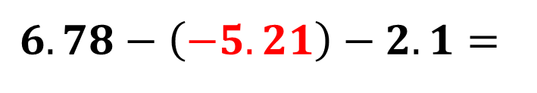
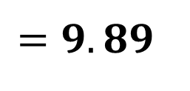
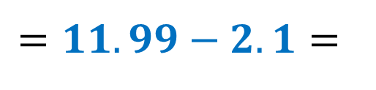
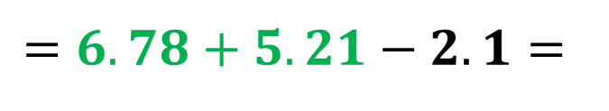
Operations with Rational Numbers
Sample Problem 1: Find each sum or difference.
d.
$$6.78−\left(−5.21\right)−2.1=$$
$$=6.78+5.21−2.1=$$
$$=11.99−2.1=$$
$$=9.89$$

Slide 15
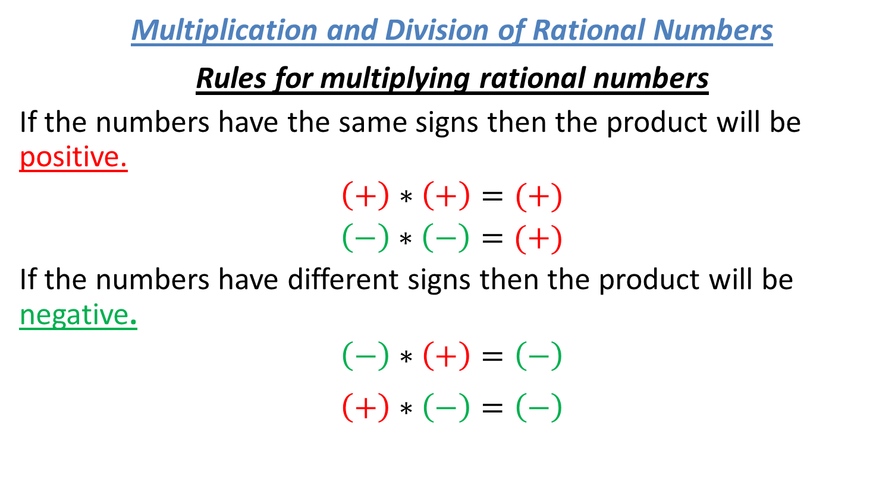
Operations with Rational Numbers
Multiplication and Division of Rational Numbers
Rules for multiplying rational numbers
If the numbers have the same signs then the product will be positive.
$$\left(+\right)∗\left(+\right)=(+)$$
$\left(−\right)∗\left(−\right)=(+)$
If the numbers have different signs then the product will be negative.
$$\left(−\right)∗\left(+\right)=\left(−\right)$$
$$\left(+\right)∗\left(−\right)=\left(−\right)$$

Slide 16
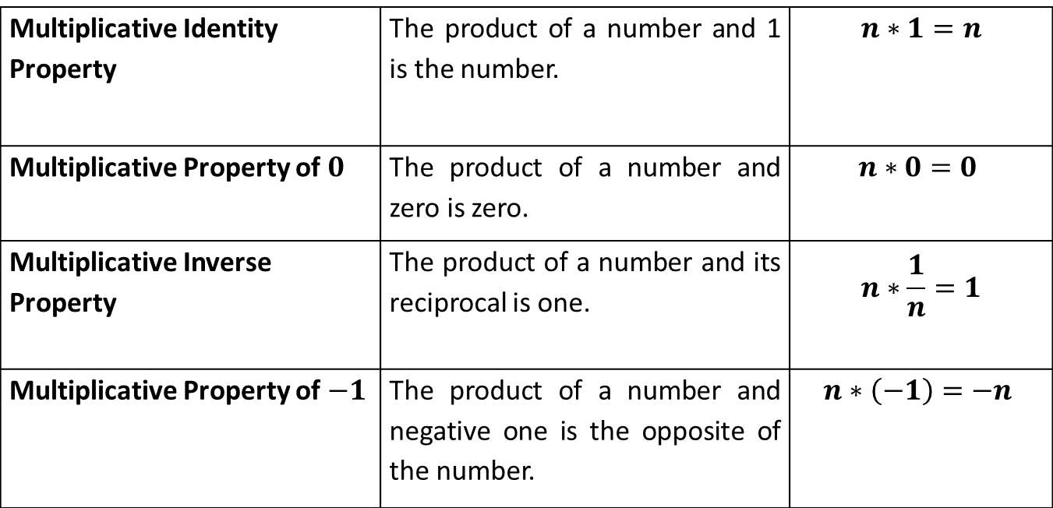
Operations with Rational Numbers
Multiplicative Properties:
Multiplicative Identity Property | The product of a number and 1 is the number. | $$n∗1=n$$
Multiplicative Property of $0$ | The product of a number and zero is zero. | $$n∗0=0$$
Multiplicative Inverse Property | The product of a number and its reciprocal is one. | $$n∗\frac{1}{n}=1$$
Multiplicative Property of $−1$ | The product of a number and negative one is the opposite of the number. | $$n∗\left(−1\right)=−n$$

Slide 17
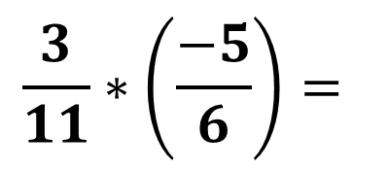
Operations with Rational Numbers
Sample Problem 2: Find each product.
$$\frac{3}{11}∗\left(\frac{−5}{6}\right)=$$
a.

Slide 18
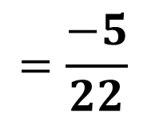
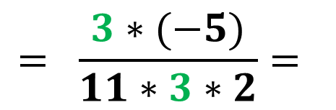
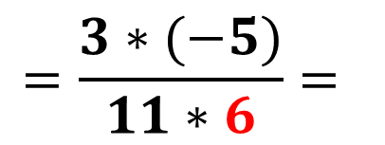
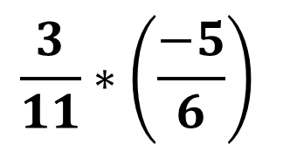
Operations with Rational Numbers
Sample Problem 2: Find each product.
$$\frac{3}{11}∗\left(\frac{−5}{6}\right)$$
a.
$$=\frac{3∗(−5)}{11∗6}=$$
$$= \frac{3∗(−5)}{11∗3∗2}=$$
$$=\frac{−5}{22}$$

Slide 19
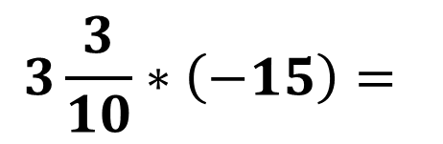
Operations with Rational Numbers
Sample Problem 2: Find each product.
$$3\frac{3}{10}∗\left(−15\right)=$$
b.

Slide 20
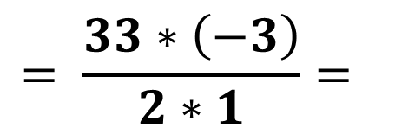
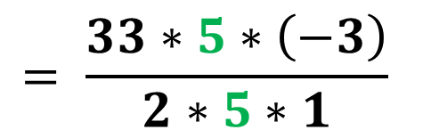
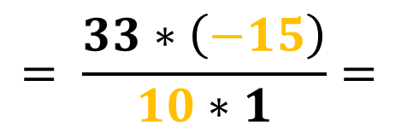
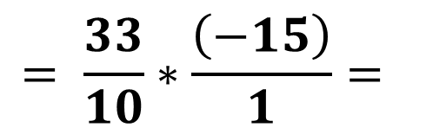
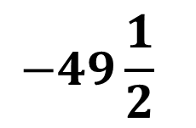
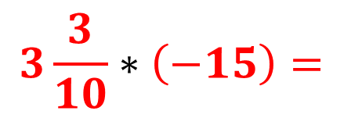
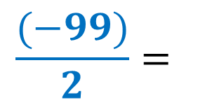
Operations with Rational Numbers
Sample Problem 2: Find each product.
$$3\frac{3}{10}∗\left(−15\right)=$$
b.
$$= \frac{33}{10}∗\frac{\left(−15\right)}{1}=$$
$$= \frac{33∗\left(−15\right)}{10∗1}=$$
$$= \frac{33∗5∗\left(−3\right)}{2∗5∗1}$$
$$= \frac{33∗\left(−3\right)}{2∗1}=$$
$$\frac{(−99)}{2}=$$
$$−49\frac{1}{2}$$

Slide 21
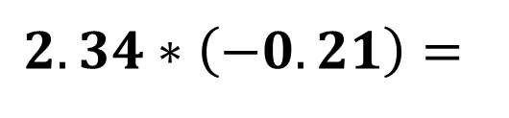
Operations with Rational Numbers
Sample Problem 2: Find each product.
c.
$$2.34∗\left(−0.21\right)=$$

Slide 22
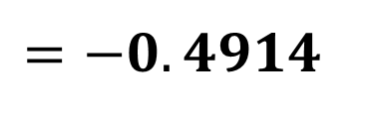
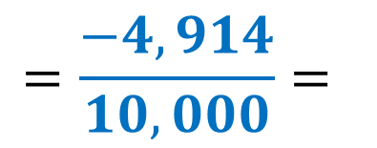
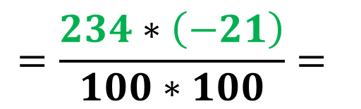
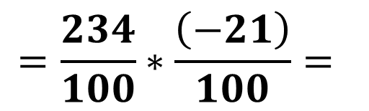
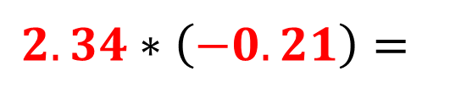
Operations with Rational Numbers
Sample Problem 2: Find each product.
c.
$$2.34∗\left(−0.21\right)=$$
$$=\frac{234}{100}∗\frac{\left(−21\right)}{100}=$$
$$=\frac{234∗\left(−21\right)}{100∗100}=$$
$$=\frac{−4,914}{10,000}=$$
$$=−0.4914$$

Slide 23
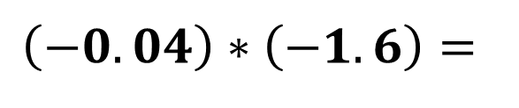
Operations with Rational Numbers
Sample Problem 2: Find each product.
d.
$$\left(−0.04\right)∗\left(−1.6\right)=$$

Slide 24
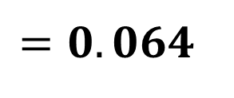
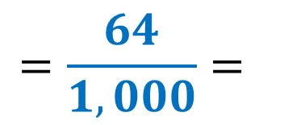
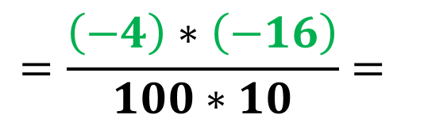
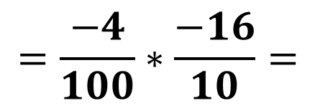
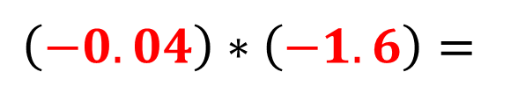
Operations with Rational Numbers
Sample Problem 2: Find each product.
d.
$$\left(−0.04\right)∗\left(−1.6\right)=$$
$$=\frac{−4}{100}∗\frac{−16}{10}=$$
$$=\frac{\left(−4\right)∗\left(−16\right)}{100∗10}=$$
$$=\frac{64}{1,000}=$$
$$=0.064$$

Slide 25
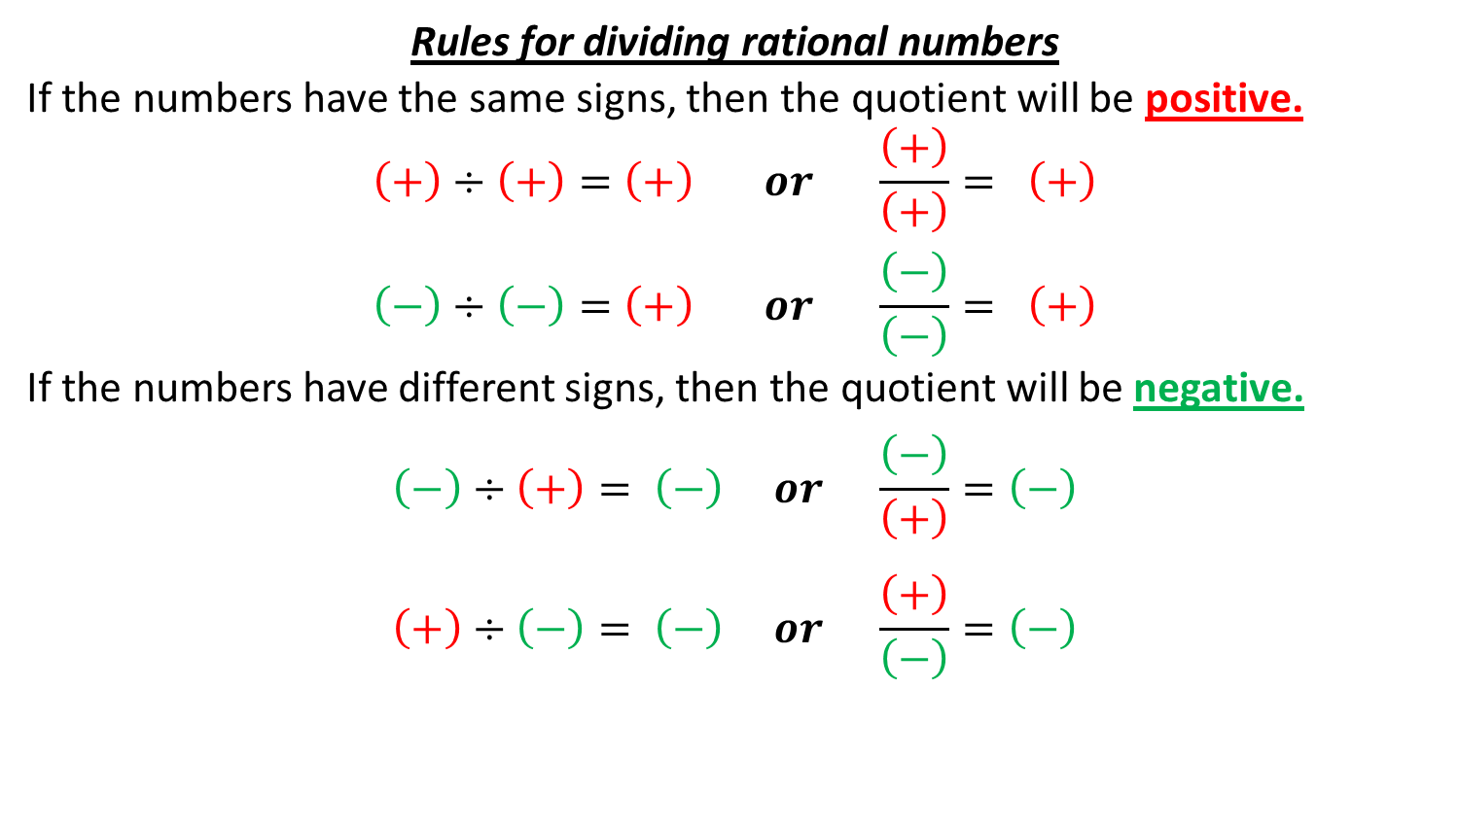
Operations with Rational Numbers
Rules for dividing rational numbers
If the numbers have the same signs, then the quotient will be positive.
$$\left(+\right)÷\left(+\right)=\left(+\right) or \frac{\left(+\right)}{\left(+\right)}= \left(+\right)$$
$$\left(−\right)÷\left(−\right)=\left(+\right) or \frac{\left(−\right)}{\left(−\right)}= \left(+\right)$$
If the numbers have different signs, then the quotient will be negative.
$$\left(−\right)÷\left(+\right)= \left(−\right) or \frac{\left(−\right)}{\left(+\right)}=\left(−\right)$$
$$\left(+\right)÷\left(−\right)= \left(−\right) or \frac{\left(+\right)}{\left(−\right)}=\left(−\right)$$

Slide 26
Operations with Rational Numbers
Division is multiplying by the reciprocal.
You only have to use the division rule if at least one of the numbers is a fraction or if the quotient will not be an integer.

Slide 27
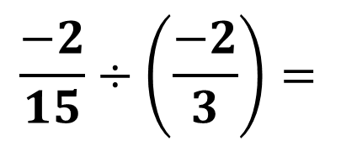
Operations with Rational Numbers
Sample Problem 3: Find each quotient.
$$\frac{−2}{15}÷\left(\frac{−2}{3}\right)=$$
a.

Slide 28
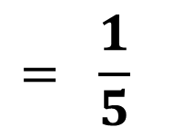
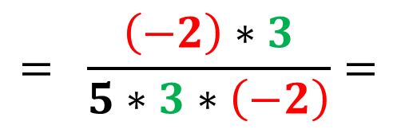


Operations with Rational Numbers
Sample Problem 3: Find each quotient.
$$\frac{−2}{15}÷\left(\frac{−2}{3}\right)=$$
a.
$$= \frac{−2}{15}∗\left(\frac{3}{−2}\right)=$$
$$= \frac{\left(−2\right)∗3}{5∗3∗\left(−2\right)}=$$
$$= \frac{1}{5}$$

Slide 29

Operations with Rational Numbers
Sample Problem 3: Find each quotient.
$$1\frac{4}{11}÷\left(−5\right)=$$
b.

Slide 30





Operations with Rational Numbers
Sample Problem 3: Find each quotient.
$$1\frac{4}{11}÷\left(−5\right)=$$
b.
$$= \frac{15}{11}∗\frac{1}{\left(−5\right)}=$$
$$= \frac{15∗1}{11∗\left(−5\right)}=$$
$$= \frac{3∗5∗1}{11∗\left(−5\right)}$$
$$= \frac{3}{−11}$$

Slide 31

Operations with Rational Numbers
Sample Problem 3: Find each quotient.
c.
$$−0.4÷(−5.2)=$$

Slide 32







Operations with Rational Numbers
Sample Problem 3: Find each quotient.
c.
$$−0.4÷\left(−5.2\right)=$$
$$=\frac{−4}{10}÷\frac{\left(−52\right)}{10}=$$
$$=\frac{−4}{10}∗\frac{10}{\left(−52\right)}=$$
$$=\frac{−4∗10}{10∗\left(−52\right)}=$$
$$=\frac{−4}{−52}=$$
$$\frac{\left(−4\right)}{\left(−4\right)∗13}$$
$$=\frac{1}{13}$$

Slide 33

Operations with Rational Numbers
Sample Problem 3: Find each quotient.
d.
$$\left(−0.36\right)÷12=$$

Slide 34






Operations with Rational Numbers
Sample Problem 3: Find each quotient.
d.
$$\left(−0.36\right)÷12=$$
$$=\frac{−36}{100}÷\frac{12}{1}=$$
$$=\frac{−36}{100}∗\frac{1}{12}=$$
$$=\frac{\left(−3\right)∗12∗1}{100∗12}=$$
$$\frac{−3}{100}$$
$$=−0.03$$

