Slide 1

Order of Operations and Evaluating Expressions
Unit 1 Lesson 2

Slide 2

ORDER OF OPERATIONS AND EVALUATING EXPRESSIONS
Students will be able to:
evaluate algebraic expression
by using the order of operations.
Key Vocabulary:
Evaluate
Order of Operations
Grouping Symbols
Fraction bar

Slide 3
ORDER OF OPERATIONS AND EVALUATING EXPRESSIONS
EVALUATE ALGEBRAIC EXPRESSIONS means to find its numerical value.
ORDER OF OPERATIONS is a method used to evaluate an expression involving more than one operation. In algebraic expressions, it can only by evaluated if the values of the variables are known.
Step 1 | Replace the variables with their numerical values.
Step 2 | Evaluate expressions inside grouping symbols.
Step 3 | Evaluate all powers.
Step 4 | Do all multiplications and/or divisions from left to right.
Step 5 | Do all additions and/or subtractions from left to right.

Slide 4
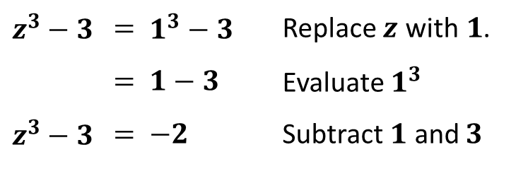

ORDER OF OPERATIONS AND EVALUATING EXPRESSIONS
  Example: Evaluate $z^{3}−3$, if $z=1$.
$$z^{3}−3$$ | $$=$$ | $$1^{3}−3$$ | Replace $z$ with$1$.
 | $$=$$ | $$1−3$$ | Evaluate $1^{3}$
$$z^{3}−3$$ | $$=$$ | $$−2$$ | Subtract $1$ and $3$

Slide 5
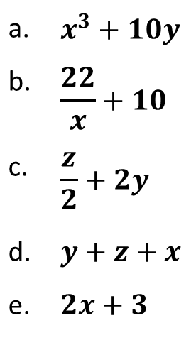

ORDER OF OPERATIONS AND EVALUATING EXPRESSIONS
Sample Problem 1: Evaluate each expression if $x=1$, $y=2$, and $z=4$.
a. | $$x^{3}+10y$$
b. | $$\frac{22}{x}+10$$
c. | $$\frac{z}{2}+2y$$
d. | $$y+z+x$$
e. | $$2x+3$$

Slide 6
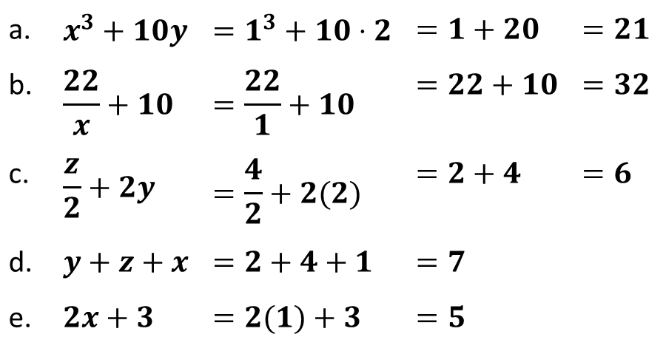
ORDER OF OPERATIONS AND EVALUATING EXPRESSIONS
Sample Problem 1: Evaluate each expression if $x=1$, $y=2$, and $z=4$.
a. | $$x^{3}+10y$$ | $$=1^{3}+10⋅2$$ | $$=1+20$$ | $$=21$$
b. | $$\frac{22}{x}+10$$ | $$=\frac{22}{1}+10$$ | $$=22+10$$ | $$=32$$
c. | $$\frac{z}{2}+2y$$ | $$=\frac{4}{2}+2(2)$$ | $$=2+4$$ | $$=6$$
d. | $$y+z+x$$ | $$=2+4+1$$ | $$=7$$
e. | $$2x+3$$ | $$=2(1)+3$$ | $$=5$$

Slide 7

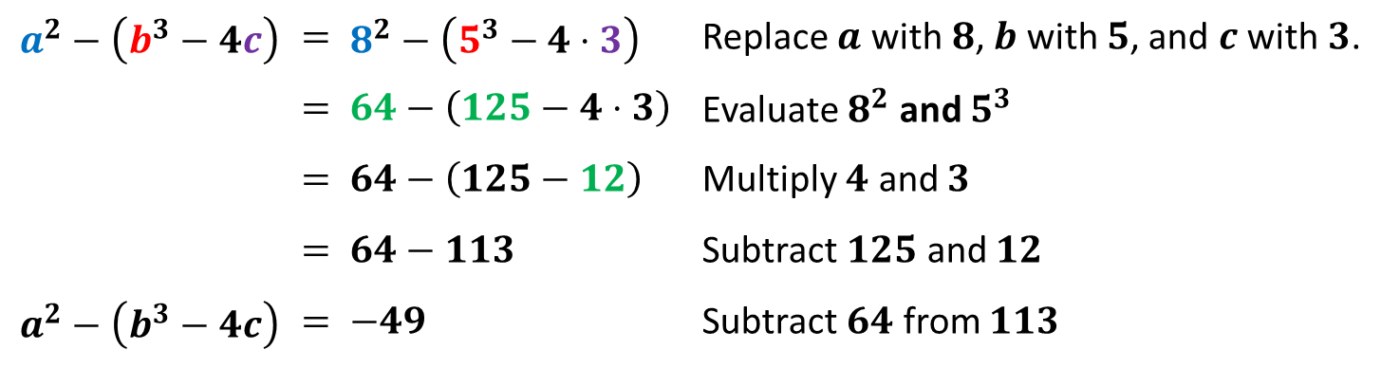
ORDER OF OPERATIONS AND EVALUATING EXPRESSIONS
GROUPING SYMBOLS, such as parentheses or brackets , indicate the order in which the operations should be performed first.
  Example: Evaluate $a^{2}−\left(b^{3}−4c\right)$, if $a=8$, $b=5$, and $c=3$.
$$a^{2}−\left(b^{3}−4c\right)$$ | $$=$$ | $$8^{2}−\left(5^{3}−4⋅3\right)$$ | Replace $a$ with$8$, $b$ with $5$, and $c$ with $3$.
 | $$=$$ | $$64−\left(125−4⋅3\right)$$ | Evaluate $8^{2}$ and $5^{3}$
 | $$=$$ | $$64−\left(125−12\right)$$ | Multiply $4$ and $3$
 | $$=$$ | $$64−113$$ | Subtract $125$ and $12$
$$a^{2}−\left(b^{3}−4c\right)$$ | $$=$$ | $$−49$$ | Subtract $64$ from $113$

Slide 8
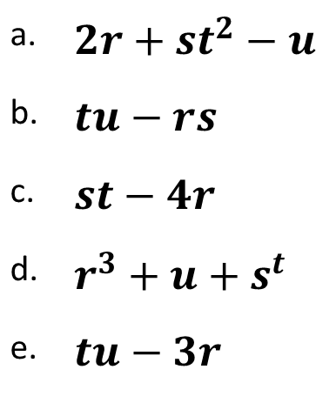

ORDER OF OPERATIONS AND EVALUATING EXPRESSIONS
Sample Problem 2: Evaluate each expression if $r=1$, $s=3$, $t=3$, and $u=10$.
a. | $$2r+st^{2}−u$$
b. | $$tu−rs$$
c. | $$st−4r$$
d. | $$r^{3}+u+s^{t}$$
e. | $$tu−3r$$

Slide 9
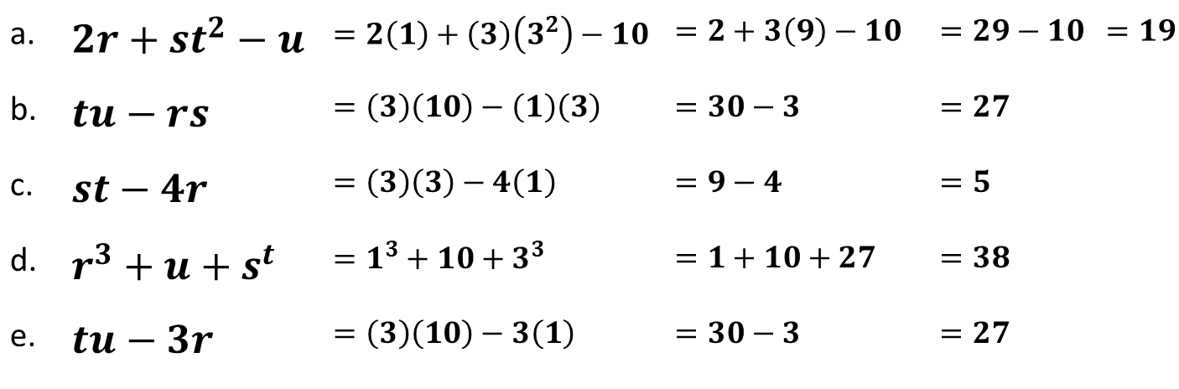
ORDER OF OPERATIONS AND EVALUATING EXPRESSIONS
Sample Problem 2: Evaluate each expression if $r=1$, $s=3$, $t=3$, and $u=10$.
a. | $$2r+st^{2}−u$$ | $$=2\left(1\right)+\left(3\right)\left(3^{2}\right)−10$$ | $$=2+3\left(9\right)−10$$ | $$=29−10$$ | $$=19$$
b. | $$tu−rs$$ | $$=\left(3\right)\left(10\right)−\left(1\right)\left(3\right)$$ | $$=30−3$$ | $$=27$$
c. | $$st−4r$$ | $$=\left(3\right)\left(3\right)−4\left(1\right)$$ | $$=9−4$$ | $$=5$$
d. | $$r^{3}+u+s^{t}$$ | $$=1^{3}+10+3^{3}$$ | $$=1+10+27$$ | $$=38$$
e. | $$tu−3r$$ | $$=\left(3\right)\left(10\right)−3\left(1\right)$$ | $$=30−3$$ | $$=27$$

Slide 10

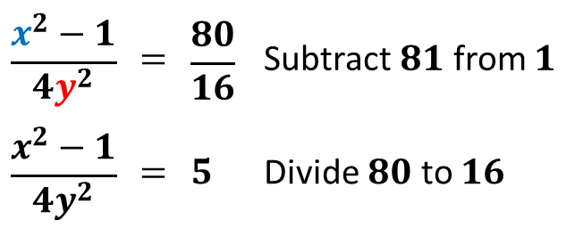
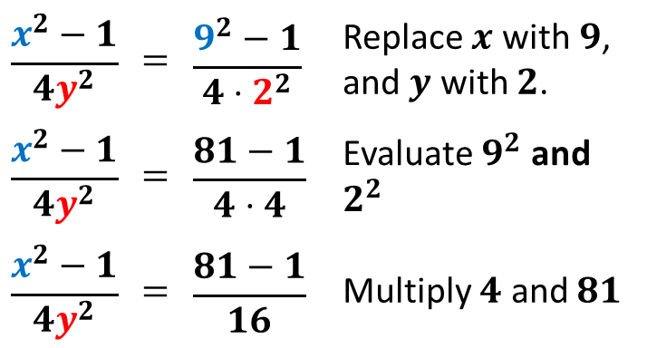
ORDER OF OPERATIONS AND EVALUATING EXPRESSIONS
FRACTION BAR is another type of grouping symbol. It indicates that the numerator and denominator should each be treated as a single value.
  Example: Evaluate$\frac{x^{2}−1}{4y^{2}}$, if $x=9$, and $y=2$.
$$\frac{x^{2}−1}{4y^{2}}$$ | $$=$$ | $$\frac{9^{2}−1}{4⋅2^{2}}$$ | Replace $x$ with$9$, and $y$ with $2$.
$$\frac{x^{2}−1}{4y^{2}}$$ | $$=$$ | $$\frac{81−1}{4⋅4}$$ | Evaluate $9^{2}$ and $2^{2}$
$$\frac{x^{2}−1}{4y^{2}}$$ | $$=$$ | $$\frac{81−1}{16}$$ | Multiply $4$ and $81$
$$\frac{x^{2}−1}{4y^{2}}$$ | $$=$$ | $$\frac{80}{16}$$ | Subtract $81$ from $1$
$$\frac{x^{2}−1}{4y^{2}}$$ | $$=$$ | $$5$$ | Divide $80$ to $16$

Slide 11

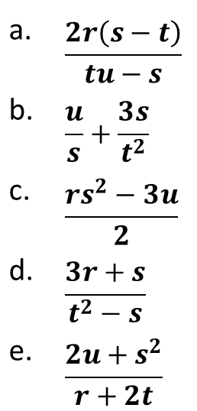
ORDER OF OPERATIONS AND EVALUATING EXPRESSIONS
Sample Problem 3: Evaluate each expression if $r=2$, $s=4$, $t=6$, and $u=8$.
a. | $$\frac{2r\left(s−t\right)}{tu−s}$$
b. | $$\frac{u}{s}+\frac{3s}{t^{2}}$$
c. | $$\frac{rs^{2}−3u}{2}$$
d. | $$\frac{3r+s}{t^{2}−s}$$
e. | $$\frac{2u+s^{2}}{r+2t}$$

Slide 12
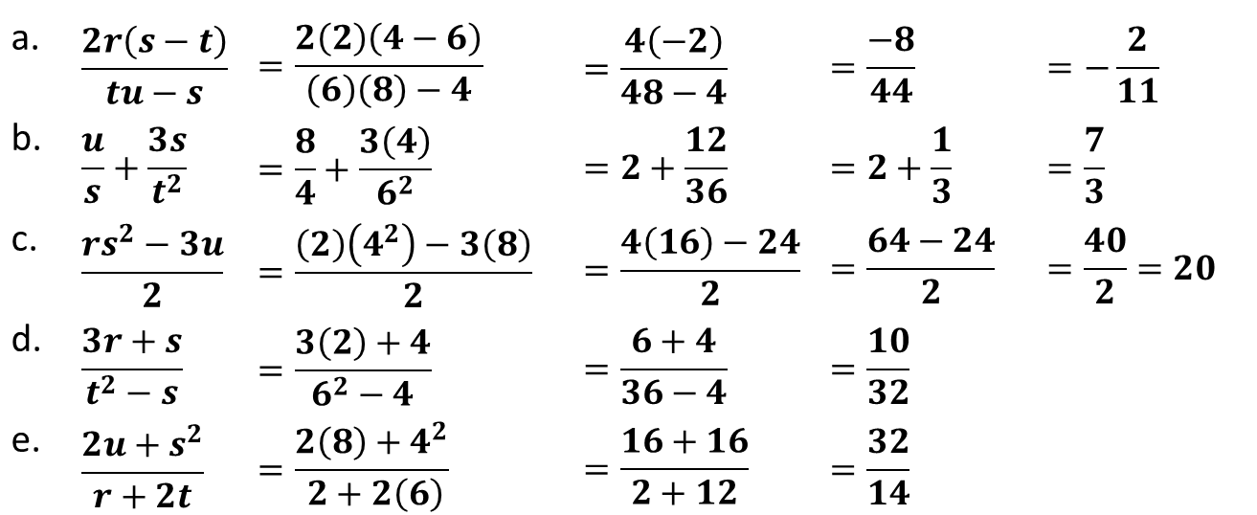


ORDER OF OPERATIONS AND EVALUATING EXPRESSIONS
Sample Problem 3: Evaluate each expression if $r=2$, $s=4$, $t=6$, and $u=8$.
a. | $$\frac{2r\left(s−t\right)}{tu−s}$$ | $$=\frac{2\left(2\right)\left(4−6\right)}{\left(6\right)\left(8\right)−4}$$ | $$=\frac{4\left(−2\right)}{48−4}$$ | $$=\frac{−8}{44}$$ | $$=−\frac{2}{11}$$
b. | $$\frac{u}{s}+\frac{3s}{t^{2}}$$ | $$=\frac{8}{4}+\frac{3\left(4\right)}{6^{2}}$$ | $$=2+\frac{12}{36}$$ | $$=2+\frac{1}{3}$$ | $$=\frac{7}{3}$$
c. | $$\frac{rs^{2}−3u}{2}$$ | $$=\frac{\left(2\right)\left(4^{2}\right)−3\left(8\right)}{2}$$ | $$=\frac{4\left(16\right)−24}{2}$$ | $$=\frac{64−24}{2}$$ | $$=\frac{40}{2}=20$$
d. | $$\frac{3r+s}{t^{2}−s}$$ | $$=\frac{3\left(2\right)+4}{6^{2}−4}$$ | $$=\frac{6+4}{36−4}$$ | $$=\frac{10}{32}$$
e. | $$\frac{2u+s^{2}}{r+2t}$$ | $$=\frac{2\left(8\right)+4^{2}}{ 2+2\left(6\right)}$$ | $$=\frac{16+16}{2+12}$$ | $$=\frac{32}{14}$$
$$=\frac{5}{16}$$
$$=\frac{16}{7}$$

