Slide 1
Translating Expressions with Parentheses
Unit 1 Lesson 2
Math 5

Slide 2
Translating Expressions with Parentheses
Students will be able to:
Describe the purpose and meaning of parentheses in a numerical expression.
Compare verbal statements that need parentheses to those that do not.
Identify the correct placement of the parentheses in a given verbal statement.
Translate verbal expressions with parentheses.

Slide 3
Translating Expressions with Parentheses
Key Vocabulary:
Numerical expression
Parentheses
Operations
Grouping
Verbal phrase

Slide 4
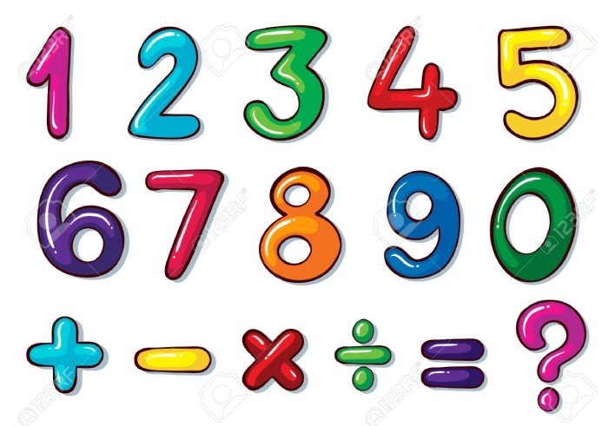
Translating Expressions with Parentheses
What are NUMERICAL EXPRESSIONS?
A numerical expression is a mathematical phrase representing a single value consisting of one or more numbers and operations. These operations involve Addition, Subtraction, Multiplication, and Division.

Slide 5
Translating Expressions with Parentheses
What are NUMERICAL EXPRESSIONS?
The picture shows the numbers and operations you can mix up to form a numerical expression.
Also, remember that there should be NO equal sign “=” in the expression because that would be a different story ☺!

Slide 6
Translating Expressions with Parentheses
Expressions WITH or WITHOUT Parentheses
This lesson is an in-depth discussion of when to use and not to use parentheses in translating verbal expressions into numerical expressions.
When do you use parenthesis?
Parentheses, with the symbol “( )”, in numerical expressions are used to:

Slide 7
Translating Expressions with Parentheses
When do you use parenthesis?

Slide 8
Translating Expressions with Parentheses
When do you use parenthesis?

Slide 9
Translating Expressions with Parentheses
When do you use parenthesis?

Slide 10
Translating Expressions with Parentheses
How do you compare a verbal phrase with parentheses and without them?

Slide 11
Translating Expressions with Parentheses
How do you compare a verbal phrase with parentheses and without them?
Parentheses for numerical expressions are used to group numbers with operations that must be done first. Let’s compare the two verbal phrases above and let’s find out which one needs parentheses and which one does not.

Slide 12
Translating Expressions with Parentheses
Example 1:
If you are asked to translate the verbal phrase above to its corresponding numerical expression, you must read and UNDERSTAND it carefully.
Eleven minus the sum of five and four

Slide 13
Translating Expressions with Parentheses
Here, you must pay attention to the clues… PLUS and SUM both mean to ADD. But… the word “sum” in the phrase above must be grouped, enclosed in PARENTHESES, and must be performed first.

Slide 14
Translating Expressions with Parentheses
So… going back to the example:
Eleven minus the sum of five and four
will be translated as a numerical expression:
$$11−(5+4)$$

Slide 15
Translating Expressions with Parentheses
Example 2:
Eleven minus five plus four
The same thing goes for this example; you must READ and UNDERSTAND the phrase carefully.
Eleven minus five plus four
The standard way to translate this verbal phrase into a numerical expression is:
$$11−5+4$$

Slide 16
Translating Expressions with Parentheses
Notice that everything is still there except the “parentheses”. Here instead of the word “sum”,… the word “plus” is used. There is no need for grouping in this type of example.
Each expression when evaluated, will give different values.

Slide 17
Translating Expressions with Parentheses
Sample Problem 1:
Highlight the verbal phrase that needs parentheses GREEN.
The sum of three times four plus seven
Three times four plus seven
Three times the sum of four and seven
Ten divided by two times five
The quotient of ten and two times five
Ten divided by the product of two and five

Slide 18
Translating Expressions with Parentheses
Solution:
Highlight the verbal phrase that needs parentheses GREEN.
The sum of three times four plus seven
Three times four plus seven
Three times the sum of four and seven
Ten divided by two times five
The quotient of ten and two times five
Ten divided by the product of two and five

Slide 19
Translating Expressions with Parentheses

Slide 20
Translating Expressions with Parentheses
Sample Problem 2:
Translate the statements in Sample Problem 2 into numerical expressions. Place the parentheses (if needed) correctly.

