Slide 1
Unit Rate
Unit 1 Lesson 2
Math 6

Slide 2
Unit Rates
Students will be able to:
Determine the unit rate of the given quantities.
Solve word problems involving unit rates.

Slide 3
Unit Rate
Key Vocabulary:
Ratio
Rate
Unit Rate
Terms

Slide 4
Unit Rate
Ratio vs. Rates
Ratio is the comparison of two numerical measurements. Each measurement is called a "term."
The ratio of bananas to apples is
2:5

Slide 5
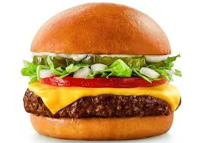
Unit Rate
Rate is a little bit different than the ratio, it is a special ratio. It is a comparison of measurements that have different units.
Example:
If 15 burgers cost $75, the rate is $75 for 15 yummy burgers.
In ratio: $75 : 15

Slide 6
Unit Rate
In the example, the first term of the ratio is the price in dollars and the second term is the number of burgers.
You can write this rate as $75/15 burgers or $75:15 burgers. Both expressions mean that you pay $75 "for every" 15 burgers.

Slide 7
Unit Rate
Sample Problem 1:
Tell whether the given quantities represent a mere RATIO or a RATE.
a. 10 pieces of red pens to 6 pieces of blue pens Solution: RATIO
b.200 miles to 4 hours
Solution: RATE

Slide 8
Unit Rate
Unit Rate is a rate in which the second term equals "1."
If you want you determine a unit rate, you need to know how much of the first term exists for every one unit of the second term

Slide 9
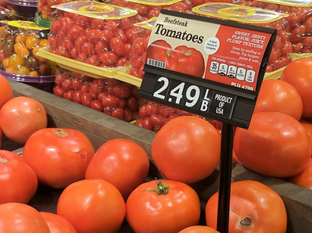
Unit Rate
Unit Rate
Example:
Here, the rate is $2.49 for every kilo of tomatoes, or in ratio $2.49:1.

Slide 10
Unit Rate
Unit Rate
Notice that the value of the second term in the ratio is 1. Therefore, when rates are expressed as a quantity of 1, then the rate
$2.49 per kilo is a unit rate.

Slide 11
Unit Rate
Unit Rate
And since ratios can be expressed as fractions, it is also CORRECT to say that a unit rate has 1 as the denominator.

Slide 12
Unit Rate
Sample Problem 2:
Which among the given quantities express a unit rate?
90 words per 30 minutes
3 words per minute
180 words per hour
60 words per 20 minutes

Slide 13
Unit Rate
How Do We Calculate the Unit Rate?
Step 1: Check what information is given.
The problem must have two terms, and you must be asked to determine how much of one term exists per unit of the other term.

Slide 14
Unit Rate
How Do We Calculate the Unit Rate?

Slide 15
Unit Rate
Example:
A bakeshop can bake 400 chocolate cupcakes in an 8 hour work day. How many chocolate cupcakes can that same bakeshop make in one hour?

Slide 16
Unit Rate
In other words, how many chocolate cupcakes are typically baked per hour?

Slide 17
Unit Rate
Step 2: Rewrite the given date as a quotient or a fraction.

Slide 18
Unit Rate
Step 3: Divide the first term (numerator) and the second term (denominator) by the value of the denominator.
Remember that we want to express the rate as a SINGLE unit which means that the denominator MUST be equal to 1.

Slide 19
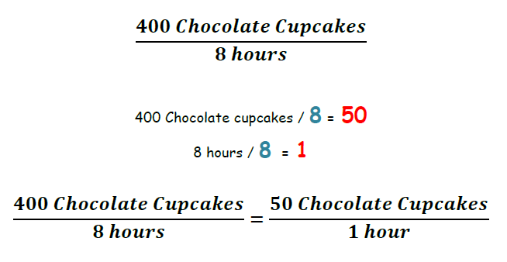
Unit Rate

Slide 20
Unit Rate
Step 4: Write the unit rate expression.
Therefore, the bakeshop can bake 50 chocolate cupcakes per hour.

Slide 21
Unit Rate
Sample Problem 3:
Answer the problem.
James traveled 200 miles in 4 hours. If he used the same speed the entire trip, how fast did he drive miles per hour?

Slide 22
Unit Rate
Solution:
Step 1: 200 miles in 4 hours
Step 2: $\frac{200 miles}{4 hours}$
Step 3: 200 miles / 4 = 50
4 hours / 4 = 1
Step 4: Therefore, he drives 4 miles per hour.

