Slide 1
Variables and Expressions
Unit 1 Lesson 2

Slide 2
Variables and Expressions
Students will be able to:
Write expressions that record operations with numbers and with letters standing for numbers.
Key Vocabulary:
Variable
Constant
Expressions
Terms
Coefficient

Slide 3
Variables and Expressions
A numerical expression is a mathematical phrase that contains only constants and/or operations
To evaluate a numerical expression, you find its numerical value.

Slide 4
Variables and Expressions
Sample Problem 1: Find the value of each numerical expression. Follow the order of operations when finding each value.
a.
$$12+10÷2−4=$$

Slide 5
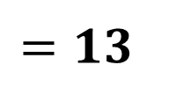
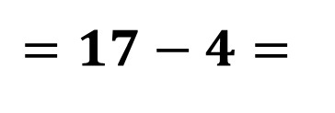
Variables and Expressions
Sample Problem 1: Find the value of each numerical expression. Follow the order of operations when finding each value.
a.
$$12+10÷2−4=$$
$$=12+5−4=$$
$$=17−4=$$
$$=13$$

Slide 6
Variables and Expressions
Sample Problem 1: Find the value of each numerical expression. Follow the order of operations when finding each value.
b.
$$20÷10+6=$$

Slide 7
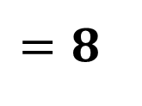
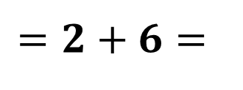
Variables and Expressions
Sample Problem 1: Find the value of each numerical expression. Follow the order of operations when finding each value.
b.
$$20÷10+6=$$
$$=2+6=$$
$$=8$$

Slide 8
Variables and Expressions
Sample Problem 1: Find the value of each numerical expression. Follow the order of operations when finding each value.
c.
$$12∗2−6÷3=$$

Slide 9
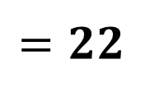
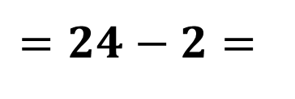
Variables and Expressions
Sample Problem 1: Find the value of each numerical expression. Follow the order of operations when finding each value.
c.
$$12∗2−6÷3=$$
$$=24−2=$$
$$=22$$

Slide 10
Variables and Expressions
A variable expression is a mathematical phrase that may contain variables, constants, and/or operations.
A variable is a letter that is used to represent one or more numbers.
The letters $x and y$ are used very often as variables in algebra, but variables can be any letter $(z, k, l, m, k )$.

Slide 11
Variables and Expressions
Any number not joined to a variable is called a constant.
It’s called that because its value doesn’t change, even if the value of the variable changes.
Each algebraic expression is made up of terms.
A term can be a signed number, a variable, or a constant multiplied by a variable or variables.

Slide 12
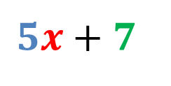
Variables and Expressions
Each term in an algebraic expression is separated by a + sign or a – sign.
When a term is made up of a constant multiplied by a variable or variables, that constant is called
a coefficient.
Example:
Coefficient
$$5x+7$$
Constant
Variable

Slide 13
Variables and Expressions
The terms having the same algebraic factors are called like terms.
The terms having different algebraic factors are called unlike terms.
Expression with one term is called a monomial, with two unlike terms is called a binomial, in general, an expression with one or more than one term (with nonnegative integral exponents of the variables) is called a polynomial.

Slide 14
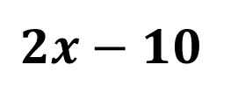
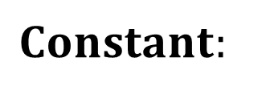
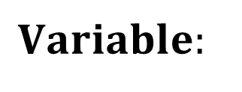
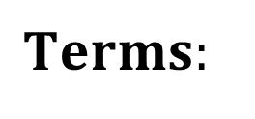
Variables and Expressions
Sample Problem 2: Find the terms, constant/s and coefficient/s for each expression.
a.
$$2x−10$$
$$Terms:$$
$$Variable:$$
$$Constant:$$
$$Coefficient$$

Slide 15
Variables and Expressions
Sample Problem 2: Find the terms, constant/s and coefficient/s for each expression.
a.
$$2x−10$$
$$Terms: 2x and 10$$
$$Variable: x$$
$$Constant: 10$$
$$Coefficient: 2$$

Slide 16
Variables and Expressions
Sample Problem 2: Find the terms, constant/s and coefficient/s for each expression.
b.
$$x+4y+32$$
$$Terms:$$
$$Variable:$$
$$Constant:$$
$$Coefficients:$$

Slide 17
Variables and Expressions
Sample Problem 2: Find the terms, constant/s and coefficient/s for each expression.
b.
$$x+4y+32$$
$$Terms: x , 4y ,and 32$$
$$Variable: x ,y$$
$$Constant: 32$$
$$Coefficients: 1 and 4$$

Slide 18
Variables and Expressions
Expressions are like instructions that tell you what you have to do to a number or variable.
Expressions are used to write word problems in math terms.

Slide 19
Variables and Expressions
Sample Problem 3: Write an algebraic expression for each verbal phrase.
a.
A number minus 10

Slide 20
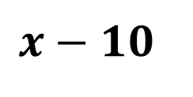
Variables and Expressions
Sample Problem 3: Write an algebraic expression for each verbal phrase.
a.
A number minus 10
$$x−10$$

Slide 21
Variables and Expressions
Sample Problem 3: Write an algebraic expression for each verbal phrase.
b.
The product of a number and 6

Slide 22
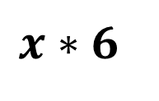
Variables and Expressions
Sample Problem 3: Write an algebraic expression for each verbal phrase.
b.
The product of a number and 6
$$x∗6$$

Slide 23
Variables and Expressions
Sample Problem 3: Write an algebraic expression for each verbal phrase.
c.
12 less than a number

Slide 24
Variables and Expressions
Sample Problem 3: Write an algebraic expression for each verbal phrase.
c.
12 less than a number
$$x−12$$

Slide 25
Variables and Expressions
Sample Problem 3: Write an algebraic expression for each verbal phrase.
d.
16 plus a number

Slide 26
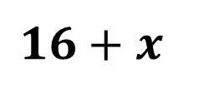
Variables and Expressions
Sample Problem 3: Write an algebraic expression for each verbal phrase.
d.
16 plus a number
$$16+x$$

Slide 27
Variables and Expressions
Sample Problem 3: Write an algebraic expression for each verbal phrase.
e.
The sum of $n$ and 8, divided by 4

Slide 28
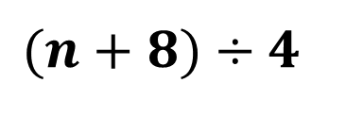
Variables and Expressions
Sample Problem 3: Write an algebraic expression for each verbal phrase.
e.
The sum of $n$ and 8, divided by 4
$$(n+8)÷4$$

Slide 29
Variables and Expressions
Sample Problem 3: Write an algebraic expression for each verbal phrase.
f.
4 more than 2 times a number

Slide 30
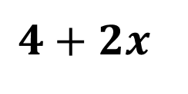
Variables and Expressions
Sample Problem 3: Write an algebraic expression for each verbal phrase.
f.
4 more than 2 times a number
$$4+2x$$

Slide 31
Variables and Expressions
Substituting Values into Algebraic Expressions
To evaluate an algebraic expression, you substitute values for the variables and then simplify the resulting numerical expression.

Slide 32
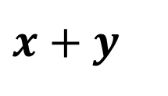
Variables and Expressions
Sample Problem 4: Evaluate each expression using the values given.
a.
$x+y$
$$when x=2 and y=6$$

Slide 33
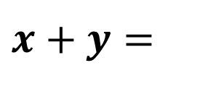
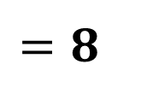
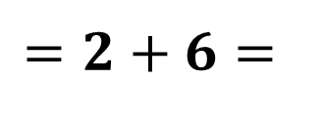
Variables and Expressions
Sample Problem 4: Evaluate each expression using the values given.
a.
$x+y=$
$$when x=2 and y=6$$
$$=2+6=$$
$$=8$$

Slide 34
Variables and Expressions
Sample Problem 4: Evaluate each expression using the values given.
b.
$$3x−4 when x=7 and y=1$$

Slide 35
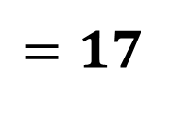
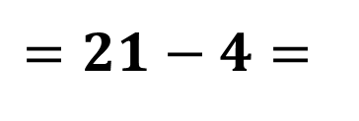
Variables and Expressions
Sample Problem 4: Evaluate each expression using the values given.
b.
$$3x−4y when x=7 and y=1$$
$$=3∗7−4∗1=$$
$$=21−4=$$
$$=17$$

Slide 36
Variables and Expressions
Sample Problem 4: Evaluate each expression using the values given.
c.
$$10a−4\left(2+b\right) when a=7 and b=2$$

Slide 37
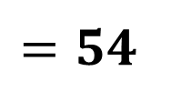
Variables and Expressions
Sample Problem 4: Evaluate each expression using the values given.
c.
$$10a−4\left(2+b\right) when a=7 and b=2$$
$$=10∗7−4\left(2+2\right)=$$
$$=70−4∗4=$$
$$=70−16=$$
$$=54$$

Slide 38
Variables and Expressions
Sample Problem 5: If $a=8$, $b=3$, and $c=6$, evaluate the following by substituting these values into the following expressions.
a.
$a+4b÷c=$

Slide 39
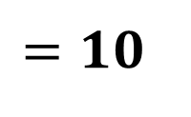
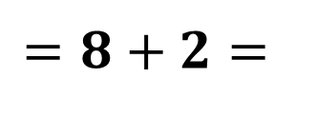
Variables and Expressions
Sample Problem 5: If $a=8$, $b=3$, and $c=6$, evaluate the following by substituting these values into the following expressions.
a.
$a+4b÷c=$
$=8+4∗3÷6=$
$$=8+12÷6=$$
$$=8+2=$$
$$=10$$

Slide 40
Variables and Expressions
Sample Problem 5: If $a=8$, $b=3$, and $c=6$, evaluate the following by substituting these values into the following expressions.
b.
$$4a+2bc−3=$$

Slide 41
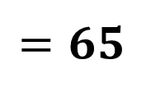
Variables and Expressions
Sample Problem 5: If $a=8$, $b=3$, and $c=6$, evaluate the following by substituting these values into the following expressions.
b.
$$4a+2bc−3=$$
$$=4∗8+2∗3∗6−3=$$
$$=32+36−3=$$
$$=32+33=$$
$$=65$$

Slide 42
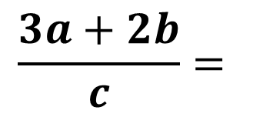
Variables and Expressions
Sample Problem 5: If $a=8$, $b=3$, and $c=6$, evaluate the following by substituting these values into the following expressions.
c.
$$\frac{3a+2b}{c}=$$

Slide 43
Variables and Expressions
Sample Problem 5: If $a=8$, $b=3$, and $c=6$, evaluate the following by substituting these values into the following expressions.
c.
$$\frac{3a+2b}{c}=$$
$$=\frac{3∗8+2∗3}{6}=$$
$$=\frac{24+6}{6}=\frac{30}{6}=5$$

