Slide 1

Converting Fractions and Decimals
Unit 1 Lesson 3

Slide 2

Converting Fractions and Decimals
Students will be able to:
Convert fractions and decimals

Slide 3
Converting Fractions and Decimals
Key Vocabulary:
Terminating decimal
Repeating decimal
Fraction

Slide 4
Converting Fractions and Decimals
Converting a Fraction to a Decimal
To convert a fraction to a decimal, divide the numerator by the denominator.
To convert a fraction to a decimal, write an equivalent fraction (if possible) whose denominator is 10, 100, or 1000.
Remember that the numerator is the dividend and the denominator is the divisor.

Slide 5
Converting Fractions and Decimals
Converting a Fraction to a Decimal
A terminating decimal is a decimal with a finite number of digits after the decimal point.
A repeating decimal is a decimal in which one digit or a group of digits is repeated without end.

Slide 6
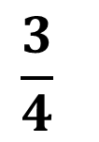
Converting Fractions and Decimals
Sample Problem 1: Convert each fraction to a decimal, then determine if its decimal expansion is repeating or terminating.
$$\frac{3}{4}$$
a.

Slide 7
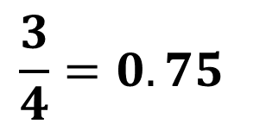
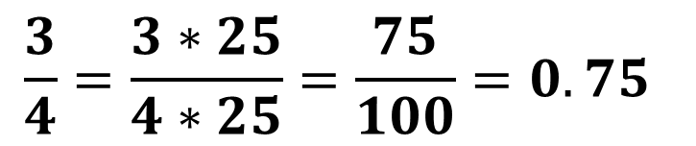
Converting Fractions and Decimals
Sample Problem 1: Convert each fraction to a decimal, then determine if its decimal expansion is repeating or terminating.
$$\frac{3}{4}$$
a.
$$\frac{3}{4}=\frac{3∗25}{4∗25}=\frac{75}{100}=0.75$$
$$\frac{3}{4}=0.75$$
A terminating decimal

Slide 8
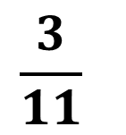
Converting Fractions and Decimals
Sample Problem 1: Convert each fraction to a decimal, then determine if its decimal expansion is repeating or terminating.
$$\frac{3}{11}$$
b.

Slide 9
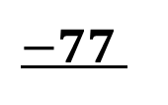

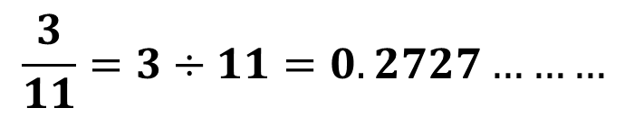
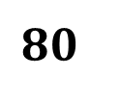
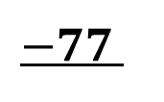

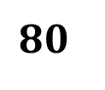
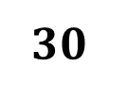
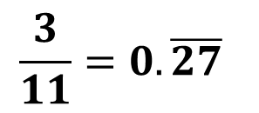

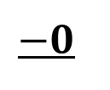
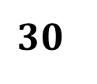
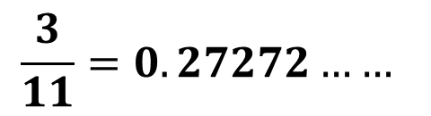
Converting Fractions and Decimals
Sample Problem 1: Convert each fraction to a decimal, then determine if its decimal expansion is repeating or terminating.
$$\frac{3}{11}=3÷11=0.2727………$$
b.
$$−0$$
$$30$$
$$\frac{3}{11}=0.27272……$$
$$−22$$
$$80$$
$$−77$$
$$\frac{3}{11}=0.\overline{27}$$
$$30$$
$$−22$$
$$80$$
A repeating decimal
$$−77$$
$$3$$

Slide 10
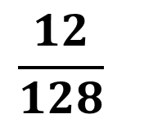
Converting Fractions and Decimals
Sample Problem 1: Convert each fraction to a decimal, then determine if its decimal expansion is repeating or terminating.
$$\frac{12}{128}$$
c.

Slide 11


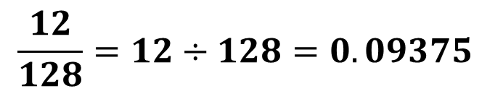
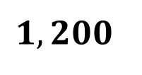
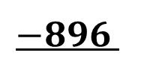
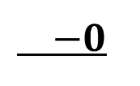



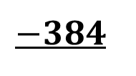

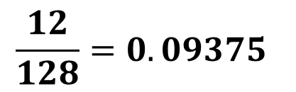
Converting Fractions and Decimals
Sample Problem 1: Convert each fraction to a decimal, then determine if its decimal expansion is repeating or terminating.
$$\frac{12}{128}=12÷128=0.09375$$
c.
$$−0$$
$$120$$
$$\frac{12}{128}=0.09375$$
$$−0$$
$$1,200$$
$$−1,152$$
$$480$$
$$−384$$
$$960$$
$$−896$$
A terminating decimal
$$640$$
$$640$$

Slide 12
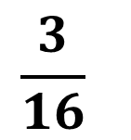
Converting Fractions and Decimals
Sample Problem 1: Convert each fraction to a decimal, then determine if its decimal expansion is repeating or terminating.
$$\frac{3}{16}$$
d.

Slide 13


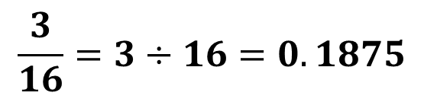

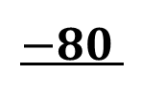



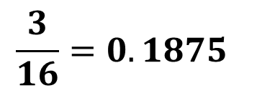
Converting Fractions and Decimals
Sample Problem 1: Convert each fraction to a decimal, then determine if its decimal expansion is repeating or terminating.
$$\frac{3}{16}=3÷16=0.1875$$
d.
$$−0$$
$$30$$
$$\frac{3}{16}=0.1875$$
$$−16$$
$$140$$
$$−128$$
$$120$$
$$−112$$
$$80$$
A terminating decimal
$$−80$$
$$0$$

Slide 14
Converting Fractions and Decimals
Converting a Decimal to a Fraction
A terminating decimal can be written as a fraction simply by writing it as decimal fractions.

Slide 15
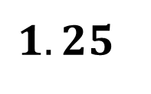
Converting Fractions and Decimals
Sample Problem 2: Convert each terminating decimal to a fraction.
a.
$$1.25$$

Slide 16
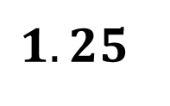
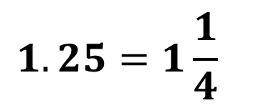
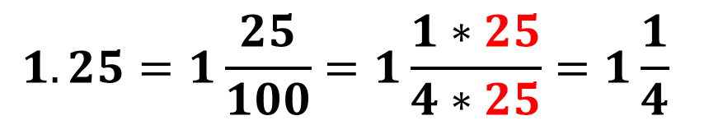
Converting Fractions and Decimals
Sample Problem 2: Convert each terminating decimal to a fraction.
a.
$$1.25$$
$$1.25=1\frac{25}{100}=1\frac{1∗25}{4∗25}=1\frac{1}{4}$$
$$1.25=1\frac{1}{4}$$

Slide 17
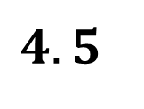
Converting Fractions and Decimals
Sample Problem 2: Convert each terminating decimal to a fraction.
b.
$$4.5$$

Slide 18
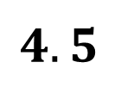
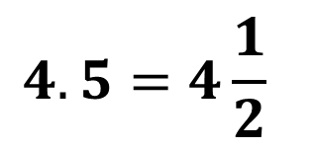
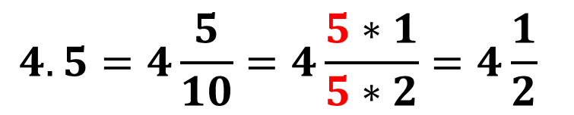
Converting Fractions and Decimals
Sample Problem 2: Convert each terminating decimal to a fraction.
b.
$$4.5$$
$$4.5=4\frac{5}{10}=4\frac{5∗1}{5∗2}=4\frac{1}{2}$$
$$4.5=4\frac{1}{2}$$

Slide 19
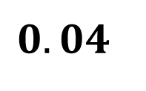
Converting Fractions and Decimals
Sample Problem 2: Convert each terminating decimal to a fraction.
c.
$$0.04$$

Slide 20
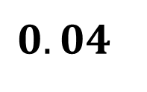
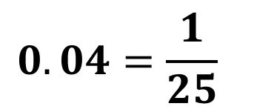
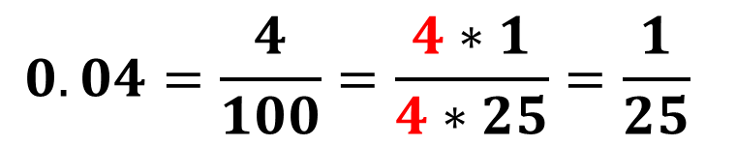
Converting Fractions and Decimals
Sample Problem 2: Convert each terminating decimal to a fraction.
c.
$$0.04$$
$$0.04=\frac{4}{100}=\frac{4∗1}{4∗25}=\frac{1}{25}$$
$$0.04=\frac{1}{25}$$

Slide 21

Converting Fractions and Decimals
Sample Problem 2: Convert each terminating decimal to a fraction.
d.
$$−5.12$$

Slide 22



Converting Fractions and Decimals
Sample Problem 2: Convert each terminating decimal to a fraction.
d.
$$−5.12$$
$$−5.12=−5\frac{12}{100}=−5\frac{4∗3}{4∗25}=−5\frac{3}{25}$$
$$−5.12=−5\frac{3}{25}$$

Slide 23
Converting Fractions and Decimals
A repeating decimal can be written as a fraction.
Follow these steps, to change each repeating decimal to a fraction.
Step 1: Let 𝑥 equal the repeating decimal.
Step 2: Multiply by powers of 1, 10, or 100 to create 2 equations that isolate the repeating part of the decimal.
Step 3: Subtract the equations to remove the repeating part of the decimal.
Step 4: Solve the resulting equation and simplify the fraction.

Slide 24

Converting Fractions and Decimals
Sample Problem 3: Convert each repeating decimal to a fraction.
a.
$$0.666666…….$$

Slide 25






Converting Fractions and Decimals
Sample Problem 3: Convert each repeating decimal to a fraction.
a.
$$0.666666…….$$
$$10x=6.66666$$
_________________
$$− x=0.66666$$
$$9x=6$$
$$x=\frac{6}{9}=\frac{2∗3}{3∗3}$$
$$x=\frac{2}{3}$$

Slide 26

Converting Fractions and Decimals
Sample Problem 3: Convert each repeating decimal to a fraction.
b.
$$1.252525……$$

Slide 27





Converting Fractions and Decimals
Sample Problem 3: Convert each repeating decimal to a fraction.
b.
$$1.252525……$$
$$100x=125.2525$$
$$− x= 1.2525$$
_______________
$$99x=124$$
$$x=\frac{124}{99}$$

Slide 28

Converting Fractions and Decimals
Sample Problem 3: Convert each repeating decimal to a fraction.
c.
$$0.181818……..$$

Slide 29






Converting Fractions and Decimals
Sample Problem 3: Convert each repeating decimal to a fraction.
c.
$$0.181818…$$
$$100x=18.1818$$
_________________
$$− x= 0.1818$$
$$99x=18$$
$$x=\frac{18}{99}=\frac{9∗2}{9∗11}$$
$$x=\frac{2}{11}$$

Slide 30

Converting Fractions and Decimals
Sample Problem 3: Convert each repeating decimal to a fraction.
d.
$$0.3717171717…….$$

Slide 31






Converting Fractions and Decimals
Sample Problem 3: Convert each repeating decimal to a fraction.
d.
$$0.3717171717…….$$
$$1,000x=371.7171$$
$$− 10x= 3.7171$$
_________________
$$990x=368$$
$$x=\frac{368}{990}=\frac{2∗184}{2∗495}$$
$$x=\frac{184}{495}$$

