Slide 1
Equivalent Ratios and Tables
Unit 1 Lesson 3
Math 6

Slide 2
Equivalent Ratios and Tables
Students will be able to:
Write equivalent ratios.
Determine the unknown terms in equivalent ratios and tables.
Plot equivalent ratios in a coordinate plane.

Slide 3
Equivalent Ratios and Tables
Key Vocabulary:
Ratio
Equivalent Ratio
Ratio Table
Scale Up/Down
Coordinate Plane

Slide 4
Equivalent Ratios and Tables
Equivalent Ratios
Remember that a ratio is a comparison of two quantities and each ratio can be written in another way.
This shows a comparison between the number of boys to the number of girls, expressed as 4:2.
But 4:2 can also be written as 2:1.
4:2 and 2:1 are EQUIVALENT RATIOS

Slide 5
Equivalent Ratios and Tables
How do we write equivalent ratios?
Equivalent ratios can be determined by SCALING UP or SCALING DOWN a ratio.

Slide 6
Equivalent Ratios and Tables
SCALING UP A RATIO
We scale up a ratio by a scale factor, which means multiplying each term of the ratio by a given scale factor.

Slide 7
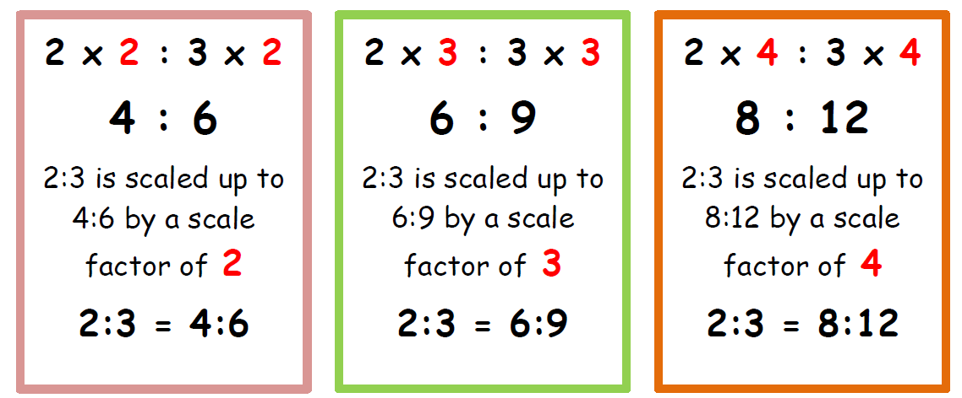
Equivalent Ratios and Tables
Example: Give 3 equivalent ratios for 2:3.

Slide 8
Equivalent Ratios and Tables
Sample Problem 1:
Which among the following is an equivalent ratio of 3:5? Give all possible answers.
6:15 b. 9:10 c. 6:10
d. 12:20 e. 45:75

Slide 9
Equivalent Ratios and Tables
SCALING DOWN A RATIO
We scale down a ratio by a scale factor, which means dividing each term of the ratio by a given scale factor.

Slide 10
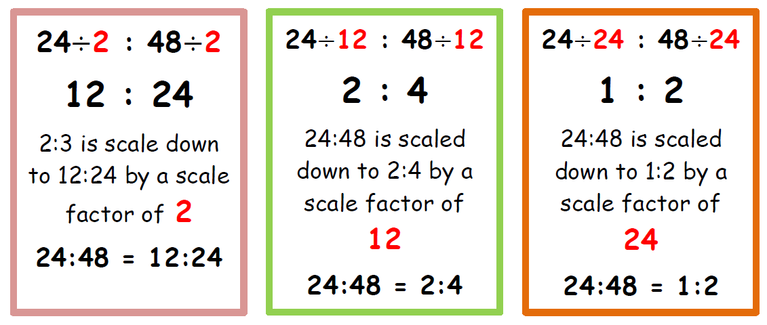
Equivalent Ratios and Tables
Example: Give 3 equivalent ratios for 24:48.

Slide 11
Equivalent Ratios and Tables
Sample Problem 2:
Which among the following is an equivalent ratio of 36:18? Give all possible answers.
1:2 b. 4:2 c. 2:1
d. 12:6 e. 6:12

Slide 12
Equivalent Ratios and Tables
But there is another way!!!
To determine equivalent ratios, you need to follow these steps.
Step 1: Express the ratios in fraction form.
Step 2: Express the fractions in lowest term.
Step 3: If the fractions in lowest term are equal, then the ratios are equivalent.

Slide 13
Equivalent Ratios and Tables

Slide 14
Equivalent Ratios and Tables
Sample Problem 3:
Show that the following ratios 6:10, 12:20 and 15:25 are equivalent ratios.
Solution:
Step 1: $\frac{6}{10}$, $\frac{12}{20}$ and $\frac{15}{25}$
Step 2: $\frac{3}{5}$, $\frac{3}{5}$ and $\frac{3}{5}$
Step 3: Therefore, 6:10, 12:20 and 15:25 are equivalent ratios.

Slide 15
Equivalent Ratios and Tables
Finding the Unknown Term in Equivalent Ratios
Example: Find the unknown term in the equivalent ratios 12:16 and 6:x

Slide 16
Equivalent Ratios and Tables
Method 1:
Step 1: Express the equivalent ratios as fractions.
$$\frac{12}{16}= \frac{6}{x}$$
Step 2: Cross multiply
12x = 96
Step 3: Solve for the unknown
$\frac{12x}{12}= \frac{96}{12}$
X = 8

Slide 17
Equivalent Ratios and Tables
Method 2:
Step 1: Equate the equivalent ratios
12:16 = 6:x
Step 2: Multiply the inner terms and the outer terms.
12 : 16 = 6 : x
Here, 16 and 6 are the inner terms and 12 and x are the outer terms.
(12)(x) = (16)(6)
12x = 96
$$\frac{12x}{12}= \frac{96}{12}$$
X = 8

Slide 18
Equivalent Ratios and Tables
Sample Problem 4:
The ratio of boys to girls in a photography club is 3:4, If there are 12 boys, how many girls are there?
Solution:
3:4 = 12:x
3x = 48
$$\frac{3x}{3}= \frac{48}{3}$$
X = 16
Therefore, there are 16 girls in the photography club

Slide 19
Equivalent Ratios and Tables
Table of Equivalent Ratios
Equivalent ratio tables are tables that show the relationship of two values. Each and every ratio in the table is exactly the same as the all the others. The values in an equivalent ratio has either been scaled up or scaled down.

Slide 20
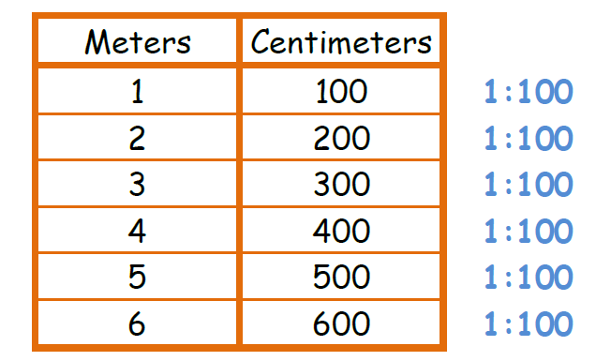
Equivalent Ratios and Tables
Table of Equivalent Ratios
The table of equivalent ratios is used to solve problems involving ratios with ease.

Slide 21
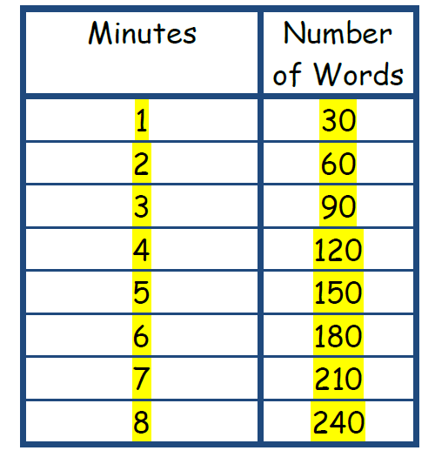
Equivalent Ratios and Tables
Sample Problem 5:
Mark can type 30 words per minute. Complete the table of equivalent ratios and answer the questions that follow.

Slide 22
Equivalent Ratios and Tables
How many words can Mark type in 5 minutes?
Solution: 150 words
b. How long can Mark type 210 words?
Solution: 7 minutes

Slide 23
Equivalent Ratios and Tables
Finding the Missing Values in a Ratio Table
The process in finding the missing terms in a ratio table is the same as finding equivalent ratios.

Slide 24
Equivalent Ratios and Tables
Ratios on Coordinate Plane
The pairs of values in the table of equivalent ratio can be plotted in a coordinate plane. The graph should be a straight line.
Example:
Plot the table of equivalent ratios in a coordinate plane.

Slide 25
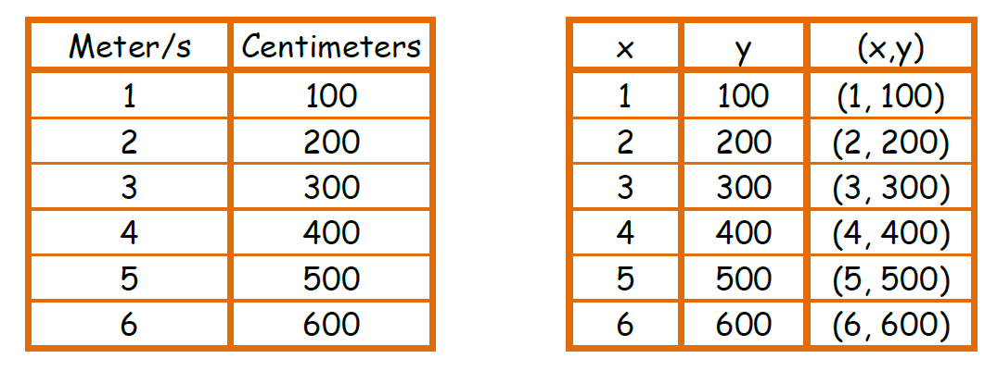
Equivalent Ratios and Tables
Step 1: Write the pairs of values in the table as coordinates.

Slide 26
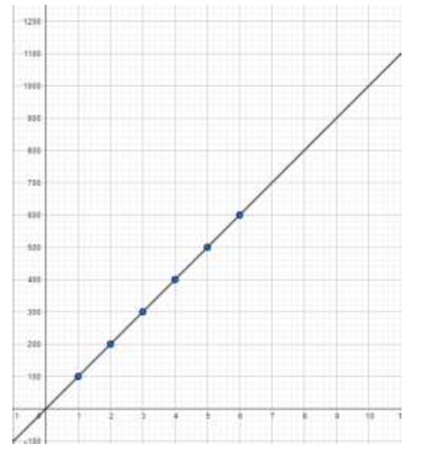
Equivalent Ratios and Tables
Step 2: Plot the points and connect so you could scale up or scale down the values.

Slide 27
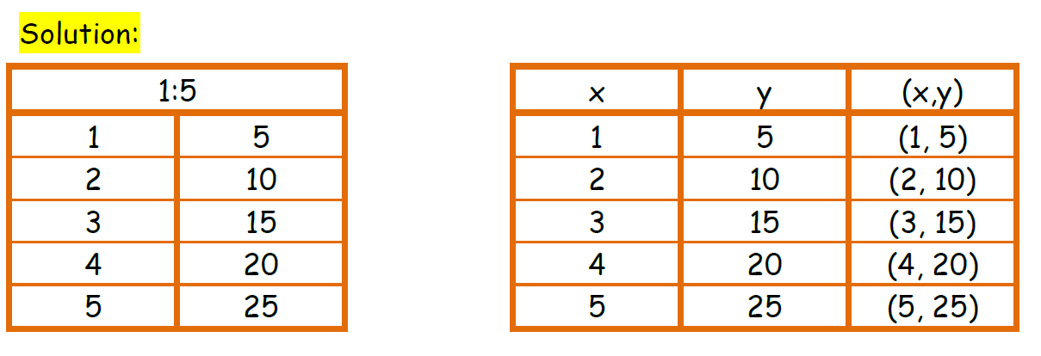
Equivalent Ratios and Tables
Sample Problem 6:
Make a table of equivalent ratio for 1:5 and plot the points in a coordinate plane.

Slide 28
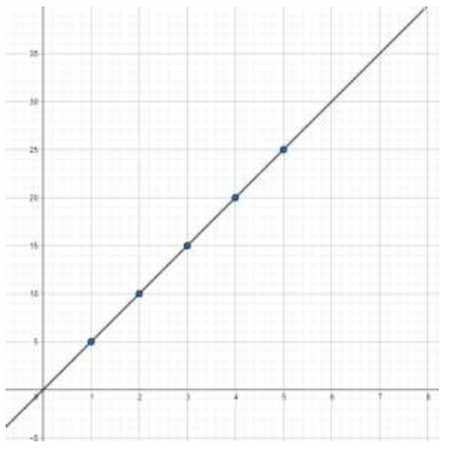
Equivalent Ratios and Tables
Sample Problem 6:
Make a table of equivalent ratio for 1:5 and plot the points in a coordinate plane.

