Slide 1
Order of Operations without Parentheses
Unit 1 Lesson 3
Math 5

Slide 2
Order of Operations without Parentheses
Students will be able to:
Identify the order of operation in a numerical expression (without parentheses).
Demonstrate understanding of the order of operations in a numerical expression (without parentheses).
Evaluate numerical expressions (without parentheses) using the MDAS rule.
Evaluate numerical expressions (without parentheses) using the funnel method.
Solve problems involving numerical expressions, following the correct order of operations.

Slide 3
Order of Operations without Parentheses
Key Vocabulary:
Numerical Expression
Order of Operations
MDAS Rule
Funnel Method
Evaluate

Slide 4
Order of Operations without Parentheses
Order of Operations
Similar to the word order is the word “arrangement.” Operations, on the other hand, would mean adding, subtracting, dividing, and multiplying. So “Order of Operations” means the correct arrangement of the operations involved in a numerical expression.

Slide 5
Order of Operations without Parentheses
For instance, James and Sally were asked to give the value of $5+2×10$.
Who do you think did it right?

Slide 6
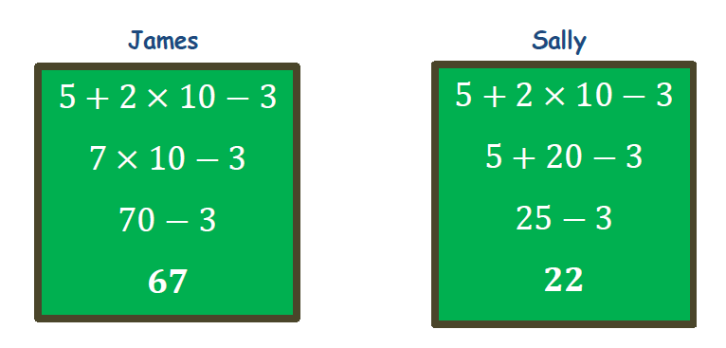
Order of Operations without Parentheses

Slide 7
Order of Operations without Parentheses
Sally and James came up with different answers. Both steps may look OK, but only ONE is correct, and the other one is just deceiving you
Questions like “What should go first?” and “What must be done next?” are just some of the many questions when asked to EVALUATE numerical expressions.

Slide 8
Order of Operations without Parentheses
Evaluating Numerical Expressions (without Parentheses)
The word EVALUATE means to “calculate” or to “get” the value of a given expression. Going back to the answers of James and Sally, they were asked to evaluate:
$$5+2×10−3$$

Slide 9
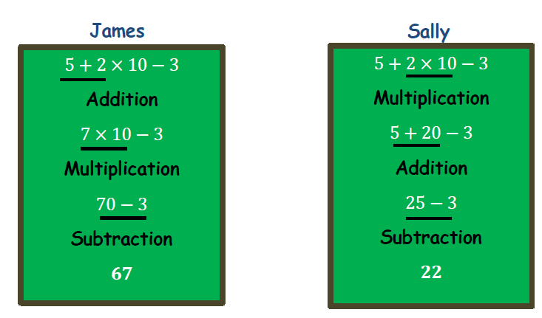
Order of Operations without Parentheses
As mentioned earlier, there could only be ONE correct answer. Below is a comparison of the order of operations each of them used.

Slide 10
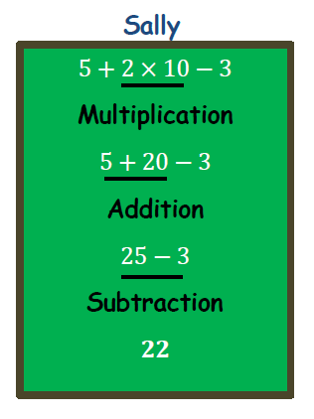
Order of Operations without Parentheses
So who got it right??? Sally got it right!!!

Slide 11
Order of Operations without Parentheses
In Mathematics, we must ensure that answers are accurate and valid. How do we ensure they are “accurate” and “valid”? Why is James incorrect?
To get an “accurate” and “valid” answer, certain rules must be followed. You can’t just do anything whichever you like and however, you would want to.
What are those RULES?

Slide 12
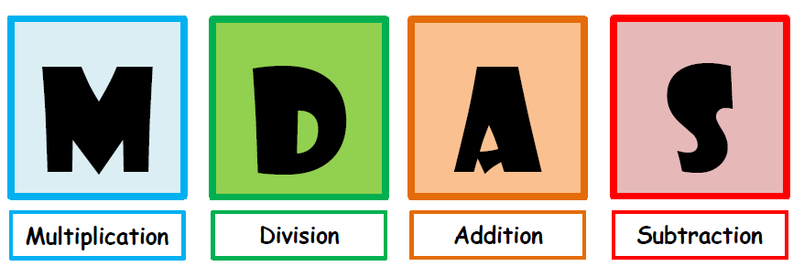
Order of Operations without Parentheses
Multiplication–Division–Addition–Subtraction (MDAS)
Following a pattern, arrangement, or order in evaluating numerical expressions will lead you to the correct answer. Let’s first evaluate numerical expressions without parentheses using the MDAS rule.

Slide 13
Order of Operations without Parentheses
Step #1
Always work from left to right, like the arrows below.
Step #2
Work with MULTIPLICATION or DIVISION, whichever comes first, from LEFT to RIGHT.
Step #3
Work with ADDITION or SUBTRACTION, whichever comes first, from LEFT to RIGHT.
Let’s find out why Sally got it right and James didn’t!

Slide 14
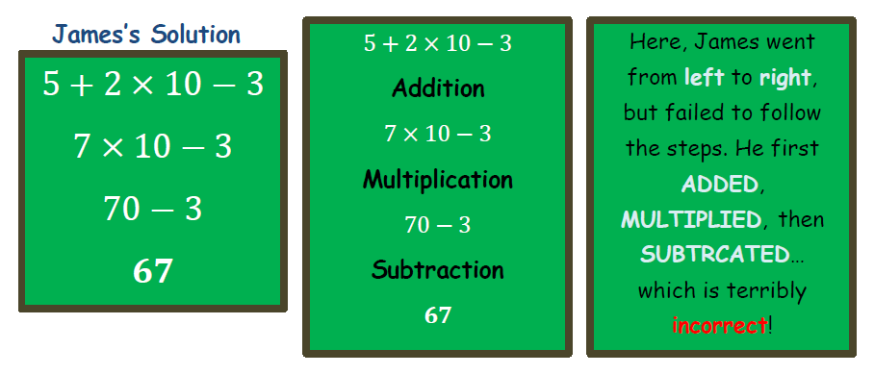
Order of Operations without Parentheses
Let’s find out why Sally got it right and James didn’t!

Slide 15
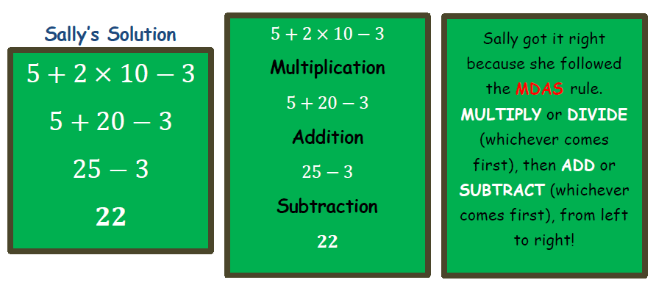
Order of Operations without Parentheses
Let’s find out why Sally got it right and James didn’t!

Slide 16
Order of Operations without Parentheses
WARNING!!!...
One wrong move and you’ll get it all WRONG ☹!

Slide 17
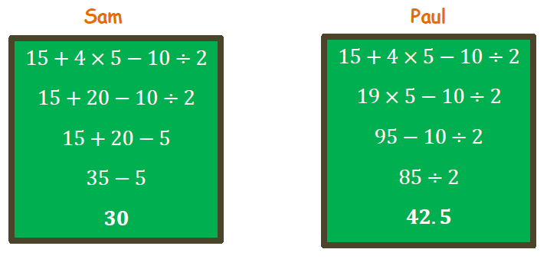
Order of Operations without Parentheses
Example:
Sam and Paul were asked to evaluate $15+4×5−10÷2$. Each of their solutions is shown below. Who among the two followed the MDAS rule? Explain your answer.

Slide 18
Order of Operations without Parentheses
Solution:
The one who did it right is Sam. He followed the MDAS rule. First, he multiplied 4 and 5 to get 20 and then got the quotient of 10 and 2, which is 5. Next, he got the sum of 15 and 20, which is 35. Lastly, he got a difference of 35 and 5. They were all done from left to right.
On the other hand, Paul is incorrect because even though he worked from left to right, he failed to follow the MDAS rule.

Slide 19
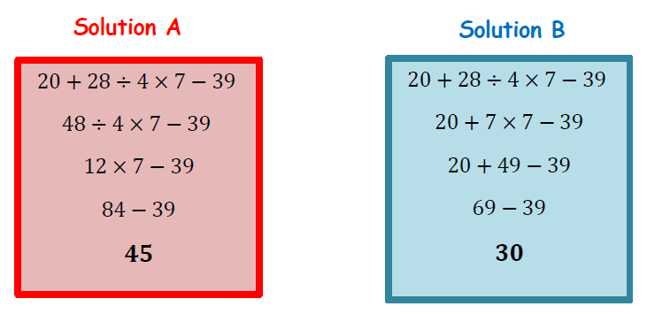
Order of Operations without Parentheses
Sample Problem 1:
The numerical expression $20+28÷4×7−39$ is solved in two different ways with different answers.

Slide 20
Order of Operations without Parentheses
Sample Problem 1:
Which of the two solutions is correct and why?
What makes the other one incorrect?

Slide 21
Order of Operations without Parentheses
Sample Problem 1:
Solution:
Which of the two solutions is correct and why?
Solution B is correct because the MDAS rule was followed.
b. What makes the other one incorrect?
Solution A is incorrect because even though the operations performed were from left to right, the MDAS rule needed to be followed.

Slide 22
Order of Operations without Parentheses
The Funnel Method
To make sure that you get the CORRECT answer, the use of the FUNNEL METHOD can help. Why is it called FUNNEL METHOD? Because it looks like a funnel! ☺
The examples we did earlier made use of the funnel method.

Slide 23
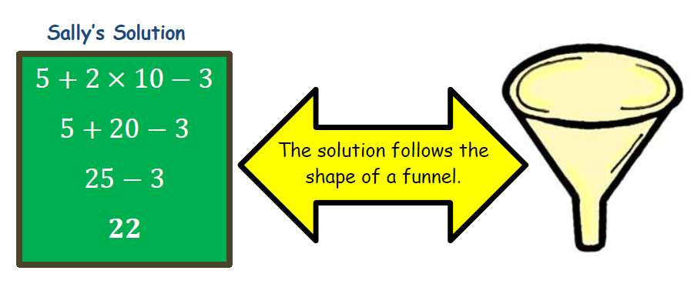
Order of Operations without Parentheses
The Funnel Method

Slide 24
Order of Operations without Parentheses
The Funnel Method
Write the expression horizontally.
2. Determine the operation that should be done first, following the MDAS rule, and underline it.
3. Perform the said operation and rewrite the expression the way it appeared in the original expression.

Slide 25
Order of Operations without Parentheses
4. Underline the next operation following the MDAS rule.
5. Continue performing the operations one at a time, and rewrite the expression after each step until you’ve completed all the operations… and have one value left.

Slide 26
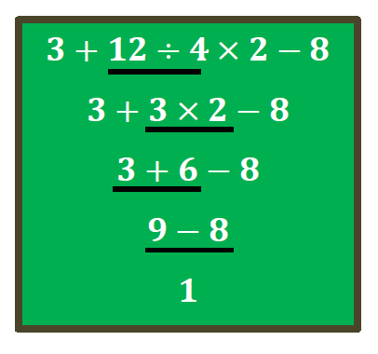
Order of Operations without Parentheses
Example:
Evaluate the numerical expression $3+12÷4×2−8$ using the funnel method.

Slide 27
Order of Operations without Parentheses
Sample Problem 2:
Evaluate the following numerical expressions.
a. $10+5×6÷10−13$
b.$45÷15×3+2−4+3$

Slide 28
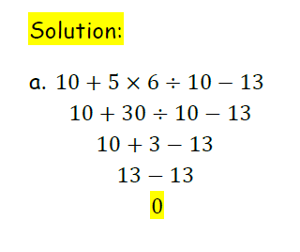
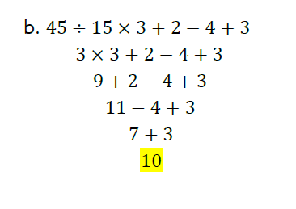
Order of Operations without Parentheses

Slide 29
Order of Operations without Parentheses
Order of Operations in the Real World
The MDAS rule is also used to solve real-life problems. These problems happen daily without us realizing that we are using this rule. Below is an example:

Slide 30
Order of Operations without Parentheses

Slide 31
Order of Operations without Parentheses
Sample Problem 3:
Read the problem below and answer the questions that follow.
Paul bought 4 burgers for $2.50 each and 4 medium fries for $1.25.
Write a numerical expression that represents the problem.
How much money did Paul spend?

Slide 32
Order of Operations without Parentheses
Solution:
Write a numerical expression that represents the problem.
$4×2.50+4×1.25$
How much money did Paul spend?
$4×2.50+4×1.25$
$10+4×1.25$
$10+5$
$15$
Paul spent $15 on the burgers and fries.

