Slide 1

Real Numbers and the Number Line
Unit 1 Lesson 3

Slide 2

REAL NUMBERS AND THE NUMBER LINE
Students will be able to:
graph and compare real numbers using the number line.
Key Vocabulary:
Real Number • Rational Number • Irrational number
Non-Integers • Integers • Negative Numbers
Numbers • Whole Numbers • Zero
Natural Numbers • Number line • Graph
Plot • Absolute Value

Slide 3









REAL NUMBERS AND THE NUMBER LINE
Real Numbers
$$π, e, \frac{22}{7}, \sqrt{2}, \sqrt{3}, \sqrt{7},\frac{3}{4},\frac{27}{11}, 9i, −2, −1, 0, 1, 2, 3$$
Irrational Numbers
Rational Numbers
$$\frac{3}{4},\frac{27}{11}, 9i, −2, −1, 0, 1, 2, 3$$
$$π, e, \frac{22}{7}, \sqrt{2}, \sqrt{3}, \sqrt{7}$$
Non-Integers
Integers
$$−\frac{3}{4},\frac{27}{11}, 9i$$
$$…,−3,−2, −1, 0, 1, 2, 3,…$$
Negative Numbers
Whole Numbers
$$…, −5, −4, −3,−2$$
$$0, 1, 2, 3, 4, 5, 6,…$$
Zero
Natural Numbers
$$0$$
$$1, 2, 3, 4, 5, 6, 7, 8,…$$

Slide 4
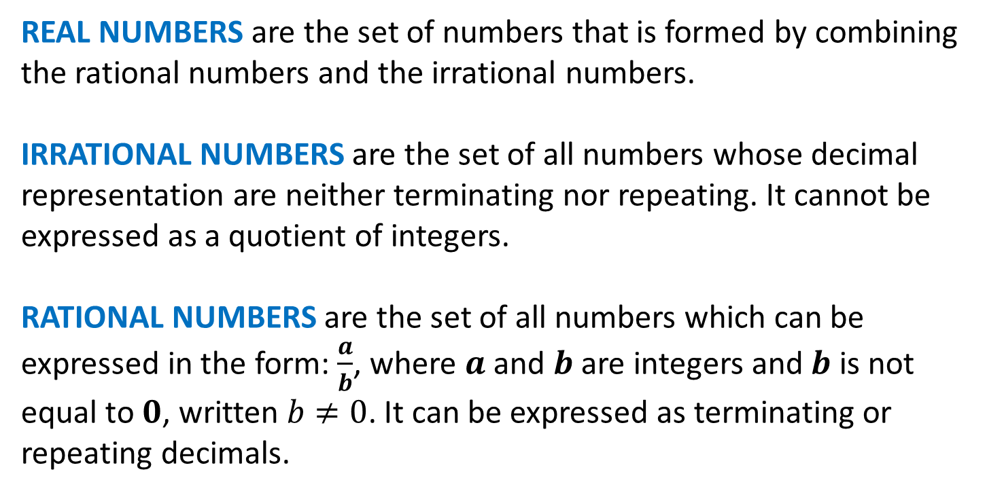
REAL NUMBERS AND THE NUMBER LINE
REAL NUMBERS are the set of numbers that is formed by combining the rational numbers and the irrational numbers.
IRRATIONAL NUMBERS are the set of all numbers whose decimal representation are neither terminating nor repeating. It cannot be expressed as a quotient of integers.
RATIONAL NUMBERS are the set of all numbers which can be expressed in the form: $\frac{a}{b}$, where $a$ and $b$ are integers and $b$ is not equal to $0$, written $b≠0$. It can be expressed as terminating or repeating decimals.

Slide 5
REAL NUMBERS AND THE NUMBER LINE
NON-INTEGERS are the set of all numbers that is neither a positive whole number, nor a negative whole number, nor zero. These include decimals, fractions, and imaginary numbers.
INTEGERS are the set of numbers formed by positive whole numbers, negative whole numbers, and zero.
NEGATIVE NUMBERS are numbers less than zero and usually mean a value that is a deficit or shortage.

Slide 6
REAL NUMBERS AND THE NUMBER LINE
WHOLE NUMBERS are the set of numbers formed by adding 0 to the set of natural numbers.
ZERO denotes the absence of all magnitude or quantity.
NATURAL NUMBERS are used for counting.

Slide 7
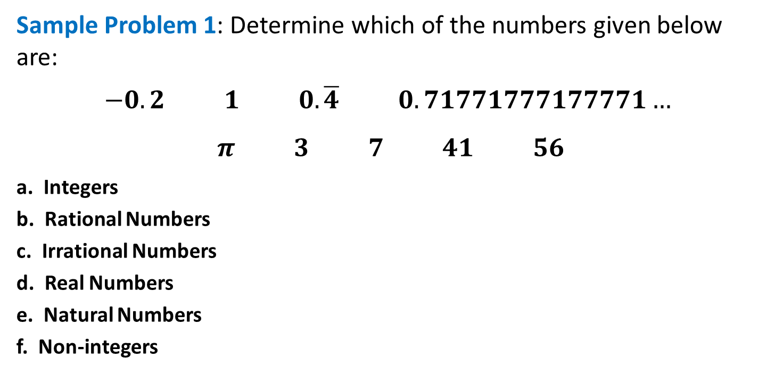
REAL NUMBERS AND THE NUMBER LINE
Sample Problem 1: Determine which of the numbers given below are:
$$−0.2 1 0.\overline{4} 0.71771777177771…$$
$$π 3 7 41 56$$
a. Integers
b. Rational Numbers
c. Irrational Numbers
d. Real Numbers
e. Natural Numbers
f. Non-integers

Slide 8
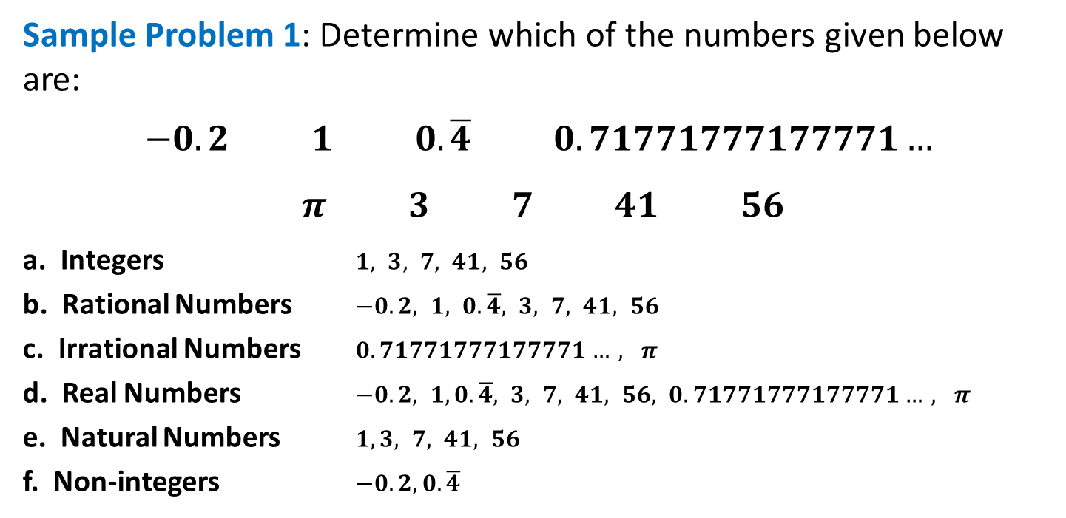
REAL NUMBERS AND THE NUMBER LINE
Sample Problem 1: Determine which of the numbers given below are:
$$−0.2 1 0.\overline{4} 0.71771777177771…$$
$$π 3 7 41 56$$
a. Integers $1, 3, 7, 41, 56$
b. Rational Numbers $−0.2, 1, 0.\overline{4}, 3, 7, 41, 56$
c. Irrational Numbers $0.71771777177771…, π$
d. Real Numbers $−0.2, 1,0.\overline{4}, 3, 7, 41, 56, 0.71771777177771…, π$
e. Natural Numbers $1,3, 7, 41, 56$
f. Non-integers $−0.2,0.\overline{4}$

Slide 9
REAL NUMBERS AND THE NUMBER LINE
NUMBER LINE is used to show the sets of natural numbers, whole numbers, and integers. Also, it can be used to show the set of rational numbers. The point that corresponds to a number is the graph of the number, and drawing the point is called graphing the number or plotting the point.
Integers
Whole Numbers
Natural Numbers
-9
-8
-7
-6
-5
-4
-3
-2
-1
0
1
2
3
4
5
6
7
8
9
Negative Numbers
Positive Numbers

Slide 10

REAL NUMBERS AND THE NUMBER LINE
Sample Problem 2: Graph the numbers $−2.4$ and $\frac{3}{2}$ on the number line.

Slide 11

REAL NUMBERS AND THE NUMBER LINE
Sample Problem 2: Graph the numbers $−2.4$ and $\frac{3}{2}$ on the number line.
-4
-3
-2
-1
0
1
2
3
4
$$\frac{3}{2}$$
$$−2.4$$

Slide 12

REAL NUMBERS AND THE NUMBER LINE
Sample Problem 3: Graph the numbers $−4$ and $−6$ on the number line and write two inequalities that compare the two numbers.

Slide 13



REAL NUMBERS AND THE NUMBER LINE
Sample Problem 3: Graph the numbers $−4$ and $−6$ on the number line and write two inequalities that compare the two numbers.
$−6<−4$ $−4>−6$
-8
-7
-6
-5
-4
-3
-2
-1
0
$$−6$$
$$−4$$

Slide 14

REAL NUMBERS AND THE NUMBER LINE
Sample Problem 4: Graph the numbers $−1, 3, 0, 2, \frac{3}{4}, −\frac{1}{2}$ and $−2.6$ on the number line and write the numbers in increasing order.

Slide 15

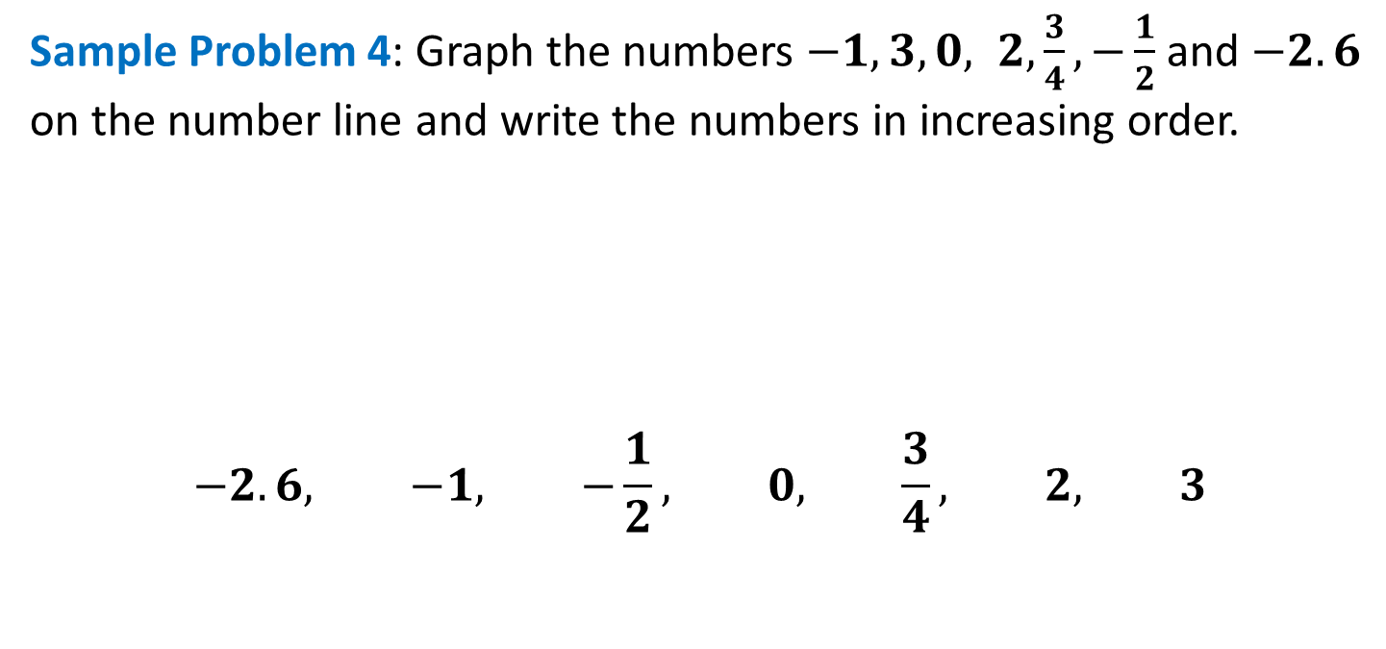





REAL NUMBERS AND THE NUMBER LINE
Sample Problem 4: Graph the numbers $−1, 3, 0, 2, \frac{3}{4}, −\frac{1}{2}$ and $−2.6$ on the number line and write the numbers in increasing order.
$$−2.6, −1, −\frac{1}{2}, 0, \frac{3}{4}, 2, 3$$
$$\frac{−1}{2}$$
$$\frac{3}{4}$$
$$−2.6$$
$$−1$$
$$0$$
$$2$$
$$3$$
-4
-3
-2
-1
0
1
2
3
4

Slide 16

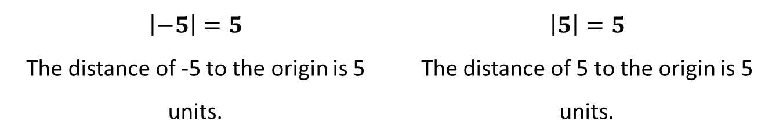
REAL NUMBERS AND THE NUMBER LINE
ABSOLUTE VALUE of a real number is the distance between the origin and the point representing the real number. The symbol$\left|x\right|$represents the absolute value of a number$x$.
5 units
5 units
-6
-5
-4
-3
-2
-1
0
1
2
3
4
5
6
$$\left|−5\right|=5$$ The distance of -5 to the origin is 5 units. | $$\left|5\right|=5$$ The distance of 5 to the origin is 5 units.

Slide 17

REAL NUMBERS AND THE NUMBER LINE
Sample Problem 5: Evaluate and graph the numbers $\left|2.5\right|$ and $\left|−\frac{1}{2}\right|$ on the number line.

Slide 18
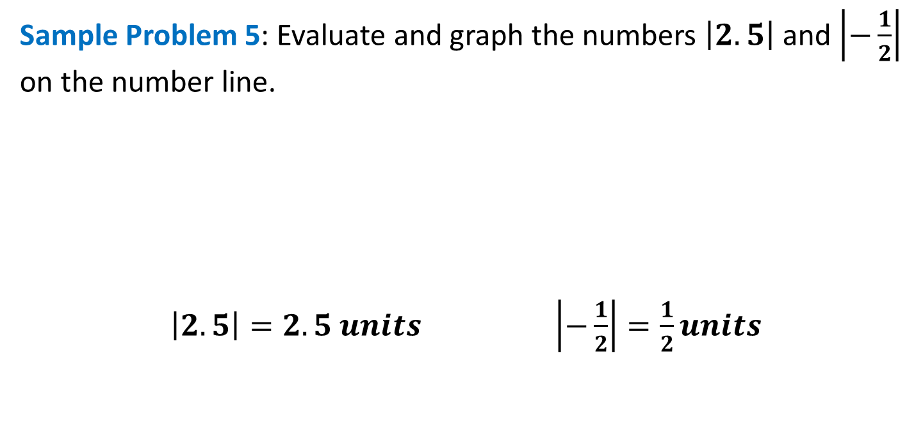


REAL NUMBERS AND THE NUMBER LINE
Sample Problem 5: Evaluate and graph the numbers $\left|2.5\right|$ and $\left|−\frac{1}{2}\right|$ on the number line.
$\left|2.5\right|=2.5 units$ $\left|−\frac{1}{2}\right|=\frac{1}{2}units$
$\frac{1}{2}$units
2.5 units
$$\frac{1}{2}$$
$$2.5$$
-4
-3
-2
-1
0
1
2
3
4

