Slide 1

Comparing Ratios
Unit 1 Lesson 4
Math 6

Slide 2

Comparing Ratios
Students will be able to:
Compare ratios using different methods.
Make decisions by comparing ratios.

Slide 3
Comparing Ratios
Key Vocabulary:
Ratio
Cross Multiply
Similar Fractions
Unit Rate
LCM

Slide 4
Comparing Ratios
Comparison of Ratios
A ratio is a comparison of two quantities. To compare ratios is to determine whether the two given ratios are equal or not, and if one is greater or lesser than the other. This is very helpful in making decisions in real life situations. These comparisons can be obtained using different methods.

Slide 5
Comparing Ratios

Slide 6
Comparing Ratios
Method 1:
COMPARING BY CROSS MULTIPLICATION
Remember that ratios can be written as fractions, so one way to compare them is through the process of cross multiplying.

Slide 7
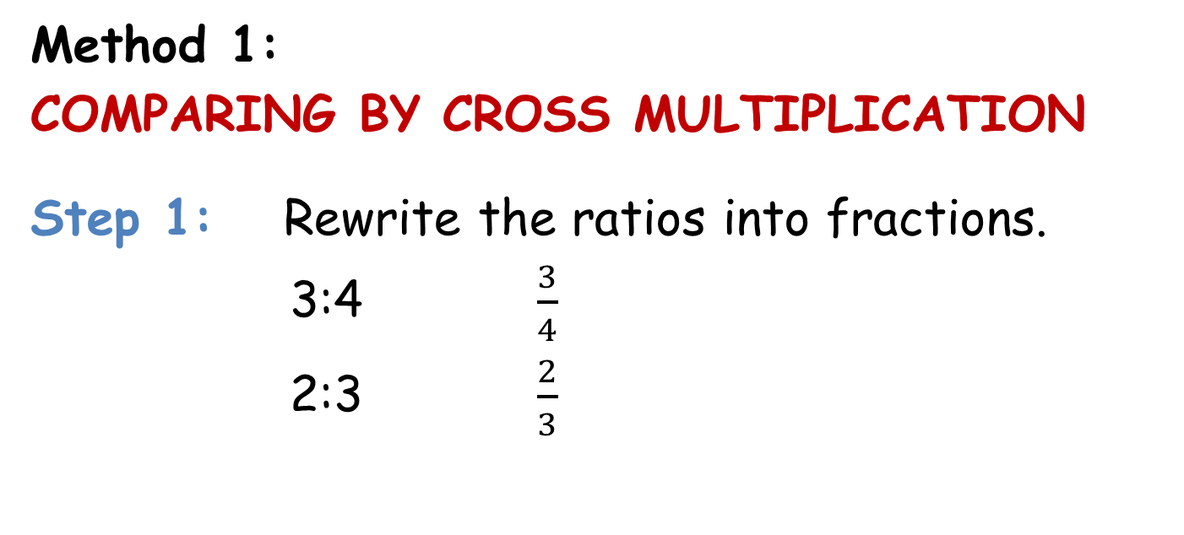
Comparing Ratios
Method 1:
COMPARING BY CROSS MULTIPLICATION
Step 1: Rewrite the ratios into fractions.
3:4 $\frac{3}{4}$
2:3 $\frac{2}{3}$

Slide 8
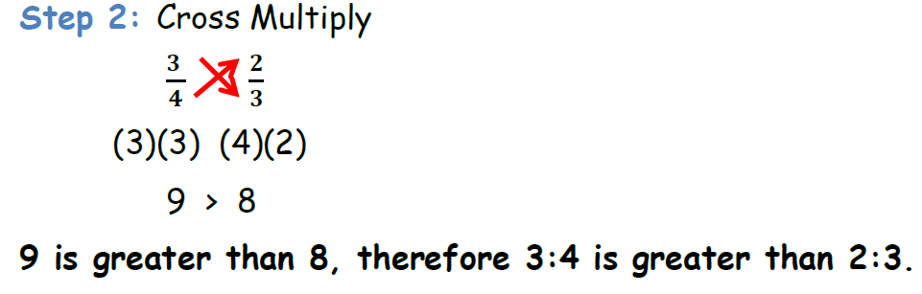
Comparing Ratios
Method 1:
COMPARING BY CROSS MULTIPLICATION

Slide 9
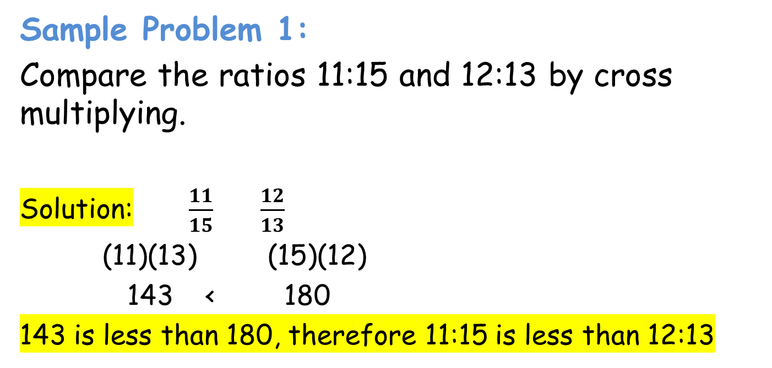
Comparing Ratios
Sample Problem 1:
Compare the ratios 11:15 and 12:13 by cross multiplying.
Solution: $\frac{11}{15}$ $\frac{12}{13}$
(11)(13) (15)(12)
143 < 180
143 is less than 180, therefore 11:15 is less than 12:13

Slide 10
Comparing Ratios

Slide 11
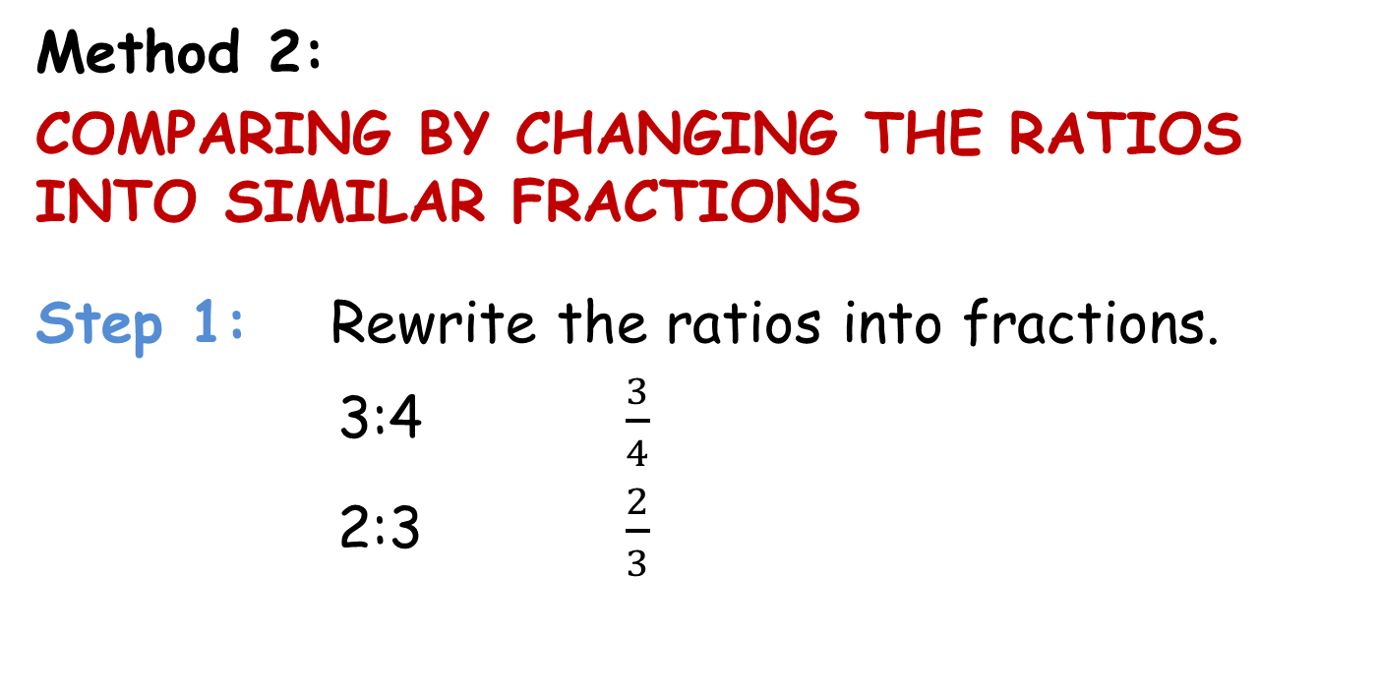
Comparing Ratios
Method 2:
COMPARING BY CHANGING THE RATIOS INTO SIMILAR FRACTIONS
Step 1: Rewrite the ratios into fractions.
3:4 $\frac{3}{4}$
2:3 $\frac{2}{3}$

Slide 12
Comparing Ratios
Method 2:
COMPARING BY CHANGING THE RATIOS INTO SIMILAR FRACTIONS

Slide 13
Comparing Ratios

Slide 14
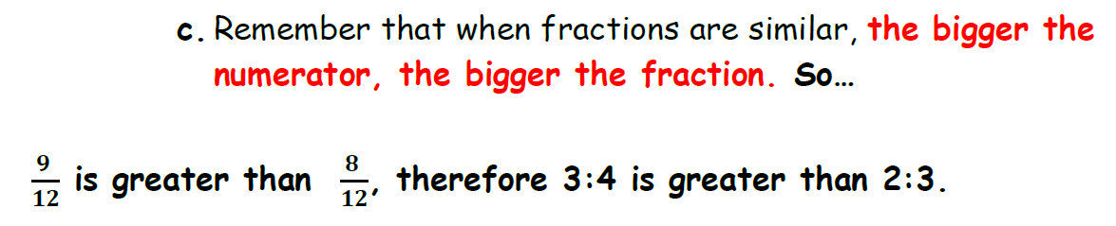
Comparing Ratios
Method 2:
COMPARING BY CHANGING THE RATIOS INTO SIMILAR FRACTIONS

Slide 15
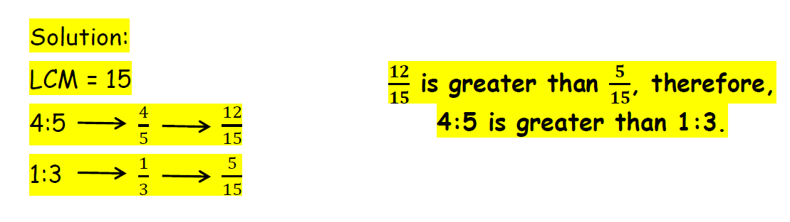
Comparing Ratios
Sample Problem 2:
Compare the ratios 4:5 and 1:3 by changing them into similar fractions.

Slide 16
Comparing Ratios

Slide 17
Comparing Ratios
Method 3:
COMPARING BY DETERMINING THE UNIT RATE
Remember that unit rate is a rate where the second term of the ratio (or the denominator of a fraction) is equal to "1". Or to make it simpler, we get the quotient of the terms of a ratio (or the quotient of the numerator and denominator of a ratio expressed as a fraction).

Slide 18
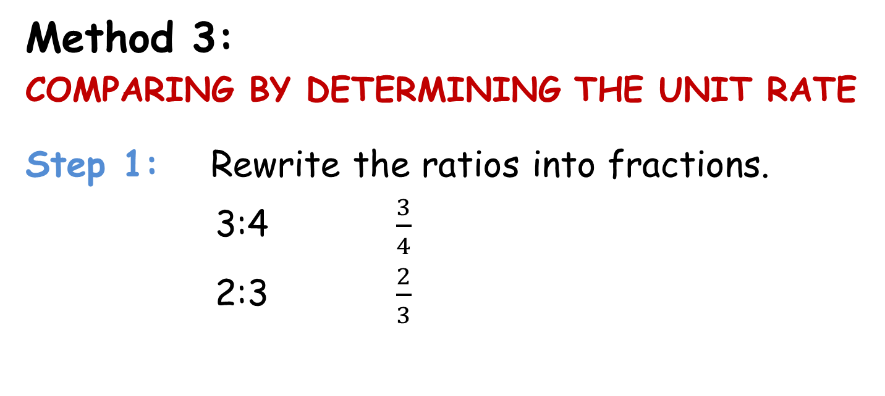
Comparing Ratios
Method 3:
COMPARING BY DETERMINING THE UNIT RATE
Step 1: Rewrite the ratios into fractions.
3:4 $\frac{3}{4}$
2:3 $\frac{2}{3}$

Slide 19
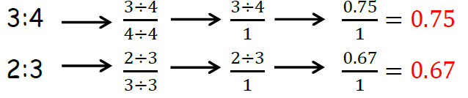
Comparing Ratios
Method 3:
COMPARING BY DETERMINING THE UNIT RATE
Step 2: Find the unit rate of each ratio. (Divide the numerator and the denominator of the fractions to make the denominator equal to 1.

Slide 20
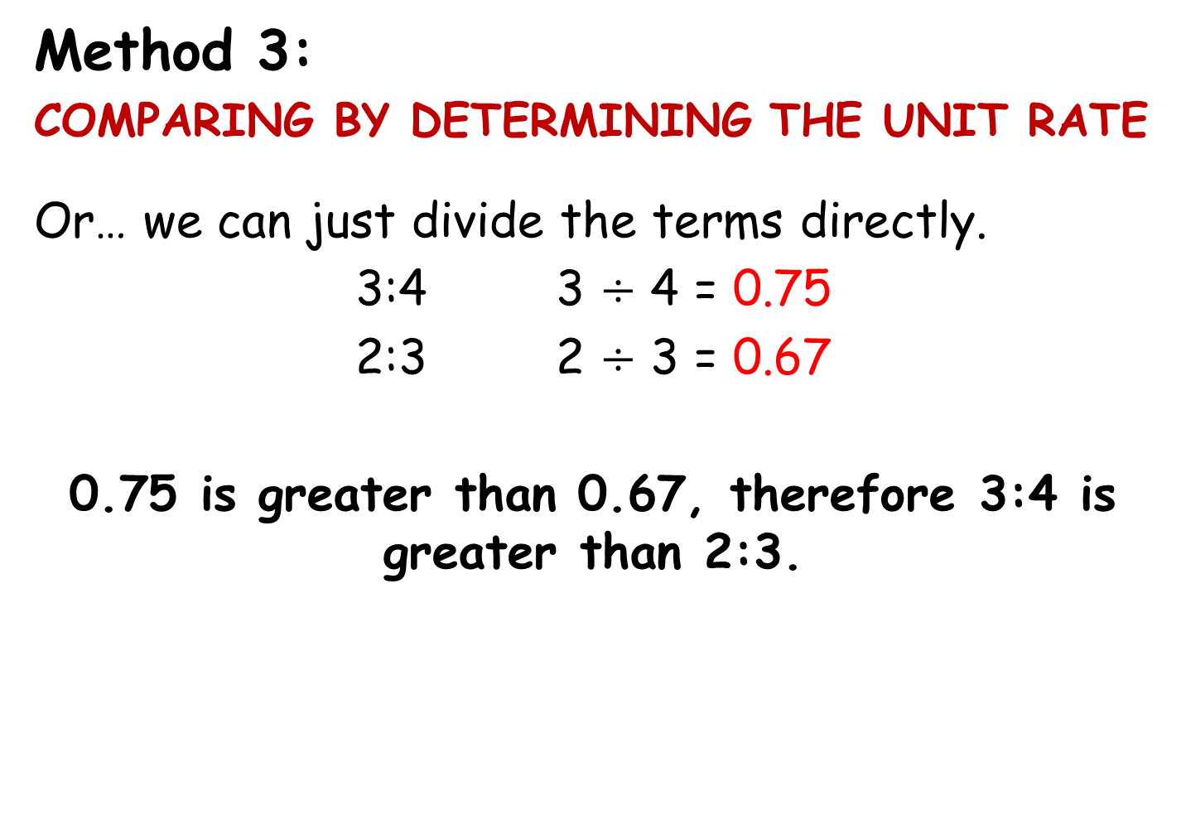
Comparing Ratios
Method 3:
COMPARING BY DETERMINING THE UNIT RATE
Or… we can just divide the terms directly.
3:4 3 $÷$ 4 = 0.75
2:3 2 $÷$ 3 = 0.67
0.75 is greater than 0.67, therefore 3:4 is greater than 2:3.

Slide 21
Comparing Ratios
Sample Problem 3:
Compare the ratios 4:3 and 7:5 by determining the unit rate.

