Slide 1

Extrema and Average Rates of Change
Unit 1 Lesson 4

Slide 2

Extrema and Average Rates of Change
Students will be able to:
Interpret key features of graphs and tables in terms of the quantities, and sketch graphs showing key features given a verbal description of the relationship. Key features include: intervals where the function is increasing, decreasing, positive, or negative; relative maximums and minimums.
Calculate and interpret the average rate of change of a function (presented symbolically or as a table) over a specified interval. Estimate the rate of change from a graph.

Slide 3
Extrema and Average Rates of Change
Key Vocabulary:
Critical points,
Absolute maximum and minimum,
Relative maximum and minimum,
A point of inflection,
Average rates of change.

Slide 4

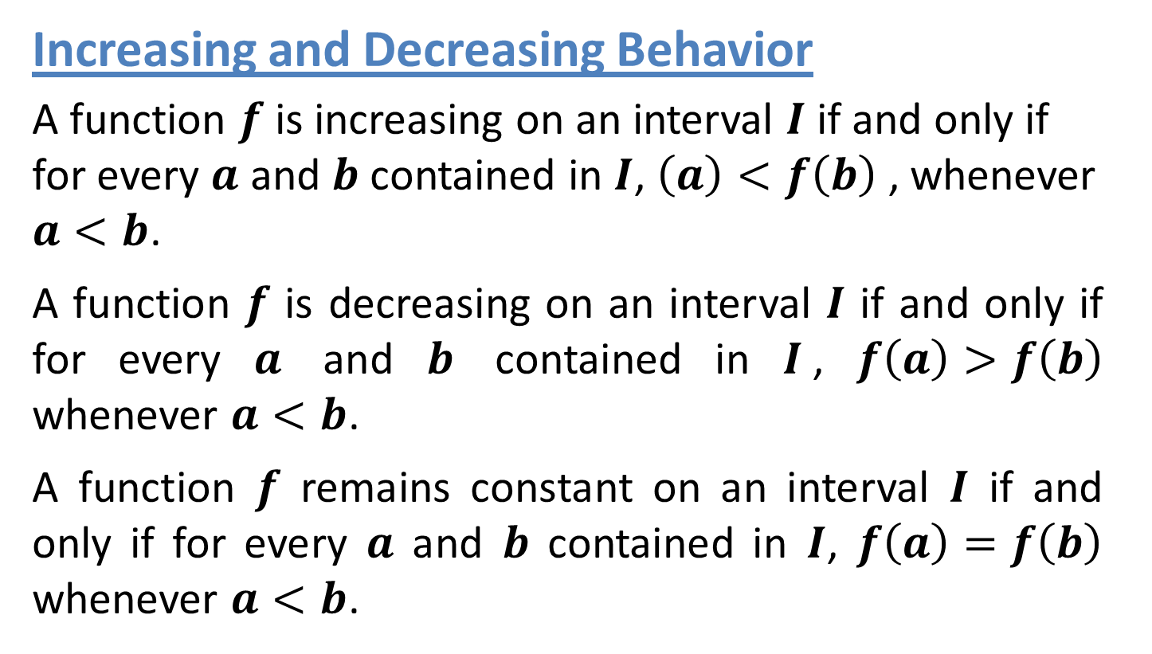
Extrema and Average Rates of Change
Increasing and Decreasing Behavior
A function $f$ is increasing on an interval $I$ if and only if for every $a$ and $b$ contained in $I$, $\left(a\right)<f\left(b\right)$ , whenever $a<b$.
A function $f$ is decreasing on an interval $I$ if and only if for every $a$ and $b$ contained in $I$, $f\left(a\right)>f\left(b\right)$ whenever $a<b$.
A function $f$ remains constant on an interval $I$ if and only if for every $a$ and $b$ contained in $I$, $f\left(a\right)=f\left(b\right)$ whenever $a<b$.

Slide 5
Extrema and Average Rates of Change
Points in the domain of a function where the function changes from increasing to decreasing or from decreasing to increasing are called critical points.
At these points, a line drawn tangent to the curve is horizontal or vertical.

Slide 6

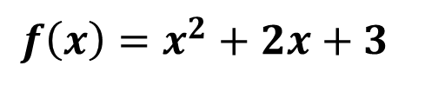
Extrema and Average Rates of Change
Sample Problem 1: Use the graph of each function to estimate intervals on which the function is increasing, decreasing, or constant. Support the answer numerically.
a.
$${f\left(x\right)=x}^{2}+2x+3$$

Slide 7
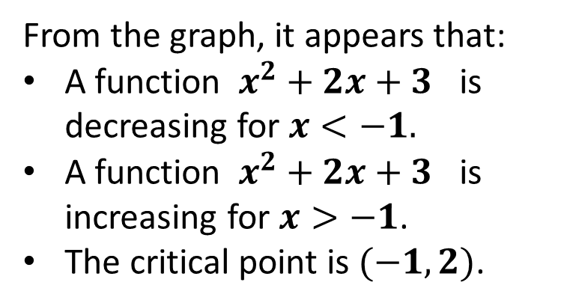
Extrema and Average Rates of Change
Sample Problem 1: Use the graph of each function to estimate intervals on which the function is increasing, decreasing, or constant. Support the answer numerically.
a.
$${f\left(x\right)=x}^{2}+2x+3$$
From the graph, it appears that:
A function $x^{2}+2x+3$ is decreasing for $x<−1.$
A function $x^{2}+2x+3$ is increasing for $x>−1$.
The critical point is $(−1,2)$.

Slide 8
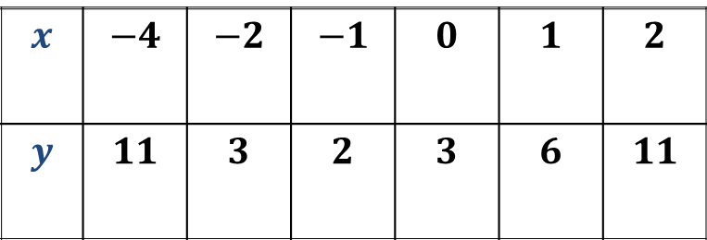
Extrema and Average Rates of Change
Sample Problem 1: Use the graph of each function to estimate intervals on which the function is increasing, decreasing, or constant. Support the answer numerically.
a.
$${f\left(x\right)=x}^{2}+2x+3$$
$$x$$ | $$−4$$ | $$−2$$ | $$−1$$ | $$0$$ | $$1$$ | $$2$$
$$y$$ | $$11$$ | $$3$$ | $$2$$ | $$3$$ | $$6$$ | $$11$$
The table supports this conjecture.

Slide 9
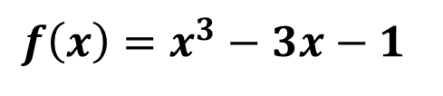
Extrema and Average Rates of Change
Sample Problem 1: Use the graph of each function to estimate intervals on which the function is increasing, decreasing, or constant. Support the answer numerically.
b.
$$f\left(x\right)=x^{3}−3x−1$$

Slide 10
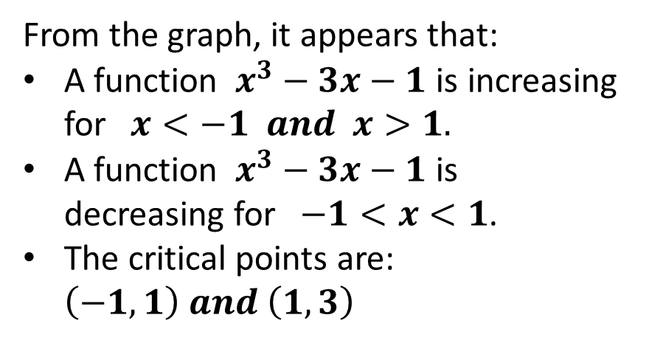
Extrema and Average Rates of Change
Sample Problem 1: Use the graph of each function to estimate intervals on which the function is increasing, decreasing, or constant. Support the answer numerically.
b.
$$f\left(x\right)=x^{3}−3x−1$$
From the graph, it appears that:
A function $x^{3}−3x−1$ is increasing for$x<−1 and x>1.$
A function $x^{3}−3x−1$ is decreasing for$−1<x<1$.
The critical points are: $\left(−1,1\right) and \left(1,3\right)$

Slide 11
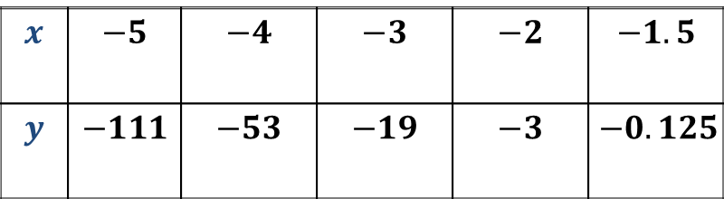
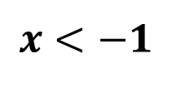
Extrema and Average Rates of Change
Sample Problem 1: Use the graph of each function to estimate intervals on which the function is increasing, decreasing, or constant. Support the answer numerically.
b.
$$f\left(x\right)=x^{3}−3x−1$$
$$x<−1$$
$$x$$ | $$−5$$ | $$−4$$ | $$−3$$ | $$−2$$ | $$−1.5$$
$$y$$ | $$−111$$ | $$−53$$ | $$−19$$ | $$−3$$ | $$−0.125$$

Slide 12
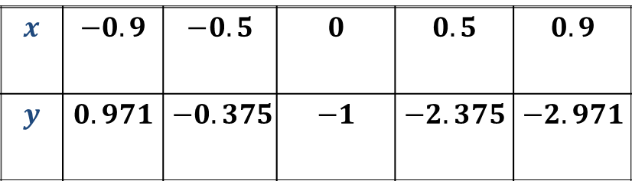
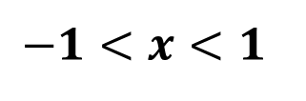
Extrema and Average Rates of Change
Sample Problem 1: Use the graph of each function to estimate intervals on which the function is increasing, decreasing, or constant. Support the answer numerically.
b.
$$f\left(x\right)=x^{3}−3x−1$$
$$−1<x<1$$
$$x$$ | $$−0.9$$ | $$−0.5$$ | $$0$$ | $$0.5$$ | $$0.9$$
$$y$$ | $$0.971$$ | $$−0.375$$ | $$−1$$ | $$−2.375$$ | $$−2.971$$

Slide 13
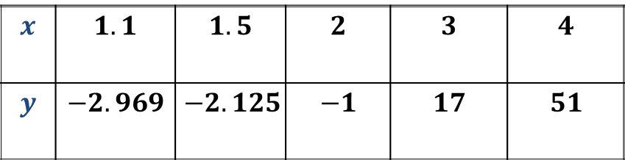
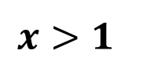
Extrema and Average Rates of Change
Sample Problem 1: Use the graph of each function to estimate intervals on which the function is increasing, decreasing, or constant. Support the answer numerically.
b.
$$f\left(x\right)=x^{3}−3x−1$$
$$x>1$$
$$x$$ | $$1.1$$ | $$1.5$$ | $$2$$ | $$3$$ | $$4$$
$$y$$ | $$−2.969$$ | $$−2.125$$ | $$−1$$ | $$17$$ | $$51$$
The tables support this conjecture.

Slide 14
Extrema and Average Rates of Change
Extrema are critical points at which a function changes its increasing or decreasing behavior. At these points, the function has a maximum or a minimum value, either relative or absolute.
The greatest value that a function assumes over its domain is called the absolute maximum.
The least value that a function assumes over its domain is called the absolute minimum.

Slide 15
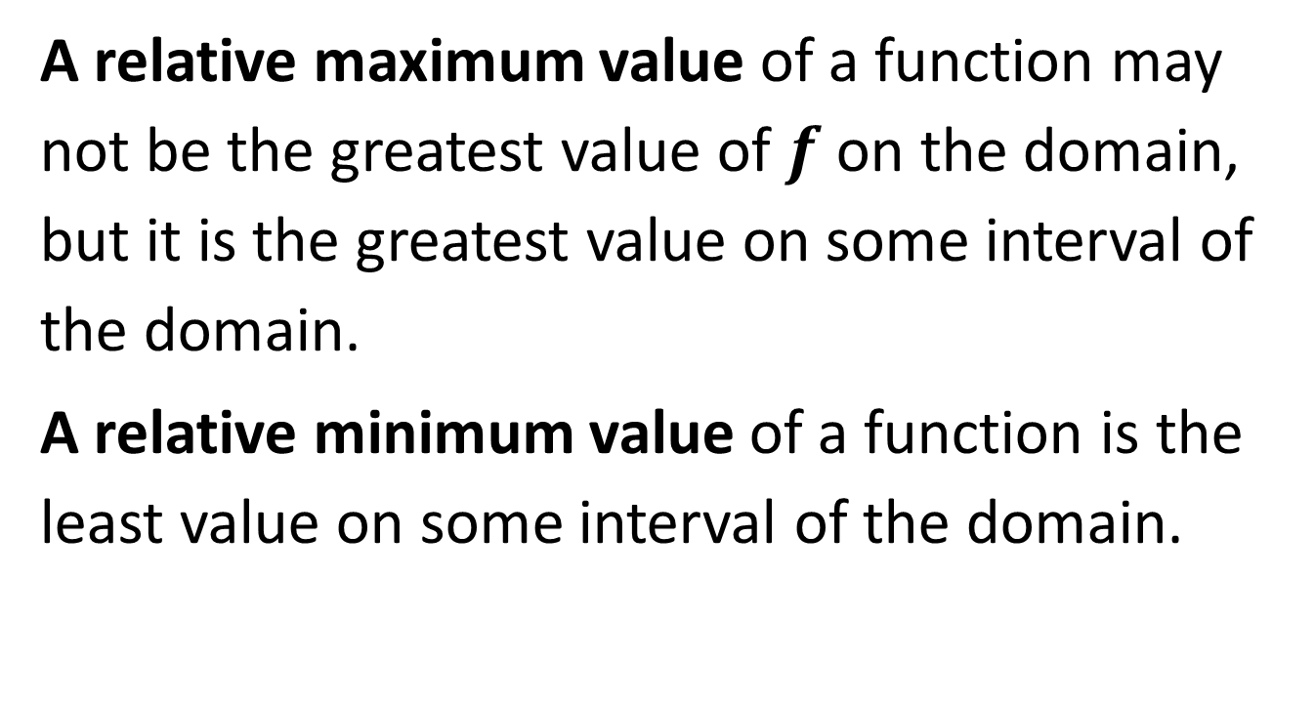
Extrema and Average Rates of Change
A relative maximum value of a function may not be the greatest value of$f$ on the domain, but it is the greatest value on some interval of the domain.
A relative minimum value of a function is the least value on some interval of the domain.

Slide 16
Extrema and Average Rates of Change
A point of inflection can also be a critical point. At these points, the graph changes its shape, but not it’s increasing or decreasing behavior. Instead, the curve changes from being bent upward to being bent downward, or vice versa.

Slide 17
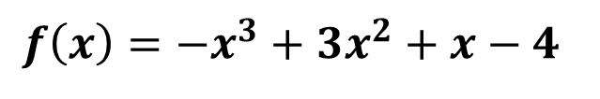
Extrema and Average Rates of Change
Sample Problem 2: Estimate and classify the extrema for the graph of each function. Support the answers numerically.
a.
$$f\left(x\right)=−x^{3}+3x^{2}+x−4$$

Slide 18
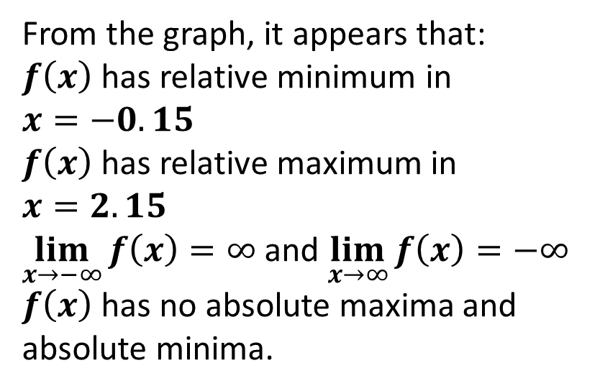
Extrema and Average Rates of Change
Sample Problem 2: Estimate and classify the extrema for the graph of each function. Support the answers numerically.
a.
$$f\left(x\right)=−x^{3}+3x^{2}+x−4$$
From the graph, it appears that:
$f\left(x\right)$ has relative minimum in $x=−0.15$
$f\left(x\right)$ has relative maximum in $x=2.15$
$\lim_{x→−∞}{f\left(x\right)=∞}$and $\lim_{x→∞}{f\left(x\right)=−∞}$
$f\left(x\right)$ has no absolute maxima and absolute minima.

Slide 19
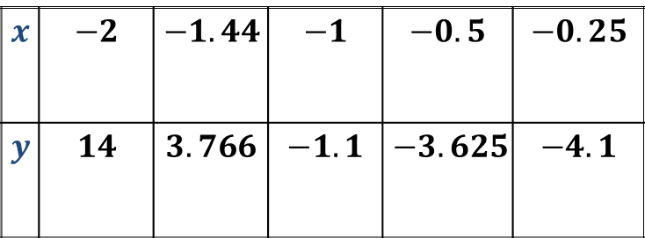
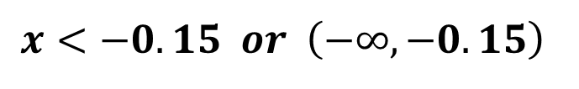
Extrema and Average Rates of Change
Sample Problem 2: Estimate and classify the extrema for the graph of each function. Support the answers numerically.
a.
$$f\left(x\right)=−x^{3}+3x^{2}+x−4$$
$$x<−0.15 or \left(−∞,−0.15\right)$$
$$x$$ | $$−2$$ | $$−1.44$$ | $$−1$$ | $$−0.5$$ | $$−0.25$$
$$y$$ | $$14$$ | $$3.766$$ | $$−1.1$$ | $$−3.625$$ | $$−4.1$$

Slide 20
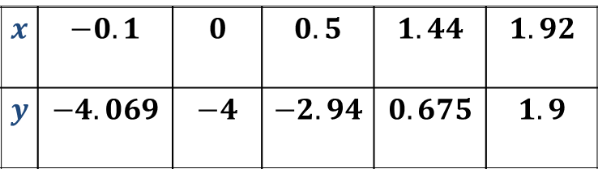
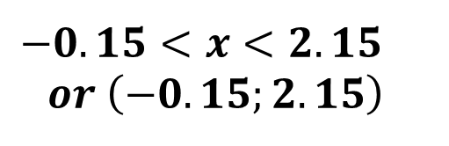
Extrema and Average Rates of Change
Sample Problem 2: Estimate and classify the extrema for the graph of each function. Support the answers numerically.
a.
$$f\left(x\right)=−x^{3}+3x^{2}+x−4$$
$$−0.15<x<2.15$$
$$or \left(−0.15;2.15\right)$$
$$x$$ | $$−0.1$$ | $$0$$ | $$0.5$$ | $$1.44$$ | $$1.92$$
$$y$$ | $$−4.069$$ | $$−4$$ | $$−2.94$$ | $$0.675$$ | $$1.9$$

Slide 21
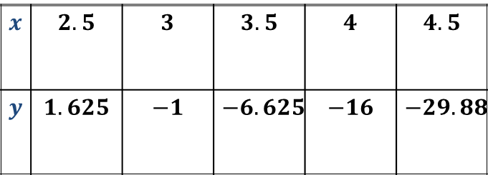
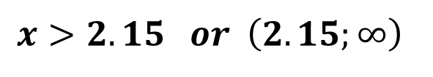
Extrema and Average Rates of Change
Sample Problem 2: Estimate and classify the extrema for the graph of each function. Support the answers numerically.
a.
$$f\left(x\right)=−x^{3}+3x^{2}+x−4$$
$$x>2.15 or \left(2.15;∞\right)$$
$$x$$ | $$2.5$$ | $$3$$ | $$3.5$$ | $$4$$ | $$4.5$$
$$y$$ | $$1.625$$ | $$−1$$ | $$−6.625$$ | $$−16$$ | $$−29.88$$
The tables support this conjecture.

Slide 22
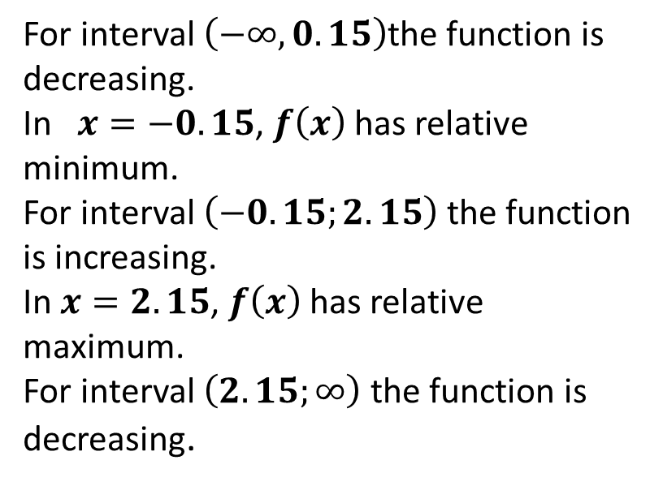
Extrema and Average Rates of Change
Sample Problem 2: Estimate and classify the extrema for the graph of each function. Support the answers numerically.
a.
$$f\left(x\right)=−x^{3}+3x^{2}+x−4$$
For interval $\left(−∞,0.15\right)$the function is decreasing.
In $x=−0.15$, $f\left(x\right)$ has relative minimum.
For interval $\left(−0.15;2.15\right)$the function is increasing.
In $x=2.15$, $f\left(x\right)$ has relative maximum.
For interval $\left(2.15;∞\right)$the function is decreasing.

Slide 23
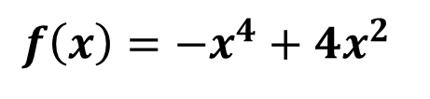
Extrema and Average Rates of Change
Sample Problem 2: Estimate and classify the extrema for the graph of each function. Support the answers numerically.
b.
$$f\left(x\right)=−x^{4}+4x^{2}$$

Slide 24
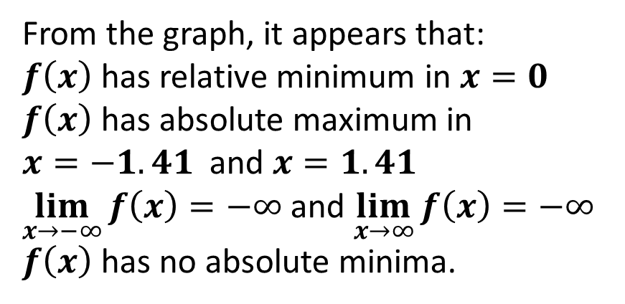
Extrema and Average Rates of Change
Sample Problem 2: Estimate and classify the extrema for the graph of each function. Support the answers numerically.
b.
$$f\left(x\right)=−x^{4}+4x^{2}$$
From the graph, it appears that:
$f\left(x\right)$ has relative minimum in $x=0$
$f\left(x\right)$ has absolute maximum in
$x=−1.41$ and $x=1.41$
$\lim_{x→−∞}{f\left(x\right)=−∞}$and $\lim_{x→∞}{f\left(x\right)=−∞}$
$f\left(x\right)$ has no absolute minima.

Slide 25
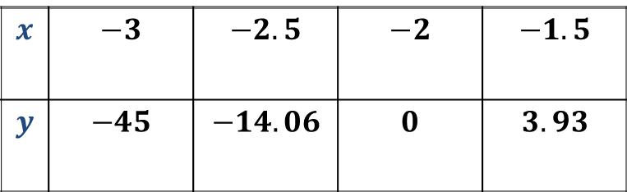
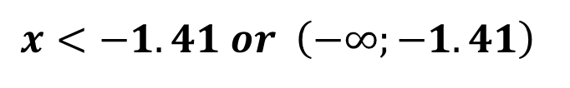
Extrema and Average Rates of Change
Sample Problem 2: Estimate and classify the extrema for the graph of each function. Support the answers numerically.
b.
$$f\left(x\right)=−x^{4}+4x^{2}$$
$$x<−1.41 or \left(−∞;−1.41\right)$$
$$x$$ | $$−3$$ | $$−2.5$$ | $$−2$$ | $$−1.5$$
$$y$$ | $$−45$$ | $$−14.06$$ | $$0$$ | $$3.93$$

Slide 26
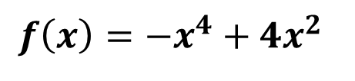
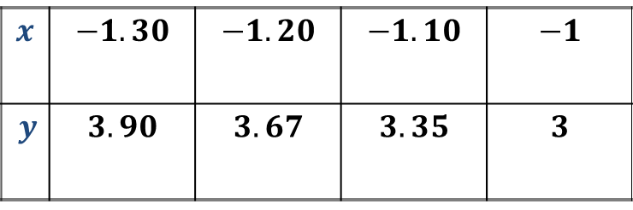
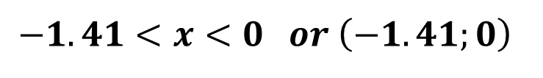
Extrema and Average Rates of Change
Sample Problem 2: Estimate and classify the extrema for the graph of each function. Support the answers numerically.
b.
$$f\left(x\right)=−x^{4}+4x^{2}$$
$$−1.41<x<0 or \left(−1.41;0\right)$$
$$x$$ | $$−1.30$$ | $$−1.20$$ | $$−1.10$$ | $$−1$$
$y$ | $$3.90$$ | $$3.67$$ | $$3.35$$ | $$3$$

Slide 27
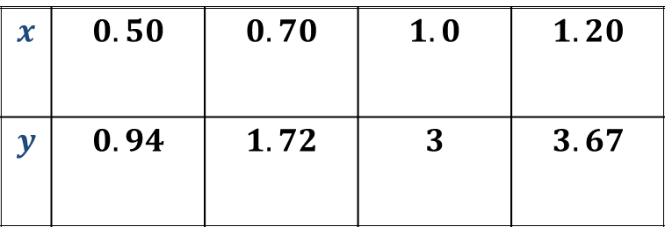
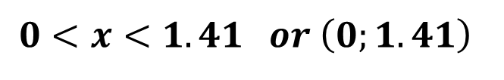
Extrema and Average Rates of Change
Sample Problem 2: Estimate and classify the extrema for the graph of each function. Support the answers numerically.
b.
$$f\left(x\right)=−x^{4}+4x^{2}$$
$$0<x<1.41 or \left(0;1.41\right)$$
$$x$$ | $$0.50$$ | $$0.70$$ | $$1.0$$ | $$1.20$$
$$y$$ | $$0.94$$ | $$1.72$$ | $$3$$ | $$3.67$$

Slide 28
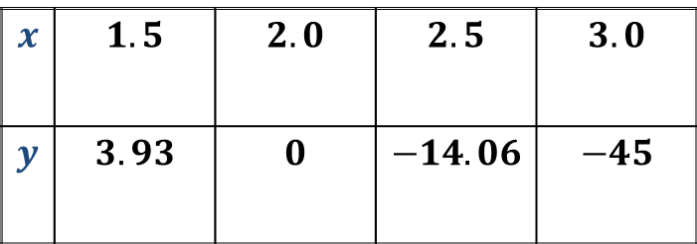
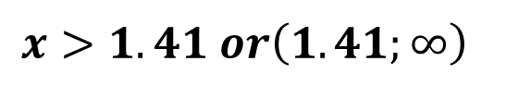
Extrema and Average Rates of Change
Sample Problem 2: Estimate and classify the extrema for the graph of each function. Support the answers numerically.
b.
$$f\left(x\right)=−x^{4}+4x^{2}$$
$$x>1.41 or\left(1.41;∞\right)$$
$$x$$ | $$1.5$$ | $$2.0$$ | $$2.5$$ | $$3.0$$
$$y$$ | $$3.93$$ | $$0$$ | $$−14.06$$ | $$−45$$
The tables support this conjecture.

Slide 29
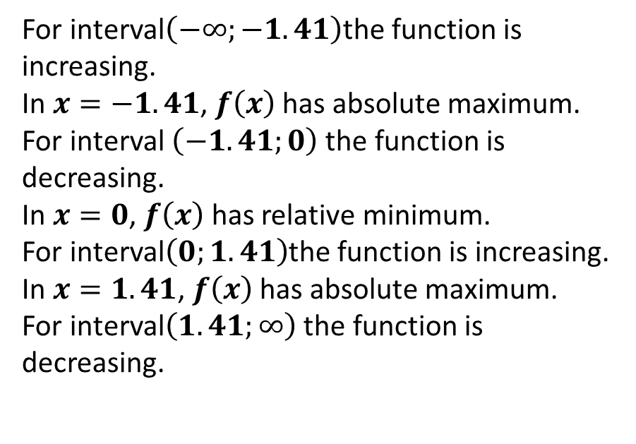
Extrema and Average Rates of Change
Sample Problem 2: Estimate and classify the extrema for the graph of each function. Support the answers numerically.
b.
$$f\left(x\right)=−x^{4}+4x^{2}$$
For interval$\left(−∞;−1.41\right)$the function is increasing.
In $x=−1.41$, $f\left(x\right)$ has absolute maximum.
For interval $\left(−1.41;0\right)$ the function is decreasing.
In$x=0$, $f\left(x\right)$ has relative minimum.
For interval$\left(0;1.41\right)$the function is increasing.
In $x=1.41$, $f\left(x\right)$ has absolute maximum.
For interval$\left(1.41;∞\right)$ the function is decreasing.

Slide 30
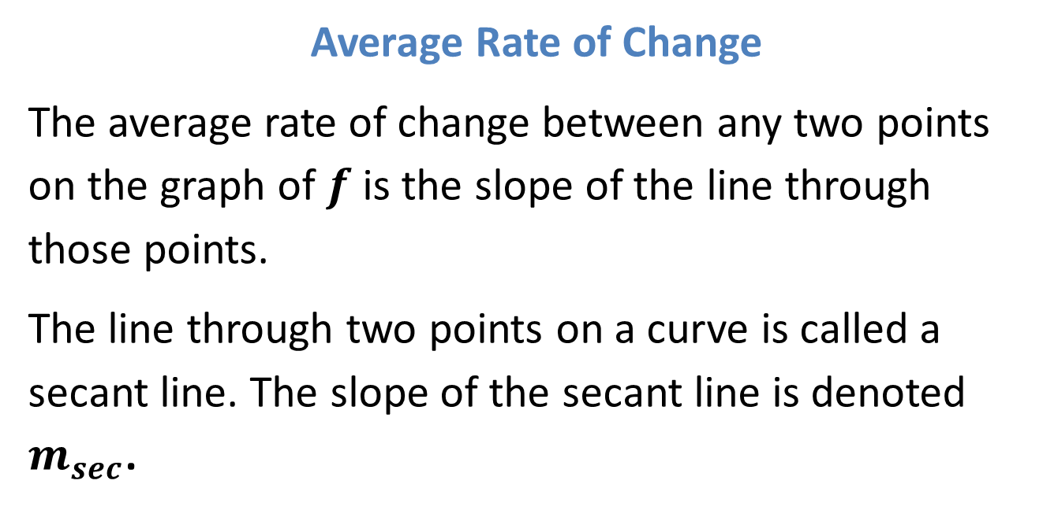
Extrema and Average Rates of Change
Average Rate of Change
The average rate of change between any two points on the graph of$f$ is the slope of the line through those points.
The line through two points on a curve is called a secant line. The slope of the secant line is denoted $m_{sec}$.

Slide 31
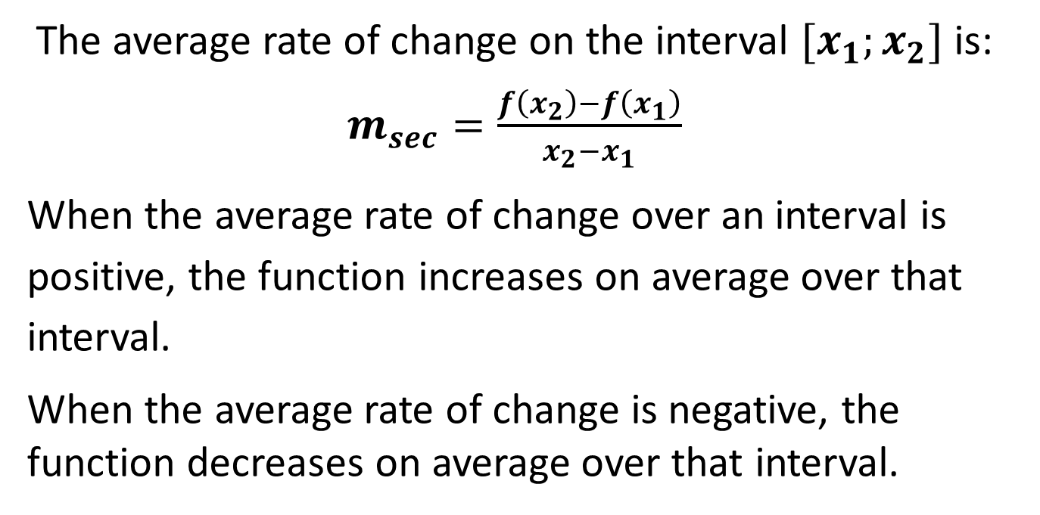
Extrema and Average Rates of Change
The average rate of change on the interval $[x_{1};x_{2}]$ is: $m_{sec}=\frac{f\left(x_{2}\right)−f\left(x_{1}\right)}{x_{2}−x_{1}}$
When the average rate of change over an interval is positive, the function increases on average over that interval.
When the average rate of change is negative, the function decreases on average over that interval.

Slide 32
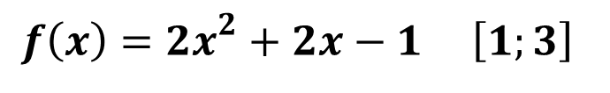
Extrema and Average Rates of Change
Sample Problem 3: Find the average rate of change of each function on the given interval.
a.
$$f\left(x\right)={2x}^{2}+2x−1 \left[1;3\right]$$

Slide 33
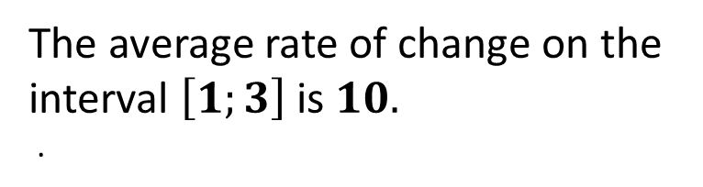
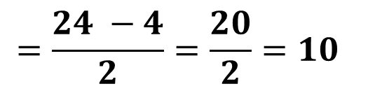
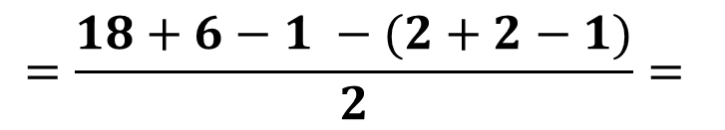
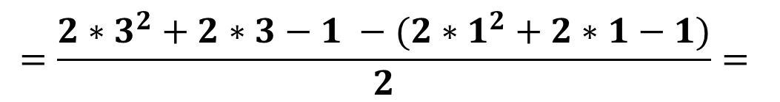
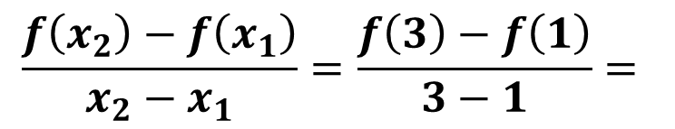
Extrema and Average Rates of Change
Sample Problem 3: Find the average rate of change of each function on the given interval.
a.
$$f\left(x\right)={2x}^{2}+2x−1 \left[1;3\right]$$
$$\frac{f\left(x_{2}\right)−f\left(x_{1}\right)}{x_{2}−x_{1}}=\frac{f\left(3\right)−f\left(1\right)}{3−1}=$$
$$=\frac{{2∗3}^{2}+2∗3−1 −({2∗1}^{2}+2∗1−1)}{2}=$$
$$=\frac{18+6−1 −(2+2−1)}{2}=$$
The average rate of change on the interval $\left[1;3\right]$is $10.$
.
$$=\frac{24 −4}{2}=\frac{20}{2}=10$$

Slide 34
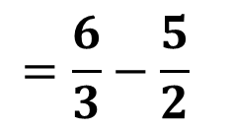
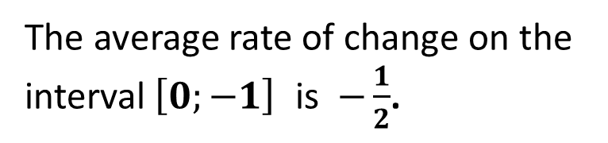
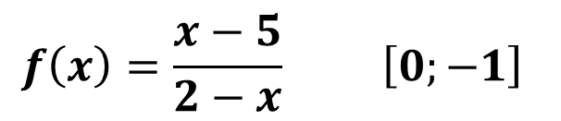
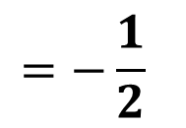
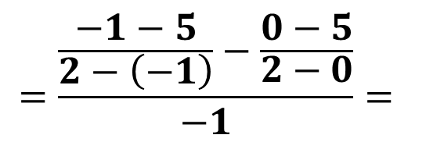
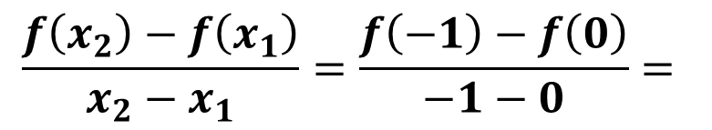
Extrema and Average Rates of Change
Sample Problem 3: Find the average rate of change of each function on the given interval.
$$f\left(x\right)=\frac{x−5}{2−x} \left[0;−1\right]$$
b.
$$\frac{f\left(x_{2}\right)−f\left(x_{1}\right)}{x_{2}−x_{1}}=\frac{f\left(−1\right)−f\left(0\right)}{−1−0}=$$
$$=\frac{\frac{−1−5}{2−\left(−1\right)}−\frac{0−5}{2−0}}{−1}=$$
The average rate of change on the interval$\left[0;−1\right]$ is$−\frac{1}{2}$.
$$=\frac{6}{3}−\frac{5}{2}$$
$$=−\frac{1}{2}$$

Slide 35
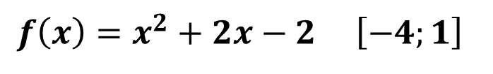
Extrema and Average Rates of Change
Computing Average Rate of Change from a Graph
Sample Problem 4: Find the average rate of change of a function on the given interval.
a.
$$f\left(x\right)=x^{2}+2x−2 \left[−4;1\right]$$

Slide 36
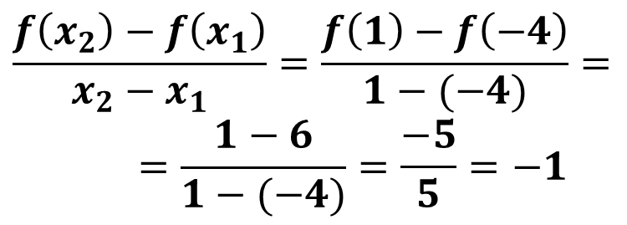
Extrema and Average Rates of Change
Computing Average Rate of Change from a Graph
Sample Problem 4: Find the average rate of change of a function on the given interval.
a.
$$f\left(x\right)=x^{2}+2x−2 \left[−4;1\right]$$
$$\frac{f\left(x_{2}\right)−f\left(x_{1}\right)}{x_{2}−x_{1}}=\frac{f\left(1\right)−f\left(−4\right)}{1−(−4)}==\frac{1−6}{1−(−4)}=\frac{−5}{5}=−1$$

