Slide 1

Identifying Irrational Numbers
Unit 1 Lesson 4

Slide 2

Identifying Irrational Numbers
Students will be able to:
Identify irrational numbers

Slide 3
Identifying Irrational Numbers
Key Vocabulary:
Irrational Numbers
Square root
Perfect square root

Slide 4
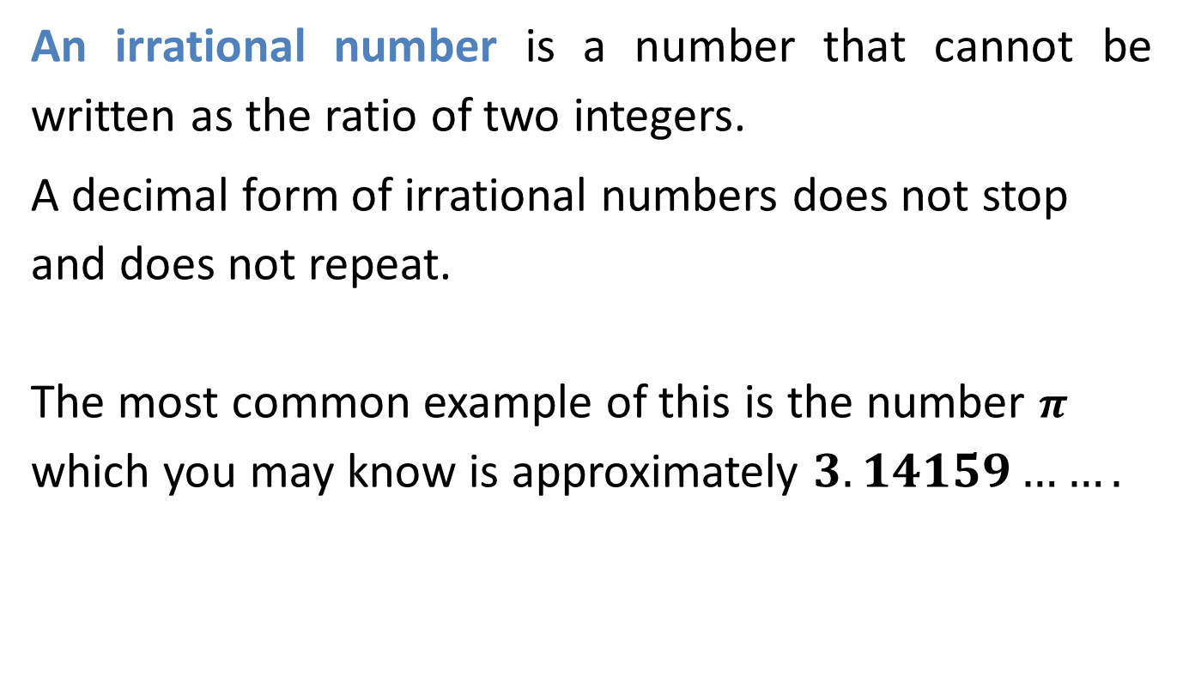
Identifying Irrational Numbers
An irrational number is a number that cannot be written as the ratio of two integers.
A decimal form of irrational numbers does not stop and does not repeat.
The most common example of this is the number $π$ which you may know is approximately $3.14159…….$

Slide 5
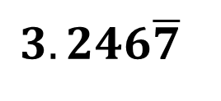
Identifying Irrational Numbers
Sample Problem 1: Determine whether each number is rational or irrational.
a.
$$3.246\overline{7}$$

Slide 6
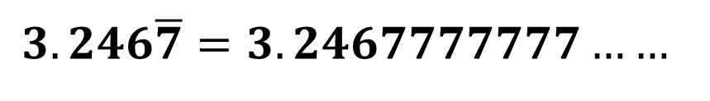
Identifying Irrational Numbers
Sample Problem 1: Determine whether each number is rational or irrational.
a.
$$3.246\overline{7}$$
$$3.246\overline{7}=3.2467777777……$$
This number is a repeating decimal,
so the number is rational.

Slide 7
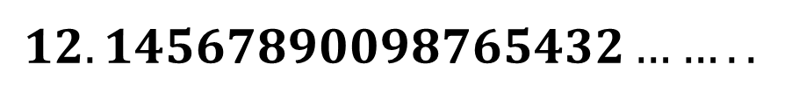
Identifying Irrational Numbers
Sample Problem 1: Determine whether each number is rational or irrational.
b.
$$12.14567890098765432……..$$

Slide 8
Identifying Irrational Numbers
Sample Problem 1: Determine whether each number is rational or irrational.
b.
$$12.14567890098765432……..$$
This number is irrational.

Slide 9
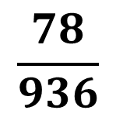
Identifying Irrational Numbers
Sample Problem 1: Determine whether each number is rational or irrational.
$$\frac{78}{936}$$
c.

Slide 10
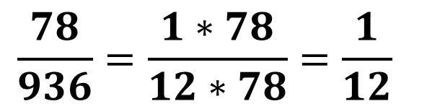
Identifying Irrational Numbers
Sample Problem 1: Determine whether each number is rational or irrational.
$$\frac{78}{936}$$
c.
$$\frac{78}{936}=\frac{1∗78}{12∗78}=\frac{1}{12}$$

Slide 11
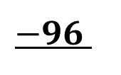

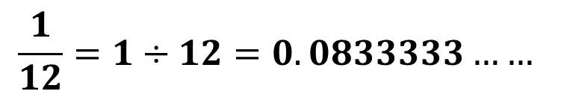

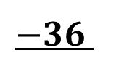

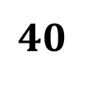
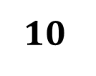

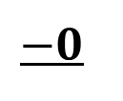
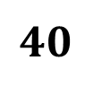
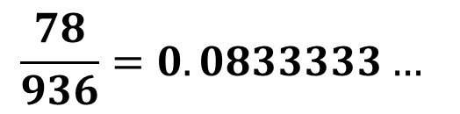
Identifying Irrational Numbers
Sample Problem 1: Determine whether each number is rational or irrational.
$$\frac{1}{12}=1÷12=0.0833333……$$
c.
$$−0$$
$$10$$
$$\frac{78}{936}=0.0833333…$$
$$−0$$
$$100$$
$$−96$$
This number is a repeating decimal,
so the number is rational.
$$40$$
$$−36$$
$$40$$
$$−36$$
$$4$$

Slide 12
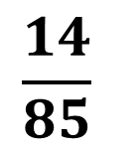
Identifying Irrational Numbers
Sample Problem 1: Determine whether each number is rational or irrational.
$$\frac{14}{85}$$
d.

Slide 13
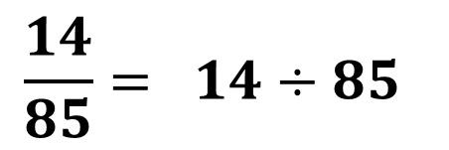
Identifying Irrational Numbers
Sample Problem 1: Determine whether each number is rational or irrational.
$$\frac{14}{85}$$
d.
$$\frac{14}{85}= 14÷85$$

Slide 14

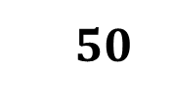
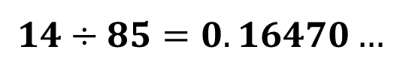

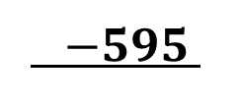






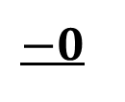

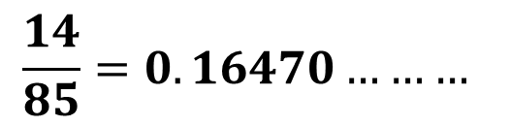
Identifying Irrational Numbers
Sample Problem 1: Determine whether each number is rational or irrational.
d.
$$14÷85=0.16470…$$
$$−0$$
$$140$$
$$\frac{14}{85}=0.16470………$$
$$−85$$
$$550$$
$$−510$$
$400$
$$−340$$
$600$
$−595$
This number is irrational.
$$50$$
$−0$
$$………$$

Slide 15
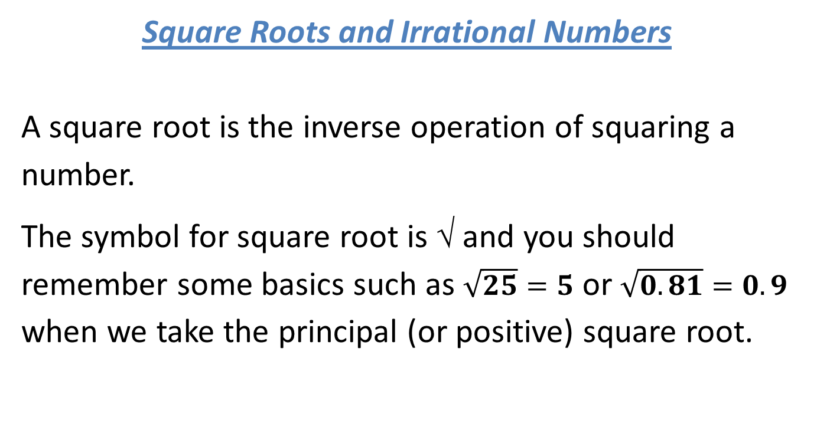
Identifying Irrational Numbers
Square Roots and Irrational Numbers
A square root is the inverse operation of squaring a number.
The symbol for square root is √ and you should remember some basics such as $\sqrt{25}=5$ or $\sqrt{0.81}=0.9$ when we take the principal (or positive) square root.

Slide 16
Identifying Irrational Numbers
Square Roots and Irrational Numbers
Square roots of perfect squares are always whole numbers, so they are rational.
But the decimal forms of square roots of numbers that are not perfect squares never stop and never repeat, so these square roots are irrational.

Slide 17
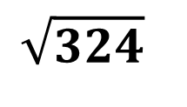
Identifying Irrational Numbers
Sample Problem 2: Determine whether each square root is rational or irrational number.
a.
$$\sqrt{324}$$

Slide 18
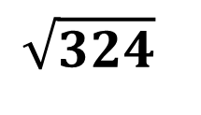
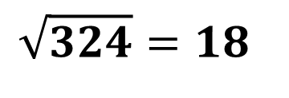
Identifying Irrational Numbers
Sample Problem 2: Determine whether each square root is rational or irrational number.
a.
$$\sqrt{324}$$
$$\sqrt{324}=18$$
This number is rational.

Slide 19
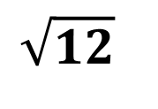
Identifying Irrational Numbers
Sample Problem 2: Determine whether each square root is rational or irrational number.
b.
$$\sqrt{12}$$

Slide 20
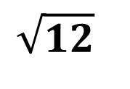
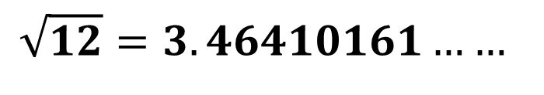
Identifying Irrational Numbers
Sample Problem 2: Determine whether each square root is rational or irrational number.
b.
$$\sqrt{12}$$
$$\sqrt{12}=3.46410161……$$
This number is irrational.

Slide 21
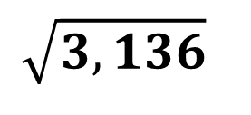
Identifying Irrational Numbers
Sample Problem 2: Determine whether each square root is rational or irrational number.
c.
$$\sqrt{3,136}$$

Slide 22
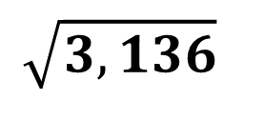
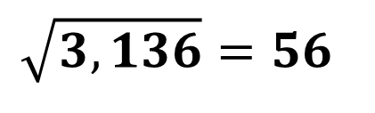
Identifying Irrational Numbers
Sample Problem 2: Determine whether each square root is rational or irrational number.
c.
$$\sqrt{3,136}$$
$$\sqrt{3,136}=56$$
This number is rational.

Slide 23
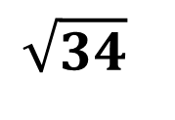
Identifying Irrational Numbers
Sample Problem 2: Determine whether each square root is rational or irrational number.
d.
$$\sqrt{34}$$

Slide 24
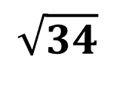
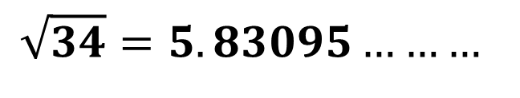
Identifying Irrational Numbers
Sample Problem 2: Determine whether each square root is rational or irrational number.
d.
$$\sqrt{34}$$
$$\sqrt{34}=5.83095………$$
This number is irrational.

