Slide 1
Order of Operations with Parentheses
Unit 1 Lesson 4
Math 5

Slide 2
Order of Operations with Parentheses
Students will be able to:
Identify the order of operation in a numerical expression (with parentheses).
Demonstrate understanding of the order of operations in a numerical expression (with parentheses).
Evaluate numerical expressions (with parentheses) using the PEMDAS rule.
Evaluate numerical expressions (with parentheses) using the funnel method.
Solve problems involving numerical expressions (with parentheses), following the correct order of operations.

Slide 3
Order of Operations with Parentheses
Key Vocabulary:
Numerical Expression
Order of Operations
PEMDAS Rule
Funnel Method
Evaluate
Parentheses
Brackets
Braces

Slide 4
Order of Operations with Parentheses
Order of Operations
Numerical expressions are evaluated correctly by following a specific order of operations. Some expressions don’t involve grouping symbols, such as parentheses and the like, but some have these.

Slide 5
Order of Operations with Parentheses
Order of Operations
For numerical expressions with no grouping symbols, we make use of the MDAS rule. What will happen if numerical expressions have these grouping symbols? Will the rule change?

Slide 6
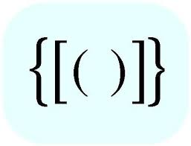
Order of Operations with Parentheses
Grouping Symbols
Reading and analyzing a verbal statement is very important in writing a correct numerical expression. There are instances where some numbers and operations are grouped
together using symbols.

Slide 7
Order of Operations with Parentheses
Grouping Symbols
Parentheses are not the only grouping symbols used, there are other symbols that you need to know.
What are these symbols?

Slide 8
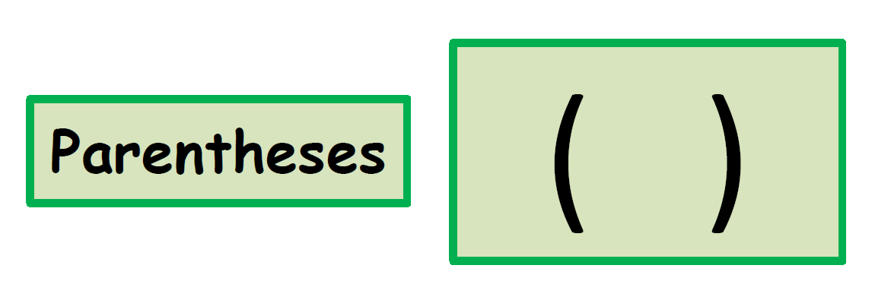
Order of Operations with Parentheses
Grouping Symbols

Slide 9
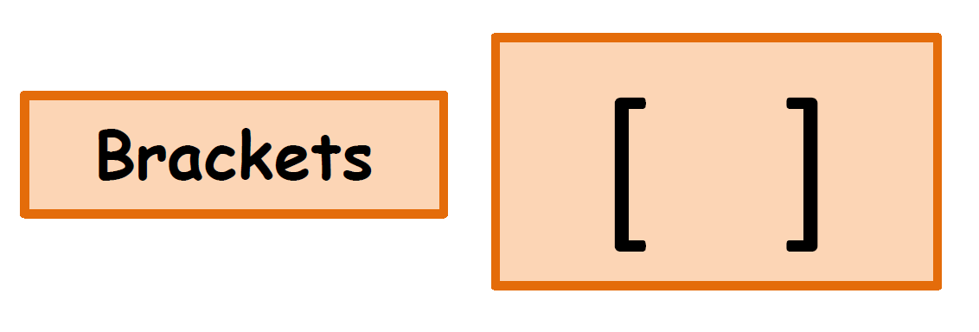
Order of Operations with Parentheses
Grouping Symbols

Slide 10
Order of Operations with Parentheses
Grouping Symbols

Slide 11
Order of Operations with Parentheses
The Order of Symbols
Aside from operations, symbols such as parentheses, brackets, and braces, follow a specific order too!
First, you carry out the operation inside the PARENTHESES.
Then, you carry out the operation inside the BRACKETS.
Lastly, you carry out the operation inside the BRACES.

Slide 12
Order of Operations with Parentheses
Evaluating Numerical Expressions with Parentheses
The word EVALUATE means to “calculate” or to “get” the value of a given expression. This time, the numbers and operations in a numerical expression are grouped using the different grouping symbols. How are these types of numerical expressions evaluated?

Slide 13
Order of Operations with Parentheses
Example:
Paul and Ana were asked to evaluate the numerical expression:
$$4×\left(2+5\right)−9÷3$$
Their solutions are shown on the next slide

Slide 14
Order of Operations with Parentheses

Slide 15
Order of Operations with Parentheses
There could only be ONE correct answer.
Who do you think did it right?
Is it Paul or Ana?

Slide 16
Order of Operations with Parentheses
To ensure that the answer is “valid” and “accurate,” there are specific steps to follow. For numerical expressions without grouping symbols, we use the MDAS rule, and the PEMDAS rule is used for numerical expressions involving grouping symbols such as parentheses, brackets, and braces.
What is the PEMDAS rule???

Slide 17
Order of Operations with Parentheses
PEMDAS Rule
Applying the PEMDAS rule is very important in evaluating numerical expressions. Why is PEMDAS very important? What does it stand for?
Let’s see on the next slide!

Slide 18
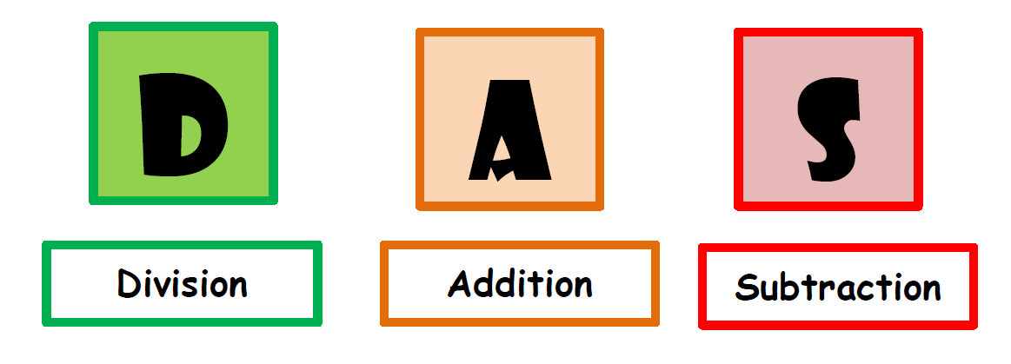
Order of Operations with Parentheses

Slide 19
Order of Operations with Parentheses
PEMDAS Rule
Following the PEMDAS rule is very important, especially if your goal is to get the correct answer. Below are the steps to make sure that you are doing it right!!!
Step #1
You work on the numbers and operations inside the grouping symbols first. Work on the calculation inside the parentheses, the calculation inside the brackets, and the calculations inside the braces.

Slide 20
Order of Operations with Parentheses
Step #2
Find the value of numbers with exponents (if there are any).
Step #3
If all the calculations inside the grouping symbols are done, you may now start working on the calculations from left to right, like the arrows below.

Slide 21
Order of Operations with Parentheses
Step #4
Work with MULTIPLICATION or DIVISION, whichever comes first, from LEFT to RIGHT.
Step #5
Work with ADDITION or SUBTRACTION, whichever comes first, from LEFT to RIGHT.

Slide 22
Order of Operations with Parentheses
So… going back to Paul and Ana’s solution:

Slide 23
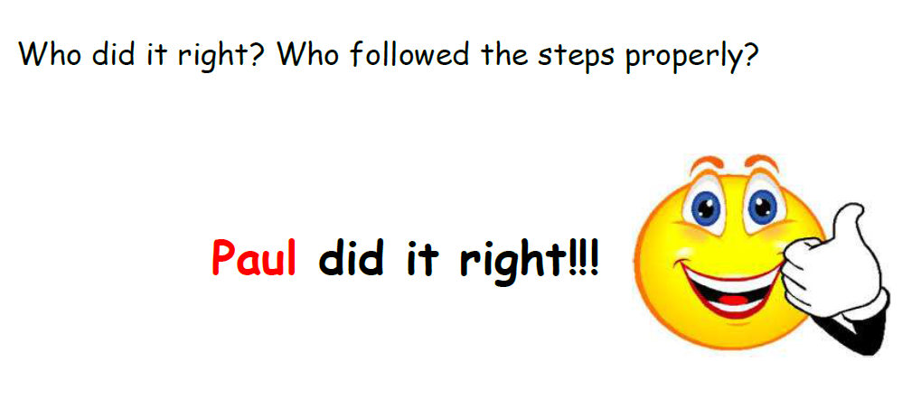
Order of Operations with Parentheses

Slide 24
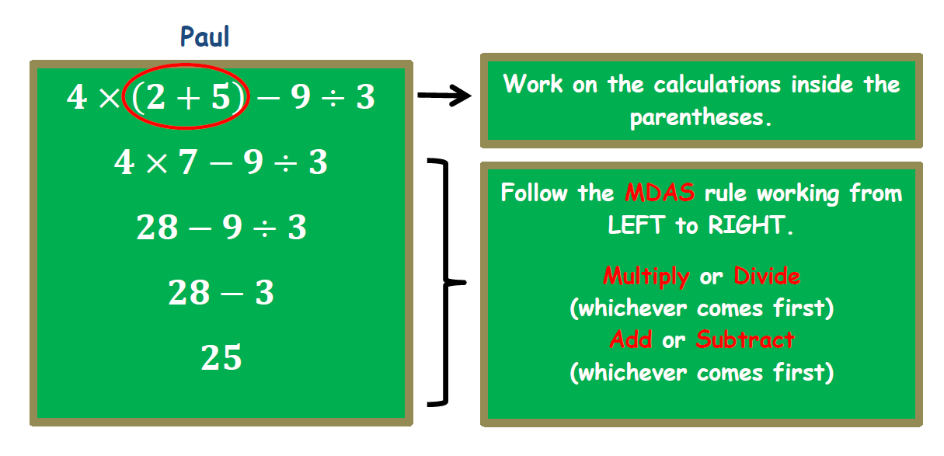
Order of Operations with Parentheses
Let’s find out how he did it right!

Slide 25
Order of Operations with Parentheses
On the other hand, ANA failed to follow the PEMDAS rule.
$$4×\left(2+5\right)−9÷3$$
$$8+5−9÷3$$
$$13−9÷3$$
$$13−3$$
$$10$$
Not working on the calculations inside grouping symbols first, like parentheses, is totally a WRONG move! Thus, the answer will be INCORRECT ☹

Slide 26
Order of Operations with Parentheses
Sample Problem 1:
Two students were asked to evaluate the numerical expression below. Who has the correct answer? Why do you think so?
$$\left(8+7\right)÷3+(4−2)×3$$

Slide 27
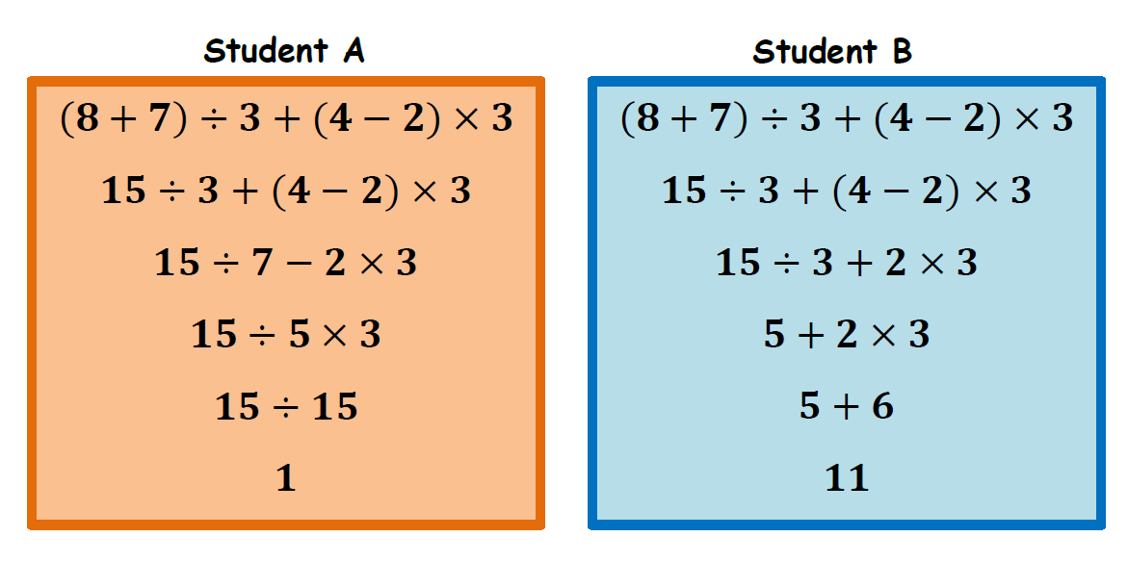
Order of Operations with Parentheses
$$\left(8+7\right)÷3+(4−2)×3$$

Slide 28
Order of Operations with Parentheses
Sample Problem 1:
Two students were asked to evaluate the numerical expression below. Who has the correct answer? Why do you think so?
$$\left(8+7\right)÷3+(4−2)×3$$
Solution: (Answers may vary)
Student B’s solution is correct. He/she followed the PEMDAS rule correctly.

Slide 29
Order of Operations with Parentheses
Sample Problem 2:
Evaluate the numerical expression $\left(10+2\right)÷4×[\left(15÷3\right)−4]$ using the PEMDAS rule.
Solution:
$$\left(10+2\right)÷4×[\left(15÷3\right)−4]$$
$$12÷4×[\left(15÷3\right)−4]$$
$$12÷4×[5−4]$$
$$12÷4×1$$
$$3×1$$
3

Slide 30
Order of Operations with Parentheses
The FUNNEL Method
Suppose the steps involved in evaluating numerical expressions confuse you. Like when you see the numbers and they all dance in your head. You can use a method that will help you get the correct answer one step at a time J!☺!

Slide 31
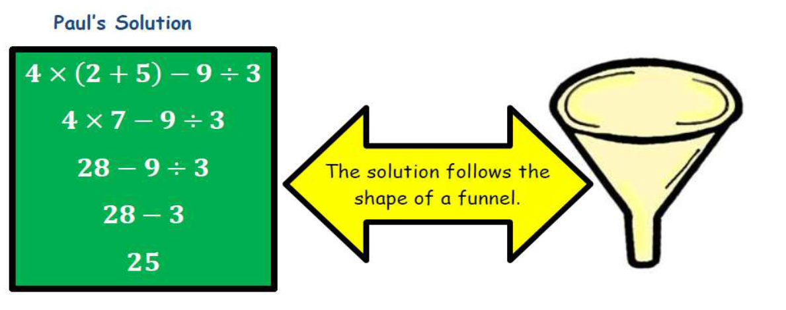
Order of Operations with Parentheses
The FUNNEL Method

Slide 32
Order of Operations without Parentheses
The Funnel Method
Write the expression horizontally.
Determine the operation that should be done first, following the PEMDAS rule, and underline it.
Perform the said operation and rewrite the expression the way it appeared in the original expression.

Slide 33
Order of Operations without Parentheses
4. Underline the next operation following the MDAS rule.
5. Continue performing the operations one at a time, rewrite the expression after each step until you’ve completed all the operations… and you have one value left.

Slide 34
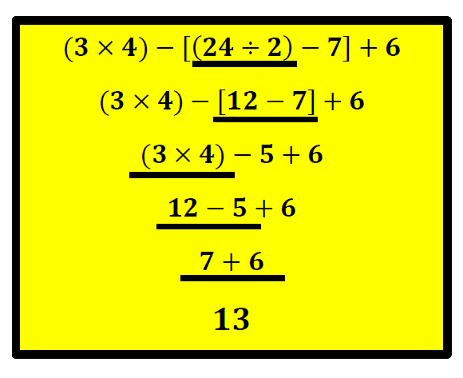
Order of Operations with Parentheses
Example:
Using the Funnel Method evaluate the numerical expression $(3×4)−\left[\left(24÷2\right)−7\right]+6$.
Solution:

Slide 35
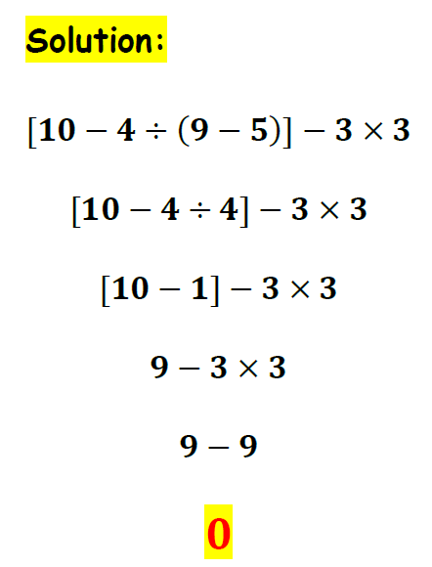
Order of Operations with Parentheses
Sample Problem 3:
Evaluate the expression $[10−4÷\left(9−5\right)]−3×3$ using the funnel method.

Slide 36
Order of Operations with Parentheses
Order of Operations in the Real World
The PEMDAS rule is also used to solve real-life problems. These problems happen daily without us realizing we are using such a rule. Below is an example:
Example:
Kyle saved for a year and he was able to raise $2000. He gave his mom $500 and divided the remaining amount into 4 parts and kept 1 part for himself. Then, he bought a new shirt that cost $100.

Slide 37
Order of Operations with Parentheses
Write a numerical expression to represent the above.
Solution:
Write a numerical expression to represent the situation.
$$\left(2000−500\right)÷4−100$$

Slide 38
Order of Operations with Parentheses
How much money did he have left?
$$\left(2000−500\right)÷4−100$$
$$1500÷4−100$$
$$375−100$$
$$275$$
He has $275 left.

Slide 39
Order of Operations with Parentheses
b. How much money did he have left?
$$\left(2000−500\right)÷4−100$$
$$1500÷4−100$$
$$375−100$$
$$275$$
He has $275 left.

