Slide 1


Properties of Real Numbers
Unit 1 Lesson 4

Slide 2
PROPERTIES OF REAL NUMBERS
Students will be able to:
Recognize and use the properties of real numbers.
Key Vocabulary:
Identity Property
Inverse Property
Equality Property
Associative Property
Commutative Property

Slide 3

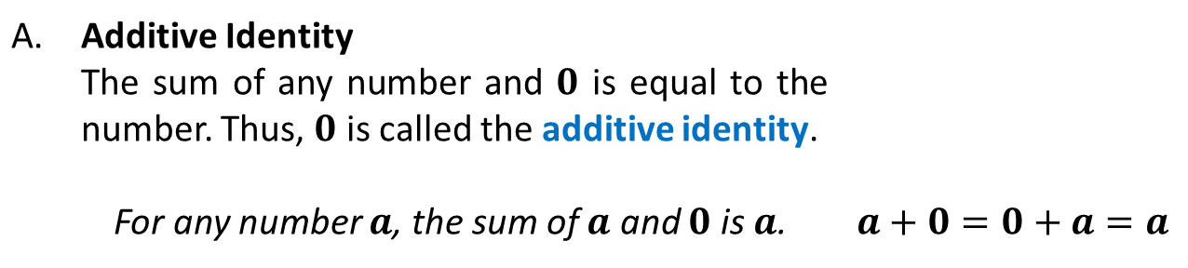
PROPERTIES OF REAL NUMBERS
PROPERTIES OF REAL NUMBERS
Let$a$, $b$, and $c$ be any real numbers
1. IDENTITY PROPERTIES
A. | Additive Identity
 | The sum of any number and $0$ is equal to the number. Thus, $0$ is called the additive identity.
 | For any number $a$, the sum of $a$ and $0$ is $a$. | $$a+0=0+a=a$$

Slide 4
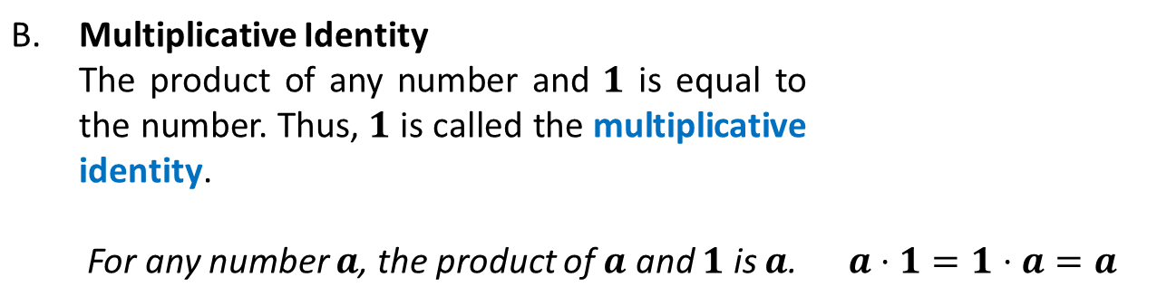
PROPERTIES OF REAL NUMBERS
PROPERTIES OF REAL NUMBERS
Let$a$, $b$, and $c$ be any real numbers
1. IDENTITY PROPERTIES
B. | Multiplicative Identity
 | The product of any number and $1$ is equal to the number. Thus, $1$ is called the multiplicative identity.
 | For any number $a$, the product of $a$ and $1$ is $a$. | $$a⋅1=1⋅a=a$$

Slide 5
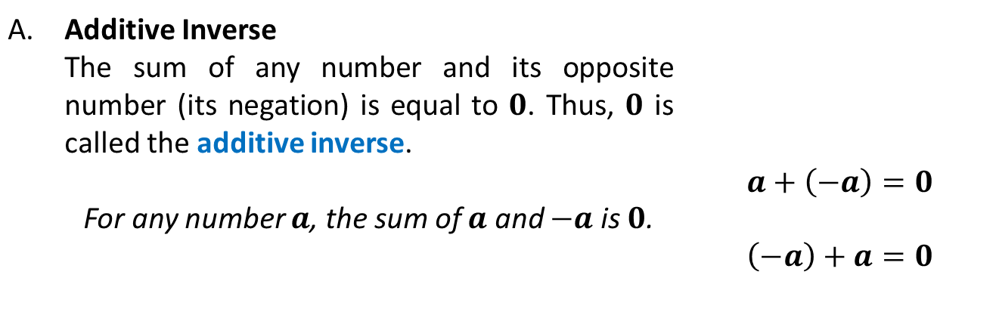
PROPERTIES OF REAL NUMBERS
2. INVERSE PROPERTIES
A. | Additive Inverse | $$a+\left(−a\right)=0$$ $$\left(−a\right)+a=0$$
 | The sum of any number and its opposite number (its negation) is equal to $0$. Thus, $0$ is called the additive inverse.
 | For any number $a$, the sum of $a$ and $−a$ is $0$.

Slide 6
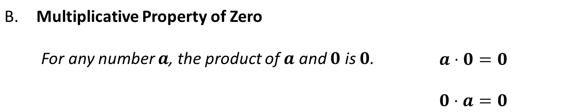
PROPERTIES OF REAL NUMBERS
2. INVERSE PROPERTIES
B. | Multiplicative Property of Zero
 | For any number $a$, the product of $a$ and $0$ is $0$. | $$a⋅0=0$$ $$0⋅a=0$$

Slide 7
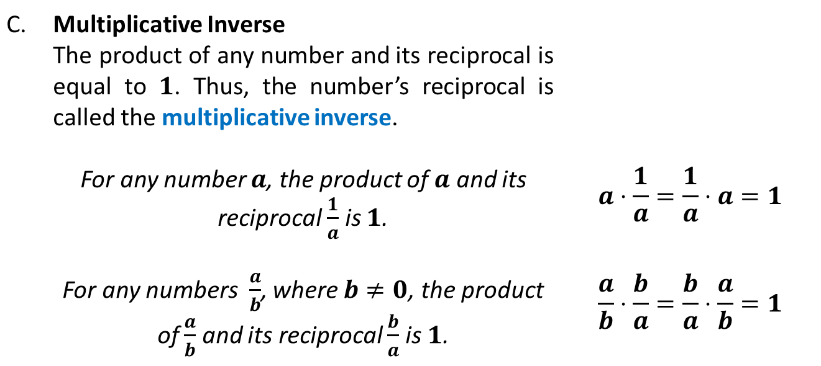
PROPERTIES OF REAL NUMBERS
2. INVERSE PROPERTIES
C. | Multiplicative Inverse
 | The product of any number and its reciprocal is equal to $1$. Thus, the number’s reciprocal is called the multiplicative inverse.
 | For any number $a$, the product of $a$ and its reciprocal $\frac{1}{a}$ is $1$. | $$a⋅\frac{1}{a}=\frac{1}{a}⋅a=1$$
 | For any numbers$\frac{a}{b}$, where $b≠0$, the product of $\frac{a}{b}$ and its reciprocal $\frac{b}{a}$ is $1$. | $$\frac{a}{b}⋅\frac{b}{a}=\frac{b}{a}⋅\frac{a}{b}=1$$

Slide 8

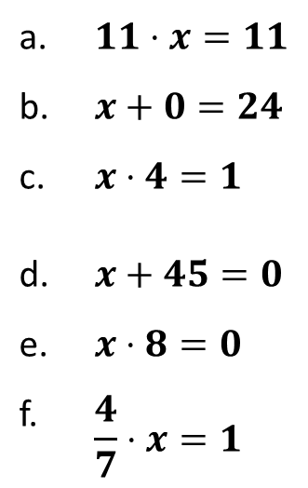
PROPERTIES OF REAL NUMBERS
Sample Problem 1: Name the property in each equation. Then find the value of $x$.
a. | $$11⋅x=11$$
b. | $$x+0=24$$
c. | $$x⋅4=1$$
d. | $$x+45=0$$
e. | $$x⋅8=0$$
f. | $$\frac{4}{7}⋅x=1$$

Slide 9
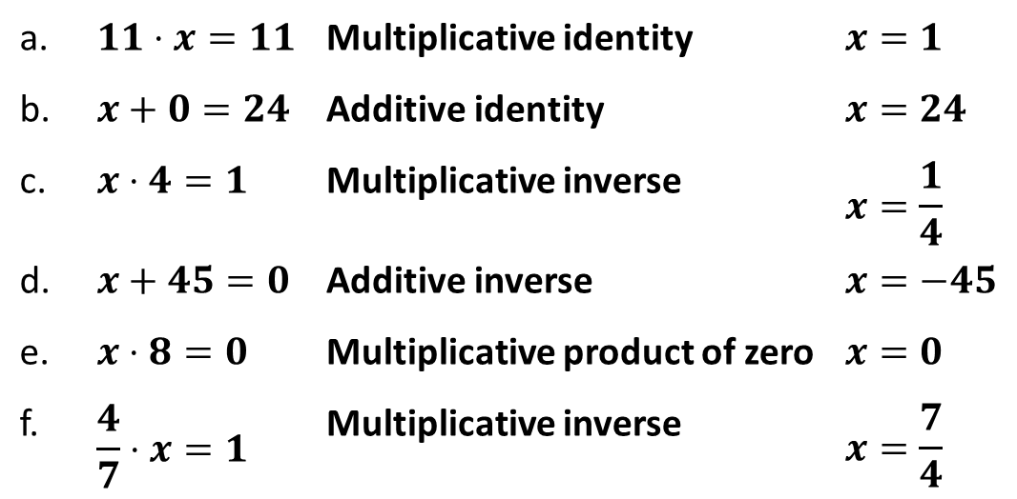
PROPERTIES OF REAL NUMBERS
Sample Problem 1: Name the property in each equation. Then find the value of $x$.
a. | $$11⋅x=11$$ | Multiplicative identity | $$x=1$$
b. | $$x+0=24$$ | Additive identity | $$x=24$$
c. | $$x⋅4=1$$ | Multiplicative inverse | $$x=\frac{1}{4}$$
d. | $$x+45=0$$ | Additive inverse | $$x=−45$$
e. | $$x⋅8=0$$ | Multiplicative product of zero | $$x=0$$
f. | $$\frac{4}{7}⋅x=1$$ | Multiplicative inverse | $$x=\frac{7}{4}$$

Slide 10
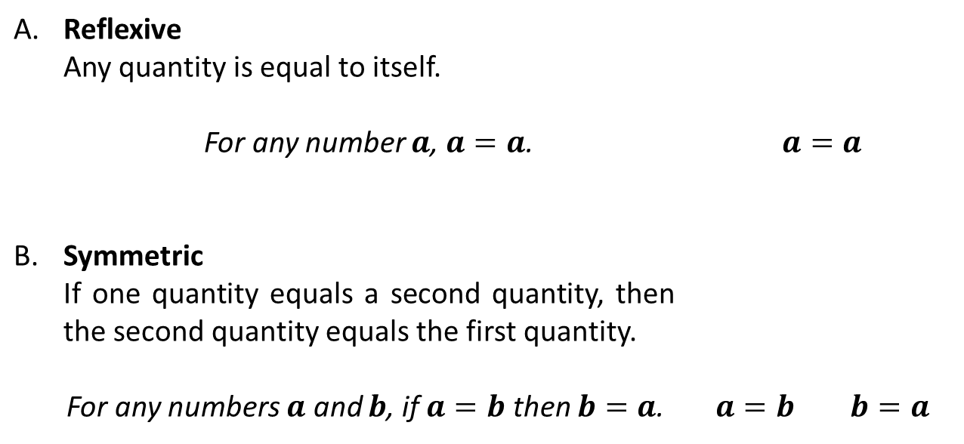
PROPERTIES OF REAL NUMBERS
3. EQUALITY PROPERTIES
A. | Reflexive
 | Any quantity is equal to itself.
 | For any number $a$, $a=a$. | $$a=a$$
B. | Symmetric
 | If one quantity equals a second quantity, then the second quantity equals the first quantity.
 | For any numbers $a$ and $b$, if $a=b$ then $b=a$. | $a=b$ $b=a$

Slide 11
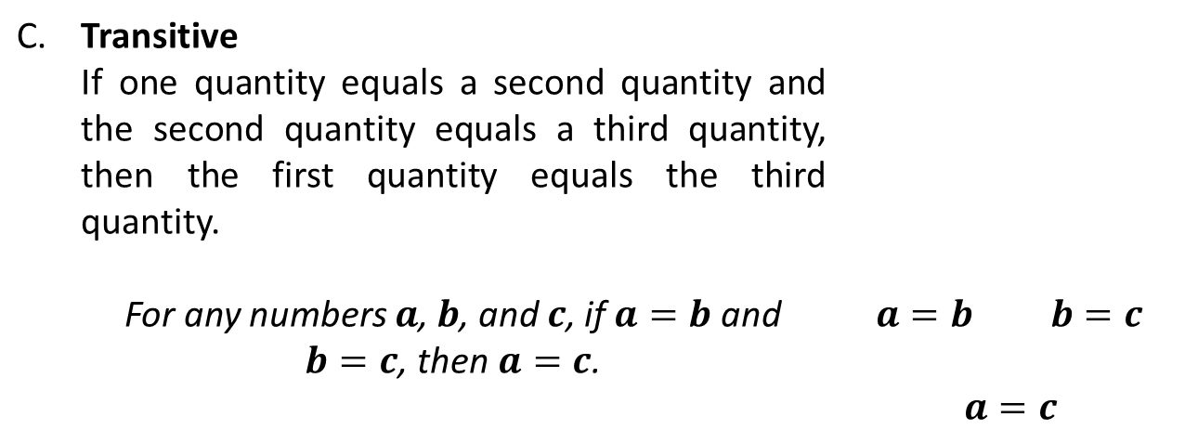
PROPERTIES OF REAL NUMBERS
3. EQUALITY PROPERTIES
C. | Transitive
 | If one quantity equals a second quantity and the second quantity equals a third quantity, then the first quantity equals the third quantity.
 | For any numbers $a$, $b$, and $c$, if $a=b$ and $b=c$, then$a=c$. | $a=b$ $b=c$ $$a=c$$

Slide 12
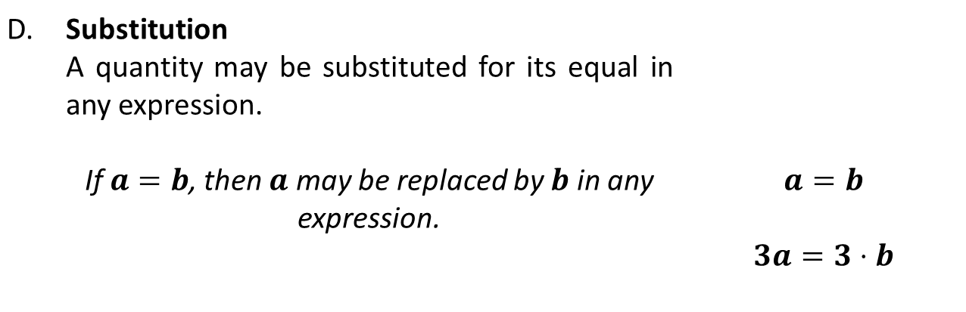
PROPERTIES OF REAL NUMBERS
3. EQUALITY PROPERTIES
D. | Substitution
 | A quantity may be substituted for its equal in any expression.
 | If $a=b$, then $a$ may be replaced by $b$ in any expression. | $$a=b$$ $$3a=3⋅b$$

Slide 13

PROPERTIES OF REAL NUMBERS
Sample Problem 2: Evaluate$x\left(xy−5\right)+y⋅\frac{1}{y}$, if $x=4$ and $y=5$. Name the property of equality used in each step.

Slide 14
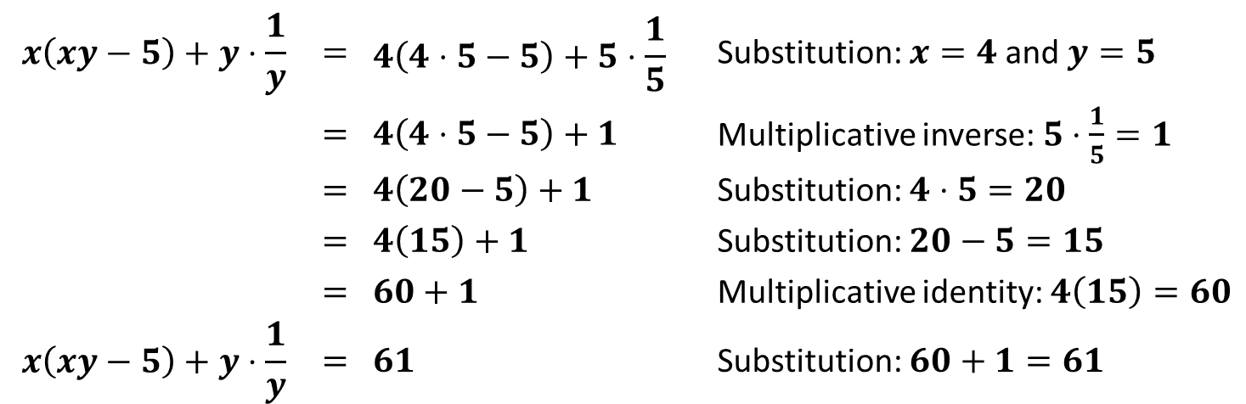
PROPERTIES OF REAL NUMBERS
Sample Problem 2: Evaluate$x\left(xy−5\right)+y⋅\frac{1}{y}$, if $x=4$ and $y=5$. Name the property of equality used in each step.
$$x\left(xy−5\right)+y⋅\frac{1}{y}$$ | $$=$$ | $$4\left(4⋅5−5\right)+5⋅\frac{1}{5}$$ | Substitution: $x=4$ and $y=5$
 | $$=$$ | $$4\left(4⋅5−5\right)+1$$ | Multiplicative inverse: $5⋅\frac{1}{5}=1$
 | $$=$$ | $$4\left(20−5\right)+1$$ | Substitution: $4⋅5=20$
 | $$=$$ | $$4\left(15\right)+1$$ | Substitution: $20−5=15$
 | $$=$$ | $$60+1$$ | Multiplicative identity: $4\left(15\right)=60$
$$x\left(xy−5\right)+y⋅\frac{1}{y}$$ | $$=$$ | $$61$$ | Substitution: $60+1=61$

Slide 15
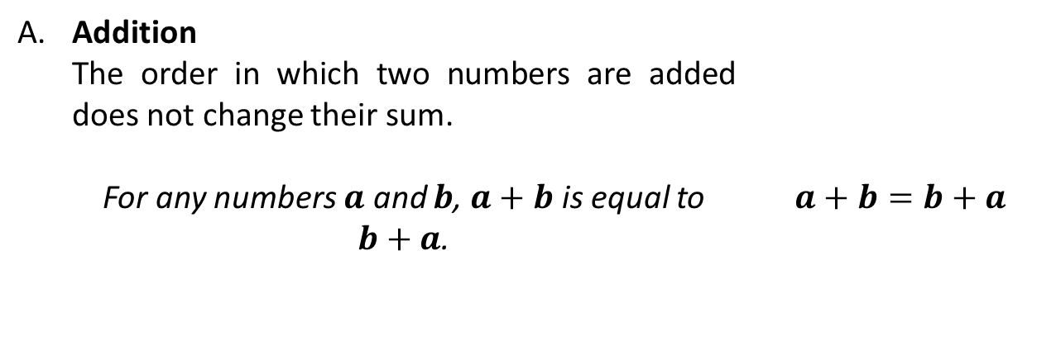
PROPERTIES OF REAL NUMBERS
4. COMMUTATIVE PROPERTIES
A. | Addition
 | The order in which two numbers are added does not change their sum.
 | For any numbers $a$ and $b$, $a+b$ is equal to $b+a$. | $$a+b=b+a$$

Slide 16
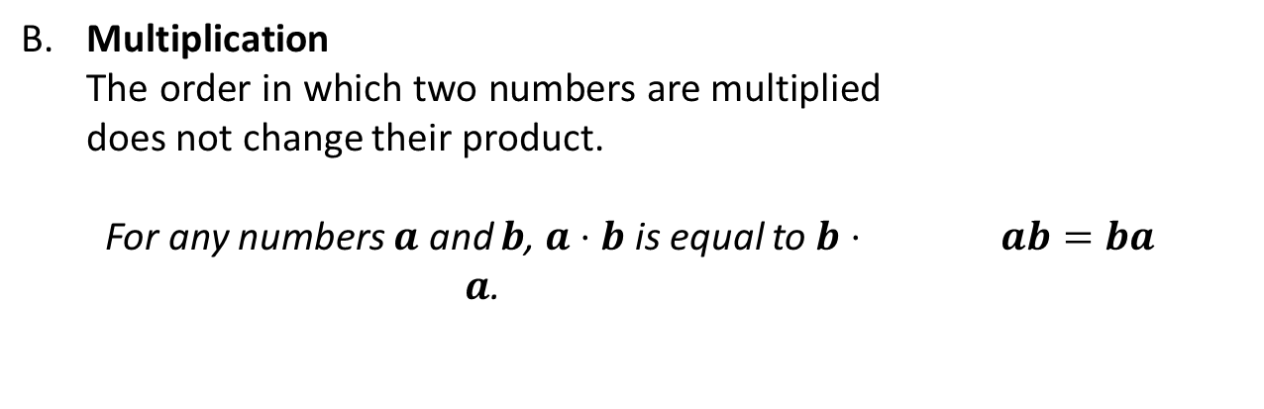
PROPERTIES OF REAL NUMBERS
4. COMMUTATIVE PROPERTIES
B. | Multiplication
 | The order in which two numbers are multiplied does not change their product.
 | For any numbers $a$ and $b$, $a⋅b$ is equal to $b⋅a$. | $$ab=ba$$

Slide 17
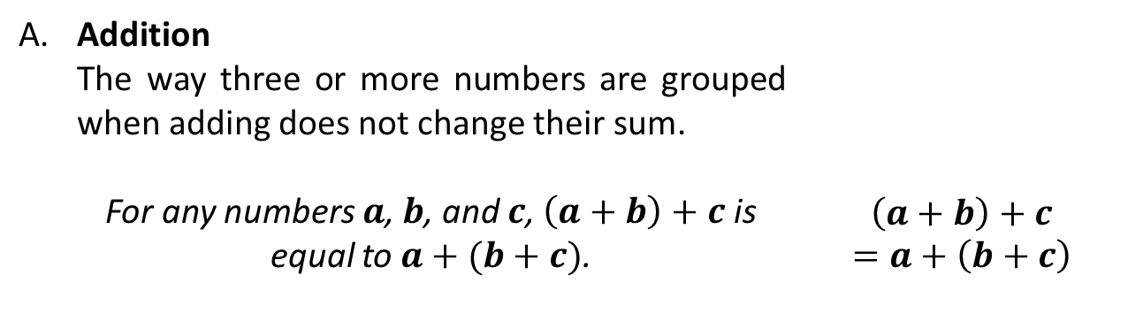
PROPERTIES OF REAL NUMBERS
5. ASSOCIATIVE PROPERTIES
A. | Addition
 | The way three or more numbers are grouped when adding does not change their sum.
 | For any numbers $a$, $b$, and $c$, $\left(a+b\right)+c$ is equal to $a+(b+c)$. | $$\left(a+b\right)+c$$ $$=a+\left(b+c\right)$$

Slide 18
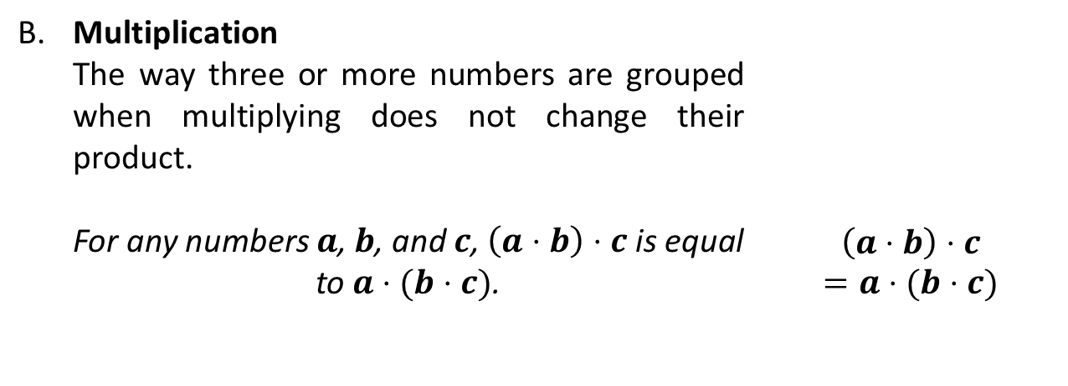
PROPERTIES OF REAL NUMBERS
5. ASSOCIATIVE PROPERTIES
B. | Multiplication
 | The way three or more numbers are grouped when multiplying does not change their product.
 | For any numbers $a$, $b$, and $c$, $\left(a⋅b\right)⋅c$ is equal to $a⋅(b⋅c)$. | $$\left(a⋅b\right)⋅c$$ $$=a⋅(b⋅c)$$

Slide 19
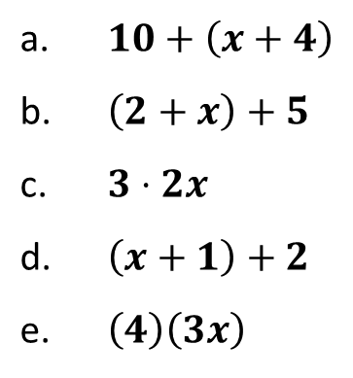
PROPERTIES OF REAL NUMBERS
Sample Problem 3: Simplify variable expressions. Show all possible answers.
a. | $$10+\left(x+4\right)$$
b. | $$\left(2+x\right)+5$$
c. | $$3⋅2x$$
d. | $$\left(x+1\right)+2$$
e. | $$\left(4\right)\left(3x\right)$$

Slide 20
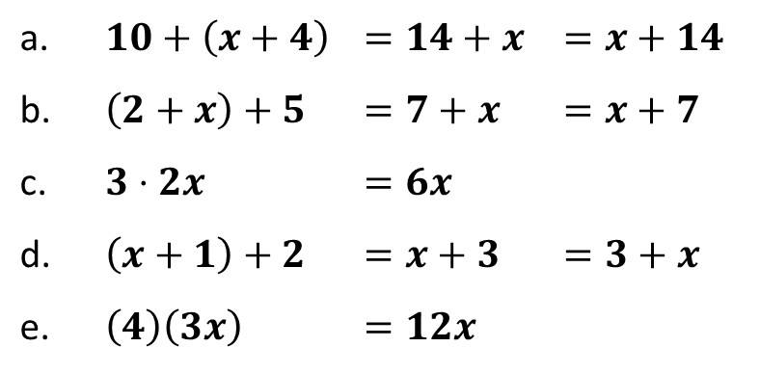
PROPERTIES OF REAL NUMBERS
Sample Problem 3: Simplify variable expressions. Show all possible answers.
a. | $$10+\left(x+4\right)$$ | $$=14+x$$ | $$=x+14$$
b. | $$\left(2+x\right)+5$$ | $$=7+x$$ | $$=x+7$$
c. | $$3⋅2x$$ | $$=6x$$
d. | $$\left(x+1\right)+2$$ | $$=x+3$$ | $$=3+x$$
e. | $$\left(4\right)\left(3x\right)$$ | $$=12x$$

