Slide 1
Writing and Evaluating Expressions
Unit 1 Lesson 4

Slide 2
Writing and Evaluating Expressions
Students will be able to:
Write and evaluate expressions
Key Vocabulary:
An algebraic expression
Addition
Subtraction
Multiplication
Division

Slide 3
Writing and Evaluating Expressions
Writing Expressions
Word problems use expressions that you can write with symbols. An algebraic expression has at least one variable.
A variable is a letter or symbol that represents one or more numbers.
Writing algebraic expressions for words helps you solve word problems.

Slide 4
Writing and Evaluating Expressions
To translate a verbal phrase into an algebraic expression, the first step is to define a variable.
When you define a variable, you choose a variable to represent an unknown quantity.
Always look for the placement of commas in the verbal statements. They will help you decide how to properly group terms in your algebraic expression.

Slide 5
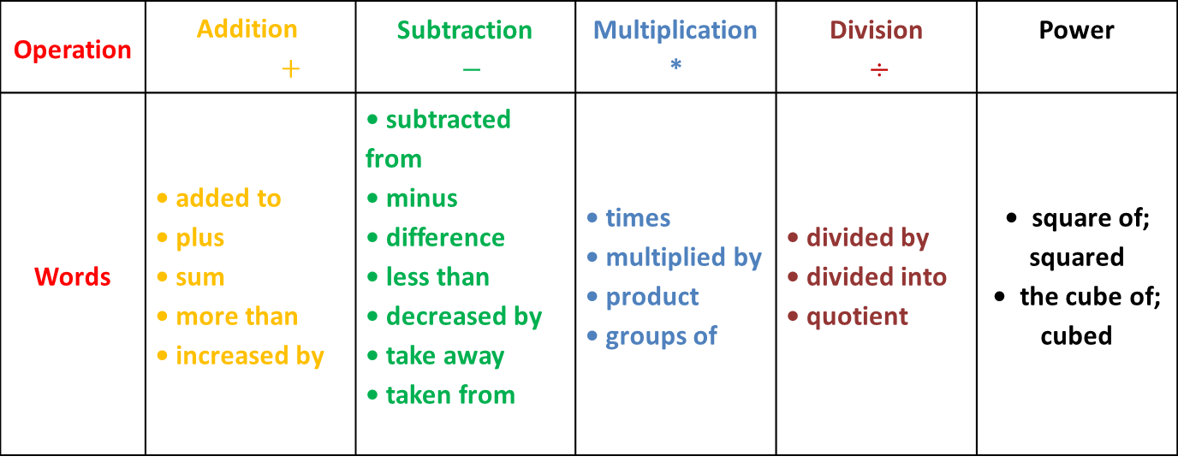
Writing and Evaluating Expressions
There are several different ways to describe expressions with words.
Operation | Addition $$+$$ | Subtraction $−$ | Multiplication * | Division $÷$ | Power
Words | • added to • plus • sum • more than • increased by | • subtracted from • minus • difference • less than • decreased by • take away • taken from | • times • multiplied by • product • groups of | • divided by • divided into • quotient | • square of; squared • the cube of; cubed

Slide 6
Writing and Evaluating Expressions
Sample Problem 1: Write an algebraic expression for the word expression.
a.
$$\text{12 }\text{divided} \text{by} \text{the} \text{sum} \text{of} x \text{and}\text{ 2}$$

Slide 7
Writing and Evaluating Expressions
Sample Problem 1: Write an algebraic expression for the word expression.
a.
$$\text{12 }\text{divided} \text{by} \text{the} \text{sum} \text{of} x \text{and}\text{ 2}$$
$$12÷(x+2)$$

Slide 8
Writing and Evaluating Expressions
Sample Problem 1: Write an algebraic expression for the word expression.
b.
$$\text{9 }\text{more} \text{than}\text{ 2 }\text{multiplied} \text{by} z$$

Slide 9
Writing and Evaluating Expressions
Sample Problem 1: Write an algebraic expression for the word expression.
b.
$$\text{9 }\text{more} \text{than}\text{ 2 }\text{multiplied} \text{by} z$$
$$9+2∗z or 9+2z$$

Slide 10
Writing and Evaluating Expressions
Sample Problem 1: Write an algebraic expression for the word expression.
c.
$$\text{The} \text{sum} \text{of}\text{ 6 }\text{multiplied} \text{by} a \text{and}\text{ 8 }\text{multiplied} \text{by} b$$

Slide 11
Writing and Evaluating Expressions
Sample Problem 1: Write an algebraic expression for the word expression.
c.
$$\text{The} \text{sum} \text{of}\text{ 6 }\text{multiplied} \text{by} a \text{and}\text{ 8 }\text{multiplied} \text{by} b$$
$$6∗a+8∗b or 6a+8b$$

Slide 12
Writing and Evaluating Expressions
Sample Problem 1: Write an algebraic expression for the word expression.
d.
$$\text{14 }\text{more} \text{than} \text{the} \text{difference} \text{of} x \text{and} y$$

Slide 13
Writing and Evaluating Expressions
Sample Problem 1: Write an algebraic expression for the word expression.
d.
$$\text{14 }\text{more} \text{than} \text{the} \text{difference} \text{of} x \text{and} y$$
$$14+(x−y)$$

Slide 14
Writing and Evaluating Expressions
Sample Problem 1: Write an algebraic expression for the word expression.
e.
$$\text{The} \text{quotient} \text{of} m \text{and}\text{ 7 }\text{decreased} \text{by}\text{ 10}$$

Slide 15
Writing and Evaluating Expressions
Sample Problem 1: Write an algebraic expression for the word expression.
e.
$$\text{The} \text{quotient} \text{of} m \text{and}\text{ 7 }\text{decreased} \text{by}\text{ 10}$$
$$\frac{m}{7}−10 or m÷7−10$$

Slide 16
Writing and Evaluating Expressions
Sample Problem 1: Write an algebraic expression for the word expression.
f.
$$\text{5 }\text{times}\text{, }\text{a} \text{number} \text{increased} \text{by}\text{ 6}$$

Slide 17
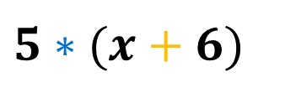
Writing and Evaluating Expressions
Sample Problem 1: Write an algebraic expression for the word expression.
f.
$$\text{5 }\text{times}\text{, }\text{a} \text{number} \text{increased} \text{by}\text{ 6}$$
$$5∗(x+6)$$

Slide 18
Writing and Evaluating Expressions
Sample Problem 2: Write an expression to match the words.
a.
$$\text{If} \text{a} \text{car} \text{traveled} \text{for}\text{ 6 }\text{hours} \text{at} \text{an} \text{average} \text{rate} \text{of} r \text{kilometers} \text{per} \text{hour}\text{, }\text{represent} \text{the} \text{distance} \text{it} \text{traveled}\text{.}$$

Slide 19
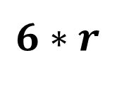
Writing and Evaluating Expressions
Sample Problem 2: Write an expression to match the words.
a.
$$\text{If} \text{a} \text{car} \text{traveled} \text{for}\text{ 6 }\text{hours} \text{at} \text{an} \text{average} \text{rate} \text{of} r \text{kilometers} \text{per} \text{hour}\text{, }\text{represent} \text{the} \text{distance} \text{it} \text{traveled}\text{.}$$
$$r =an average rate\left(\frac{km}{h}\right)$$
$$Distance (km)$$
$$6∗r$$

Slide 20
Writing and Evaluating Expressions
Sample Problem 2: Write an expression to match the words.
b.
Represent the total number of days in $x$ weeks and
5 days.

Slide 21
Writing and Evaluating Expressions
Sample Problem 2: Write an expression to match the words.
b.
Represent the total number of days in $x$ weeks and
5 days.
$$x−number of weeks$$
$$Every week has 7 days$$
$$Total number of days 7x+5$$

Slide 22
Writing and Evaluating Expressions
Sample Problem 2: Write an expression to match the words.
c.
$$\text{After}\text{ 12 }\text{centimeters} \text{had} \text{been} \text{cut} \text{from} \text{a} \text{piece} \text{of}$$
$$\text{lumber}\text{, }y \text{centimeters} \text{were} \text{left}\text{.}\text{Represent} \text{the} \text{length} \text{of} \text{the} \text{original} \text{piece} \text{of} \text{lumber}\text{.}$$

Slide 23
Writing and Evaluating Expressions
Sample Problem 2: Write an expression to match the words.
c.
$$\text{After}\text{ 12 }\text{centimeters} \text{had} \text{been} \text{cut} \text{from} \text{a} \text{piece} \text{of}$$
$$\text{lumber}\text{, }y \text{centimeters} \text{were} \text{left}\text{.}\text{Represent} \text{the} \text{length} \text{of} \text{the} \text{original} \text{piece} \text{of} \text{lumber}\text{.}$$
$$y−length of piece \left(cm\right)$$
$$Length of original piece \left(cm\right) 12+y$$

Slide 24
Writing and Evaluating Expressions
Modeling Algebraic Expressions
Algebraic expressions can also be represented with models.

Slide 25
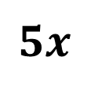
Writing and Evaluating Expressions
Sample Problem 3: Use a bar model to represent each expression.
a.
$$5x$$

Slide 26
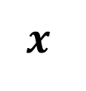
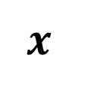
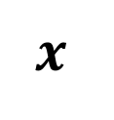
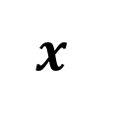
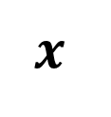
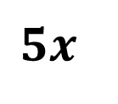
Writing and Evaluating Expressions
Sample Problem 3: Use a bar model to represent each expression.
a.
$$5x$$
$$5x$$
$$x$$
$$x$$
$$x$$
$$x$$
$$x$$

Slide 27
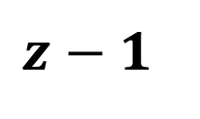
Writing and Evaluating Expressions
Sample Problem 3: Use a bar model to represent each expression.
b.
$$z−1$$

Slide 28
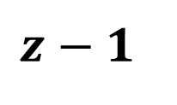
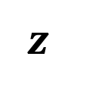
Writing and Evaluating Expressions
Sample Problem 3: Use a bar model to represent each expression.
b.
$$z−1$$
$$z−1$$
$$z$$

Slide 29
Writing and Evaluating Expressions
Evaluating Expressions
To evaluate an expression follow these steps:
Substitute the value for the variable.
Then find the value of the expression following the order of operations.

Slide 30
Writing and Evaluating Expressions
Sample Problem 4: Evaluate each of the following expressions when $x=3$and $y=5$.
a.
$$3x^{2}−\left(2x+y\right)=$$

Slide 31
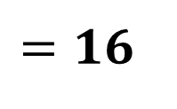
Writing and Evaluating Expressions
Sample Problem 4: Evaluate each of the following expressions when $x=3$and $y=5$.
a.
$$3x^{2}−\left(2x+y\right)=$$
$$=3∗3^{2}−\left(2∗3+5\right)=$$
$$=3∗9−\left(6+5\right)=$$
$$=27−11=$$
$$=16$$

Slide 32
Writing and Evaluating Expressions
Sample Problem 4: Evaluate each of the following expressions when $x=3$and $y=5$.
b.
$${\left(3x−y\right)}^{2}+2xy=$$

Slide 33
Writing and Evaluating Expressions
Sample Problem 4: Evaluate each of the following expressions when $x=3$and $y=5$.
b.
$${\left(3x−y\right)}^{2}+2xy=$$
$$={\left(3∗3−5\right)}^{2}+2∗3∗5=$$
$$={\left(9−5\right)}^{2}+6∗5=$$
$$=4^{2}+30=$$
$$=16+30=46$$

Slide 34
Writing and Evaluating Expressions
Sample Problem 4: Evaluate each of the following expressions when $x=3$and $y=5$.
$$2(\frac{3x}{9}+2x−y)=$$
c.

Slide 35
Writing and Evaluating Expressions
Sample Problem 4: Evaluate each of the following expressions when $x=3$and $y=5$.
$$2(\frac{3x}{9}+2x−y)=$$
c.
$$=2(\frac{3∗3}{9}+2∗3−5)=$$
$$=2∗(\frac{9}{9}+6−5)=$$
$$=2∗(1+6−5)=$$
$$=2∗(7−5)=2∗2=4$$

