Slide 1

Adding and Subtracting Real Numbers
Unit 1 Lesson 5

Slide 2

ADDING AND SUBTRACTING REAL NUMBERS
Students will be able to:
add and subtract integers and rational numbers.
Key Vocabulary:
Rules of Addition
Rule of Subtraction
Opposites
Additive Inverse

Slide 3
ADDING AND SUBTRACTING REAL NUMBERS
We can use a number line to add any real numbers.
Adding a positive number by moving to the right.
Adding a negative number by moving to left.
-9
-8
-7
-6
-5
-4
-3
-2
-1
0
1
2
3
4
5
6
7
8
9
Negative Numbers
Positive Numbers

Slide 4
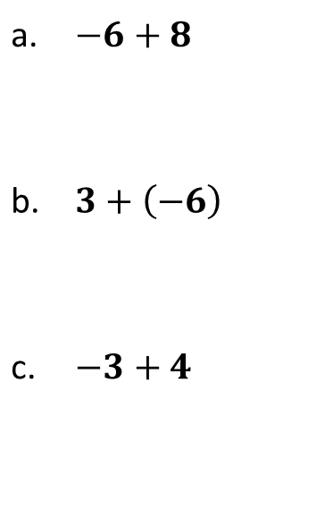
ADDING AND SUBTRACTING REAL NUMBERS
Sample Problem 1: Use a number line to find the sum.
a. | $$−6+8$$
b. | $$3+\left(−6\right)$$
c. | $$−3+4$$
-9
-8
-7
-6
-5
-4
-3
-2
-1
0
1
2
3
4
5
6
7
8
9
-9
-8
-7
-6
-5
-4
-3
-2
-1
0
1
2
3
4
5
6
7
8
9
-9
-8
-7
-6
-5
-4
-3
-2
-1
0
1
2
3
4
5
6
7
8
9

Slide 5
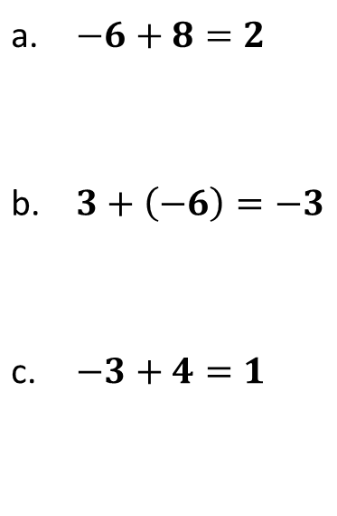
ADDING AND SUBTRACTING REAL NUMBERS
Sample Problem 1: Use a number line to find the sum.
a. | $$−6+8=2$$
b. | $$3+\left(−6\right)=−3$$
c. | $$−3+4=1$$
Move 8 units to the right
-9
-8
-7
-6
-5
-4
-3
-2
-1
0
1
2
3
4
5
6
7
8
9
Move 6 units to the left
-9
-8
-7
-6
-5
-4
-3
-2
-1
0
1
2
3
4
5
6
7
8
9
Move 4 units to the right
-9
-8
-7
-6
-5
-4
-3
-2
-1
0
1
2
3
4
5
6
7
8
9

Slide 6
ADDING AND SUBTRACTING REAL NUMBERS
RULES OF ADDITION: without a number line
  To add two numbers with the same sign:
  Add their absolute values.
  Attach the common sign.
  To add two numbers with opposite signs:
  Subtract the smaller absolute value from the larger absolute value.
  Attach the sign of the number with the larger absolute value.

Slide 7
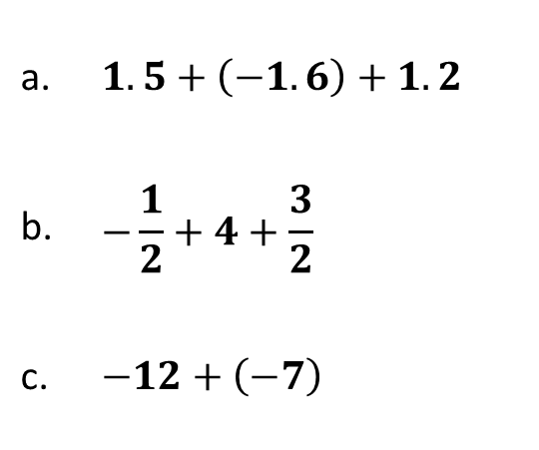
ADDING AND SUBTRACTING REAL NUMBERS
Sample Problem 2: Find the sum.
a. | $$1.5+\left(−1.6\right)+1.2$$
b. | $$−\frac{1}{2}+4+\frac{3}{2}$$
c. | $$−12+\left(−7\right)$$

Slide 8
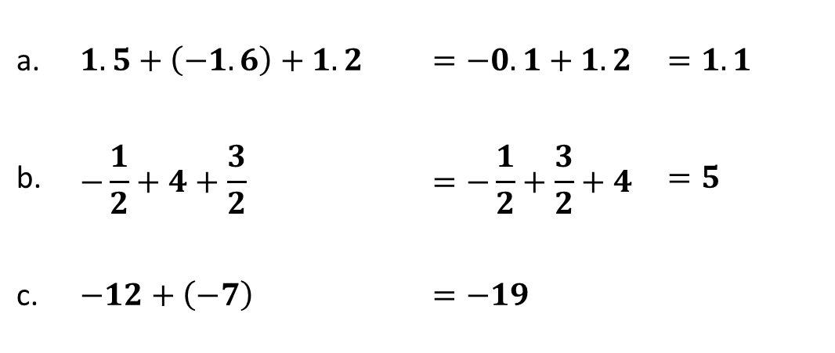
ADDING AND SUBTRACTING REAL NUMBERS
Sample Problem 2: Find the sum.
a. | $$1.5+\left(−1.6\right)+1.2$$ | $$=−0.1+1.2$$ | $$=1.1$$
b. | $$−\frac{1}{2}+4+\frac{3}{2}$$ | $$=−\frac{1}{2}+\frac{3}{2}+4$$ | $$=5$$
c. | $$−12+\left(−7\right)$$ | $$=−19$$

Slide 9
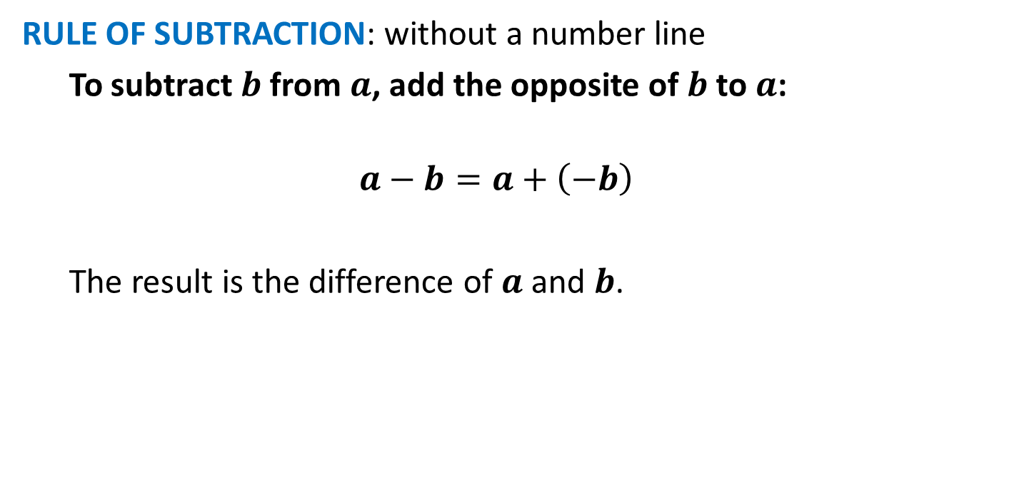
ADDING AND SUBTRACTING REAL NUMBERS
RULE OF SUBTRACTION: without a number line
  To subtract $b$ from$a$, add the opposite of $b$ to $a$:
  $$a−b=a+\left(−b\right)$$
  The result is the difference of $a$ and $b$.

Slide 10
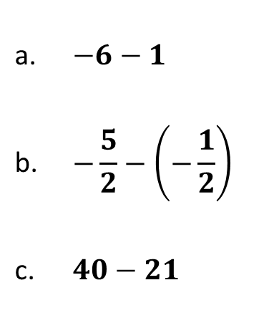
ADDING AND SUBTRACTING REAL NUMBERS
Sample Problem 3: Find the difference.
a. | $$−6−1$$
b. | $$−\frac{5}{2}−\left(−\frac{1}{2}\right)$$
c. | $$40−21$$

Slide 11
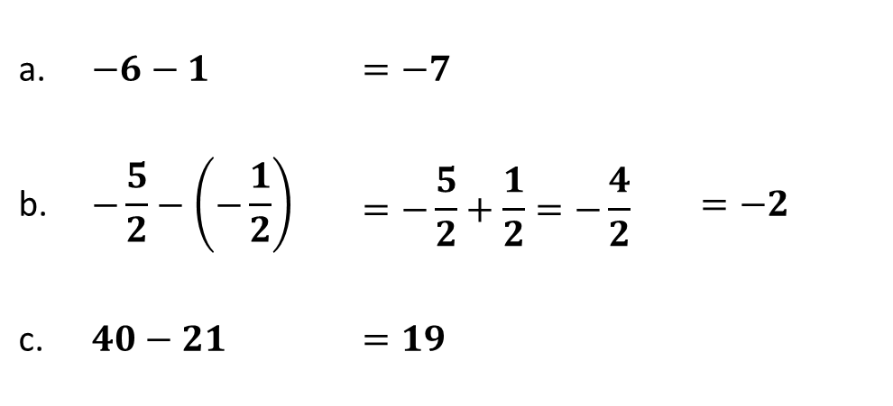
ADDING AND SUBTRACTING REAL NUMBERS
Sample Problem 3: Find the difference.
a. | $$−6−1$$ | $$=−7$$
b. | $$−\frac{5}{2}−\left(−\frac{1}{2}\right)$$ | $$=−\frac{5}{2}+\frac{1}{2}=−\frac{4}{2}$$ | $$=−2$$
c. | $$40−21$$ | $$=19$$

Slide 12
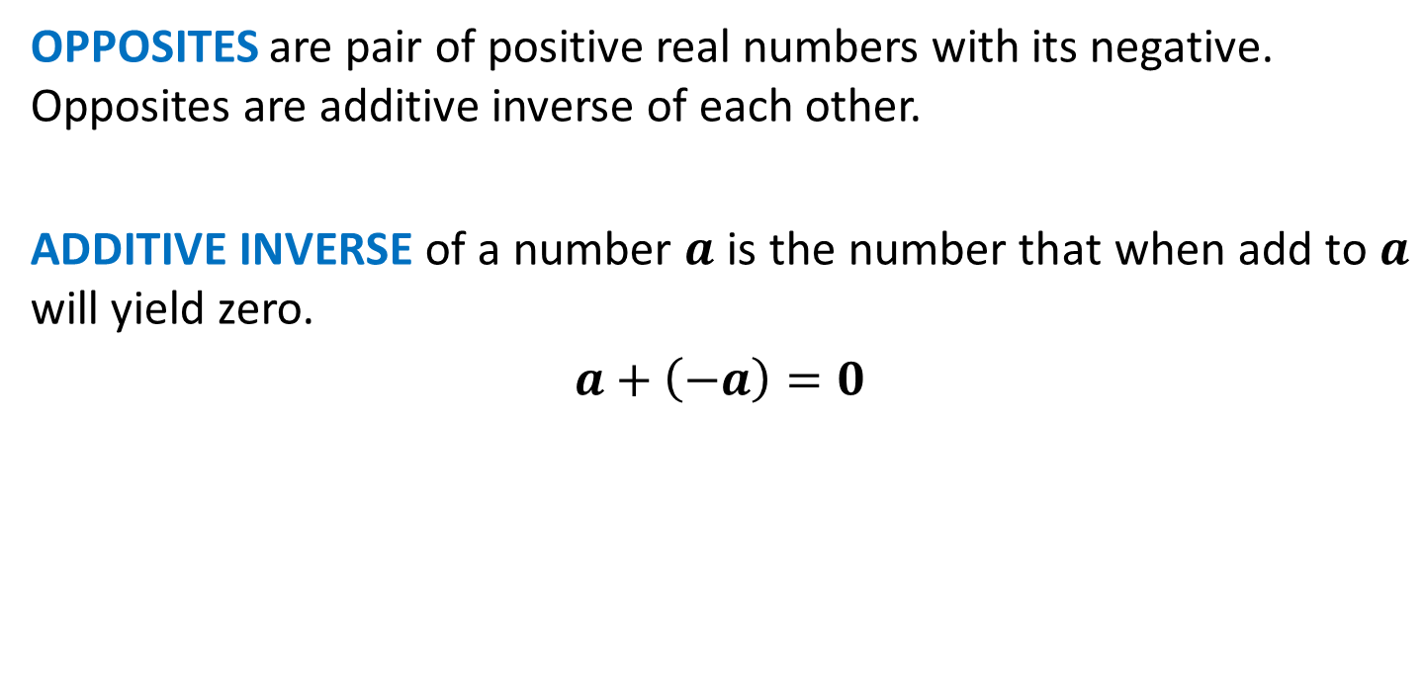


ADDING AND SUBTRACTING REAL NUMBERS
OPPOSITES are pair of positive real numbers with its negative. Opposites are additive inverse of each other.
ADDITIVE INVERSE of a number $a$ is the number that when add to $a$ will yield zero.
$$a+\left(−a\right)=0$$
The opposite of $−5$ is $5$.
The opposite of $6$ is $–6$.
-6
-5
-4
-3
-2
-1
0
1
2
3
4
5
6

Slide 13
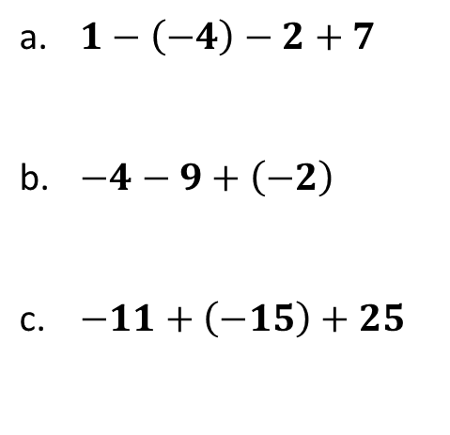
ADDING AND SUBTRACTING REAL NUMBERS
Sample Problem 4: Evaluate each expression.
a. | $$1−\left(−4\right)−2+7$$
b. | $$−4−9+\left(−2\right)$$
c. | $$−11+\left(−15\right)+25$$

Slide 14
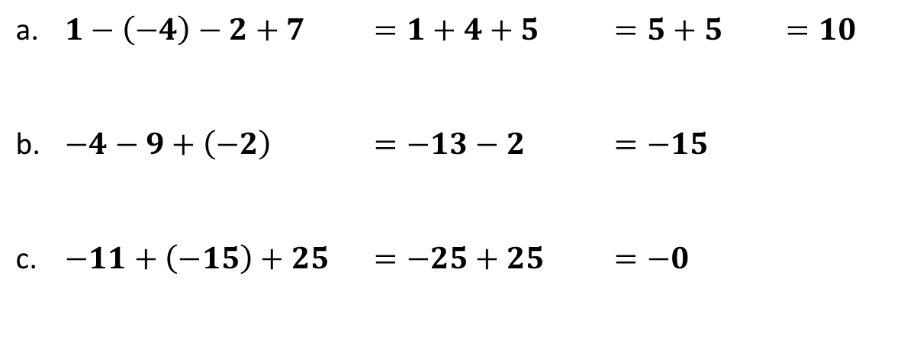
ADDING AND SUBTRACTING REAL NUMBERS
Sample Problem 4: Evaluate each expression.
a. | $$1−\left(−4\right)−2+7$$ | $$=1+4+5$$ | $$=5+5$$ | $$=10$$
b. | $$−4−9+\left(−2\right)$$ | $$=−13−2$$ | $$=−15$$
c. | $$−11+\left(−15\right)+25$$ | $$=−25+25$$ | $$=−0$$

Slide 15
ADDING AND SUBTRACTING REAL NUMBERS
Sample Problem 5: The average height of a NBA player is 75 inches while the height of an average man is 64 inches. What is the difference between their heights?

Slide 16
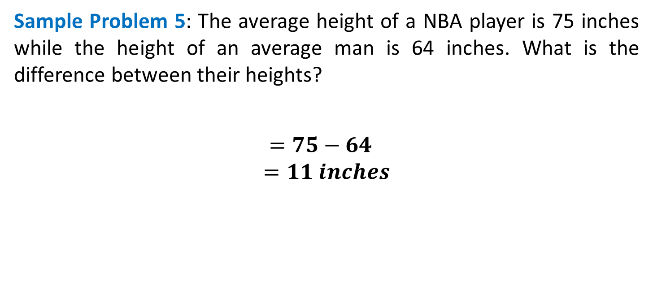
ADDING AND SUBTRACTING REAL NUMBERS
Sample Problem 5: The average height of a NBA player is 75 inches while the height of an average man is 64 inches. What is the difference between their heights?
$=75−64$
$$=11 inches$$

