Slide 1
Integers and Absolute Value
Unit 1 Lesson 5

Slide 2

Integers and Absolute Value
Students will be able to:
Understand integers and absolute value
Key Vocabulary:
An integer
Positive number
Negative number
Absolute value
Opposite

Slide 3
Integers and Absolute Value
Integers
An integer is a positive or negative whole number.
A positive number is a number greater than zero.
A negative number is a number less than zero.

Slide 4
Integers and Absolute Value
This number line shows integers.
Negative integers Positive integers
-6
-5
-4
-3
-2
-1
0
1
2
3
4
5
6
Zero is neither positive nor negative

Slide 5
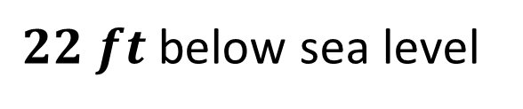
Integers and Absolute Value
Sample Problem 1: Write an integer to represent each situation.
a.
$$22 ft \text{below} \text{sea} \text{level}$$

Slide 6
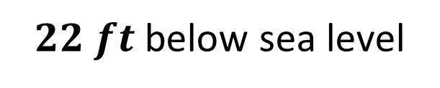
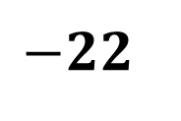
Integers and Absolute Value
Sample Problem 1: Write an integer to represent each situation.
a.
$$22 ft \text{below} \text{sea} \text{level}$$
$$−22$$

Slide 7
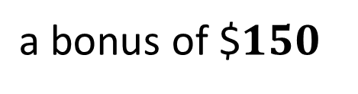
Integers and Absolute Value
Sample Problem 1: Write an integer to represent each situation.
b.
$$\text{a} \text{bonus} \text{of}\text{ \$}150$$

Slide 8
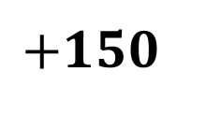
Integers and Absolute Value
Sample Problem 1: Write an integer to represent each situation.
b.
$$\text{a} \text{bonus} \text{of}\text{ \$}150$$
$$+150$$

Slide 9
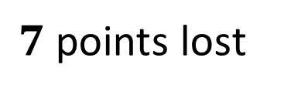
Integers and Absolute Value
Sample Problem 1: Write an integer to represent each situation.
c.
$$7 \text{points} \text{lost}$$

Slide 10
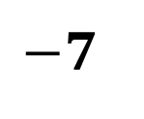
Integers and Absolute Value
Sample Problem 1: Write an integer to represent each situation.
c.
$$7 \text{points} \text{lost}$$
$$−7$$

Slide 11
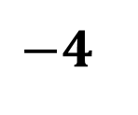
Integers and Absolute Value
Sample Problem 2: Graph each integer or set of integers on a number line.
a.
$$−4$$

Slide 12
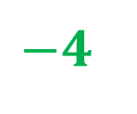
Integers and Absolute Value
Sample Problem 2: Graph each integer or set of integers on a number line.
a.
$$−4$$
-6
-5
-4
-3
-2
-1
0
1
2
3
4
5
6

Slide 13
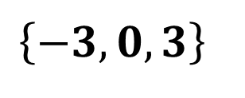
Integers and Absolute Value
Sample Problem 2: Graph each integer or set of integers on a number line.
b.
$$\left\{−3,0,3\right\}$$

Slide 14
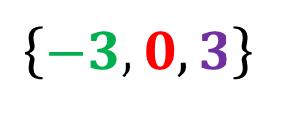
Integers and Absolute Value
Sample Problem 2: Graph each integer or set of integers on a number line.
b.
$$\left\{−3,0,3\right\}$$
-6
-5
-4
-3
-2
-1
0
1
2
3
4
5
6

Slide 15
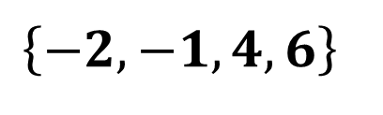
Integers and Absolute Value
Sample Problem 2: Graph each integer or set of integers on a number line.
c.
$$\left\{−2,−1, 4,6\right\}$$

Slide 16
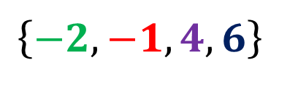
Integers and Absolute Value
Sample Problem 2: Graph each integer or set of integers on a number line.
c.
$$\left\{−2,−1, 4,6\right\}$$
-6
-5
-4
-3
-2
-1
0
1
2
3
4
5
6

Slide 17
Integers and Absolute Value
Every integer has an opposite integer.
A number and its opposite are the same distance from 0.

Slide 18
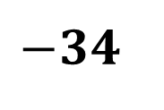
Integers and Absolute Value
Sample Problem 3: Find the opposite of each integer.
a.
$$−34$$

Slide 19
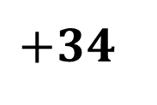
Integers and Absolute Value
Sample Problem 3: Find the opposite of each integer.
a.
$$−34$$
$$+34$$

Slide 20
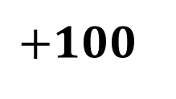
Integers and Absolute Value
Sample Problem 3: Find the opposite of each integer.
b.
$$+100$$

Slide 21
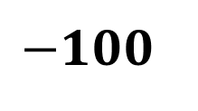
Integers and Absolute Value
Sample Problem 3: Find the opposite of each integer.
b.
$$+100$$
$$−100$$

Slide 22
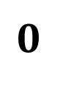
Integers and Absolute Value
Sample Problem 3: Find the opposite of each integer.
c.
$$0$$

Slide 23

Integers and Absolute Value
Sample Problem 3: Find the opposite of each integer.
c.
$$0$$
$$\text{No}\text{ne} \text{opposite}$$

Slide 24
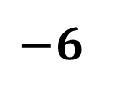
Integers and Absolute Value
Sample Problem 4: Graph each integer and its opposite on a number line.
a.
$$−6$$

Slide 25
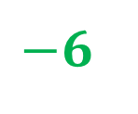
Integers and Absolute Value
Sample Problem 4: Graph each integer and its opposite on a number line.
a.
$$−6$$
-6
-5
-4
-3
-2
-1
0
1
2
3
4
5
6

Slide 26
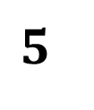
Integers and Absolute Value
Sample Problem 4: Graph each integer and its opposite on a number line.
b.
$$5$$

Slide 27

Integers and Absolute Value
Sample Problem 4: Graph each integer and its opposite on a number line.
b.
$$5$$
-6
-5
-4
-3
-2
-1
0
1
2
3
4
5
6

Slide 28
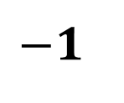
Integers and Absolute Value
Sample Problem 4: Graph each integer and its opposite on a number line.
c.
$$−1$$

Slide 29
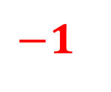
Integers and Absolute Value
Sample Problem 4: Graph each integer and its opposite on a number line.
c.
$$−1$$
-6
-5
-4
-3
-2
-1
0
1
2
3
4
5
6

Slide 30
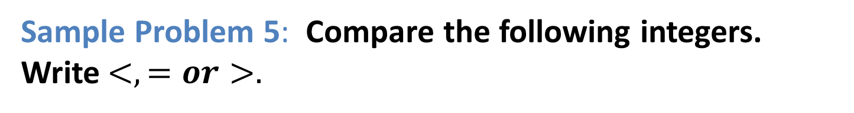
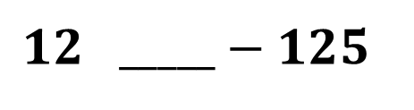
Integers and Absolute Value
Sample Problem 5: Compare the following integers. Write$<,=or>.$
a.
$$12 _____−125$$

Slide 31
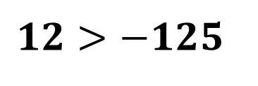
Integers and Absolute Value
Sample Problem 5: Compare the following integers. Write$<,=or>.$
a.
$$12>−125$$

Slide 32
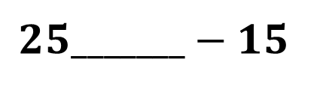
Integers and Absolute Value
Sample Problem 5: Compare the following integers. Write$<,=or>.$
b.
$$25_______−15$$

Slide 33
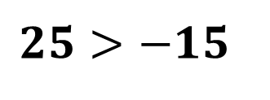
Integers and Absolute Value
Sample Problem 5: Compare the following integers. Write$<,=or>.$
b.
$$25>−15$$

Slide 34
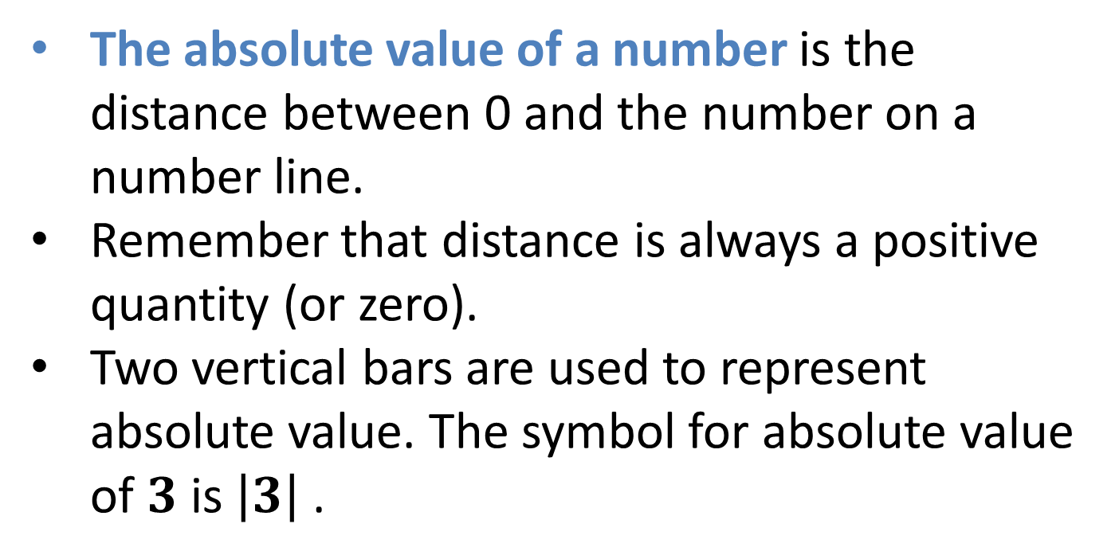
Integers and Absolute Value
The absolute value of a number is the distance between 0 and the number on a number line.
Remember that distance is always a positive quantity (or zero).
Two vertical bars are used to represent absolute value. The symbol for absolute value of $3$ is $\left|3\right|$ .

Slide 35
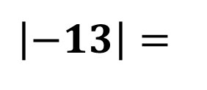
Integers and Absolute Value
Sample Problem 6: Find the absolute value of the following numbers.
a.
$$\left|−13\right|=$$

Slide 36
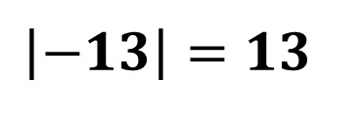
Integers and Absolute Value
Sample Problem 6: Find the absolute value of the following numbers.
a.
$$\left|−13\right|=$$
$$\left|−13\right|=13$$

Slide 37
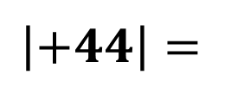
Integers and Absolute Value
Sample Problem 6: Find the absolute value of the following numbers.
b.
$$\left|+44\right|=$$

Slide 38
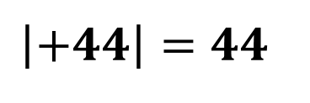
Integers and Absolute Value
Sample Problem 6: Find the absolute value of the following numbers.
b.
$$\left|+44\right|=$$
$$\left|+44\right|=44$$

Slide 39
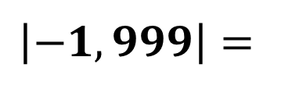
Integers and Absolute Value
Sample Problem 6: Find the absolute value of the following numbers.
c.
$$\left|−1,999\right|=$$

Slide 40
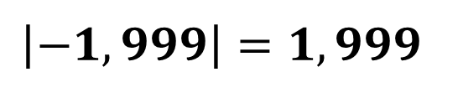
Integers and Absolute Value
Sample Problem 6: Find the absolute value of the following numbers.
c.
$$\left|−1,999\right|=$$
$$\left|−1,999\right|=1,999$$

Slide 41
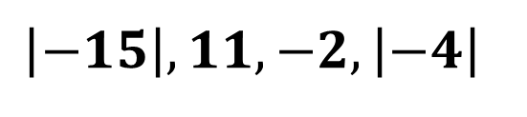
Integers and Absolute Value
Sample Problem 7: Order the values from least to greatest.
a.
$$\left|−15\right|, 11,−2, \left|−4\right|$$

Slide 42
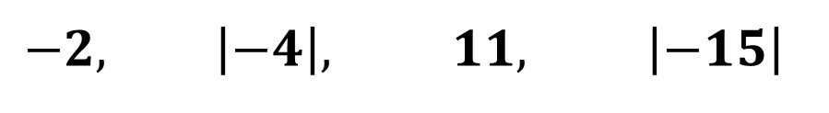
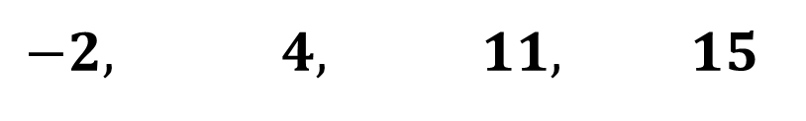
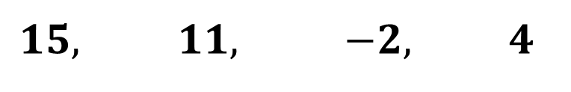
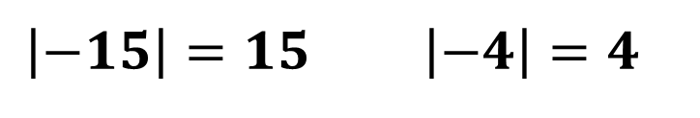
Integers and Absolute Value
Sample Problem 7: Order the values from least to greatest.
a.
$$\left|−15\right|, 11,−2, \left|−4\right|$$
$$\left|−15\right|=15 \left|−4\right|=4$$
$$15, 11, −2, 4$$
$$−2, 4, 11, 15$$
$$−2, \left|−4\right|, 11, \left|−15\right|$$

Slide 43
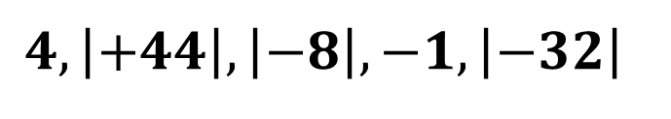
Integers and Absolute Value
Sample Problem 7: Order the values from least to greatest.
b.
$$4, \left|+44\right|,\left|−8\right|, −1, \left|−32\right|$$

Slide 44
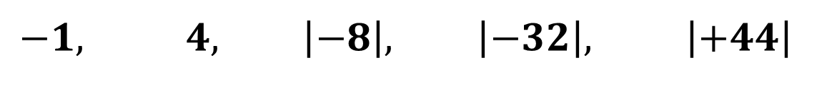
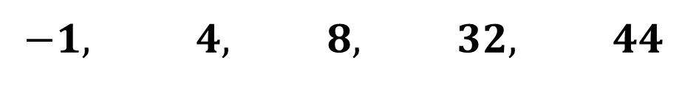
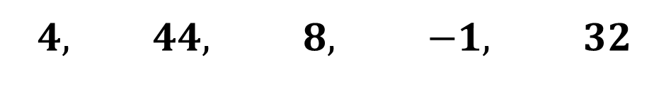
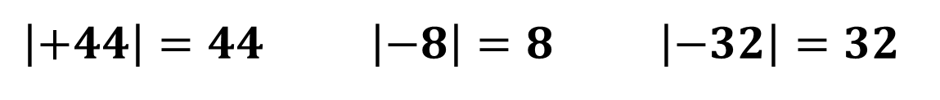
Integers and Absolute Value
Sample Problem 7: Order the values from least to greatest.
b.
$$4, \left|+44\right|,\left|−8\right|, −1, \left|−32\right|$$
$$\left|+44\right|=44 \left|−8\right|=8 \left|−32\right|=32$$
$$4, 44, 8, −1, 32$$
$$−1, 4, 8, 32, 44$$
$$−1, 4, \left|−8\right|, \left|−32\right|, \left|+44\right|$$

Slide 45
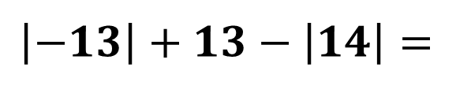
Integers and Absolute Value
Sample Problem 8: Evaluate each of the following expressions.
a.
$$\left|−13\right|+13−\left|14\right|=$$

Slide 46
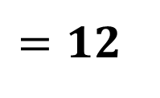
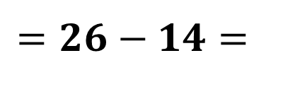
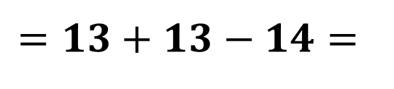
Integers and Absolute Value
Sample Problem 8: Evaluate each of the following expressions.
a.
$$\left|−13\right|+13−\left|14\right|=$$
$$=13+13−14=$$
$$=26−14=$$
$$=12$$

Slide 47
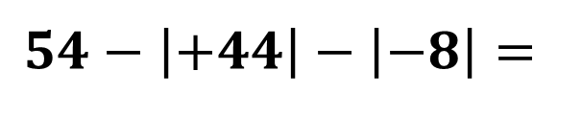
Integers and Absolute Value
Sample Problem 8: Evaluate each of the following expressions.
b.
$$54−\left|+44\right|−\left|−8\right|=$$

Slide 48



Integers and Absolute Value
Sample Problem 8: Evaluate each of the following expressions.
b.
$$54−\left|+44\right|−\left|−8\right|=$$
$$=54−44−8=$$
$$=10−8=$$
$$=2$$

Slide 49

Integers and Absolute Value
Sample Problem 8: Evaluate each of the following expressions.
c.
$$128+\left|−9\right|∗10∗\left|−4\right|=$$

Slide 50




Integers and Absolute Value
Sample Problem 8: Evaluate each of the following expressions.
c.
$$128+\left|−9\right|∗10∗\left|−4\right|=$$
$$=128+9∗10∗4=$$
$$=128+90∗4=$$
$$=128+360=$$
$$=488$$

