Slide 1
Nets and Drawings for Visualizing Geometry
Unit 1 Lesson 1

Slide 2
Nets and Drawings for Visualizing Geometry
Students will be able to:
• Represent three-dimensional figures using nets.
Make isometric and orthographic drawings.

Slide 3
Nets and Drawings for Visualizing Geometry
Key Vocabulary:
Net
Isometric drawing
Orthographic drawing

Slide 4
Nets and Drawings for Visualizing Geometry
A net is a two-dimensional diagram that you can fold to form a three-dimensional figure.
A net shows all of the surfaces of a figure in one view.

Slide 5
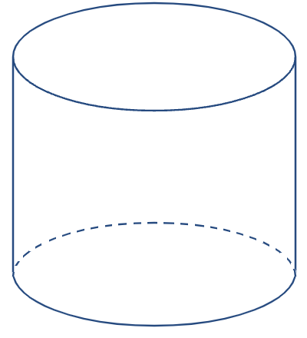
Nets and Drawings for Visualizing Geometry
Sample Problem 1: Identify each figure as two-dimensional or three-dimensional.
a.

Slide 6
Nets and Drawings for Visualizing Geometry
Sample Problem 1: Identify each figure as two-dimensional or three-dimensional.
a.
3-D Cylinder

Slide 7
Nets and Drawings for Visualizing Geometry
Sample Problem 1: Identify each figure as two-dimensional or three-dimensional.
b.

Slide 8
Nets and Drawings for Visualizing Geometry
Sample Problem 1: Identify each figure as two-dimensional or three-dimensional.
b.
3-D
Rectangular Prism

Slide 9
Nets and Drawings for Visualizing Geometry
Sample Problem 1: Identify each figure as two-dimensional or three-dimensional.
c.

Slide 10
Nets and Drawings for Visualizing Geometry
Sample Problem 1: Identify each figure as two-dimensional or three-dimensional.
c.
2-D
Triangle

Slide 11
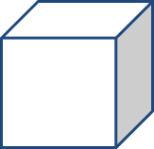
Nets and Drawings for Visualizing Geometry
Sample Problem 2: Draw a net for each figure and then list what 2D shapes you would need to make each one.
a.

Slide 12
Nets and Drawings for Visualizing Geometry
Sample Problem 2: Draw a net for each figure and then list what 2D shapes you would need to make each one.
a.
6 squares

Slide 13
Nets and Drawings for Visualizing Geometry
Sample Problem 2: Draw a net for each figure and then list what 2D shapes you would need to make each one.
b.

Slide 14
Nets and Drawings for Visualizing Geometry
Sample Problem 2: Draw a net for each figure and then list what 2D shapes you would need to make each one.
b.
2 circles and 1 rectangle

Slide 15
Nets and Drawings for Visualizing Geometry
Sample Problem 2: Draw a net for each figure and then list what 2D shapes you would need to make each one.
c.

Slide 16
Nets and Drawings for Visualizing Geometry
Sample Problem 2: Draw a net for each figure and then list what 2D shapes you would need to make each one.
c.
4 triangles

Slide 17
Nets and Drawings for Visualizing Geometry
Sample Problem 3: : Name a three-dimensional figure that can be formed from each net.
a.

Slide 18
Nets and Drawings for Visualizing Geometry
Sample Problem 3: : Name a three-dimensional figure that can be formed from each net.
a.
Square Pyramid

Slide 19
Nets and Drawings for Visualizing Geometry
Sample Problem 3: : Name a three-dimensional figure that can be formed from each net.
b.

Slide 20
Nets and Drawings for Visualizing Geometry
Sample Problem 3: : Name a three-dimensional figure that can be formed from each net.
b.
Hexagonal Prism

Slide 21
Nets and Drawings for Visualizing Geometry
An isometric drawing
An isometric drawing shows a corner view of a three-dimensional figure.
You can draw an isometric drawing on isometric dot paper.

Slide 22
Nets and Drawings for Visualizing Geometry
Sample Problem 4: Make an isometric drawing of each cube structure on isometric dot paper.
a.

Slide 23
Nets and Drawings for Visualizing Geometry
Sample Problem 4: Make an isometric drawing of each cube structure on isometric dot paper.
a.

Slide 24
Nets and Drawings for Visualizing Geometry
Sample Problem 4: Make an isometric drawing of each cube structure on isometric dot paper.
b.

Slide 25
Nets and Drawings for Visualizing Geometry
Sample Problem 4: Make an isometric drawing of each cube structure on isometric dot paper.
b.

Slide 26
Nets and Drawings for Visualizing Geometry
An orthographic drawing
An orthographic drawing is another way to represent a three-dimensional figure.
It shows a top view, front view, and right-side view.

Slide 27
Nets and Drawings for Visualizing Geometry
Sample Problem 5: Make an orthographic drawing for each structure.
a.

Slide 28
Nets and Drawings for Visualizing Geometry
Sample Problem 5: Make an orthographic drawing for each structure.
a.
Top view
Front view
Right-side view

Slide 29
Nets and Drawings for Visualizing Geometry
Sample Problem 5: Make an orthographic drawing for each structure.
b.

Slide 30
Nets and Drawings for Visualizing Geometry
Sample Problem 5: Make an orthographic drawing for each structure.
b.
Top view
Front view
Right-side view

