Slide 1
ALGEBRIC EQUATIONS
UNIT 01 LESSON 02

Slide 2
OBJECTIVES
Students will be able to:
Apply the Algebraic expressions to simplify algebraic expressions.
Produce an equivalent form of an expression.
Interpret a word problem into an algebraic expression.
Key Vocabulary:
Algebraic Expression.
Real Numbers Properties

Slide 3
ALGEBRAIC EXPRESSIONS
01
An algebraic expression is an expression built up from integer constants, variables, and the algebraic operations (addition, subtraction, multiplication, division and exponentiation by an exponent that is a rational number).

Slide 4
ALGEBRAIC EXPRESSIONS
02
When we simplify an expression we operate in the following order:
Simplify the expressions inside parentheses, brackets, braces and fractions bars.
  Evaluate all powers.
  Do all multiplications and division from left to right.
  Do all addition and subtractions from left to right.
1
2
3
4

Slide 5
ALGEBRAIC EXPRESSIONS
03
Remember the properties of real numbers we learnt about in the previous lesson:
  Commutative and associative properties of addition.
  Commutative and associative properties of addition.
  The distributive property.
  The additive and multiplicative inverse property.
  The multiplicative property of zero.
1
2
3
4
5

Slide 6
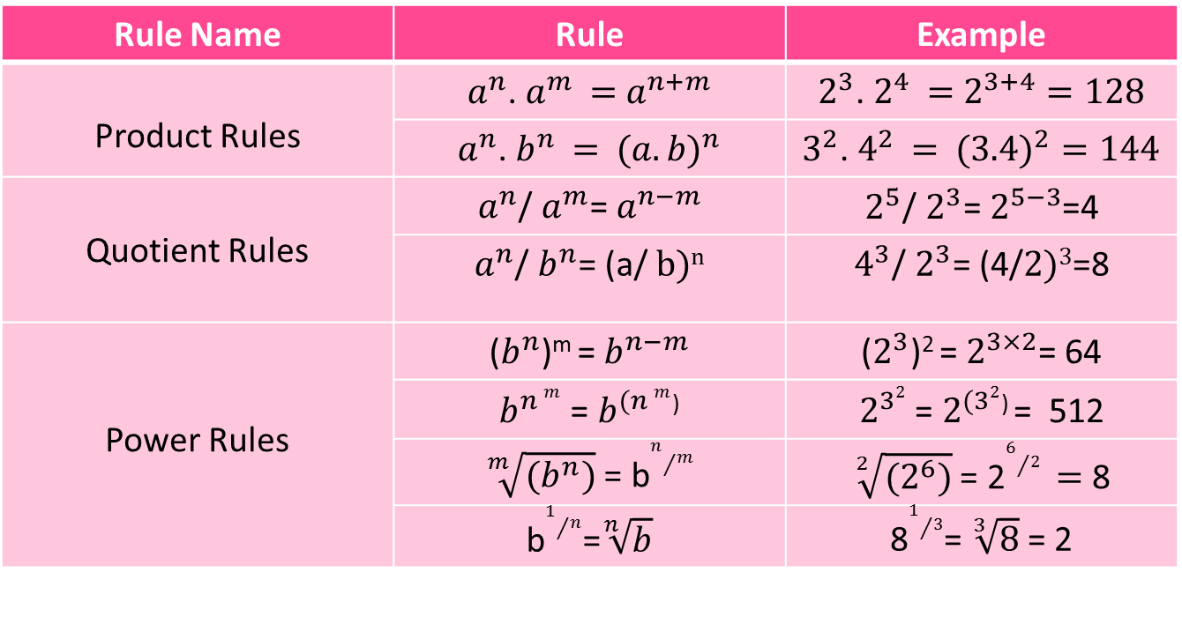
ALGEBRAIC EXPRESSIONS
04
EXPONENTS RULES
Rule Name | Rule | Example
Product Rules | $a^{n}$. $a^{m }=$ $a^{n+m}$ | $2^{3}$. $2^{4 }=$ $2^{3+4}=128$
 | $a^{n}$. $b^{n }=$ $({a.b)}^{n}$ | $3^{2}$. $4^{2 }=$ $({3.4)}^{2}=144$
Quotient Rules | $a^{n}$/ $a^{m}$= $a^{n−m}$ | $2^{5}$/ $2^{3}$= $2^{5−3}$=4
 | $a^{n}$/ $b^{n}$= (a/ $b)n$ | $4^{3}$/ $2^{3}$= (4/$2)3$=8
Power Rules | ($b^{n}$)^{m} = $b^{n−m}$ | ($2^{3}$)² = $2^{3×2}$= 64
 | $b^{n m}$ = $b^{(n m}$⁾ | $2^{32}$ = $2^{(32}$⁾ = 512
 | $\sqrt[m]{(b^{n})}$ = b$n/m$ | $\sqrt[2]{(2^{6})}$ = 2$6/2 =$ 8
 | b$1/n$=$\sqrt[n]{b}$ | 8$1/3$= $\sqrt[3]{8}$ = 2

Slide 7
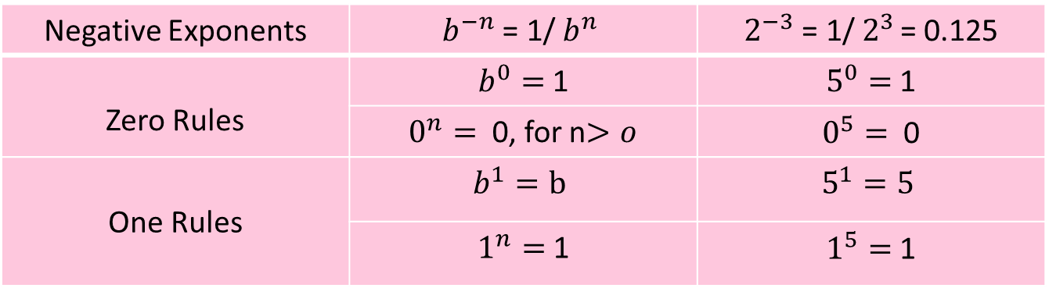
ALGEBRAIC EXPRESSIONS
05
EXPONENTS RULES
Negative Exponents | $b^{−n}$ = 1/ $b^{n }$ | $2^{−3}$ = 1/ $2^{3 }$= 0.125
Zero Rules | $b^{0}=$ 1 | $5^{0}=$ 1
 | $0^{n}=$ 0, for n$>o$ | $0^{5}=$ 0
One Rules | $$b^{1}=b$$ | $$5^{1}=5$$
 | $1^{n}=$ 1 | $1^{5}=$ 1

Slide 8
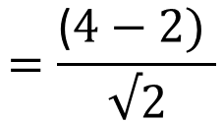
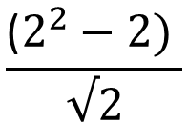
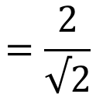
ALGEBRAIC EXPRESSIONS
06
PROBLEM 1
Simplify
$$\frac{\text{(}2^{2}−2) }{√2}$$
First we evaluate the expression inside the parentheses by evaluating the powers and do the subtraction.
$$=\frac{\text{(}4−2) }{√2}$$
$$=\frac{\text{2}}{√2}$$

Slide 9
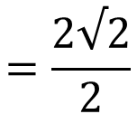
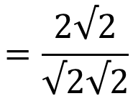

ALGEBRAIC EXPRESSIONS
07
PROBLEM 1
We then remove the parentheses and multiply both the denominator and the numerator by √2.
$$=\frac{\text{2}√2}{√2√2}$$
As a last step we do all multiplications and division from left to right.
$$=\frac{\text{2}√2}{2}$$
$$=√2$$

Slide 10
ALGEBRAIC EXPRESSIONS
08
PROBLEM 2
Simplify x³(x⁴ + 5x²)
We apply the distributive law.
We multiply x³ by x⁴, and multiply x³ by 5x² .
x³ × x⁴ + x³ × 5x²
Then we apply the power rule of the exponents
x³⁺⁴ + 5x³⁺²
x⁷ + 5x ⁵

Slide 11
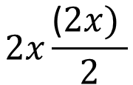
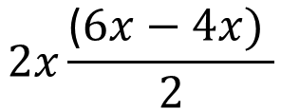
ALGEBRAIC EXPRESSIONS
09
PROBLEM 3
Simplify
$$2x\frac{\text{(}6x−4x) }{2}$$
First, we evaluate the expression inside the parentheses by doing the subtraction then doing the division.
$$2x\frac{\text{(}2x) }{2}$$

Slide 12
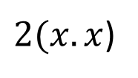
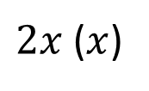
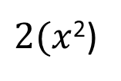
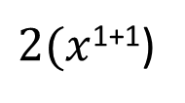
ALGEBRAIC EXPRESSIONS
10
PROBLEM 3
$2x$ ($x$)
Then we apply the commutative rule
$2(x.x$)
Then we do the multiplication using the power rule from the exponents rules.
$2(x$¹⁺¹)
$2(x$²)

Slide 13
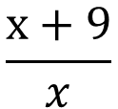
ALGEBRAIC EXPRESSIONS
11
PROBLEM 4
Translate "the ratio of 9 more than x to x" into an algebraic expression.
“9 more than x” translates into x + 9
So “the ratio of 9 more than x to x" translates into
$$\frac{\text{x}+9}{x}$$

