Slide 1
Points Lines and Planes
Unit 1 Lesson 2

Slide 2
Points Lines and Planes
Students will be able to:
• Draw points, lines, line segments, rays, and planes.
• Identify points, lines, line segments, rays, and planes.
Know the precise definitions of a line, and a line segment, based on the undefined notions of a point, and line.

Slide 3
Points Lines and Planes
Key Vocabulary:
A line
A point
A line segment
A plane
An intersection

Slide 4
Points Lines and Planes
In geometry, some words, such as point, line, and plane, are undefined terms. Although these words are not formally defined, it is important to have general agreement about what each word means.
A point has no dimension.
It is usually represented by a small dot and named by a capital letter.

Slide 5
Points Lines and Planes
Q
A
B
S
An example of points

Slide 6
Points Lines and Planes
A line extends in one dimension.
It is usually represented by a straight line with two arrowheads to indicate that the line extends without end in two directions. It is named by two points on the line or by a lowercase script letter.

Slide 7
Points Lines and Planes
Examples of lines

Slide 8
Points Lines and Planes
A plane extends in two dimensions.
It is usually represented by a shape that looks like a tabletop or wall.
You must imagine that the plane extends without end, even though the drawing of a plane appears to have edges. It is named by a capital script letter or 3 non-collinear points.

Slide 9
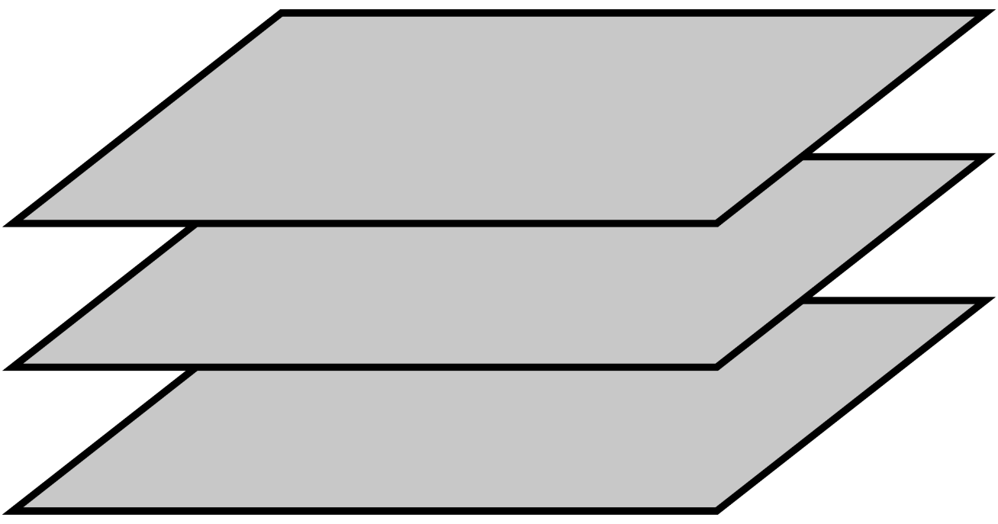
Points Lines and Planes
Three parallel planes

Slide 10
Points Lines and Planes
A line segment is a set of points and has a specific length, i.e., it does not extend indefinitely.
It has no thickness or width and is usually represented by a straight line with no arrowheads to indicate that it has a fixed length.
It is and is named by two points on the line segment with a line segment symbol above the letters.

Slide 11
Points Lines and Planes
An example of a line segment with line segment symbols

Slide 12
Points Lines and Planes
A ray is a set of points and extends in one dimension in one direction (not in two directions). It has no thickness or width and is usually represented by a straight line with one arrowhead to indicate that it extends without end in the direction of the arrowhead. It is named by two points on the ray with a ray symbol above the letters.

Slide 13
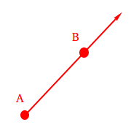
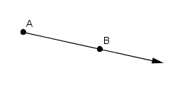
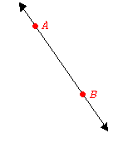
Points Lines and Planes
Examples of rays

Slide 14
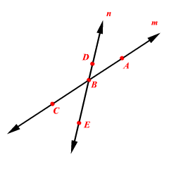
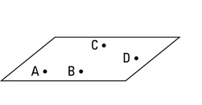
Points Lines and Planes
Collinear points are points that lie on the same line.
Coplanar points are points that lie on the same plane.

Slide 15
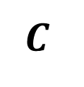
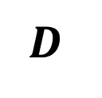
Points Lines and Planes
Sample Problem 1: Use the figure to name each of the following.
a.
$$D$$
Line
Points
Collinear points
Non collinear points
$$A B$$
$$C$$

Slide 16
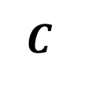
Points Lines and Planes
Sample Problem 1: Use the figure to name each of the following.
a.
$$D$$
Line $\overset{⃡}{AB}$
Points $A, B,C and D$
Collinear points $A, B$
Non collinear points $A,C,D$
$$A B$$
$$C$$

Slide 17
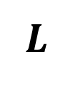
Points Lines and Planes
Sample Problem 1: Use the figure to name each of the following.
b.
$$K$$
Line segment
Points
$$L$$

Slide 18
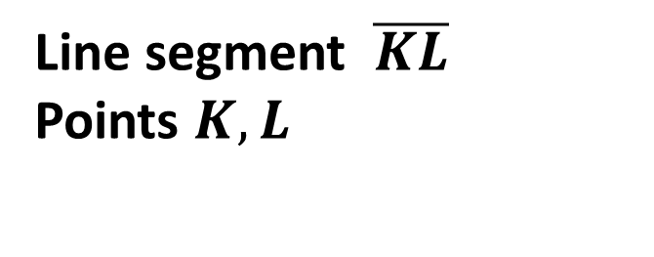
Points Lines and Planes
Sample Problem 1: Use the figure to name each of the following.
b.
$$K$$
Line segment $\overline{KL}$
Points $K, L$
$$L$$

Slide 19


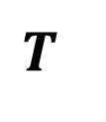
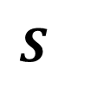
Points Lines and Planes
Sample Problem 1: Use the figure to name each of the following.
c.
$$R$$
Plane
Ray
Points
Coplanar points
Non coplanar points
$$I$$
$$S$$
$$T$$
$$O$$

Slide 20
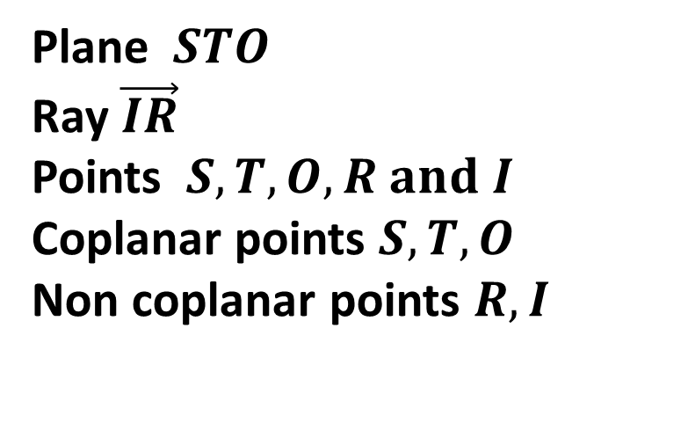
Points Lines and Planes
Sample Problem 1: Use the figure to name each of the following.
c.
$$R$$
Plane $STO$
Ray $\vec{IR}$
Points $S, T,O,R and I$
Coplanar points $S, T,O$
Non coplanar points $R,I$
$$I$$
$$S$$
$$T$$
$$O$$

Slide 21
Points Lines and Planes
Two or more geometric figures intersect, if they have one or more points in common.
The intersection of the figures is the set of points the figures have in common.

Slide 22
Points Lines and Planes
Postulate 1-1 Through any two points there is exactly one line.
Postulate 1-2 If two distinct lines intersect, then they intersect in exactly one point.
Postulate 1-3 If two distinct planes intersect, then they intersect in exactly one line.
Postulate 1-4 Through any three non collinear points there is exactly one plane.

Slide 23


Points Lines and Planes
Sample Problem 2: Refer to each figure.
a.
$$D$$
Name the intersection of line $\overset{⃡}{QZ}$ and segment $\overline{WU}$̅.
$$S$$
$$U$$
$$Q$$
$$Z$$
$$T$$
$$W$$
$$B$$
$$π$$

Slide 24
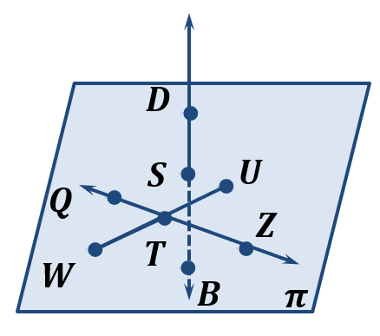
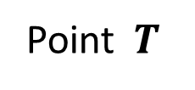
Points Lines and Planes
Sample Problem 2: Refer to each figure.
a.
Name the intersection of line $\overset{⃡}{QZ}$ and segment $\overline{WU}$̅.
Point $T$

Slide 25
Points Lines and Planes
Sample Problem 2: Refer to each figure.
a.
Name the intersection of plane $π$ and line $\overset{⃡}{DB.}$

Slide 26
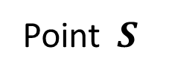
Points Lines and Planes
Sample Problem 2: Refer to each figure.
a.
Name the intersection of plane $π$ and line $\overset{⃡}{DB.}$
Point $S$

Slide 27
Points Lines and Planes
Sample Problem 2: Refer to each figure.
a.
Name the two opposite rays at point $T$.

Slide 28
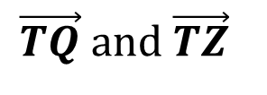
Points Lines and Planes
Sample Problem 2: Refer to each figure.
a.
Name the two opposite rays at point $T$.
$$\vec{TQ} and \vec{TZ}$$

Slide 29
Points Lines and Planes
Sample Problem 2: Refer to each figure.
a.
What is another name for plane $π$?

Slide 30
Points Lines and Planes
Sample Problem 2: Refer to each figure.
a.
What is another name for plane $π$?
Plane $TSU$

Slide 31
Points Lines and Planes
Sample Problem 2: Refer to each figure.
b.
$$S$$
Name the intersection of plane $π$ and plane $τ$.
$$L$$
$$G$$
$$C$$
$$M$$
$$π$$
$$B$$
$$τ$$
$$T$$

Slide 32
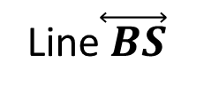
Points Lines and Planes
Sample Problem 2: Refer to each figure.
b.
$$S$$
Name the intersection of plane $π$ and plane $τ$.
$$L$$
$$G$$
$$C$$
$$M$$
Line$\overset{⃡}{ BS}$
$$π$$
$$B$$
$$τ$$
$$T$$

Slide 33
Points Lines and Planes
Sample Problem 2: Refer to each figure.
b.
$$S$$
What is another name for plane $π$?
$$L$$
$$G$$
$$C$$
$$M$$
$$π$$
$$B$$
$$τ$$
$$T$$

Slide 34
Points Lines and Planes
Sample Problem 2: Refer to each figure.
b.
$$S$$
What is another name for plane $π$?
$$L$$
$$G$$
$$C$$
$$M$$
Plane $LMG$
$$π$$
$$B$$
$$τ$$
$$T$$

Slide 35
Points Lines and Planes
Sample Problem 2: Refer to each figure.
b.
$$S$$
Name the intersection of line $\overset{⃡}{MG}$ and line $\overset{⃡}{BS}$.
$$L$$
$$G$$
$$C$$
$$M$$
$$π$$
$$B$$
$$τ$$
$$T$$

Slide 36
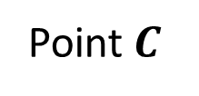
Points Lines and Planes
Sample Problem 2: Refer to each figure.
b.
$$S$$
Name the intersection of line $\overset{⃡}{MG}$ and line $\overset{⃡}{BS}$.
$$L$$
$$G$$
$$C$$
$$M$$
Point $C$
$$π$$
$$B$$
$$τ$$
$$T$$

Slide 37
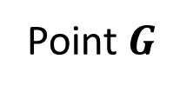
Points Lines and Planes
Sample Problem 2: Refer to each figure.
b.
$$S$$
Name a point that is collinear with $M$and $C$.
$$L$$
$$G$$
$$C$$
$$M$$
Point $G$
$$π$$
$$B$$
$$τ$$
$$T$$

Slide 38

Points Lines and Planes
Sample Problem 2: Refer to each figure.
c.
$$P$$
Name the intersection of plane $π$ and line $\overset{⃡}{LC}.$
$$H$$
$$L$$
$$τ$$
$$B$$
$$C$$
$$J$$
$$π$$

Slide 39
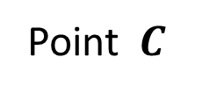
Points Lines and Planes
Sample Problem 2: Refer to each figure.
c.
$$P$$
Name the intersection of plane $π$ and line $\overset{⃡}{LC}.$
$$H$$
$$L$$
$$τ$$
Point$C$
$$B$$
$$C$$
$$J$$
$$π$$

Slide 40
Points Lines and Planes
Sample Problem 2: Refer to each figure.
c.
$$P$$
Name the intersection of plane $τ$ and line $\overset{⃡}{LC}$.
$$H$$
$$L$$
$$τ$$
$$B$$
$$C$$
$$J$$
$$π$$

Slide 41
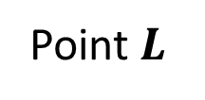
Points Lines and Planes
Sample Problem 2: Refer to each figure.
c.
$$P$$
Name the intersection of plane $τ$ and line $\overset{⃡}{LC}$.
$$H$$
$$L$$
$$τ$$
Point$L$
$$B$$
$$C$$
$$J$$
$$π$$

Slide 42
Points Lines and Planes
Sample Problem 2: Refer to each figure.
c.
$$P$$
Name a point that is coplanar with $H$and $L.$
$$H$$
$$L$$
$$τ$$
$$B$$
$$C$$
$$J$$
$$π$$

Slide 43
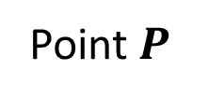
Points Lines and Planes
Sample Problem 2: Refer to each figure.
c.
$$P$$
Name a point that is coplanar with $H$and $L.$
$$H$$
$$L$$
$$τ$$
Point$P$
$$B$$
$$C$$
$$J$$
$$π$$

Slide 44
Points Lines and Planes
Sample Problem 2: Refer to each figure.
c.
$$P$$
Name the opposite ray of ray $\vec{CB}$.
$$H$$
$$L$$
$$τ$$
$$B$$
$$C$$
$$J$$
$$π$$

Slide 45
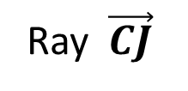
Points Lines and Planes
Sample Problem 2: Refer to each figure.
c.
$$P$$
Name the opposite ray of ray $\vec{CB}$.
$$H$$
$$L$$
$$τ$$
Ray $\vec{CJ}$
$$B$$
$$C$$
$$J$$
$$π$$

Slide 46
Points Lines and Planes
Sample Problem 3: Draw and label the figure for each relationship.
a.
Plane $ABS$contains lines $\overset{⃡}{AB}$, $\overset{⃡}{CD}$, and $\overset{⃡}{AK}$.
Lines $\overset{⃡}{AB}$ and $\overset{⃡}{CD}$ intersect at point $G$.
Lines $\overset{⃡}{CD}$and $\overset{⃡}{AK}$ intersect at point $S$.
Lines $\overset{⃡}{AB}$ and $\overset{⃡}{AK }$intersect at point $A$.

Slide 47
Points Lines and Planes
Sample Problem 3: Draw and label the figure for each relationship.
a.
Plane $ABS$contains lines $\overset{⃡}{AB}$, $\overset{⃡}{CD}$, and $\overset{⃡}{AK}$.
Lines $\overset{⃡}{AB}$ and $\overset{⃡}{CD}$ intersect at point $G$.
Lines $\overset{⃡}{CD}$ and $\overset{⃡}{AK}$ intersect at point $S$.
Lines $\overset{⃡}{AB}$ and $\overset{⃡}{AK }$intersect at point $A$.
$$S$$
$$K$$
$$A$$
$$D$$
$$G$$
$$B$$
$$C$$

Slide 48
Points Lines and Planes
Sample Problem 3: Draw and label the figure for each relationship.
b.
Plane $π$ contains line $\overset{⃡}{AB}$and point $L$.
Plane $τ$ contains line $\overset{⃡}{EF}$and point $S$.
Lines $\overset{⃡}{AB}$and $\overset{⃡}{EF}$intersect at point $H$.
The intersection of plane $π$ and plane $τ$ is line $\overset{⃡}{LU}$.

Slide 49
Points Lines and Planes
Sample Problem 3: Draw and the label figure for each relationship.
b.
Plane $π$ contains line $\overset{⃡}{AB}$and point $L$.
Plane $τ$ contains line $\overset{⃡}{EF}$and point $S$.
Lines $\overset{⃡}{AB}$and $\overset{⃡}{EF}$intersect at point $H$.
The intersection of plane $π$ and plane $τ$ is line $\overset{⃡}{LU}$.
$$S$$
$$E$$
$$U$$
$$B$$
$$H$$
$$A$$
$$π$$
$$L$$
$$F$$
$$τ$$

Slide 50
Points Lines and Planes
Sample Problem 3: Draw and label figure for each relationship.
c.
Plane $π$ and plane $τ$ do not have an intersect.
Plane $ε$ intersects plane $π$ in line $\overset{⃡}{BC}$.
Plane $ε$ intersects plane $τ$ in line $\overset{⃡}{ER}$.

Slide 51
Points Lines and Planes
Sample Problem 3: Draw and the label figure for each relationship.
c.
Plane $π$ and plane $τ$ do not have an intersect.
Plane $ε$ intersects plane $π$ in line $\overset{⃡}{BC}$.
Plane $ε$ intersects plane $τ$ in line $\overset{⃡}{ER}$.
$$B$$
$$π$$
$$C$$
$$E$$
$$τ$$
$$R$$
$$ε$$

