Slide 1
Measuring Segments
Unit 1 Lesson 3

Slide 2
Measuring Segments
Students will be able to:
• Find the measure of segments using the ruler postulate, the definition of congruent segments, midpoints, and the segment addition postulate.
• Find the length and midpoint of a segment.
• Understand the congruency of segments.

Slide 3
Measuring Segments
Key Vocabulary:
Line Segment
Distance / Length
Congruent Segments
Segment Bisector
Segment Partition
.

Slide 4
Measuring Segments
A line segment is a set of points and has a specific length, i.e., it does not extend indefinitely.
A line segment is named by two points on the line segment with a line segment symbol above the letters.
The line segment always has a certain length that can be measured using a ruler.

Slide 5
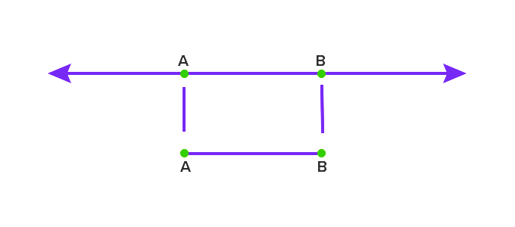
Measuring Segments
Understanding Line Segments

Slide 6
Measuring Segments
Ruler Postulate
Every point on a line can be paired with a real number. This makes a one-to-one correspondence between the points on the line and the real numbers.
The real number that corresponds to a point is called the coordinate of the point.

Slide 7
Measuring Segments
Sample Problem 1: Find the length of each segment using a ruler.
a.
$$\overline{AB}= ?$$
$$A B$$

Slide 8
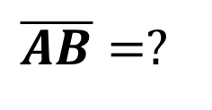
Measuring Segments
Sample Problem 1: Find the length of each segment using a ruler.
a.
$$\overline{AB}=?$$
$$A B$$
$$\overline{AB}= Actual length from your ruler$$

Slide 9
Measuring Segments
Sample Problem 1: Find the length of each segment using a ruler.
b.
$$\overline{TP}= ?$$
$$P$$
$$T$$

Slide 10
Measuring Segments
Sample Problem 1: Find the length of each segment using a ruler.
b.
$$\overline{TP}= ?$$
$$P$$
$$T$$
$$\overline{TP}= Actual length from your ruler$$

Slide 11
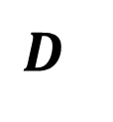
Measuring Segments
Sample Problem 1: Find the length of each segment using a ruler.
c.
$$\overline{RD}= ?$$
$$R$$
$$D$$

Slide 12
Measuring Segments
Sample Problem 1: Find the length of each segment using a ruler.
c.
$$\overline{RD}= ?$$
$$R$$
$$D$$
$$\overline{RD}= Actual length from your ruler$$

Slide 13
Measuring Segments
Finding the length of line segment using number line
The distance between points on a number line represent the length of a line segment.
The distance between any two points is the absolute value of the difference of the coordinates.
If the coordinates of points $A$ and $B$ are $a$ and $b$, then the distance between $A$ and $B$ is:
$AB=\left|a−b\right|$or $AB=\left|b−a\right|$
Two line segments with the same lengths are said to be congruent line segments.

Slide 14
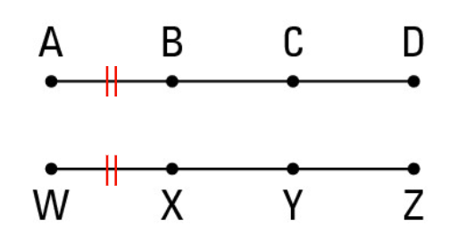
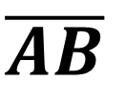
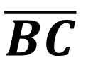
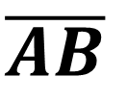
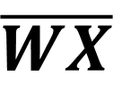
Measuring Segments
Congruent line symbol
$$\overline{AB}$$
$$\overline{BC}$$
$$\overline{AB}$$
$$\overline{WX}$$
Examples of Congruent Line Segments

Slide 15
Measuring Segments
Sample Problem 2: Find the length of each segment using the number line. Determine which segments are congruent.
a.
$$AC=? CP=? HL=? AL=?$$
$$A C H P L$$
-6
-5
-4
-3
-2
-1
0
1
2
3
4
5
6

Slide 16
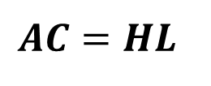
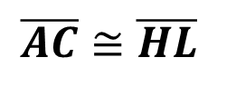
Measuring Segments
Sample Problem 2: Find the length of each segment using the number line. Determine which segments are congruent.
a.
$$AC=? CP=? HL=? AL=?$$
$$A C H P L$$
-6
-5
-4
-3
-2
-1
0
1
2
3
4
5
6
$$AC=\left|−5−\left(−2\right)\right|= \left|−5+2\right|=\left|−3\right|=3$$
$$CP=\left|−2−4\right|= \left|−6\right|=6$$
$$AC=HL$$
$$HL=\left|2−5\right|= \left|−3\right|=3$$
$$\overline{AC}≅\overline{HL}$$
$$AL=\left|−5−5\right|= \left|−10\right|=10$$

Slide 17
Measuring Segments
Sample Problem 2: Find the length of each segment using number line. Determine which segments are congruent.
b.
$$JU=? RT=? GR=? FT=?$$
$$R G T F U J$$
-6
-5
-4
-3
-2
-1
0
1
2
3
4
5
6

Slide 18
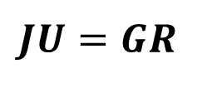
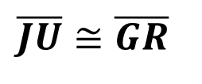
Measuring Segments
Sample Problem 2: Find the length of each segment using number line. Determine which segments are congruent.
b.
$$JU=? RT=? GR=? FT=?$$
$$R G T F U J$$
-6
-5
-4
-3
-2
-1
0
1
2
3
4
5
6
$$JU=\left|5−3\right|= \left|2\right|=2$$
$$RT=\left|−6−(−1)\right|= \left|−6+1\right|=\left|−5\right|=5$$
$$JU=GR$$
$$GR=\left|−4−(−6)\right|= \left|−4+6\right|=\left|2\right|=2$$
$$\overline{JU}≅\overline{GR}$$
$$FT=\left|2−(−1)\right|= \left|2+1\right|=\left|3\right|=3$$

Slide 19
Measuring Segments
Segment Addition Postulate:
If three points$A$, $B$, and $C$ are collinear and $B$ is between $A$ and$C$, then the distance $AC$ is the sum of distance$AB$ and $BC$.
$$AB +BC= AC$$

Slide 20
Measuring Segments
Sample Problem 3: Find the length of each segment using a segment addition postulate. Draw a diagram to represent the situation.
a.
Point $Z$ is between points $T$ and $C$. The points are collinear. $TZ=3 cm ZC=12 cm \overline{TC}= ?$

Slide 21
Measuring Segments
Sample Problem 3: Find the length of each segment using a segment addition postulate. Draw a diagram to represent the situation.
a.
Point $Z$ is between points $T$ and $C$. The points are collinear. $TZ=3 cm ZC=12 cm \overline{TC}= ?$
$$T Z C$$
$$TC=TZ +ZC$$
$$TC=3 cm+12 cm=15 cm$$
$$3 cm 12 cm$$
$$\overline{TC}=15 cm$$

Slide 22
Measuring Segments
Sample Problem 3: Find the length of each segment using a segment addition postulate. Draw a diagram to represent the situation.
b.
Point $S$ is between points $Q$ and $K$. The points are collinear. $QK=24 cm QC=10 cm \overline{SK}$= ?

Slide 23
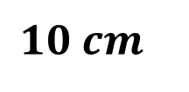
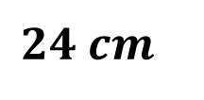
Measuring Segments
Sample Problem 3: Find the length of each segment using segment addition postulate. Draw a diagram to represent the situation.
b.
Point $S$ is between points $Q$ and $K$. The points are collinear. $QK=24 cm QS=10 cm \overline{SK}$= ?
$$24 cm$$
$$QK=QS +SK$$
$$Q S K$$
$$SK=QK−QS$$
$$SK=24 cm−10 cm=14 cm$$
$$10 cm$$
$$\overline{SK}=14 cm$$

Slide 24
Measuring Segments
The midpoint is the middle point of a line segment. It is equidistant from both endpoints, and it is the centroid both of the segment and of the endpoints.
The midpoint of a segment divides the segment into two congruent segments.
A segment bisector is a point, line or a line segment that passes through a midpoint of another segment.
A segment bisector is usually at the center of the line segment and always includes the midpoint of the line segment.

Slide 25
Measuring Segments
$$h$$
$$A B C$$
$$h is a segment bisector of \overline{AC}$$
$$B is a midpoint of \overline{AC}$$

Slide 26
Measuring Segments
Sample Problem 4: Find the length of each segment. Draw a diagram to represent the situation.
a.
Point $B$ is midpoint of segment $\overline{MN}$.
$MN=10 cm \overline{MB}= ? \overline{BN}= ?$

Slide 27
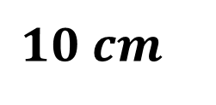
Measuring Segments
Sample Problem 4: Find the length of each segment. Draw a diagram to represent the situation.
a.
Point $B$ is midpoint of segment $\overline{MN}$.
$MN=10 cm \overline{MB}= ? \overline{BN}= ?$
$$M B N$$
$$10 cm$$

Slide 28
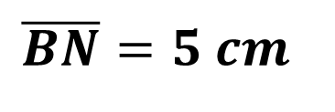
Measuring Segments
Sample Problem 4: Find the length of each segment. Draw a diagram to represent the situation.
a.
Point $B$ is midpoint of segment $\overline{MN}$.
$MN=10 cm \overline{MB}= ? \overline{BN}= ?$
$$MN=MB +BN$$
$$MB=BN$$
$$MB=BN$$
$$MN=2∗MB$$
$$MB=\frac{MN}{2}=\frac{10 cm }{2}=5 cm$$
$$\overline{BN}=5 cm$$

Slide 29
Measuring Segments
Sample Problem 4: Find the length of each segment. Draw a diagram to represent the situation.
b.
Point $D$ is midpoint of segment $\overline{FT}$.
$FD=6 in. \overline{DT}= ? \overline{FT}= ?$

Slide 30
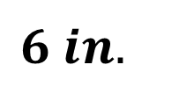
Measuring Segments
Sample Problem 4: Find the length of each segment. Draw a diagram to represent the situation.
b.
Point $D$ is midpoint of segment $\overline{FT}$.
$FD=6 in. \overline{DT}= ? \overline{FT}= ?$
$$F D T$$
$$6 in.$$

Slide 31
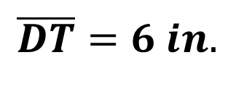
Measuring Segments
Sample Problem 4: Find the length of each segment. Draw a diagram to represent the situation.
b.
Point $D$ is midpoint of segment $\overline{FT}$.
$FD=6 in. \overline{DT}= ? \overline{FT}= ?$
$$FT=FD +DT$$
$$FD=DT$$
$$FT=6 in. +6 in.=12 in.$$
$$\overline{DT}=6 in.$$
$$\overline{FT}=12 in.$$

Slide 32
Measuring Segments
Sample Problem 5: Find the coordinate of the midpoint of each segment.
a.
$$R B$$
-3
-2
-1
0
1
2
3
4

Slide 33
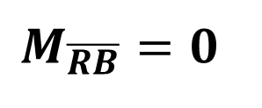
Measuring Segments
Sample Problem 5: Find the coordinate of the midpoint of each segment.
a.
$$R B$$
-3
-2
-1
0
1
2
3
4
$$M_{\overline{RB}}=\frac{−2+2}{2}=\frac{0 }{2}$$
$$M_{\overline{RB}}=0$$
The coordinate of the midpoint
of $\overline{RB} is 0$

Slide 34
Measuring Segments
Sample Problem 5: Find the coordinate of the midpoint of each segment.
b.
$$K L$$
-3
-2
-1
0
1
2
3
4

Slide 35
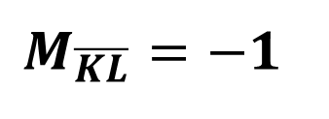
Measuring Segments
Sample Problem 5: Find the coordinate of the midpoint of each segment.
b.
$$K L$$
-3
-2
-1
0
1
2
3
4
$$M_{\overline{KL}}=\frac{−3+1}{2}=\frac{−2 }{2}$$
The coordinate of the midpoint
of $\overline{KL} is −1$
$$M_{\overline{KL}}=−1$$

Slide 36
Measuring Segments
A segment partition is a point, line or a line segment that partitions the line segment in a particular ratio.
If the ratio is equal, the segment partition becomes a segment bisector.

Slide 37
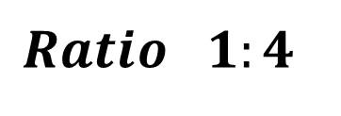
Measuring Segments
Sample Problem 6: Divide the line segment in the ratio given by putting a dot at the partition.
a.
$$V B$$
$$Ratio 1:4$$

Slide 38
Measuring Segments
Sample Problem 6: Divide the line segment in the ratio given by putting a dot at the partition.
a.
$$V B$$
$$Ratio 1:4$$

Slide 39
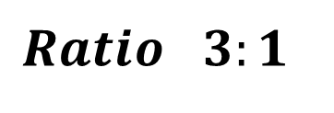
Measuring Segments
Sample Problem 6: Divide the line segment in the ratio given by putting a dot at the partition.
b.
$$H L$$
$$Ratio 3:1$$

Slide 40
Measuring Segments
Sample Problem 6: Divide the line segment in the ratio given by putting a dot at the partition.
b.
$$H L$$
$$Ratio 3:1$$

