Slide 1
SOLVING EQUATIONS
UNIT 01 LESSON 03

Slide 2
OBJECTIVES
STUDENTS WILL BE ABLE TO:
  Simplify algebraic expressions.
  Solve equations in one variable.
  Interpret a word problem into an equation.
  Rearrange a formula to highlight a quantity of interest.
KEY VOCABULARY:
Algebraic Expression
Equation

Slide 3
SOLVING EQUATIONS
01
An equation says that two things are equal.
It will have an equals sign "=" like this:
7 + 2 = 10 − 1
That equation says: what is on the left (7 + 2) is equal to
what is on the right (10 − 1)

Slide 4
SOLVING EQUATIONS
02
Solving linear equations is just a matter of undoing operations that are being done to the variable.
The task is always to isolate the variable -- >get the variable ALONE on one side of the equal sign.

Slide 5
SOLVING EQUATIONS
03
Always keep in mind the properties of real numbers
Commutative and associative properties of addition.
Commutative and associative properties of multiplication.
The distributive property.
1
2
3

Slide 6
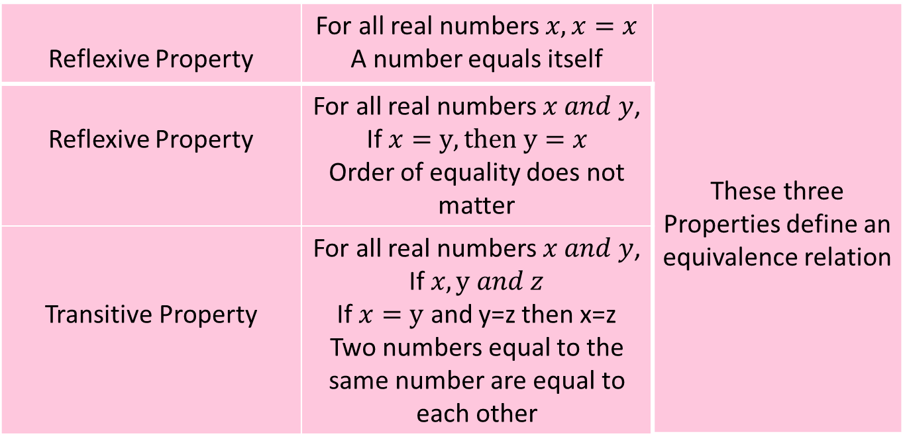
SOLVING EQUATIONS
04
PROPERTIES OF EQUATIONS
Reflexive Property | For all real numbers $x,x=x$ A number equals itself | These three Properties define an equivalence relation
Reflexive Property | For all real numbers $x and y$, If $x=y, then y=$ $x$ Order of equality does not matter
Transitive Property | For all real numbers $x and y$, If $x, y and z$ If $x=y$ and y=z then x=z Two numbers equal to the same number are equal to each other

Slide 7
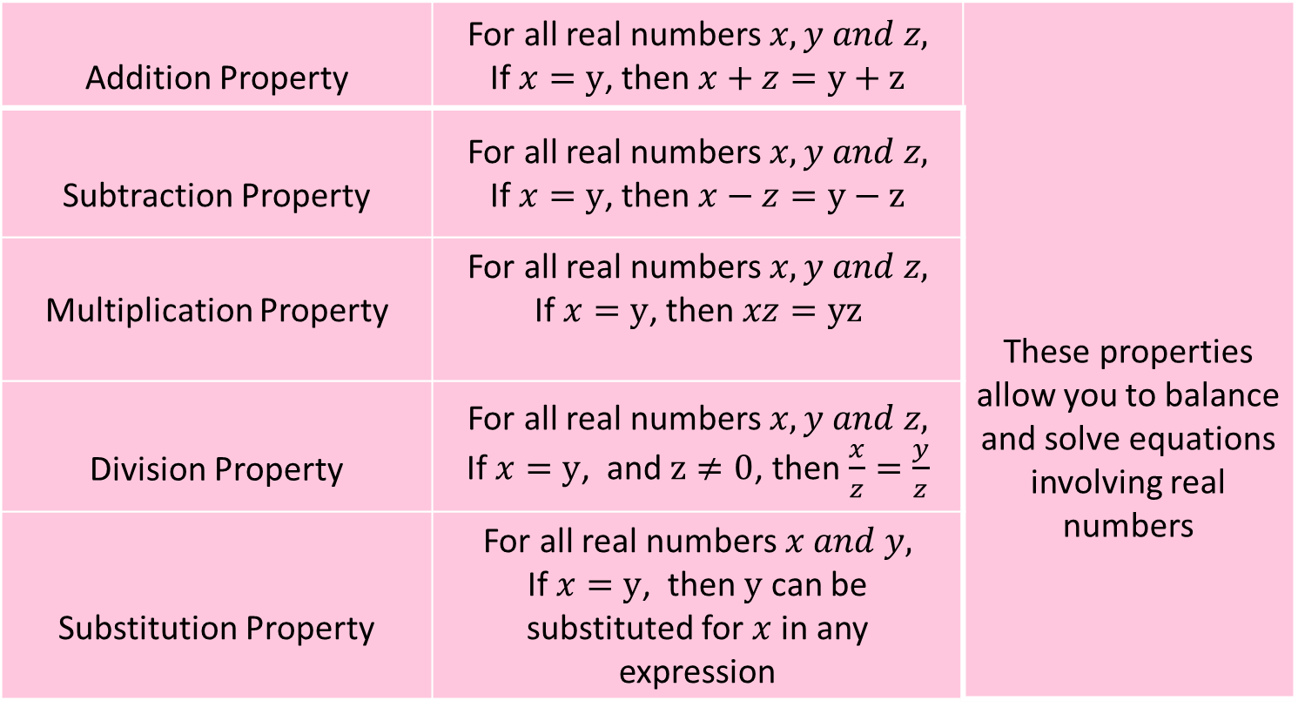
SOLVING EQUATIONS
05
PROPERTIES OF EQUATIONS
Addition Property | For all real numbers $x,y and z,$ If $x=y$, then $x+z=y+z$ | These properties allow you to balance and solve equations involving real numbers
Subtraction Property | For all real numbers $x,y and z,$ If $x=y$, then $x−z=y−z$
Multiplication Property | For all real numbers $x,y and z,$ If $x=y$, then $xz=yz$
Division Property | For all real numbers $x,y and z,$ If $x=y$, and $z≠0$, then $\frac{x}{z}=\frac{y}{z}$
Substitution Property | For all real numbers $x and y,$ If $x=y$, then $y$ can be substituted for $x$in any expression

Slide 8
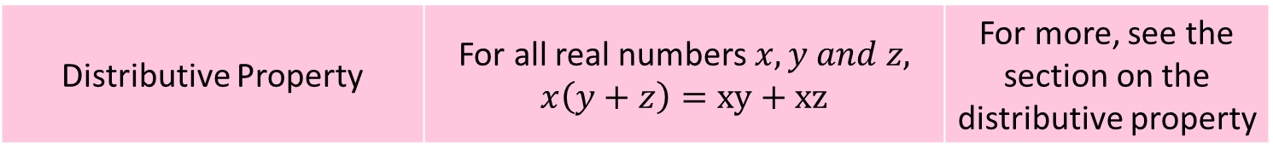
SOLVING EQUATIONS
06
PROPERTIES OF EQUATIONS
Distributive Property | For all real numbers $x,y and z,$ $$x\left(y+z\right)=xy+xz$$ | For more, see the section on the distributive property

Slide 9
SOLVING EQUATIONS
07
PROBLEM 01
Solve x + 3 = 8
Solution
Our goal is to isolate x in one side
To get rid of the 3, we can subtract 3 from both sides of the equation.
x + 3 – 3 = 8 – 3
x = 5

Slide 10
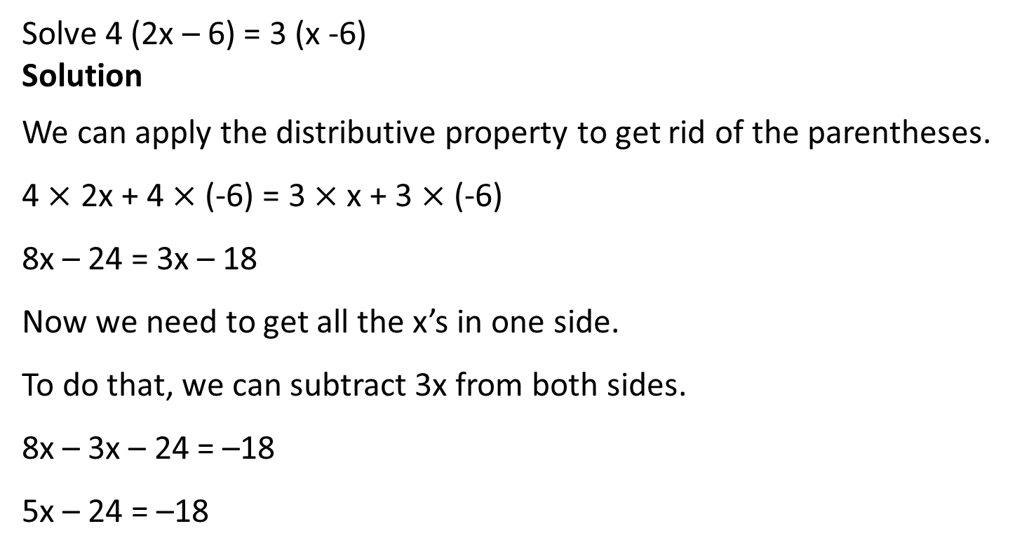
SOLVING EQUATIONS
08
PROBLEM 02
Solve 4 (2x – 6) = 3 (x -6)
Solution
We can apply the distributive property to get rid of the parentheses.
4 $×$ 2x + 4 $×$(-6) = 3 $×$ x + 3 $×$ (-6)
8x – 24 = 3x – 18
Now we need to get all the x’s in one side.
To do that, we can subtract 3x from both sides.
8x – 3x – 24 = –18
5x – 24 = –18

Slide 11

SOLVING EQUATIONS
09
PROBLEM 02
Now add 24 to both sides to get the numbers in one side.
5x = –18 + 24
5x = 6
Divide both sides by 5.
x = $\frac{6}{5}$

Slide 12
SOLVING EQUATIONS
10
PROBLEM 03
Aaron is 5 years younger than Ron. Four years later, Ron will be twice as old as Aaron. Find their present ages.
Solution
Let Ron’s present age be x.
Then Aaron’s present age = x – 5
After 4 years Ron’s age = x + 4, Aaron’s age x – 5 + 4.

Slide 13
SOLVING EQUATIONS
11
PROBLEM 03
According to the question;
Ron will be twice as old as Aaron.
Therefore, x + 4 = 2(x – 5 + 4)
⇒ x + 4 = 2(x – 1)
⇒ x + 4 = 2x – 2

Slide 14
SOLVING EQUATIONS
12
PROBLEM 03
⇒ x + 4 = 2x – 2
⇒ x – 2x = – 2 – 4
⇒ –x = –6
⇒ x = 6
Therefore, Aaron’s present age = x – 5 = 6 – 5 = 1
Therefore, present age of Ron = 6 years and present age of Aaron = 1 year.

Slide 15

SOLVING EQUATIONS
13
PROBLEM 04
The cylinder volume equation is $v= π{.r}^{2}.h$Solve for “$h$”
Solution
We divide both sides by $π{.r}^{2}$, to get h in one side.
$$\frac{v}{π.r^{2}}=h$$

