Slide 1
Measuring Angles
Unit 1 Lesson 4

Slide 2
Measuring Angles
Students will be able to:
• Recognize angles as geometric shapes that are formed wherever two rays share a common endpoint and understand concepts of angle measurement.
• Measure angles in whole-number degrees using a protractor.
• Sketch angles of specified measure.
• Know precise definitions of angle.

Slide 3
Measuring Angles
Key Vocabulary:
Degrees
Protractor
Right angle
Acute angle
Obtuse angle

Slide 4
Measuring Angles
An angle is a figure formed by two non collinear rays that have a common endpoint.
The common endpoint is called the vertex and the two rays that make up the angle are called the sides of the angle.

Slide 5
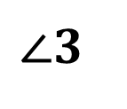
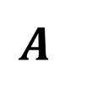
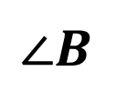
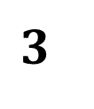
Measuring Angles
There are several ways to name the angle.
Use the vertex and a point from each side.
$$A$$
$$3$$
$$∠CBA and ∠ABC$$
$$B C$$
Use the vertex only.
$$∠B$$
Use a number.
$$∠3$$
Angles are measured in units called degrees.
The symbol for degree is °

Slide 6

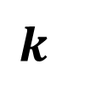
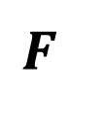

Measuring Angles
Angles Measure Postulate
For every angle, there is a unique positive number between 0 and 180 called the degree measure of the angle.
$$m∠FDR=k$$
$$R$$
$$k$$
$$0<k<180$$
$$D$$
$$F$$

Slide 7


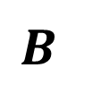
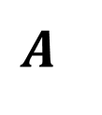
Measuring Angles
Protractor Postulate describes the relationship between angle measures and numbers.
On a plane, given $\vec{AB }$and a number $t$ between 0 and
180, there is exactly one ray with endpoint $A$ extending on each side of $\vec{AB }$such that the degree measure of the angle formed is $t$.
$$t°$$
$$A$$
$$t°$$
$$B$$

Slide 8
Measuring Angles
A protractor can be used to approximate the measure of an angle.
How to use the protractor:
1. Place the notch of the protractor at the vertex of the angle.
2. Place the edge of the protractor along a side of the angle so that the scale reads 0.
3. Read the angle size by reading the degree measure that corresponds to the second side of the angle.

Slide 9
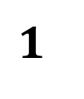
Measuring Angles
Types of Angles
Acute Angle
Right Angle
$$1$$
$$2$$
$$m∠1<90$$
$$m∠2=90$$

Slide 10
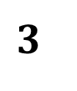
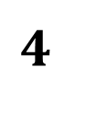
Measuring Angles
Types of Angles
Obtuse Angle
Straight Angle
$$4$$
$$3$$
$$180>m∠3>90$$
$$m∠4=180$$

Slide 11
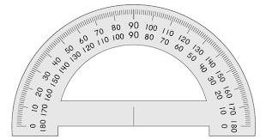
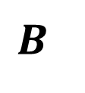
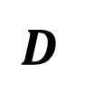
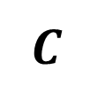
Measuring Angles
Sample Problem 1: Find the measure of each angle. Then classify each angle.
a.
$$B$$
$$C$$
$$D$$

Slide 12
Measuring Angles
Sample Problem 1: Find the measure of each angle. Then classify each angle.
a.
$$B$$
$$m∠DCB=45$$
Angle $DCB$ measures 45°
Acute angle
$$C$$
$$D$$

Slide 13
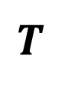

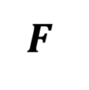
Measuring Angles
Sample Problem 1: Find the measure of each angle. Then classify each angle.
b.
$$T$$
$$F$$
$$H$$

Slide 14
Measuring Angles
Sample Problem 1: Find the measure of each angle. Then classify each angle.
b.
$$T$$
$$m∠FHT=135$$
Angle$FHT$ measures $135$°
Obtuse angle
$$F$$
$$H$$

Slide 15
Measuring Angles
Sample Problem 2: Use a protractor to draw each angle. Then classify each angle.
a.
$$m∠COB=15$$

Slide 16
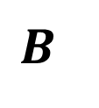
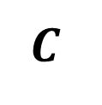
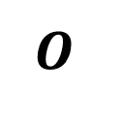
Measuring Angles
Sample Problem 2: Use a protractor to draw each angle. Then classify each angle.
a.
$$m∠COB=15$$
Acute angle
$$B$$
$$O$$
$$C$$

Slide 17
Measuring Angles
Sample Problem 2: Use a protractor to draw each angle. Then classify each angle.
b.
$$m∠HTR=150$$

Slide 18
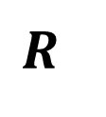


Measuring Angles
Sample Problem 2: Use a protractor to draw each angle. Then classify each angle.
b.
$$m∠HTR=150$$
$$R$$
Obtuse angle
$$H$$
$$T$$

Slide 19
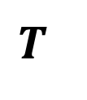
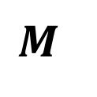
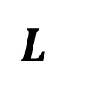

Measuring Angles
Angle Addition Postulate
If $T$ is in the interior of $∠KLM$ , then the measure of $∠KLM$ is equal to the sum of the measures of $∠MLT$ and $∠TLK$ .
$$m∠KLM =m∠MLT +m∠TLK$$
$$K$$
$$T$$
$$L$$
$$M$$

Slide 20
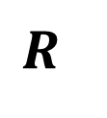
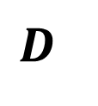
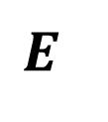
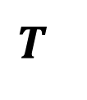
Measuring Angles
Sample Problem 3: Find the indicated angle measures.
a.
$$m∠RTD=39 m∠DTE=56 m∠RTE=?$$
$$E$$
$$D$$
$$R$$
$$T$$

Slide 21
Measuring Angles
Sample Problem 3: Find the indicated angle measures.
a.
$$m∠RTD=39 m∠DTE=56 m∠RTE=?$$
$$m∠RTE=m∠RTD+m∠DTE$$
$$E$$
$$m∠RTE=39+56$$
$$D$$
$$m∠RTE=95$$
$$R$$
$$T$$

Slide 22
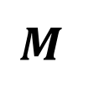
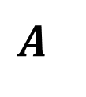
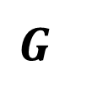
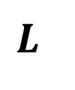
Measuring Angles
Sample Problem 3: Find the indicated angle measures.
b.
$$m∠LMA=164 m∠GMA=56 m∠LMG=?$$
$$G$$
$$A$$
$$M$$
$$L$$

Slide 23
Measuring Angles
Sample Problem 3: Find the indicated angle measures.
b.
$$m∠LMA=164 m∠GMA=56 m∠LMG=?$$
$$m∠LMA=m∠LMG+m∠GMA$$
$$G$$
$$A$$
$$m∠LMG=m∠LMA−m∠GMA$$
$$m∠LMG=164−56$$
$$m∠LMG=108$$
$$M$$
$$L$$

Slide 24
Measuring Angles
The bisector of an angle is the ray with its endpoint at the vertex of the angle extending into the interior of the angle.
The bisector separates the angle into two angles of equal measure.

Slide 25
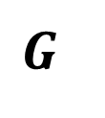
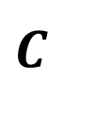
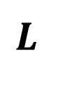
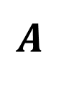
Measuring Angles
Sample Problem 4: Find the indicated angle measures.
a.
If $\vec{AC}$bisects $∠LAG$ and $m∠LAG=64$, find $m∠LAC$and $m∠CAG$.
$$G$$
$$C$$
$$A$$
$$L$$

Slide 26
Measuring Angles
Sample Problem 4: Find the indicated angle measures.
a.
If $\vec{AC}$bisects $∠LAG$ and $m∠LAG=64$, find $m∠LAC$and $m∠CAG$.
$$G$$
$$m∠LAG=m∠LAC+m∠CAG$$
$$C$$
$$m∠LAC=m∠CAG$$
$$m∠LAG=2∗m∠LAC$$
$$m∠LAC=\frac{m∠LAG}{2}=\frac{64}{2}$$
$$A$$
$$L$$
$$m∠LAC=32 m∠CAG=32$$

Slide 27
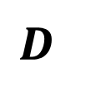
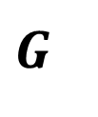
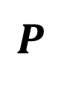
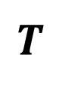
Measuring Angles
Sample Problem 4: Find the indicated angle measures.
b.
If $\vec{TG}$ bisects $∠PTD$and $m∠PTG=26$, find $m∠PTD$and $m∠GTD$.
$$D$$
$$G$$
$$T$$
$$P$$

Slide 28
Measuring Angles
Sample Problem 4: Find the indicated angle measures.
b.
If $\vec{TG}$ bisects $∠PTD$and $m∠PTG=26$, find $m∠PTD$and $m∠GTD.$
$$D$$
$$m∠GTD=m∠PTG$$
$$G$$
$$m∠GTD=26$$
$$m∠PTD=m∠PTG+m∠GTD$$
$$m∠PTD=26+26$$
$$T$$
$$P$$
$$m∠PTD=52$$

