Slide 1
SOLVING EQUATIONS
UNIT 01 LESSON 04

Slide 2
OBJECTIVES
STUDENTS WILL BE ABLE TO:
Solve inequalities in one variable.
Create Inequalities in one variable.
Understand the difference between linear inequalities and compound linear inequalities.
KEY VOCABULARY:
Inequality.
Compound Inequality

Slide 3
SOLVING INEQUALITIES
01
An inequality says that two values are not equal.
a ≠ b says that a is not equal to b
There are other special symbols that show in what way things are not equal.
a < b says that a is less than b a > b says that a is greater than b (those two are known as strict inequality)

Slide 4
SOLVING INEQUALITIES
01
a ≤ b means that a is less than or equal to b a ≥ b means that a is greater than or equal to b.

Slide 5
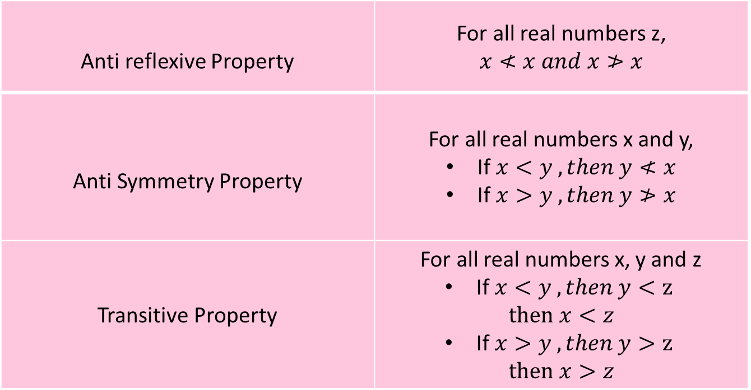
SOLVING INEQUALITIES
01
PROPERTIES OF INEQUALITIES
Anti reflexive Property | For all real numbers z, $$x≮x and x≯x$$
Anti Symmetry Property | For all real numbers x and y, If $x<y ,then y≮x$ If $x>y ,then y≯x$
Transitive Property | For all real numbers x, y and z If $x<y ,then y<z$ $$then x<z$$ If $x>y ,then y>z$ $$then x>z$$

Slide 6
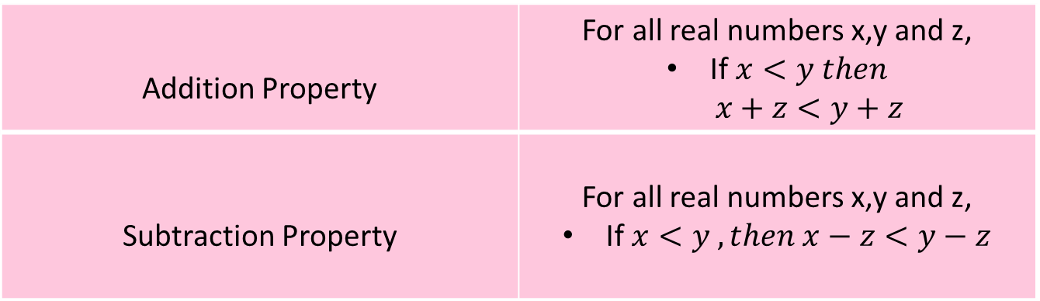
SOLVING INEQUALITIES
01
PROPERTIES OF INEQUALITIES
Addition Property | For all real numbers x,y and z, If $x<y then$ $$x+z<y+z$$
Subtraction Property | For all real numbers x,y and z, If $x<y ,then x−z<y−z$

Slide 7

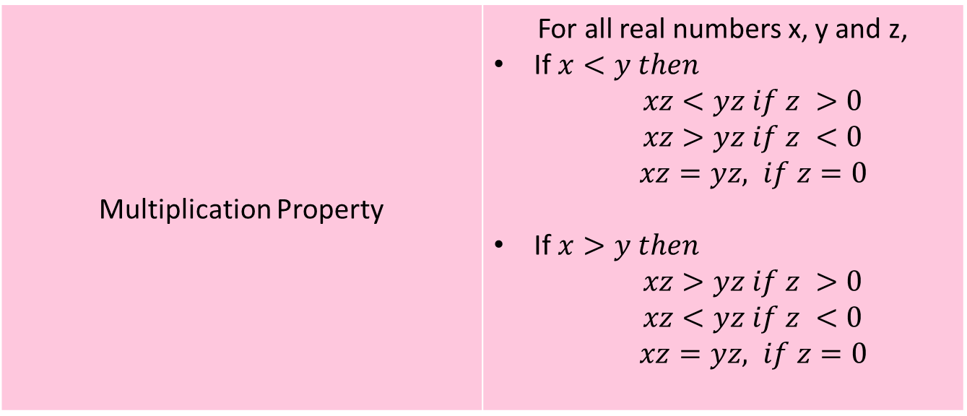
SOLVING INEQUALITIES
01
PROPERTIES OF INEQUALITIES
Multiplication Property | For all real numbers x, y and z, If $x<y then$ $$xz<yz if z >0$$ $$xz>yz if z <0$$ $xz=yz, if z=0$ If $x>y then$ $$xz>yz if z >0$$ $$xz<yz if z <0$$ $xz=yz, if z=0$

Slide 8
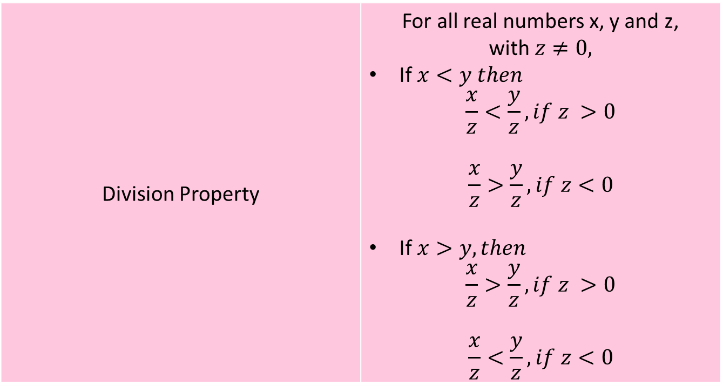
SOLVING INEQUALITIES
01
PROPERTIES OF INEQUALITIES
Division Property | For all real numbers x, y and z, with $z≠0,$ If $x<y then$ $$\frac{x}{z}<\frac{y}{z}, if z >0$$ $$\frac{x}{z}>\frac{y}{z}, if z<0$$ If $x>y, then$ $$\frac{x}{z}>\frac{y}{z}, if z >0$$ $$\frac{x}{z}<\frac{y}{z}, if z<0$$

Slide 9
SOLVING INEQUALITIES
01
Solving linear inequalities is the same as solving linear equations...
with one very important exception...
when you multiply or divide an inequality by a negative
value, it changes the direction of the inequality.

Slide 10
SOLVING INEQUALITIES
01
A compound inequality is two simple inequalities joined by "and" or "or".

Slide 11
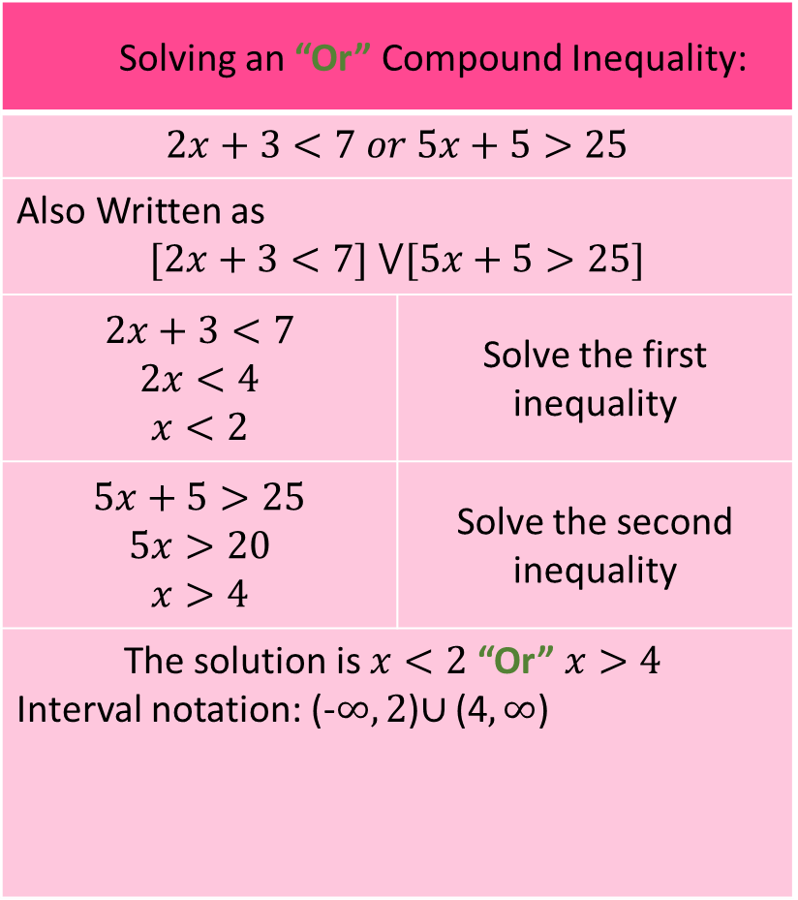
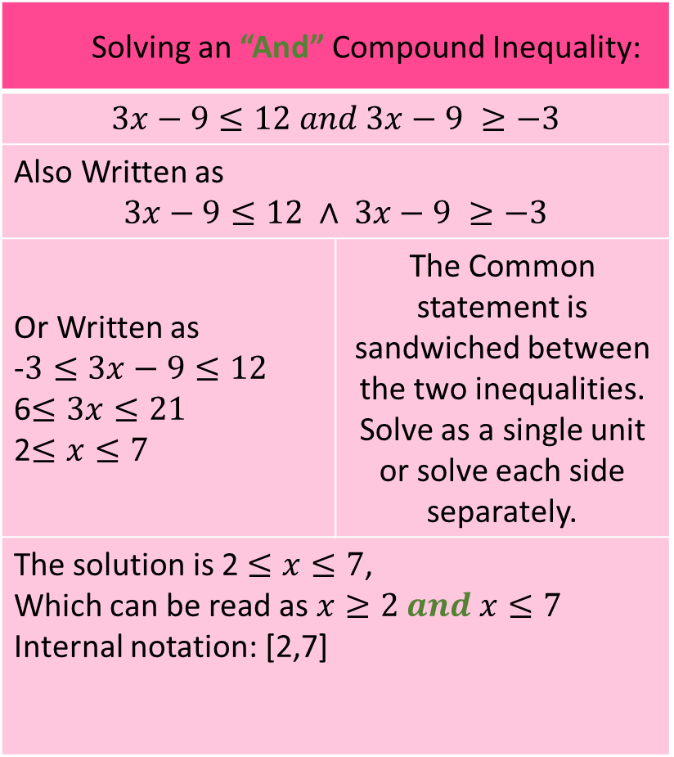
SOLVING INEQUALITIES
01
Solving an “And” Compound Inequality:
$$3x−9≤12 and 3x−9 ≥−3$$
Also Written as $$3x−9≤12 ∧ 3x−9 ≥−3$$
Or Written as -$3≤3x−9≤12$ 6$≤3x≤21$ 2$≤x≤7$ | The Common statement is sandwiched between the two inequalities. Solve as a single unit or solve each side separately.
The solution is 2 $≤x≤7$, Which can be read as $x≥2 and x≤7$ Internal notation: [2,7]
Solving an “Or” Compound Inequality:
$$2x+3<7 or 5x+5>25$$
Also Written as $$[2x+3<7] ⋁[5x+5>25]$$
$$2x+3<7$$ $$2x<4$$ $$x<2$$ | Solve the first inequality
$$5x+5>25$$ $$5x>20$$ $$x>4$$ | Solve the second inequality
The solution is $x<2$ “Or” $x>4$ Interval notation: (-$∞,2$)$∪$ (4$,∞$)
0 1 2 3 4 5 6 7 8
0 1 2 3 4 5 6 7 8

Slide 12
SOLVING INEQUALITIES
01
PROBLEM 1
Solve the inequality
2x -7 > 11
Solution
Add 7 to both sides
2x – 7 + 7 > 11 + 7
2x > 18
Divide both sides by 2
x > 9
Interval notation (9, ∞ )
3
9
14

Slide 13
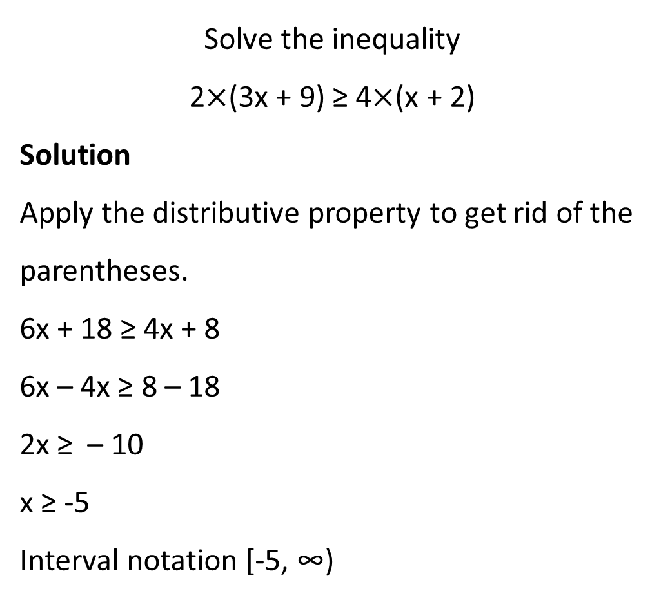
SOLVING INEQUALITIES
01
PROBLEM 2
Solve the inequality
2$×$(3x + 9) ≥ 4$×$(x + 2)
Solution
Apply the distributive property to get rid of the parentheses.
6x + 18 ≥ 4x + 8
6x – 4x ≥ 8 – 18
2x ≥ – 10
x ≥ -5
Interval notation [-5, ∞)
-8
-5
0
2

Slide 14
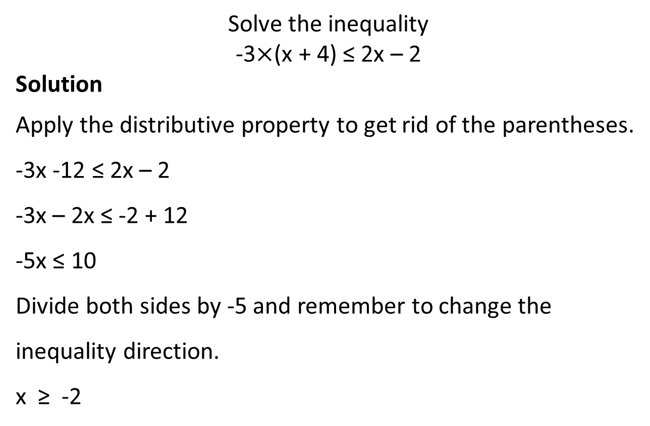
SOLVING INEQUALITIES
01
PROBLEM 3
Solve the inequality
-3$×$(x + 4) ≤ 2x – 2
Solution
Apply the distributive property to get rid of the parentheses.
-3x -12 ≤ 2x – 2
-3x – 2x ≤ -2 + 12
-5x ≤ 10
Divide both sides by -5 and remember to change the inequality direction.
x ≥ -2
-8
-2
0
5

Slide 15
SOLVING INEQUALITIES
01
PROBLEM 4
Solve the compound inequality
3x - 9 < 12 and 3x - 9 > -3
Solution
Solve the first inequality
3x < 21
x < 7
Solve the second inequality
3x > 6
x > 2

Slide 16
SOLVING INEQUALITIES
01
PROBLEM 4
The solution is 2 < x < 7,
which can be read x > 2 and x < 7.
Interval notation: [2, 7]
0 1 2 3 4 5 6 7 8

