Slide 1
ABSOLUTE VALUE EQUATIONS AND INEQUALITIES
UNIT 01 LESSON 05

Slide 2
OBJECTIVES
STUDENTS WILL BE ABLE TO:
Solve absolute value equations
Transform an absolute value inequality into a compound inequality
Solve absolute value inequality.
KEY VOCABULARY:
Equation.
Inequality.
Absolute value.

Slide 3
ABSOLUTE VALUE EQUATIONS AND INEQUALITIES
02
Absolute Value means ...
... only how far a number is from zero:
"6" is 6 away from zero,
and "−6" is also 6 away from zero.
So the absolute value of 6 is 6,
and the absolute value of −6 is also 6
6
6
-10 -9 -8 -7 -6 -5 -4 -3 -2 -1 0 1 2 3 4 5 6 7 8 9 10

Slide 4
ABSOLUTE VALUE EQUATIONS AND INEQUALITIES
03
To solve an absolute value equation, isolate the absolute value on one side of the equal sign, and establish two cases:
Case 1: |a| = b a = b Set the expression inside the absolute value symbol equal to the other given expression. | Case 2: |a| = b a = -b Set the expression inside the absolute value symbol equal to the negation of the other given expression

Slide 5
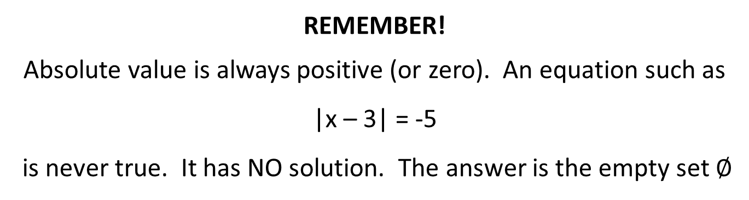
ABSOLUTE VALUE EQUATIONS AND INEQUALITIES
04
REMEMBER!
Absolute value is always positive (or zero). An equation such as
|x – 3| = -5
is never true. It has NO solution. The answer is the empty set $∅$

Slide 6
ABSOLUTE VALUE EQUATIONS AND INEQUALITIES
05
NOTICE!
Always CHECK your answers. The two cases create "derived" equations. These derived equations may not always be true equivalents to the original equation. Consequently, the roots of the derived equations MUST BE CHECKED in the original equation so that you do not list extraneous roots as answers.

Slide 7
ABSOLUTE VALUE EQUATIONS AND INEQUALITIES
06
PROBLEM 1
Solve |x-10| = 6
Solution
Case 1
x - 10 = 6
x = 16
Case 2
x – 10= -6
x = 4

Slide 8
ABSOLUTE VALUE EQUATIONS AND INEQUALITIES
07
PROBLEM 2
Solve
2|3x-3| = 12
Solution
First simplify the equation to get the absolute in one side.
Divide both sides by 2
|3x – 3| = 6

Slide 9
ABSOLUTE VALUE EQUATIONS AND INEQUALITIES
08
PROBLEM 2
Case 1
3x – 3 = 6
3x = 9
x = 3
Case 2
3x – 3 = -6
3x = -6 + 3
3x = -3
x = -1

Slide 10
ABSOLUTE VALUE EQUATIONS AND INEQUALITIES
09
Solving an absolute value inequality problem is similar to solving an absolute value equation.
Start by isolating the absolute value on one side of the inequality symbol, then follow the rules below:

Slide 11
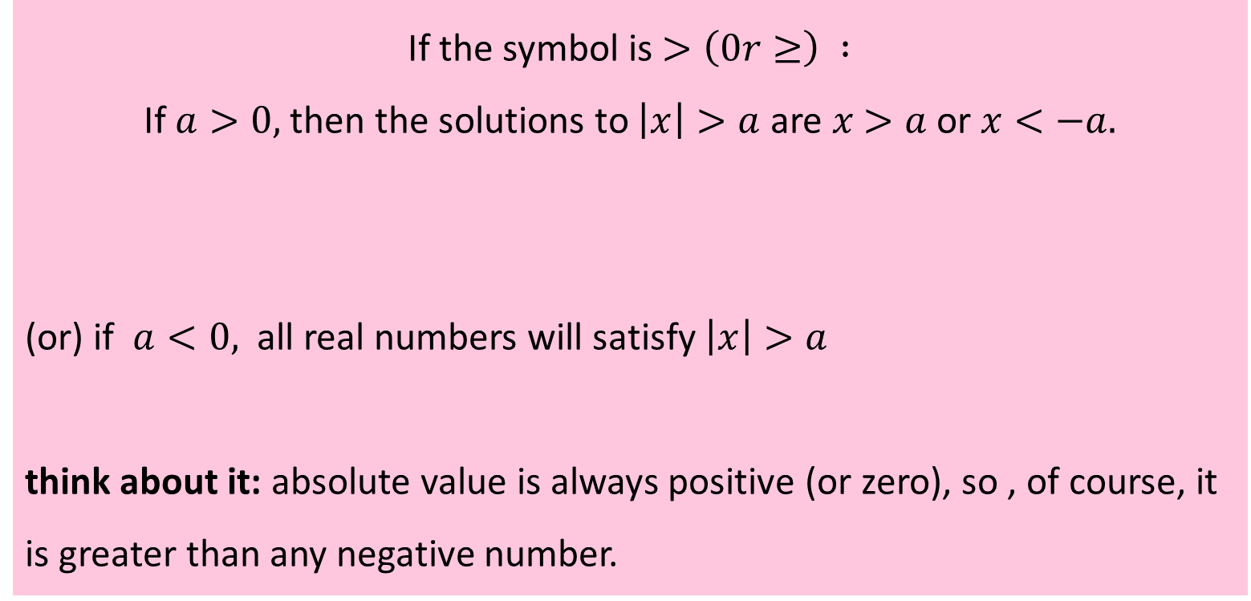
ABSOLUTE VALUE EQUATIONS AND INEQUALITIES
10
If the symbol is $>\left(0r≥\right) :$
If $a>0,$then the solutions to $\left|x\right|>a$ are $x$ $>a$ or $x<−a.$
(or) if $a<0,$ all real numbers will satisfy $\left|x\right|>a$
think about it: absolute value is always positive (or zero), so , of course, it is greater than any negative number.

Slide 12
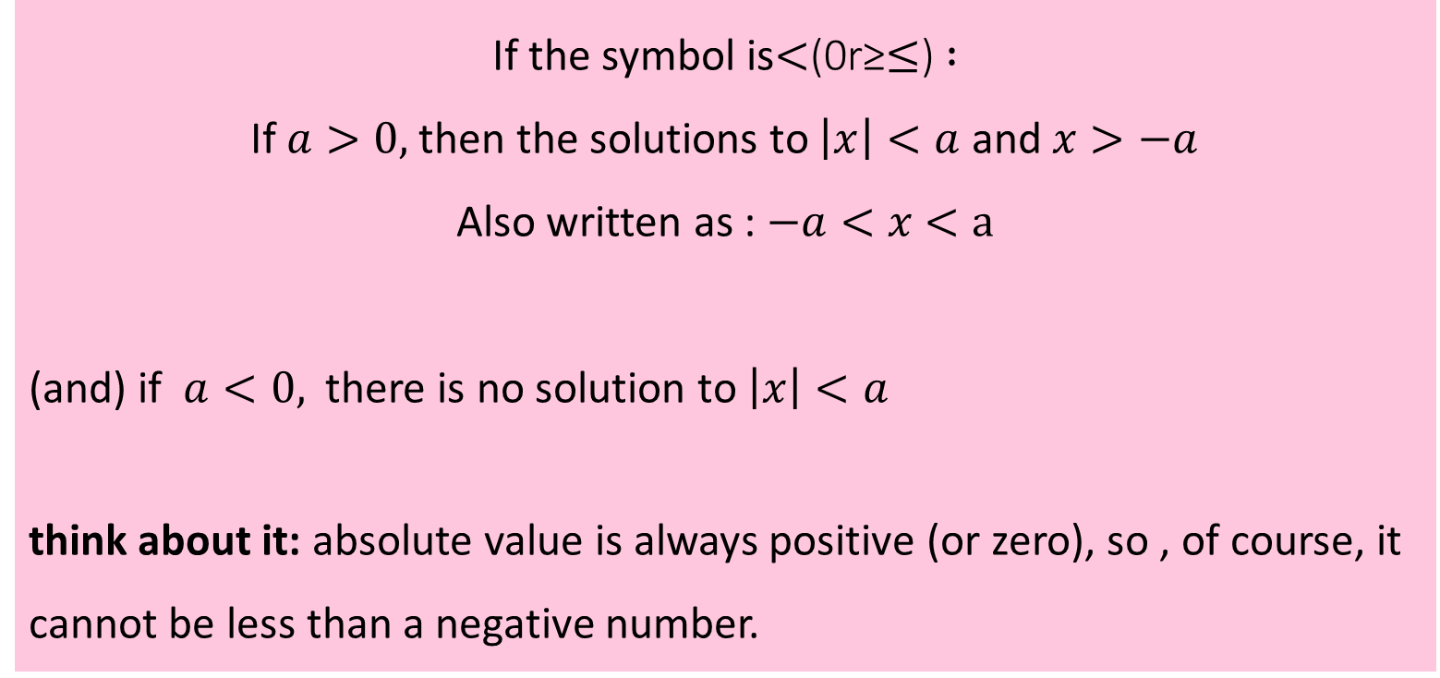
ABSOLUTE VALUE EQUATIONS AND INEQUALITIES
11
If the symbol is$<$(0r≥$≤$)$:$
If $a>0,$then the solutions to $\left|x\right|<a$ and $x>−a$
Also written as : $−a<x$ $<a$
(and) if $a<0,$ there is no solution to $\left|x\right|<a$
think about it: absolute value is always positive (or zero), so , of course, it cannot be less than a negative number.

Slide 13
ABSOLUTE VALUE EQUATIONS AND INEQUALITIES
12
PROBLEM 3
Solve |x – 20| > 5
Solution
Note that there are two parts to the solution and that the connecting word is "or".
So x < 15 or x > 25
Case 1 x – 20 > 5 x > 25 | Case 2 x – 20 < -5 x < 15
10 0 10 20 30 40

Slide 14
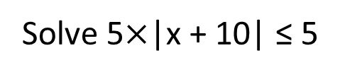
ABSOLUTE VALUE EQUATIONS AND INEQUALITIES
13
PROBLEM 4
Solve 5$×$|x + 10| ≤ 5
Solution
We need to isolate the absolute value on one side of the equation.
|x + 10| ≤ 1
Note that there are two parts to the solution and that the connecting word is "and".

Slide 15
ABSOLUTE VALUE EQUATIONS AND INEQUALITIES
14
Case 1 x + 10 ≤ 1 x ≤ -9 | Case 2 x + 10 ≥ -1 x ≥ -11
So x ≥ -11 and x ≤ -9
Also can be written as
-11 ≤ x ≤ -9
-11 -10.5 -10.0 -9.5 -9.0

