Slide 1
Exploring Angle Pairs
Unit 1 Lesson 5

Slide 2
Exploring Angle Pairs
Students will be able to:
Identify special angle pairs and use their relationships to find angle measures.
Key Vocabulary:
Adjacent angles
Linear pair of angles
Vertical angles
Complementary angles
Supplementary angles

Slide 3
Exploring Angle Pairs
Pairs of Angles
Complementary angles
Adjacent angles
Line pairs
Vertical angles
Supplementary angles

Slide 4
Exploring Angle Pairs
Adjacent Angles
$$S$$
Adjacent angles are angles that share a common side and have the same vertex, but have no interior points in common.
$$T$$
$$K L$$

Slide 5
Exploring Angle Pairs
A Linear Pair of Angles
Two angles form a linear pair if and only if they are adjacent and their non-common sides are opposite rays.
$$C$$
$$A$$
$$O$$
$$B$$

Slide 6
Exploring Angle Pairs
Sample Problem 1: Tell whether the angles are only adjacent, adjacent and form a linear pair or not adjacent.
a.
$$∠BOH and ∠AOR$$
$$H$$
$$R$$
$$∠HOR and ∠AOR$$
$$∠BOH and ∠AOH$$
$$A$$
$$O$$
$$B$$

Slide 7
Exploring Angle Pairs
Sample Problem 1: Tell whether the angles are only adjacent, adjacent and form a linear pair or not adjacent.
a.
$$∠BOH and ∠AOR$$
$$H$$
$$R$$
$$not adjacent$$
$$A$$
$$O$$
$$B$$

Slide 8
Exploring Angle Pairs
Sample Problem 1: Tell whether the angles are only adjacent, adjacent and form a linear pair or not adjacent.
a.
$$∠HOR and ∠AOR$$
$$H$$
$$R$$
$$adjacent$$
$$A$$
$$O$$
$$B$$

Slide 9
Exploring Angle Pairs
Sample Problem 1: Tell whether the angles are only adjacent, adjacent and form a linear pair or not adjacent.
a.
$$∠BOH and ∠AOH$$
$$H$$
$$R$$
$$adjacent and linear pair$$
$$A$$
$$O$$
$$B$$

Slide 10
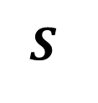
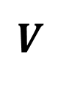
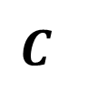
Exploring Angle Pairs
Sample Problem 1: Tell whether the angles are only adjacent, adjacent and form a linear pair or not adjacent.
b.
$$∠SFV and ∠SFC$$
$$C$$
$$P$$
$$∠TFP and ∠SFP$$
$$∠CFP and ∠SFV$$
$$S$$
$$F$$
$$T$$
$$V$$

Slide 11
Exploring Angle Pairs
Sample Problem 1: Tell whether the angles are only adjacent, adjacent and form a linear pair or not adjacent.
b.
$$∠SFV and ∠SFC$$
$$C$$
$$P$$
$$adjacent and linear pair$$
$$S$$
$$F$$
$$T$$
$$V$$

Slide 12
Exploring Angle Pairs
Sample Problem 1: Tell whether the angles are only adjacent, adjacent and form a linear pair or not adjacent.
b.
$$∠TFP and ∠SFP$$
$$C$$
$$P$$
$$adjacent and linear pair$$
$$S$$
$$F$$
$$T$$
$$V$$

Slide 13
Exploring Angle Pairs
Sample Problem 1: Tell whether the angles are only adjacent, adjacent and form a linear pair or not adjacent.
b.
$$∠CFP and ∠SFV$$
$$C$$
$$P$$
$$not adjacent$$
$$S$$
$$F$$
$$T$$
$$V$$

Slide 14
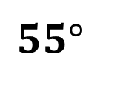
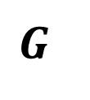
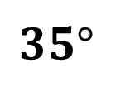
Exploring Angle Pairs
Complementary and Supplementary Angles
Two angles are complementary if and only if the sum of their degree measures is 90.
$$G$$
$$35°$$
$$55°$$
$$K$$
$$m∠K+m∠G=90$$

Slide 15

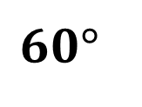
Exploring Angle Pairs
Complementary and Supplementary Angles
Two angles are supplementary if and only if the sum of their degree measures is 180.
$$120°$$
$$60°$$
$$Z$$
$$L$$
$$m∠Z+m∠L=180$$

Slide 16
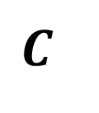
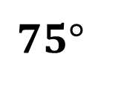
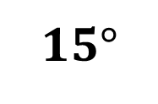

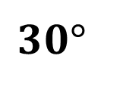

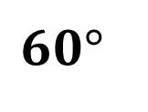
Exploring Angle Pairs
Sample Problem 2: Name a pair of adjacent complementary angles.
a.
$$K$$
$$C$$
$$P$$
$$75°$$
$$30°$$
$$15°$$
$$60°$$
$S$
$F$
$T$

Slide 17
Exploring Angle Pairs
Sample Problem 2: Name a pair of adjacent complementary angles.
a.
$$m∠TFC+m ∠CFK=60+30$$
$$K$$
$$C$$
$$m∠TFC+m ∠CFK=90$$
$$P$$
$$75°$$
$$30°$$
$$∠TFC and ∠CFK$$
$$15°$$
$$60°$$
$$m∠KFP+m ∠PFS=75+15$$
$S$
$F$
$T$
$$m∠KFP+m ∠PFS=90$$
$$∠KFP and ∠PFS$$

Slide 18
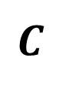
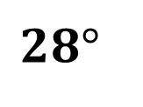
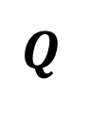
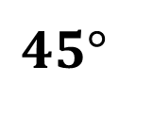

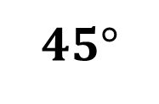
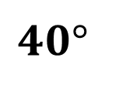

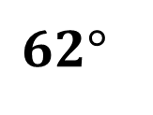
Exploring Angle Pairs
Sample Problem 2: Name a pair of adjacent complementary angles.
b.
$$T$$
$$C$$
$$40°$$
$$45°$$
$$Q$$
$$62°$$
$B$
$$45°$$
$$28°$$
$M$
$J$
$N$

Slide 19
Exploring Angle Pairs
Sample Problem 2: Name a pair of adjacent complementary angles.
b.
$$T$$
$$C$$
$$m∠JMQ+m ∠QMT=45+45$$
$$m∠JMQ+m ∠QMT=90$$
$$40°$$
$$45°$$
$$∠JMQ and ∠QMT$$
$$Q$$
$$62°$$
$B$
$$45°$$
$$m∠BMC+m ∠NMB=62+28$$
$$28°$$
$M$
$$m∠BMC+m ∠NMB=90$$
$J$
$$∠BMC and ∠NMB$$
$N$

Slide 20

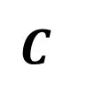
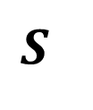
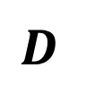
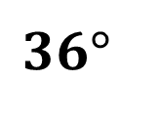
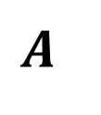

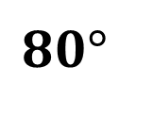
Exploring Angle Pairs
Sample Problem 3: Name a pair of adjacent supplementary angles.
a.
$$H$$
$$100°$$
$$80°$$
$$D$$
$$C$$
$$A$$
$$144°$$
$$36°$$
$$S$$

Slide 21
Exploring Angle Pairs
Sample Problem 3: Name a pair of adjacent supplementary angles.
a.
$$m∠DCH+m ∠HCA=100+80$$
$$m∠DCH+m ∠HCA=180$$
$$H$$
$$∠DCH and ∠HCA$$
$$m∠DCS+m ∠ACS=144+36$$
$$m∠DCS+m ∠ACS=180$$
$$100°$$
$$80°$$
$$∠DCS and ∠ACS$$
$$D$$
$$C$$
$$A$$
$$144°$$
$$36°$$
$$S$$

Slide 22
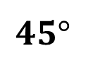
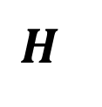
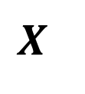
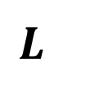
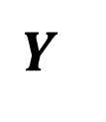
Exploring Angle Pairs
Sample Problem 3: Name a pair of adjacent supplementary angles.
b.
$$Y$$
$$H$$
$$40°$$
$$X$$
$$45°$$
$$50°$$
$$135°$$
$$J$$
$$L$$
$$I$$

Slide 23
Exploring Angle Pairs
Sample Problem 3: Name a pair of adjacent supplementary angles.
b.
$$Y$$
$$H$$
$$m∠YJX+m ∠XJI=45+135$$
$$m∠YJX+m ∠XJI=180$$
$$40°$$
$$X$$
$$45°$$
$$∠YJX and ∠XJI$$
$$50°$$
$$m∠IJL+m ∠LJY=90+\left(50+40\right)$$
$$135°$$
$$J$$
$$L$$
$$m∠IJL+m ∠LJY=180$$
$$∠IJL and ∠LJY$$
$$I$$

Slide 24
Exploring Angle Pairs
Congruent angles
Two angles are congruent if and only if they have the same degree measure.
$$60°$$
$$60°$$
$$m∠L =m∠M$$
$$L$$
$$M$$
$$∠L ≅∠M$$

Slide 25
Exploring Angle Pairs
Vertical Angles
Two angles are vertical if and only if they are two nonadjacent angles formed by a pair of intersecting lines.
Vertical angles are congruent
$$K$$
$$E$$
$$2$$
$$1$$
$$T$$
$$3$$
$$4$$
$$L$$
$$A$$
$$∠2 ≅∠4$$
$$∠1 ≅∠3$$

Slide 26
Exploring Angle Pairs
Sample Problem 4: Find the indicated angle measures.
a.
$$m∠ADG=38$$
Find $m∠LDC, m∠LDA, and m∠CDG.$
$$G$$
$$C$$
$$38°$$
$$D$$
$$A$$
$$L$$

Slide 27
Exploring Angle Pairs
Sample Problem 4: Find the indicated angle measures.
a.
$$m∠ADG=38$$
Find $m∠LDC, m∠LDA, and m∠CDG.$
$$∠ADG and ∠LDC are vertical angles$$
$$G$$
$$C$$
$$m∠ADG=m ∠LDC$$
$$m ∠LDC=38$$
$$38°$$
$$D$$
$$m∠ADG+m∠CDG=180$$
$$m∠CDG=180−38$$
$$A$$
$$L$$
$$m∠CDG=142$$
$$∠CDGand ∠LDA are vertical angles$$
$$m∠LDA=m∠CDG$$
$$m∠LDA=142$$

Slide 28
Exploring Angle Pairs
Sample Problem 4: Find the indicated angle measures.
b.
$$m∠DMR=121$$
Find $m∠TMF,m∠FMR, and m∠TMD$.
$$R$$
$$D$$
$$121°$$
$$M$$
$$F$$
$$T$$

Slide 29
Exploring Angle Pairs
Sample Problem 4: Find the indicated angle measures.
b.
$$m∠DMR=121$$
Find $m∠TMF,m∠FMR, and m∠TMD$.
$$∠DMR and ∠TMF are vertical angles$$
$$R$$
$$D$$
$$m∠DMR=m∠TMF$$
$$121°$$
$$m ∠TMF=121$$
$$m∠DMR+m∠FMR=180$$
$$M$$
$$m∠FMR=180−121$$
$$F$$
$$T$$
$$m∠FMR=59$$
$$∠TMD and ∠FMR are vertical angles$$
$$m∠TMD=m∠FMR$$
$$m∠TMD=59$$

