Slide 1
The Order of Operations
Unit 1 Lesson 3

Slide 2

The Order of Operations
Students will be able to:
Perform arithmetic operations, including those involving whole-number exponents, in the conventional order.
Key Vocabulary:
Parentheses, exponents, multiplication, division, addition subtraction

Slide 3
The Order of Operations
When we evaluate expressions, we use one set of rules so that everyone arrives at the same correct answer.
The rules used for simplifying numerical expressions are called order of operations.

Slide 4
The Order of Operations
These rules are based on doing the most powerful operations first (exponents), then the less powerful ones (multiplication and division, going from left to right), and finally, the least powerful ones last (addition and subtraction, going from left to right).
Grouping symbols, like parentheses, tell us to evaluate whatever is inside them before moving on.

Slide 5
The Order of Operations
You can remember the order of operations with the acronym PEMDAS.
Please | Excuse | My | Dear | Aunt | Sally
Parentheses | Exponents | Multiplication | Division | Addition | Subtraction
P | E | M | D | A | S

Slide 6
The Order of Operations
Expressions with Only Addition, Subtraction, Multiplication, and Division
Multiplication and division are evaluated first, from left to right.
Addition and subtraction are always evaluated last, from left to right.

Slide 7
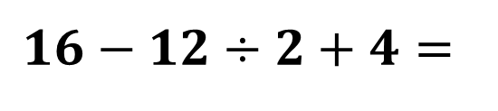
The Order of Operations
Sample Problem 1: Find the value of each numerical expression. Follow the order of operations when finding each value.
a.
$$16−12÷2+4=$$

Slide 8
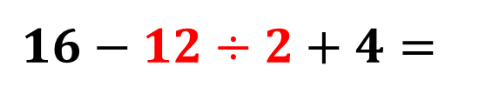



The Order of Operations
Sample Problem 1: Find the value of each numerical expression. Follow the order of operations when finding each value.
a.
$$16−12÷2+4=$$
$$=16−6+4=$$
$$=10+4=$$
$$=16$$

Slide 9
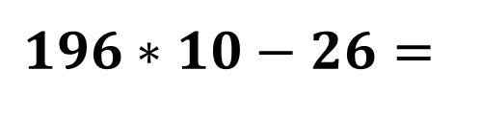
The Order of Operations
Sample Problem 1: Find the value of each numerical expression. Follow the order of operations when finding each value.
b.
$$196∗10−26=$$

Slide 10
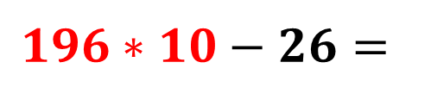
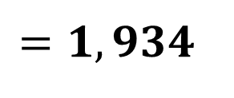
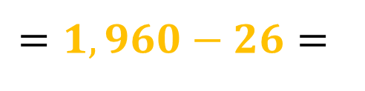
The Order of Operations
Sample Problem 1: Find the value of each numerical expression. Follow the order of operations when finding each value.
b.
$$196∗10−26=$$
$$=1,960−26=$$
$$=1,934$$

Slide 11
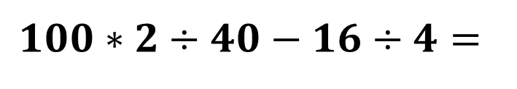
The Order of Operations
Sample Problem 1: Find the value of each numerical expression. Follow the order of operations when finding each value.
c.
$$100∗2÷40−16÷4=$$

Slide 12
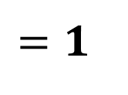
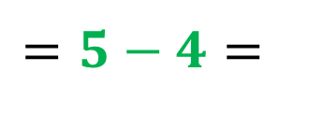
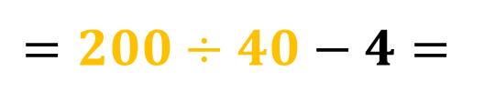
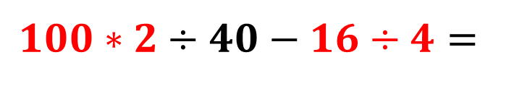
The Order of Operations
Sample Problem 1: Find the value of each numerical expression. Follow the order of operations when finding each value.
c.
$$100∗2÷40−16÷4=$$
$$=200÷40−4=$$
$$=5−4=$$
$$=1$$

Slide 13
The Order of Operations
Expressions with Four Operations and Exponents
Exponents are more powerful than multiplication or division.
If exponents are present in an expression, they are evaluated before any multiplication or division.

Slide 14
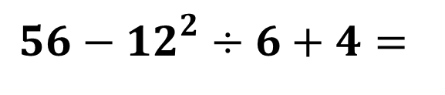
The Order of Operations
Sample Problem 2: Find the value of each numerical expression. Follow the order of operations when finding each value.
a.
$$56−{12}^{2}÷6+4=$$

Slide 15
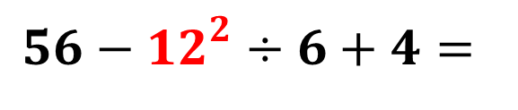
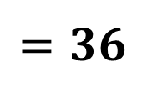
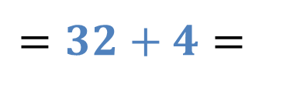
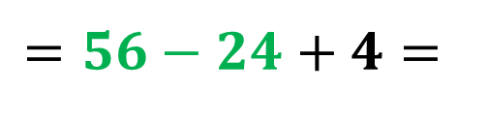
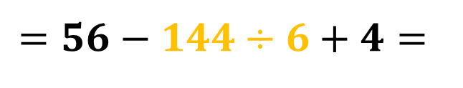
The Order of Operations
Sample Problem 2: Find the value of each numerical expression. Follow the order of operations when finding each value.
a.
$$56−{12}^{2}÷6+4=$$
$$=56−144÷6+4=$$
$$=56−24+4=$$
$$=32+4=$$
$$=36$$

Slide 16
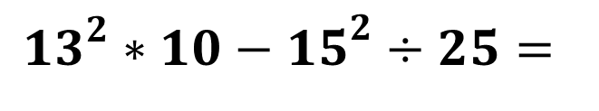
The Order of Operations
Sample Problem 2: Find the value of each numerical expression. Follow the order of operations when finding each value.
b.
$${13}^{2}∗10−{15}^{2}÷25=$$

Slide 17
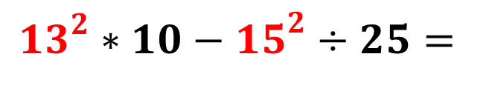
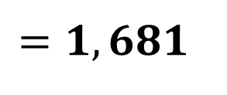
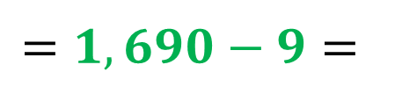
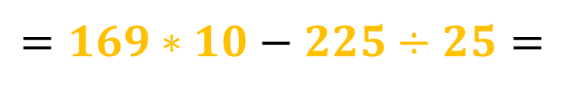
The Order of Operations
Sample Problem 2: Find the value of each numerical expression. Follow the order of operations when finding each value.
b.
$${13}^{2}∗10−{15}^{2}÷25=$$
$$=169∗10−225÷25=$$
$$=1,690−9=$$
$$=1,681$$

Slide 18
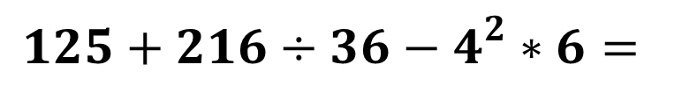
The Order of Operations
Sample Problem 2: Find the value of each numerical expression. Follow the order of operations when finding each value.
c.
$$125+216÷36−4^{2}∗6=$$

Slide 19
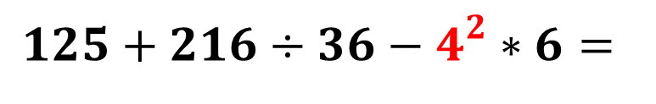
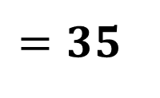
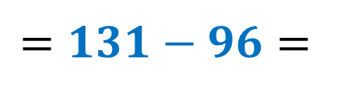
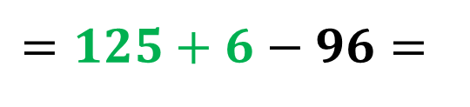
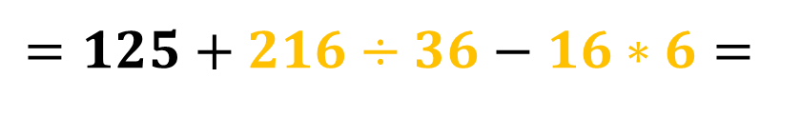
The Order of Operations
Sample Problem 2: Find the value of each numerical expression. Follow the order of operations when finding each value.
c.
$$125+216÷36−4^{2}∗6=$$
$$=125+216÷36−16∗6=$$
$$=125+6−96=$$
$$=131−96=$$
$$=35$$

Slide 20
The Order of Operations
Expressions with Parentheses
The last important rule in the order of operations involves grouping symbols, usually parentheses.
These tell us that in certain circumstances or scenarios, we need to do things out of the usual order. Operations inside grouping symbols are always evaluated first, before exponents and any operations.

Slide 21
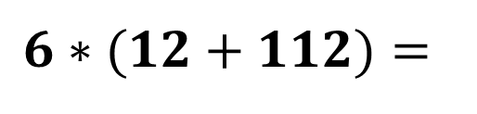
The Order of Operations
Sample Problem 3: : Find the value of each numerical expression. Follow the order of operations when finding each value.
a.
$$6∗(12+112)=$$

Slide 22
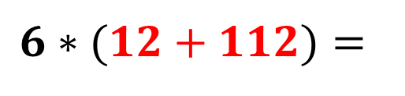
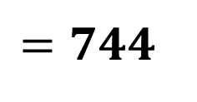
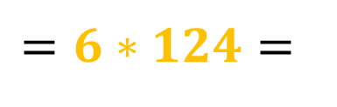
The Order of Operations
Sample Problem 3: : Find the value of each numerical expression. Follow the order of operations when finding each value.
a.
$$6∗(12+112)=$$
$$=6∗124=$$
$$=744$$

Slide 23
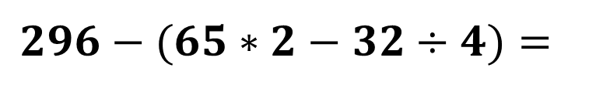
The Order of Operations
Sample Problem 3: : Find the value of each numerical expression. Follow the order of operations when finding each value.
b.
$$296−(65∗2−32÷4)=$$

Slide 24
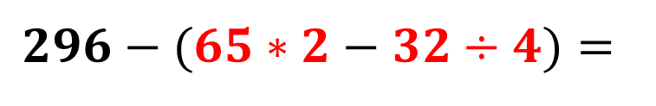
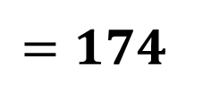
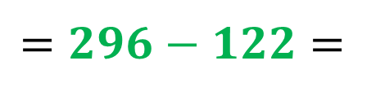
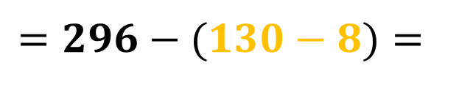
The Order of Operations
Sample Problem 3: : Find the value of each numerical expression. Follow the order of operations when finding each value.
b.
$$296−(65∗2−32÷4)=$$
$$=296−(130−8)=$$
$$=296−122=$$
$$=174$$

Slide 25
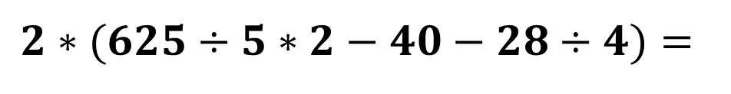
The Order of Operations
Sample Problem 3: : Find the value of each numerical expression. Follow the order of operations when finding each value.
c.
$$2∗(625÷5∗2−40−28÷4)=$$

Slide 26
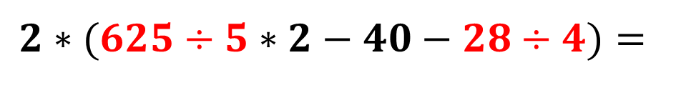
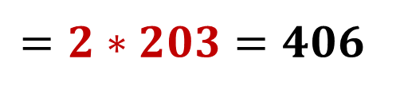
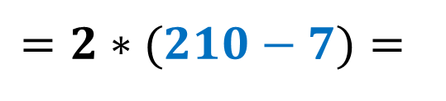
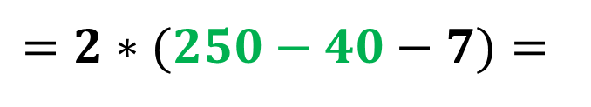
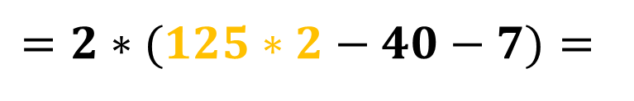
The Order of Operations
Sample Problem 3: : Find the value of each numerical expression. Follow the order of operations when finding each value.
c.
$$2∗(625÷5∗2−40−28÷4)=$$
$$=2∗(125∗2−40−7)=$$
$$=2∗(250−40−7)=$$
$$=2∗(210−7)=$$
$$=2∗203=406$$

Slide 27
The Order of Operations
Expressions with Parentheses and Exponents

Slide 28
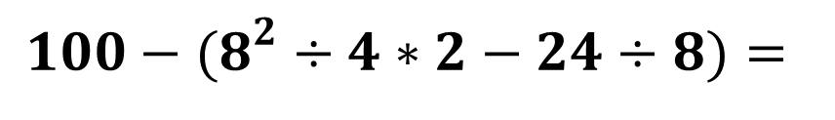
The Order of Operations
Sample Problem 4: Find the value of each numerical expression. Follow the order of operations when finding each value.
a.
$$100−(8^{2}÷4∗2−24÷8)=$$

Slide 29
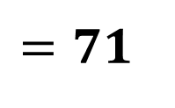
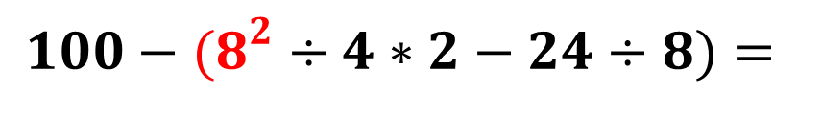
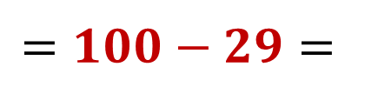
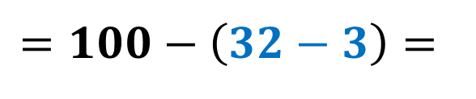
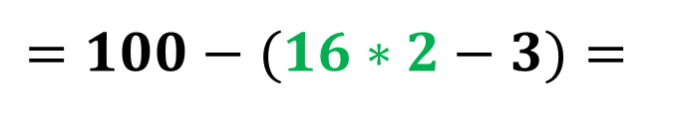
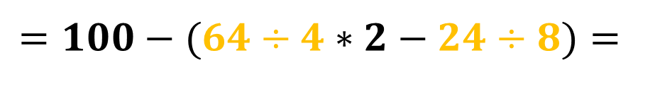
The Order of Operations
Sample Problem 4: Find the value of each numerical expression. Follow the order of operations when finding each value.
a.
$$100−(8^{2}÷4∗2−24÷8)=$$
$$=100−(64÷4∗2−24÷8)=$$
$$=100−(16∗2−3)=$$
$$=100−\left(32−3\right)=$$
$$=100−29=$$
$$=71$$

Slide 30

The Order of Operations
Sample Problem 4: Find the value of each numerical expression. Follow the order of operations when finding each value.
b.
$${20}^{2}÷100+(7^{2}+{10}^{2}÷25)=$$

Slide 31





The Order of Operations
Sample Problem 4: Find the value of each numerical expression. Follow the order of operations when finding each value.
b.
$${20}^{2}÷100+(7^{2}+{10}^{2}÷25)=$$
$$=400÷100+\left(49+100÷25\right)=$$
$$=4+\left(49+4\right)=$$
$$=4+53=$$
$$=57$$

Slide 32

The Order of Operations
Sample Problem 4: Find the value of each numerical expression. Follow the order of operations when finding each value.
$$550−{\left({11}^{2}−7^{2}∗2\right)}^{2}=$$
c.

Slide 33






The Order of Operations
Sample Problem 4: Find the value of each numerical expression. Follow the order of operations when finding each value.
$$550−{\left({11}^{2}−7^{2}∗2\right)}^{2}=$$
c.
$$=550−{\left(121−49∗2\right)}^{2}=$$
$$=550−{\left(121−98\right)}^{2}=$$
$$=550−{\left(23\right)}^{2}=$$
$$=550−529=$$
$$=21$$

