Slide 1

Rational Numbers
Unit 1 Lesson 4

Slide 2
RATIONAL NUMBERS
Students will be able to:
Define rational numbers.
Determine whether a number is rational or irrational.
Change fractions to decimals.
Determine whether a decimal number is terminating or non-terminating, repeating or non-repeating.
Change terminating decimals to fractions.
Change non-terminating and repeating decimals to fractions.

Slide 3
RATIONAL NUMBERS
Key Vocabulary:
Rational Numbers
Irrational Numbers
Terminating Decimal
Non-terminating Decimal
Repeating Decimal
Non-repeating Decimal
Fractions

Slide 4
RATIONAL NUMBERS
RATIONAL NUMBERS
Rational Numbers are numbers that can be written in the form:
It is very important to remember that dividing a number by zero is not allowed as the answer is undefined.

Slide 5
RATIONAL NUMBERS
RATIONAL NUMBERS
Examples:

Slide 6
RATIONAL NUMBERS
RATIONAL NUMBERS
Examples:

Slide 7
RATIONAL NUMBERS
RATIONAL NUMBERS
Examples:

Slide 8
RATIONAL NUMBERS
RATIONAL NUMBERS
Examples:

Slide 9
RATIONAL NUMBERS
RATIONAL NUMBERS
This only shows that a rational number can be expressed as a fraction or decimal. It can be transformed into its equivalent fraction or decimal form, and vice versa.
Study the examples on the next slide.

Slide 10
RATIONAL NUMBERS
RATIONAL NUMBERS

Slide 11
RATIONAL NUMBERS
RATIONAL NUMBERS
A terminating decimal number is one that has a finite number of digits. This means that the digits end.

Slide 12
RATIONAL NUMBERS
RATIONAL NUMBERS
A repeating decimal number is one that has digits that repeats and never ends.

Slide 13
RATIONAL NUMBERS
IRRATIONAL NUMBERS
On the other hand, there are numbers that are not rational. They are called irrational numbers. Unlike rational numbers, irrational numbers when expressed in decimal form can be a non-terminating and non-repeating.
A non-terminating and non-repeating decimal number has digits that don’t repeat and goes on and on without end.

Slide 14
RATIONAL NUMBERS
IRRATIONAL NUMBERS
Examples:

Slide 15
RATIONAL NUMBERS
Sample Problem 1: Tell whether each of the following are rational or irrational numbers.

Slide 16
RATIONAL NUMBERS
Sample Problem 1: Tell whether each of the following are rational or irrational numbers.

Slide 17
RATIONAL NUMBERS
Sample Problem 1: Solution

Slide 18
RATIONAL NUMBERS
Sample Problem 1: Solution

Slide 19
RATIONAL NUMBERS
CHANGING FRACTIONS TO DECIMALS
As mentioned earlier, rational numbers can be in fraction or decimal form. These forms are equivalent and can be transformed into one form or another. Changing fractions into its decimal form is like doing a simple division.
The required step is very simple:
Divide the numerator by the denominator.

Slide 20
RATIONAL NUMBERS
CHANGING FRACTIONS TO DECIMALS
Example 1:
In the examples above, the rational numbers expressed as decimal numbers are terminating decimals.

Slide 21
RATIONAL NUMBERS
CHANGING FRACTIONS TO DECIMALS
Example 2:
In the examples above, the rational numbers expressed as decimal numbers are repeating and non-terminating decimals. These types of decimals repeat over and over again, without end.

Slide 22
RATIONAL NUMBERS
CHANGING FRACTIONS TO DECIMALS

Slide 23
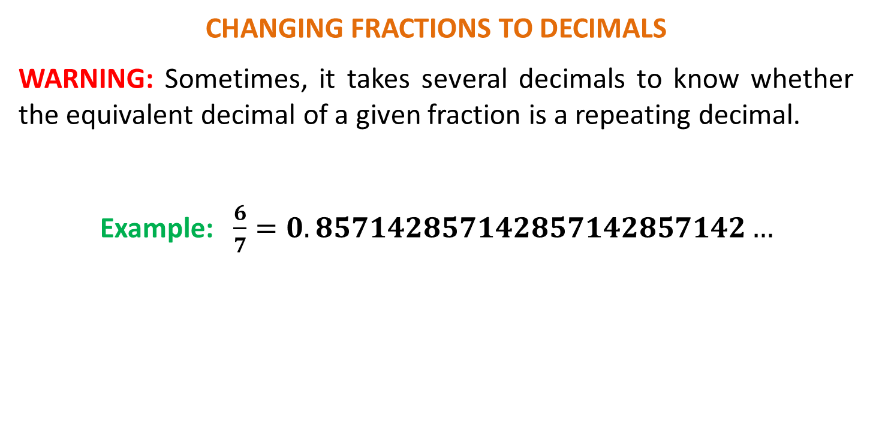
RATIONAL NUMBERS
CHANGING FRACTIONS TO DECIMALS
WARNING: Sometimes, it takes several decimals to know whether the equivalent decimal of a given fraction is a repeating decimal.
Example: $\frac{6}{7}=0.857142857142857142857142…$

Slide 24
RATIONAL NUMBERS
Sample Problem 2: Express the following fractions as decimals and determine whether the decimal number terminates or repeats.

Slide 25
RATIONAL NUMBERS
Sample Problem 2: Express the following fractions as decimals and determine whether the decimal number terminates or repeats.

Slide 26
RATIONAL NUMBERS
Sample Problem 2: Express the following fractions as decimals and determine whether the decimal number terminates or repeats.

Slide 27
RATIONAL NUMBERS
Sample Problem 2: Express the following fractions as decimals and determine whether the decimal number terminates or repeats.

Slide 28
RATIONAL NUMBERS
Sample Problem 2: Solution

Slide 29
RATIONAL NUMBERS
Sample Problem 2: Solution

Slide 30
RATIONAL NUMBERS
Sample Problem 2: Solution

Slide 31
RATIONAL NUMBERS
Sample Problem 2: Solution

Slide 32
RATIONAL NUMBERS
CHANGING TERMINATING DECIMALS TO FRACTIONS
Let’s now reverse the process. This time, we’ll transform terminating decimals to its equivalent fraction. In changing decimal numbers to fractions, we use its digits (without the decimal point) as the numerator. The denominator on the other hand must be a power of 10.
We need to select the appropriate denominator such as 10, 100, 1 000, 10 000, and so on. Don’t forget to always change the fraction in its lowest term, if possible.

Slide 33
RATIONAL NUMBERS
CHANGING TERMINATING DECIMALS TO FRACTIONS
Examples:

Slide 34
RATIONAL NUMBERS
CHANGING TERMINATING DECIMALS TO FRACTIONS
Examples:

Slide 35
RATIONAL NUMBERS
Sample Problem 3: Express the following terminating decimals in its equivalent fraction.

Slide 36
RATIONAL NUMBERS
Sample Problem 3: Solution

Slide 37
RATIONAL NUMBERS
CHANGING REPEATING AND NON-TERMINATING DECIMALS TO FRACTIONS
While changing terminating decimal numbers to fractions is a piece of cake, doing the same for repeating and non-terminating decimal numbers is a different story. But there is nothing to worry about. The steps on how to do it are explained clearly in the examples below.
Example 1: Change 0.888… to its fraction form.

Slide 38
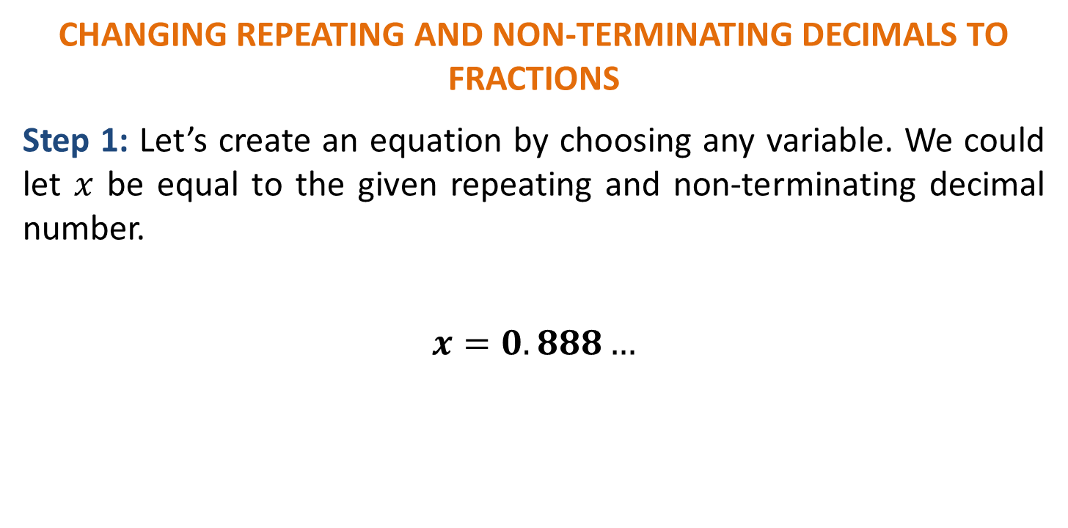
RATIONAL NUMBERS
CHANGING REPEATING AND NON-TERMINATING DECIMALS TO FRACTIONS
Step 1: Let’s create an equation by choosing any variable. We could let $x$ be equal to the given repeating and non-terminating decimal number.
$$x=0.888…$$

Slide 39
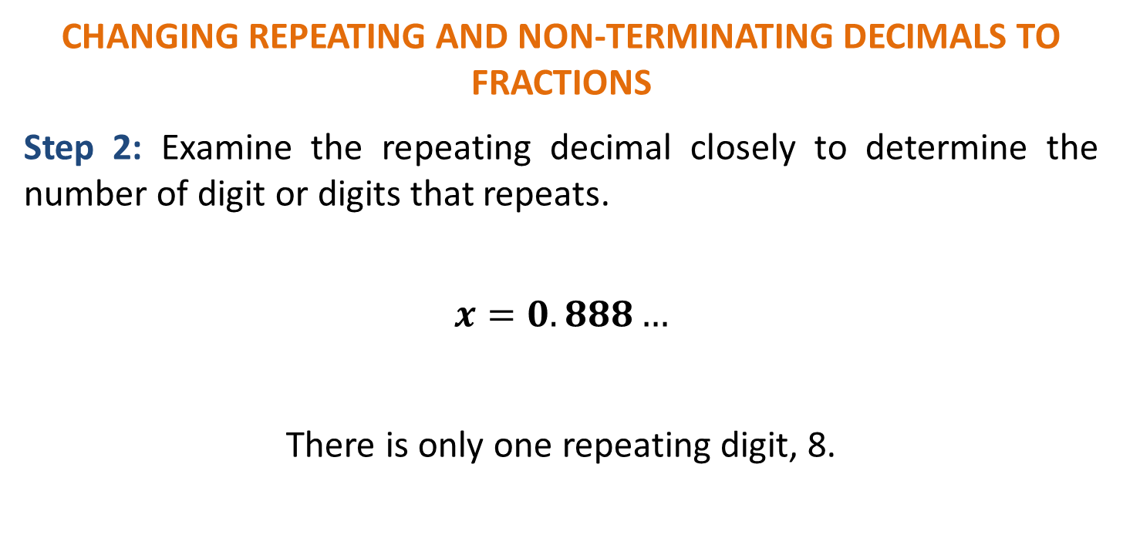
RATIONAL NUMBERS
CHANGING REPEATING AND NON-TERMINATING DECIMALS TO FRACTIONS
Step 2: Examine the repeating decimal closely to determine the number of digit or digits that repeats.
$$x=0.888…$$
There is only one repeating digit, 8.

Slide 40
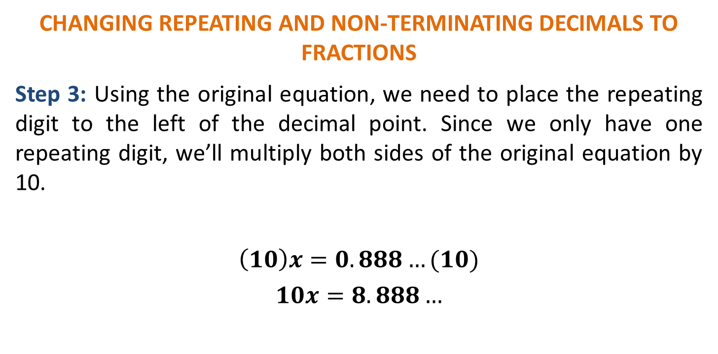
RATIONAL NUMBERS
CHANGING REPEATING AND NON-TERMINATING DECIMALS TO FRACTIONS
Step 3: Using the original equation, we need to place the repeating digit to the left of the decimal point. Since we only have one repeating digit, we’ll multiply both sides of the original equation by 10.
$$\left(10\right)x=0.888…(10)$$
$$10x=8.888…$$

Slide 41
RATIONAL NUMBERS
CHANGING REPEATING AND NON-TERMINATING DECIMALS TO FRACTIONS
Step 4: Subtract the two equations.

Slide 42
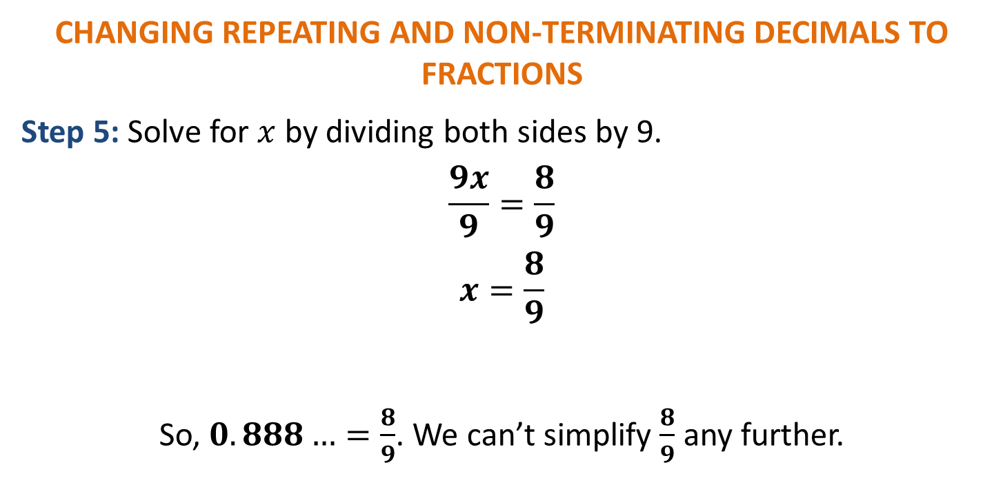
RATIONAL NUMBERS
CHANGING REPEATING AND NON-TERMINATING DECIMALS TO FRACTIONS
Step 5: Solve for $x$ by dividing both sides by 9.
$$\frac{9x}{9}=\frac{8}{9}$$
$$x=\frac{8}{9}$$
So, $0.888…=\frac{8}{9}$. We can’t simplify $\frac{8}{9}$ any further.

Slide 43
RATIONAL NUMBERS
CHANGING REPEATING AND NON-TERMINATING DECIMALS TO FRACTIONS
Let’s confirm if we are correct.
Or better yet, you may use a
calculator to confirm.

Slide 44
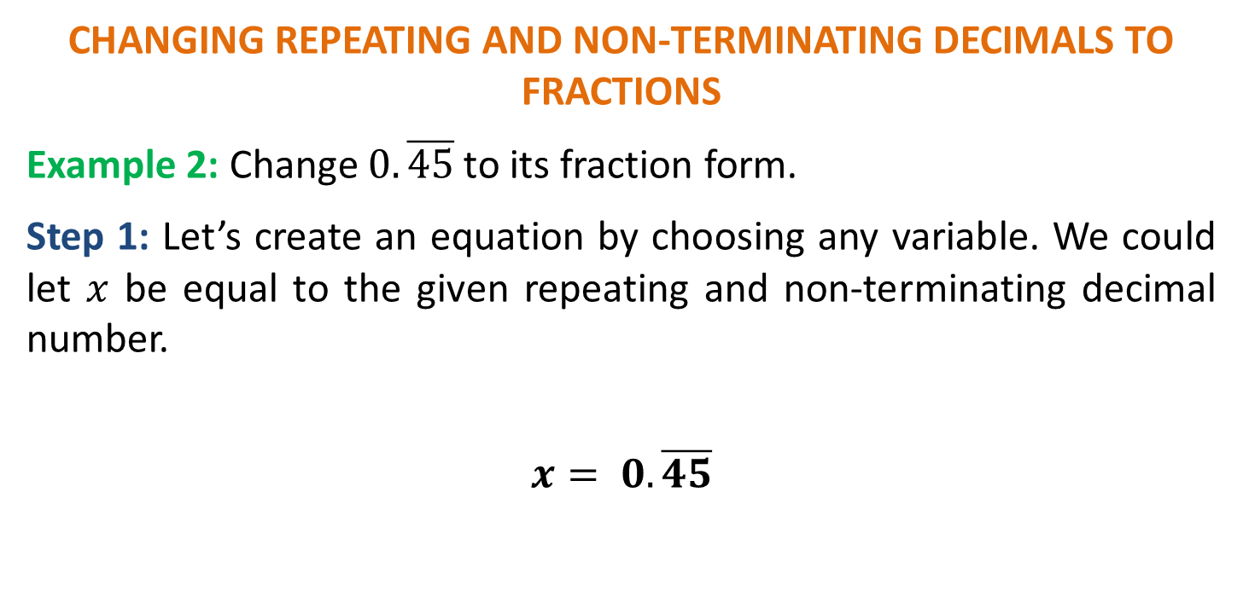
RATIONAL NUMBERS
CHANGING REPEATING AND NON-TERMINATING DECIMALS TO FRACTIONS
Example 2: Change $0.\overline{45}$ to its fraction form.
Step 1: Let’s create an equation by choosing any variable. We could let $x$ be equal to the given repeating and non-terminating decimal number.
$$x= 0.\overline{45}$$

Slide 45

RATIONAL NUMBERS
CHANGING REPEATING AND NON-TERMINATING DECIMALS TO FRACTIONS
Step 2: Examine the repeating decimal closely to determine the number of digit or digits that repeats.
$$x= 0.\overline{45}$$
There are two repeating digits, 45.

Slide 46
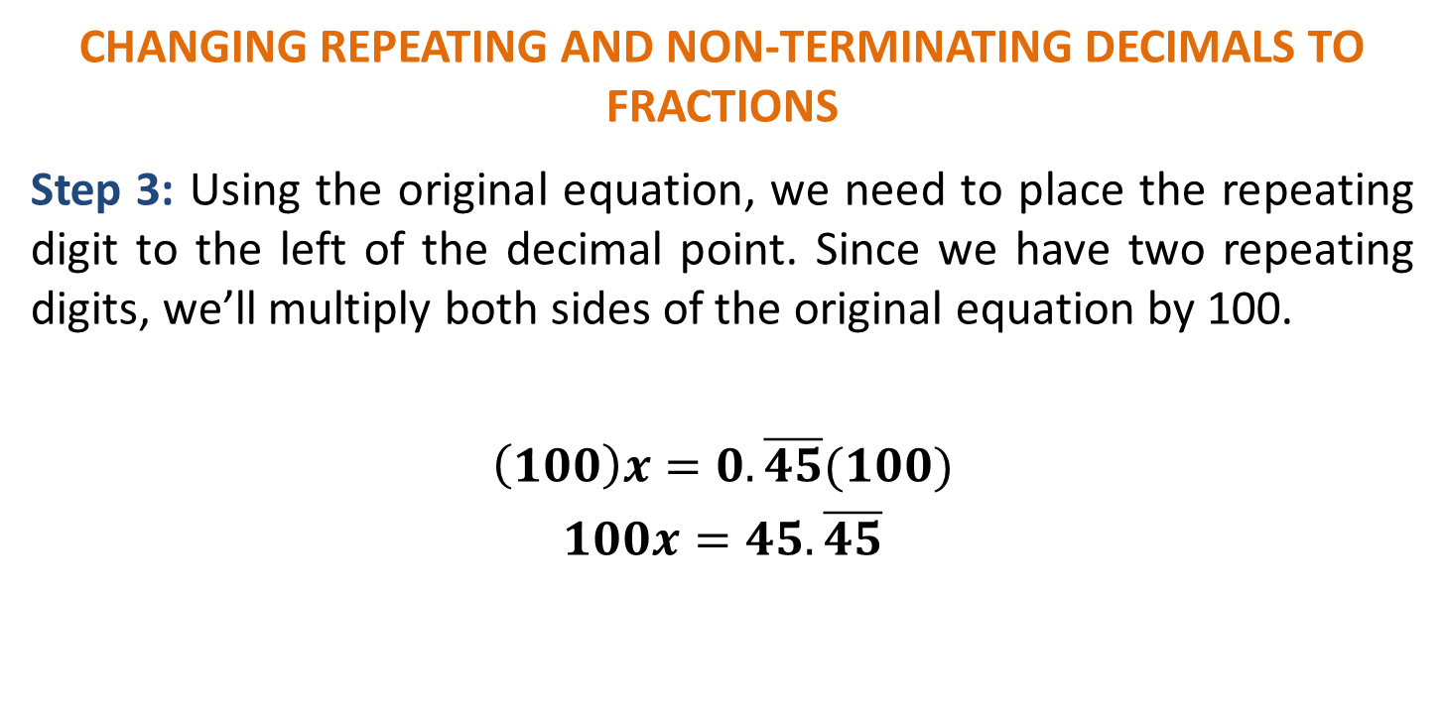
RATIONAL NUMBERS
CHANGING REPEATING AND NON-TERMINATING DECIMALS TO FRACTIONS
Step 3: Using the original equation, we need to place the repeating digit to the left of the decimal point. Since we have two repeating digits, we’ll multiply both sides of the original equation by 100.
$$\left(100\right)x=0.\overline{45}(100)$$
$$100x=45.\overline{45}$$

Slide 47
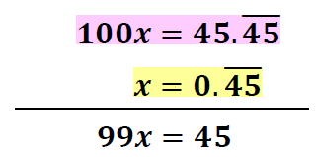
RATIONAL NUMBERS
CHANGING REPEATING AND NON-TERMINATING DECIMALS TO FRACTIONS
Step 4: Subtract the two equations.

Slide 48

RATIONAL NUMBERS
CHANGING REPEATING AND NON-TERMINATING DECIMALS TO FRACTIONS
Step 5: Solve for $x$ by dividing both sides by 99.
$$\frac{99x}{99}=\frac{45}{99}$$
$$x=\frac{45}{99}$$
So, $0.\overline{45}=\frac{45}{99}$ or $\frac{5}{11}$.

Slide 49
RATIONAL NUMBERS
Sample Problem 4: Express the following terminating decimals in its equivalent fraction.

Slide 50
RATIONAL NUMBERS
Sample Problem 4: Express the following terminating decimals in its equivalent fraction.

Slide 51
RATIONAL NUMBERS
Sample Problem 4: Solution

Slide 52
RATIONAL NUMBERS
Sample Problem 4: Solution

