Slide 1
Properties of Irrational Numbers
Unit 1 Lesson 5

Slide 2
Properties of Irrational Numbers
Students will be able to:
Understand the properties
of irrational numbers

Slide 3
Properties of Irrational Numbers
Key Vocabulary:
Irrational Numbers
Commutative Property
Associative Property
Distributive Property
Additive Identity

Slide 4
Properties of Irrational Numbers
Properties of Irrational Numbers
1. The decimal expansion of an irrational number is non-terminating non-recurring.
Example$: \sqrt{5}=2.23606797…………..$

Slide 5
Properties of Irrational Numbers
Properties of Irrational Numbers
2. The sum or difference of a rational number and an irrational number is irrational.
Example: $5+\sqrt{3}=5+1.73215……=6.73215……..$
$$5−\sqrt{3}=5−1.73215……=3.2679……..$$

Slide 6
Properties of Irrational Numbers
Properties of Irrational Numbers
3. The product or quotient of a non-zero rational number with an irrational number is irrational.
Example: $2∗\sqrt{2}=2\sqrt{2}$
$$\sqrt{2}÷\left(−3\right)=−\frac{\sqrt{2}}{3}$$

Slide 7
Properties of Irrational Numbers
Properties of Irrational Numbers
4. If you add, subtract, multiply or divide two irrationals, the result may be rational or irrational.
Example:
$$\sqrt{2}+\sqrt{3}=1.41421….+1.73215…..=3.14626…….$$
$$\sqrt{3}−\sqrt{3}=1.73215…..−1.73215….=0$$
$$\sqrt{2}−\sqrt{3}=1.41421….−1.73215…..=−0.3178…….$$

Slide 8
Properties of Irrational Numbers
Properties of Irrational Numbers
4. If you add, subtract, multiply or divide two irrationals, the result may be rational or irrational.
Example:
$$\sqrt{2}∗\sqrt{3}=1.41421….∗1.73215…..=2.49962……..$$
$$\sqrt{2}∗\sqrt{2}=2$$
$$\sqrt{2}÷\sqrt{3}=1.41421….÷1.73215…..=0.816447……..$$
$$\sqrt{2}÷\sqrt{2}=1$$

Slide 9
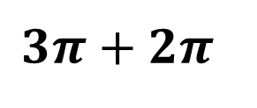
Properties of Irrational Numbers
Sample Problem 1: Identify if the answer will be rational or irrational.
a.
$$3π+2π$$

Slide 10
Properties of Irrational Numbers
Sample Problem 1: Identify if the answer will be rational or irrational.
a.
$$3π+2π$$
$$3π+2π=5π$$
$$5π=5∗3.14159……..=15.70796…$$
Irrational

Slide 11
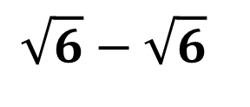
Properties of Irrational Numbers
Sample Problem 1: Identify if the answer will be rational or irrational.
b.
$$\sqrt{6}−\sqrt{6}$$

Slide 12
Properties of Irrational Numbers
Sample Problem 1: Identify if the answer will be rational or irrational.
b.
$$\sqrt{6}−\sqrt{6}$$
$$\sqrt{6}−\sqrt{6}=0$$
Rational

Slide 13
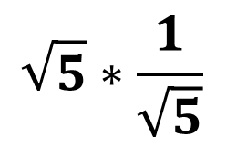
Properties of Irrational Numbers
Sample Problem 1: Identify if the answer will be rational or irrational.
$$\sqrt{5}∗\frac{1}{\sqrt{5}}$$
c.

Slide 14
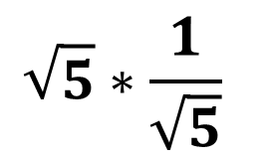
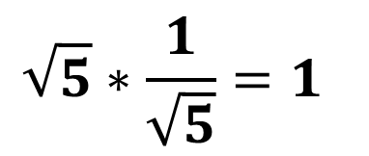
Properties of Irrational Numbers
Sample Problem 1: Identify if the answer will be rational or irrational.
$$\sqrt{5}∗\frac{1}{\sqrt{5}}$$
c.
$$\sqrt{5}∗\frac{1}{\sqrt{5}}=1$$
Rational

Slide 15
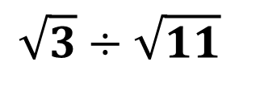
Properties of Irrational Numbers
Sample Problem 1: Identify if the answer will be rational or irrational.
$$\sqrt{3}÷\sqrt{11}$$
d.

Slide 16
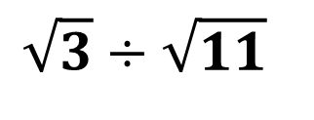
Properties of Irrational Numbers
Sample Problem 1: Identify if the answer will be rational or irrational.
d.
$$\sqrt{3}÷\sqrt{11}$$
$$1.73215…..÷3.3166…..=0.52223……$$
Irrational

Slide 17
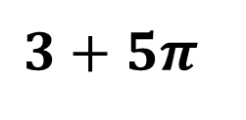
Properties of Irrational Numbers
Sample Problem 2: Identify if the answer will be rational or irrational.
a.
$$3+5π$$

Slide 18
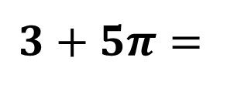
Properties of Irrational Numbers
Sample Problem 2: Identify if the answer will be rational or irrational.
a.
$$3+5π=$$
$$=3+5∗3.14159……$$
$$=3+15.707963….$$
$$=18.707963$$
Irrational

Slide 19
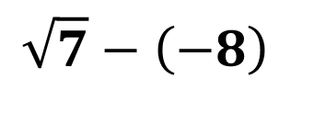
Properties of Irrational Numbers
Sample Problem 2: Identify if the answer will be rational or irrational.
b.
$$\sqrt{7}−\left(−8\right)$$

Slide 20
Properties of Irrational Numbers
Sample Problem 2: Identify if the answer will be rational or irrational.
b.
$$\sqrt{7}−\left(−8\right)=$$
$$=2.6475….+8$$
$$=10.6475…$$
Irrational

Slide 21
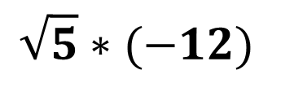
Properties of Irrational Numbers
Sample Problem 2: Identify if the answer will be rational or irrational.
c.
$$\sqrt{5}∗(−12)$$

Slide 22
Properties of Irrational Numbers
Sample Problem 2: Identify if the answer will be rational or irrational.
c.
$$\sqrt{5}∗\left(−12\right)=$$
$$=2.2360…..∗\left(−12\right)$$
$$=−26.8328…$$
Irrational

Slide 23
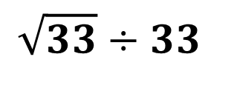
Properties of Irrational Numbers
Sample Problem 2: Identify if the answer will be rational or irrational.
d.
$$\sqrt{33}÷33$$

Slide 24
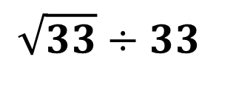
Properties of Irrational Numbers
Sample Problem 2: Identify if the answer will be rational or irrational.
d.
$$\sqrt{33}÷33$$
$$=1.73215…..÷3.3166…..$$
$$=0.52223…$$
Irrational

Slide 25
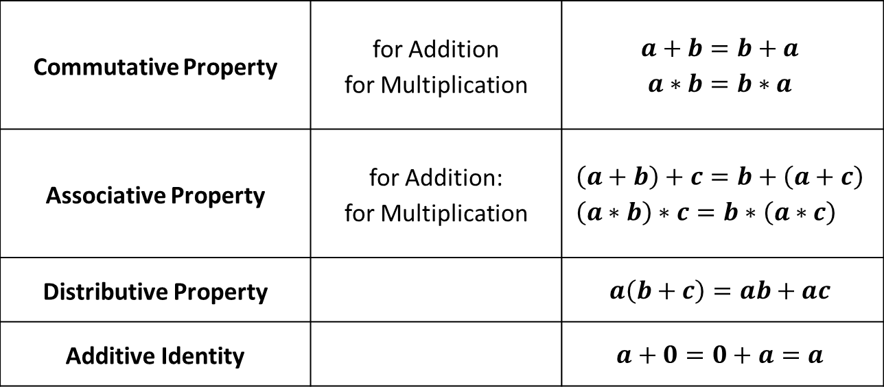
Properties of Irrational Numbers
Commutative Property | for Addition for Multiplication | $$a+b=b+a$$ $$a∗b=b∗a$$
Associative Property | for Addition: for Multiplication | $$\left(a+b\right)+c=b+\left(a+c\right) \\ \left(a∗b\right)∗c=b∗\left(a∗c\right)$$
Distributive Property |  | $$a\left(b+c\right)=ab+ac$$
Additive Identity |  | $$a+0=0+a=a$$

Slide 26
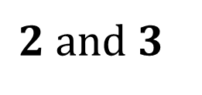
Properties of Irrational Numbers
Sample Problem 3: Insert a rational and an irrational number between each numbers.
a.
$$2 and 3$$

Slide 27
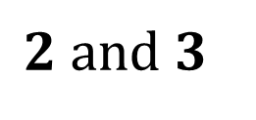
Properties of Irrational Numbers
Sample Problem 3: Insert a rational and an irrational number between each numbers.
a.
$$2 and 3$$
$$\frac{2+3}{2}=\frac{5}{2}=2.5 Rational$$
$$\sqrt{2∗3}=\sqrt{6} Irrational$$

Slide 28
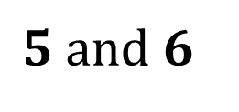
Properties of Irrational Numbers
Sample Problem 3: Insert a rational and an irrational number between each numbers.
b.
$$5 and 6$$

Slide 29
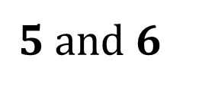
Properties of Irrational Numbers
Sample Problem 3: Insert a rational and an irrational number between each numbers.
b.
$$5 and 6$$
$$\frac{5+6}{2}=\frac{11}{2}=5.5 Rational$$
$$\sqrt{5∗6}=\sqrt{30} Irrational$$

